Slide 1
Theoretical background and euro facts

Slide 2
Elements
Theoretical background to monetary unions
The Euro Performance
The Euro and the UK
The Euro and new EU members

Slide 3
Starting with the threats
Why not a worldwide currency?
The main issue are asymmetric shocks
Questions arising:
  How do they create trouble?
  What makes them more likely?
  What makes them less painful? (OCA theory)

Slide 4
Cyclical convergence
The Maastricht Treaty emphasised the importance of achieving a high degree of sustainable convergence, if a country is to participate in EMU.

Slide 5
Cyclical convergence
"Are business cycles and economic structures compatible so that we and others could live comfortably with euro interest rates on a permanent basis?''
HM Treasury

Slide 6
Cyclical convergence
In joining EMU, interest rates in the UK would no longer be set in response to domestic economic conditions. Rather, the ECB would set interest rates to achieve price stability in the EMU area as a whole. If economic conditions in the UK were similar to those in the EMU area, then the ECB's monetary policy would be appropriate for the UK.

Slide 7
Cyclical convergence
But if conditions in the rest of the EMU area were very different from those in the UK euro interest rates could often be too high or too low for the UK, making economic conditions less stable. So it is important that the UK cycle is broadly in line when we join EMU and that this convergence is sustainable.
© Crown: ‘UK MEMBERSHIP OF THE SINGLE CURRENCY AN ASSESSMENT OF THE FIVE ECONOMIC TESTS’

Slide 8
OCA?
When outside economic shocks do arise, their impacts are often felt asymmetrically.
For countries outside a monetary union, this should not pose a problem as exchange rate flexibility can deal with such shocks.

Slide 9
OCA?
Inside the EMU, on the other hand, a substantial degree of business-cycle convergence would be highly desirable.

Slide 10
OCA?
If all economies in the union had the same business cycle, then the ECB could afford to use monetary policy as a stabilization tool.
However, a divergence in economic growth rates throughout the region tends to cause the ECB to conduct a more cautious monetary policy.

Slide 11
OCA?
The crucial point with respect to monetary unions, such as the EMU, is that in the absence of flexible exchange rates, there must be flexibility elsewhere, such as labour market flexibility or mobility.

Slide 12
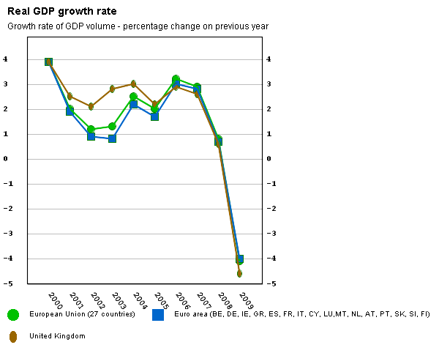
Business cycles: EU, Euro area, UK
Source: Eurostat, 2009

Slide 13
The theoretical basis for a Monetary Union
The Optimum Currency Areas (OCA) -
Conditions necessary for a successful OCA:
1. A high degree of factor mobility
(Mundell)
2. Open trade and a high degree of trade between regions/states
(McKinnon)

Slide 14
The theoretical basis for a Monetary Union…
3. Countries whose production and exports are widely diversified and of similar structure (Kenen)
4. Countries agree to compensate each other for adverse shock from an OCA (fiscal transfers)
5. Broadly similar attitudes to macro-economic policy (also: common destiny…)
Contribution of 1992 (?)

Slide 15
EMU criteria
    Criteria for Stability:
      Budget Deficit ≤ 3% of GDP
      National Debt ≤ 60% of GDP
      Inflation not > by 1.5% than average of best 3 states
      Interest rates not > by 2% than average of best 3 states

Slide 16
Interpretation of the Convergence Criteria: Budget Deficit and Debt
Problem No. 1: a few years of budgetary discipline do not guarantee long-term discipline
Problem No. 2: articifial ceilings
  (Later Evidence: Repeated breaking of the deficit rule by Germany, France, Greece)

Slide 17
From convergence criteria to membership

Slide 18
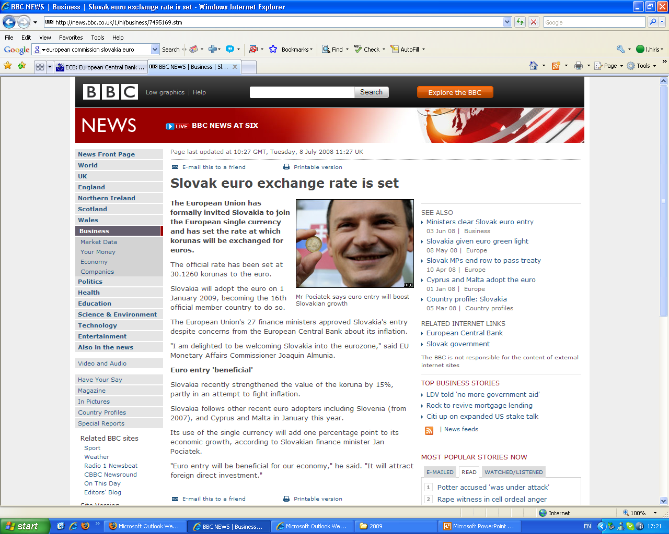

Slide 19
Convergence Report, 2008
(Slovakia’s Assessment)
© European Commission, 2008

Slide 22
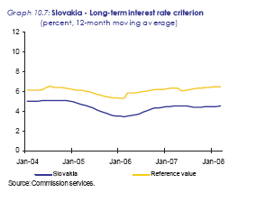

Slide 24
The Stability Pact
Objective: Convergence as a permanent rule
Elements:
  Definition of excessive deficits and exceptions
  Warning and correction mechanism
  Sanctions

Slide 25
Criteria for complete EMU
The removal of all barriers to capital transfer.
Fiscal Harmonisation and transferability of welfare rights (pensions, national insurance contributions, etc).
A central bank at the European level to centralise transfers, monitor policy and enforce banking regulations equitably throughout the Community.

Slide 26
Criteria for complete EMU
A single currency acceptable in all members states (or acceptance of all currencies in all states - a UK proposal).
The parameters of macro-economic policy will be determined at the European level. Individual governments will set targets for interest rates, monetary growth, public expenditure, etc.

Slide 27
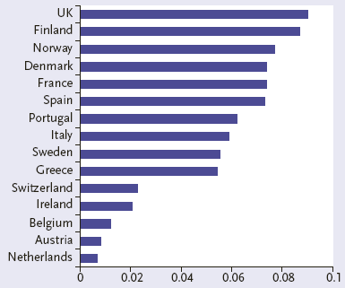
Is Europe An OCA?
Exchange rate Adjustment to asymmetric shocks
Source: Bayoumi and Eichengreen, 1997 (in Baldwin and Wyplosz)

Slide 28
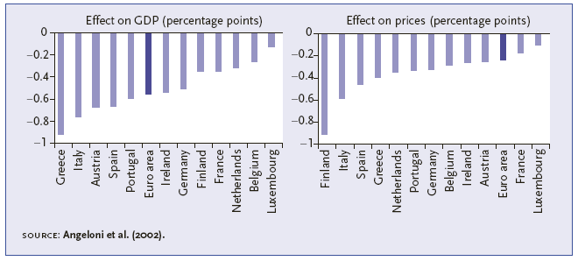
Effect of a 1% point interest rate increase
Source: Baldwin and Wyplosz)

Slide 29
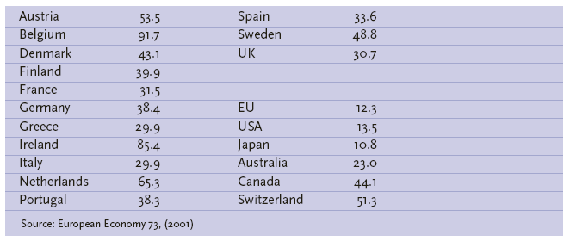
Inside the EU: Openness
Source: Baldwin and Wyplosz)

Slide 30
Inside the EU: Diversification
Most EU countries have a diversified production structure (intra-industry trade dominates)
The Kenen criterion is broadly satisfied and well explains which countries joined the euro area.

Slide 31
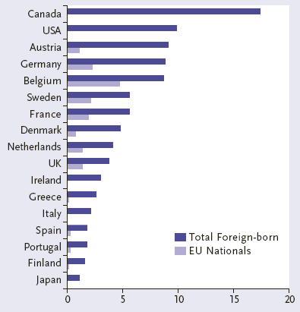
EU Labour Mobility
Source: Baldwin and Wyplosz)

Slide 32
Inside the EU: Transfers
The EU does not satisfy the transfer criterion.
The overall EU budget:
  is low, capped at 1.24% of EU GDP
  entirely used for administration, CAP, regional and structural funds.

Slide 33
Inside the EU: Homogeneity of preferences
Little is known about this criterion.

Slide 34
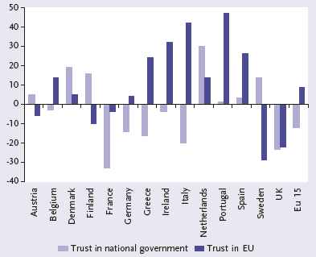
Inside the EU: Commonality of Destiny
Source: Baldwin and Wyplosz)

Slide 35
Euro: what kind of currency?
Competing with the dollar?
Economic context:
  Growth
  Interest rates

Slide 36
USD vs. Euro (recent experience)
Source: ECB, 2009

Slide 37
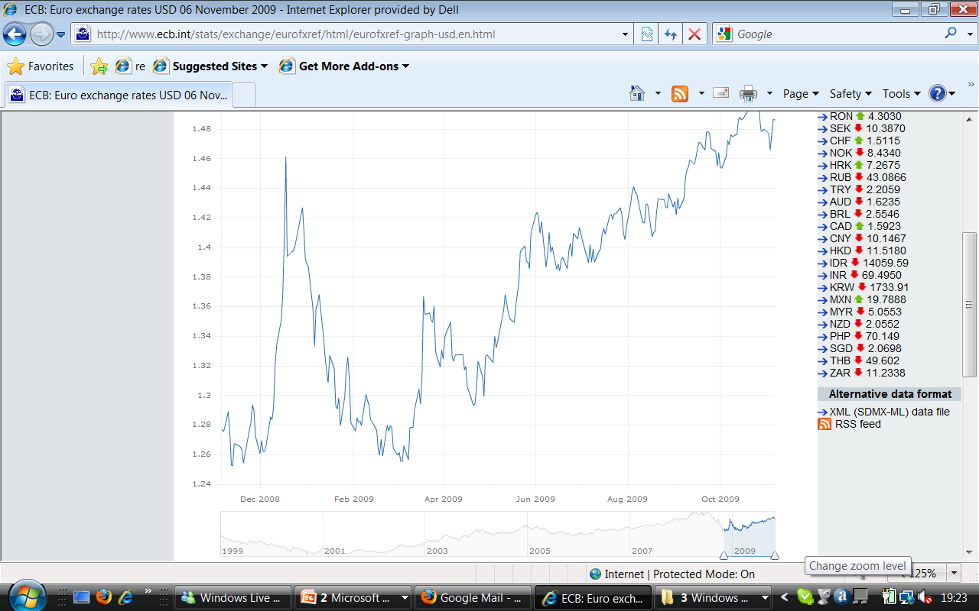

Slide 38
Pound Sterling vs. Euro (recent experience)
Source: ECB, 2009

Slide 39
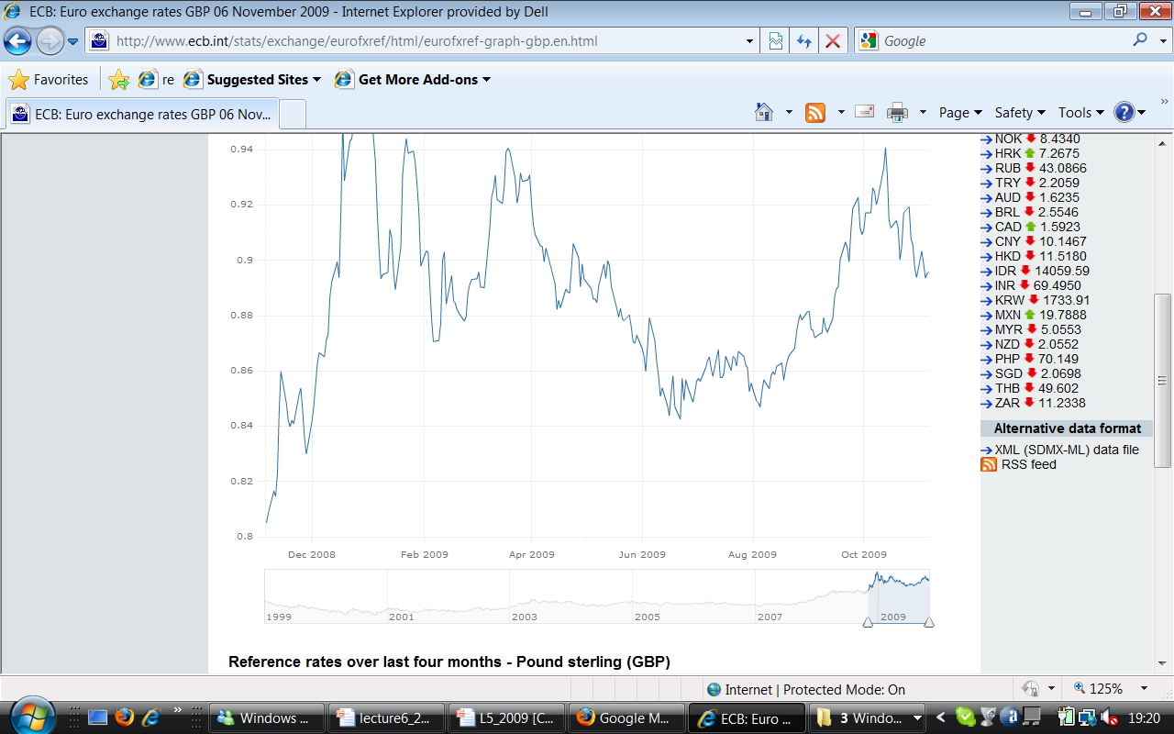

Slide 40
How desirable is EMU?
Advantages of EMU
    eliminating conversion costs
    increased competition
    elimination of exchange-rate uncertainty between members
    increased inward investment
    lower inflation and interest rates
    no need for reserves
    regional convergence
    returns to scale of one currency

Slide 41
How desirable is EMU?
Disadvantages of EMU
    not an optimal currency area?
    asymmetric shocks
    regional problems
    political arguments
    monetary policy loss

Slide 42
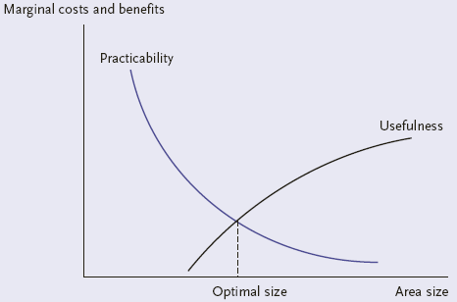
The Economic Trade-Off
Source: Baldwin and Wyplosz)

Slide 43
In the End
Monetary union is not only about economics (!?)
The OCA criteria do not send a clear signal:
  the EU is not a perfect OCA
  a monetary union may function, at a cost:
    labour markets and unemployment
    political tensions in presence of deep asymmetric shocks.

Slide 44
Readings
El- Agraa, 2004. The European Union. Ch. 8.1, 8.2, 9, 10
Baldwin and Wyplosz*, ch. 13
de Grauwe, P. 2003. Economics of Monetary Union, 5th edition. Oxford: Oxford University Press.

Slide 45
Further Readings
European Commission, 2008. Convergence Report 2008. European Economomy. No. 3. Available from: http://ec.europa.eu/economy_finance/publications/publication12574_en.pdf
The European Central Bank

