Slide 1
How healthcare is funded internationally
Cristina Peñaloza
Health Economics Unit

Slide 2
Overview
Define Healthcare & Healthcare systems
  Demographic changes and disease burden
  Epidemiological transition
Alternative financing mechanisms of healthcare systems
  Public / private mix / community-based
  Raising finances (revenue collection, risk pooling/ problems prevalent)
  Methods of purchasing and paying healthcare providers

Slide 3
Learning Objectives
By the end of the session, students should be able to:
Understand health systems in terms of approaches to revenue collection, risk pooling, purchasing and paying healthcare providers
Discuss the alternative sources of funding for healthcare systems

Slide 4
Why look at financing mechanisms?
A way of distinguishing between healthcare systems
Help understand roles private & public sector play in healthcare sector
Help understand govt. policy in healthcare sector (up to 16% of GDP spent on Healthcare)

Slide 5
Defining healthcare
“All goods and services designed to promote health, including “preventive, curative and palliative interventions, whether directed to individuals or to populations” (WHO)
Healthcare is provided through healthcare systems
Defining healthcare systems
all activities whose primary purpose is to promote, restore or maintain health (WHO)

Slide 6
Health financing, demographic changes and epidemiological transition

Slide 7
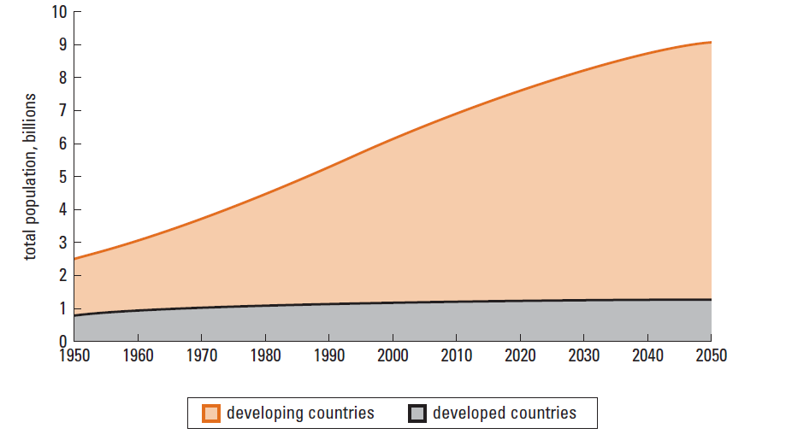
Health financing, demographic changes and disease burdens
9 billion
7.5 billion
6 billion
Source: United Nations 2005
Notes:
The health needs of rich and poor countries are changing in response to lower fertility rates, longer life expectancies, and the shifting burden of illness toward chronic diseases and injuries.
All countries are experiencing varying degrees of demographic change. High-income countries have low fertility and low mortality rates, while low income countries are moving from high to low fertility rates with variations in mortality levels.
According to the United Nations population projections, the world’s population reached 6 billion in 1999 and is projected to reach 7.5 billion by 2020 and 9 billion by 2050. As a result of varying patters of demographic change, regions around the world will confront health financing challenges of different magnitudes at different times.

Slide 8
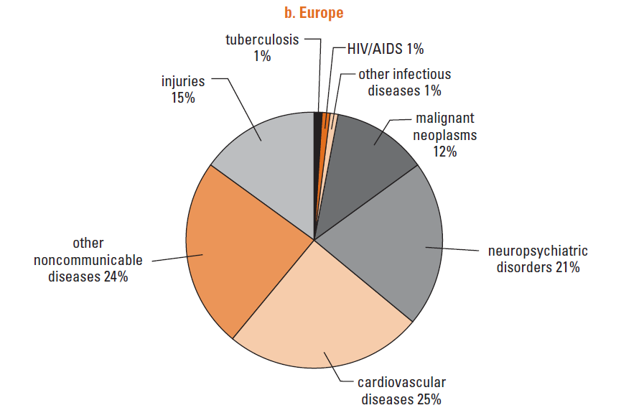
Health financing and epidemiological transition
Source: WHO, 2004
Notes:
Demographic changes and the epidemiological transition are related. Mortality levels start to decline at the beginning of the demographic transition, caused by the reduction in mortality from infectious diseases and maternal and childhood conditions. As the health transition progresses, fertility levels and the burden of communicable diseases decline, and the average age of the population increases. This causes that eventually there are more elderly people in the population, and they are more susceptible to non-communicable diseases than younger people. The increase in the number of susceptible individuals at older ages increases the overall incidence and prevalence of non-communicable diseases, thereby accelerating the epidemiological transition.
For example, 30 per cent of outpatient visits in Africa are due to malaria-related symptoms, and these symptoms are also major contributors to inpatient deaths.
Epidemiological transition influences health systems and health financing by affecting population health needs and the type and level of services demanded, and thus the amount and distribution of funds available to pay for them.

Slide 9
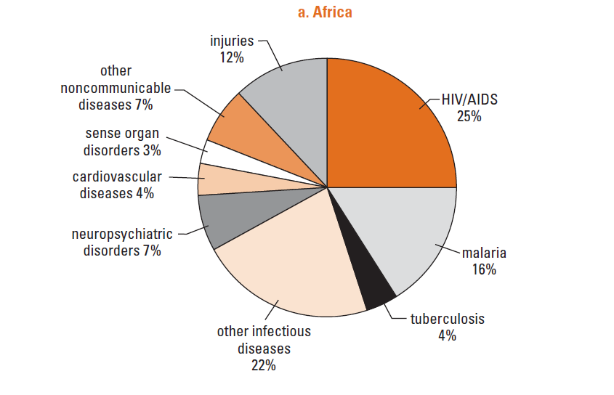
Health financing and epidemiological transition
Source: WHO, 2004
Notes:
Demographic changes and the epidemiological transition are related. Mortality levels start to decline at the beginning of the demographic transition, caused by the reduction in mortality from infectious diseases and maternal and childhood conditions. As the health transition progresses, fertility levels and the burden of communicable diseases decline, and the average age of the population increases. This causes that eventually there are more elderly people in the population, and they are more susceptible to non-communicable diseases than younger people. The increase in the number of susceptible individuals at older ages increases the overall incidence and prevalence of non-communicable diseases, thereby accelerating the epidemiological transition.
For example, 30 per cent of outpatient visits in Africa are due to malaria-related symptoms, and these symptoms are also major contributors to inpatient deaths.
Epidemiological transition influences health systems and health financing by affecting population health needs and the type and level of services demanded, and thus the amount and distribution of funds available to pay for them.

Slide 10
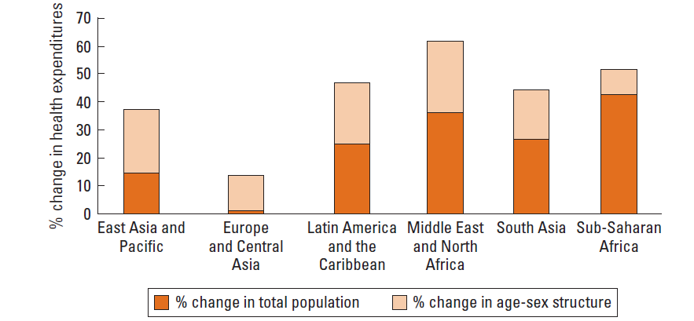
Implications of demographic changes for health financing (projections 2005-25)
Source: Gottret & Schieber. The World Bank 2006
Notes:
Actuarial estimates using per capita health expenditures in the USA show that a person age 65 to 74 spends, on average, between 3 to 4.4 times as much as a person age 35 to 44 in health services, and the amount is even higher for someone over 80.
The figure provides information by region on projected changes in total health spending between 2005 and 2025, as a result of changes in the numbers of people and changes in the demographic structure of the population.
For example, in Europe and Central Asia, a middle income region with close to zero population growth and long life expectancies, health spending is expected to rise 14 per cent overall: 1 percentage point is the result of population growth, and the other 13 percentage points are the results of sex-age structure changes.

Slide 11
Health financing

Slide 12
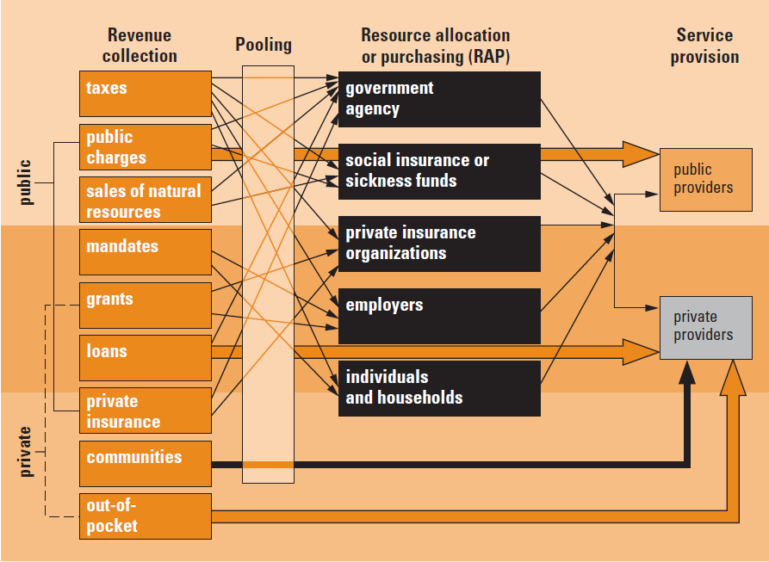
Health financing functions
Source: Schieber and Maeda 1997, The World Bank
Notes:
The figure describes the functions involved in health financing: collecting revenue, pooling resources, and purchasing goods and services. These functions often involve complex interactions.
Revenue collection is the way health systems raise money from households, businesses and external sources. Pooling deals with the accumulation and management of revenues so that members of the pool share collective health risks, thereby protecting individual pool members from large, unpredictable health expenditures. Pooling (coupled with prepayments) enables the establishment of insurance and the redistribution of health spending between high- and low-risk individuals (risk subsidies) and high- and low-income individuals (equity subsidies).
Purchasing refers to the mechanisms used to secure services from public and private providers.
In the functioning of a health system equity and efficiency are critical aspects for all financing functions. There are three broad types of efficiency concerns: efficiency of revenue collection, allocative efficiency and technical efficiency.
Health sector functions entail directly providing services; financing, regulating and mandating service provision; and providing information (Musgrove 1996)

Slide 13
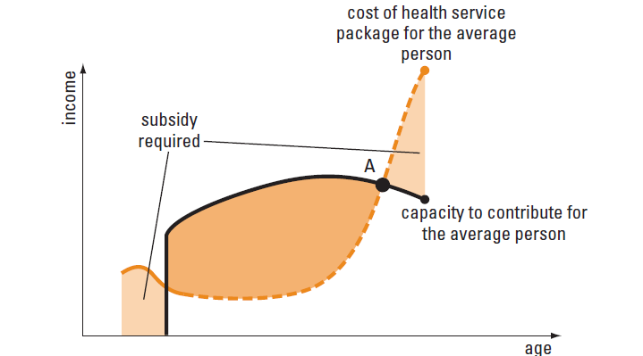
Risk pooling
Collection and management of financial resources in a way that unpredictable individual financial risks become predictable, and are distributed among all the members of the pool
Source: The World Bank
Notes:
Financial protection (no household contributes or expends so much on health that it falls into and cannot overcome poverty)
Risk pooling and prepayments is central to the creation of cross-subsidies between high-risk and low-risk individuals (risk subsidy) and low-income and high-income individuals (equity subsidy).
The figure represents the evolution of the average cost of financing a given package of health services during the lifetime of an individual, his or her capacity to pay, and his or her needs for subsidies. The dotted line shows the relationship between actual average costs and age. The solid line represents the relationship between capacity of an individual to pay for health services and age. To the right of point A the individual (or household) will need a subsidy to be able to finance and gain access to the services required without recurring in excess expenditure.
Risk pooling plays a central role in facilitating such cross-subsidization. Because of economies of scale, risk pooling potentially reduces the average cost of the package, delaying reaching A. In contrast, the absence of a system for spreading risks results in high an unexpected out-of pocket expenditures for the individual who needs health care services.

Slide 14
Risk pooling mechanisms
Four types of health insurance are widely used to pool risks, raise revenues, purchase services and pay to providers:
National health service
Social security
Voluntary private health insurance
Community-based health insurance
    No pure mechanism, usually a
    mix of two or more methods
Notes:
Different instruments for revenue collection and purchase of health services.
These organizational arrangements generate revenue and finance equity subsidies through 3 main alternatives: subsidies within a risk pool, subsidies across different risk pools, and direct public subsidies through transfers from the government.
Pooling risks in traditional national health services and social security systems is achieved through subsidies within a risk pool, whether financed through general revenues or through payroll taxes. Its goal is to generate subsidies from high- to low income individuals. These systems are effective when payroll contributions are feasible or the general revenue base is sufficient, and a large proportion of the population participates in the same risk pool.
However, in a system with multiple competing public and private insurers and a fragmented risk pool, payroll contributions may increase the incentives for risk selection. In the case of national health service or social security system, financial resources might be insufficient or inappropriate for spreading the financial risks or for creating an equity subsidy, particularly if the general revenue or payroll contribution base is regressive.

Slide 15
Purchasing
Large variety of arrangements:
National health services and Social Security organizations provide services in publicly owned facilities (staff members are public employees)
Individuals or organizations purchase services through direct payments or contracting arrangements from public and private providers (or combination of the previous two)
Resource allocation and purchasing decisions have important implications for cost, access, quality, and consumer satisfaction

Slide 16
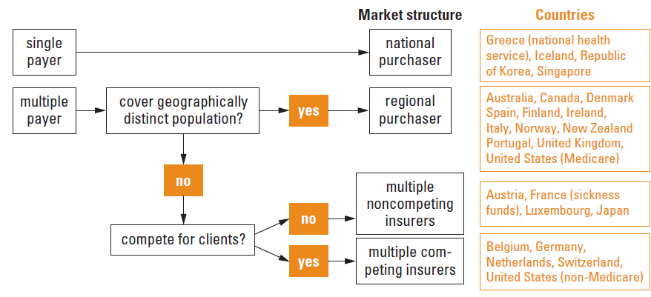
Market structures for purchasing and remuneration of providers
Source: The World Bank, adapted from Kutzin 2001.
Notes:
The number of purchasing organizations, their size, and their market structure vary widely across countries. Nonetheless, the decentralization wave has reached almost every country over the last three decades, pushing purchasing decisions down from central to regional or local authorities. Only a few countries still retain centralized single-purchaser systems.

Slide 17
Health systems

Slide 18
National (state-funded) health care system
Characteristics: funding comes from general revenues, universal coverage, a public health delivery system
Strengths: comprehensive coverage of the population, and large scope for raising resources
Weaknesses: unstable funding; disproportionate benefits for the rich; potential inefficiency in health care delivery; and sensitivity to political pressures

Slide 19
Social health insurance (Bismarckian system)
Characteristics: funding from employee and employer contributions; management through sickness funds; benefit package for all members (fully or partially cover)
Strengths: more resources in the system; less dependence on budget negotiations; high redistributive dimension (cross subsidies)
Weaknesses: possible exclusion of the poor; negative economic impact on payroll contributions; complex and expensive to manage; escalating costs; poor coverage of chronic diseases and preventive care

Slide 20
Voluntary (private) health insurance
Characteristics: affiliation is voluntary; it plays as the primary or additional source of healthcare funding; it may be the main source of health coverage, or duplicate health benefits or cover services not included by the public service
Strengths: affords financial protection; enhances access to health services; increases service capacity and promotes innovation; helps finance health care services not covered publicly (OECD, 2004)

Slide 21
Voluntary (private) health insurance
Weaknesses: financial barriers to access; differential access to health care; not served to quality improvement; increased total health expenditure; high administrative costs; removed very little cost pressure from public health financing

Slide 22
Community-based health insurance
Characteristics: community membership; high community involvement in managing the system; beneficiaries are excluded from other kinds of health coverage; members share a set of social values (voluntary affiliation, participation and solidarity)
Strengths: better access to healthcare for low-income people; complete or fill the gaps of other health financing schemes
Weaknesses: limited protection for members; sustainability is questionable; limited benefits to the poorer part of the population

Slide 23
Aspects of the healthcare market to be controlled
Consumer moral hazard
  A zero (or reduced) price at the point of use encourages a higher rate of use than would otherwise be considered efficient
Adverse selection
  The process whereby the ‘best risk’ individuals are selected out of a general insurance pool
Provider moral hazard (SID)
  Incentives on suppliers (e.g. physicians) to provide care in excess of (or short of) that which would be arrived at by trading with fully informed consumers

Slide 24
Some topics of interest

Slide 25
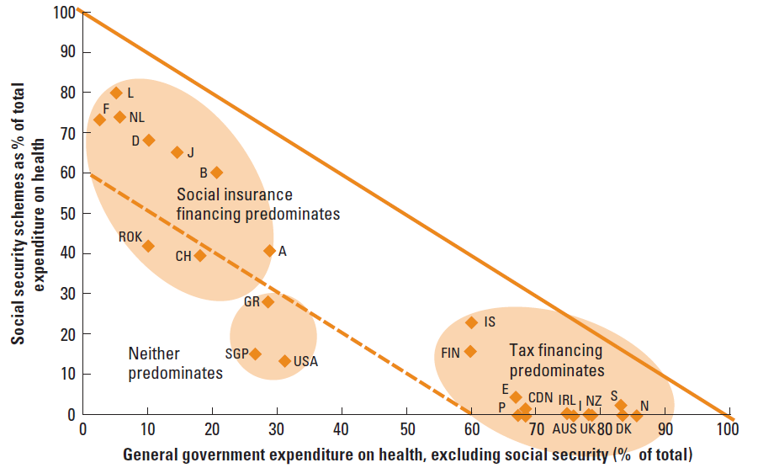
Financing mechanisms in high-income countries
Source: OECD 2004
Notes:
Apart from the USA most of the countries derive the main part of their health care resources either through social security contributions or through direct and indirect tax payments in national health services. 9 out of the 25 countries in the figure finance their health care system mainly by social health insurance contributions, while 13 countries use mainly tax payments.
Singapore, USA and Greece in a low degree, fit neither of these classifications since they finance more than half of their health expenditure though other mechanisms, such as voluntary insurance premiums and out-of-pocket payments. In Greece, private expenditure finances slightly less than 50% of the total.

Slide 26
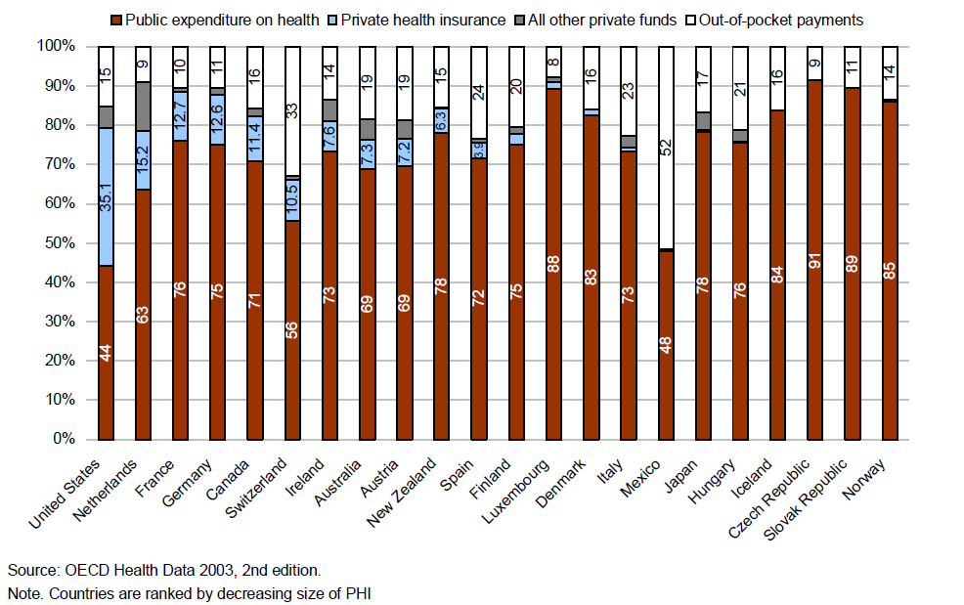
Private Health Insurance in OECD countries
Notes:
Although PHI accounts, on average, for 6.3% of total expenditure on health (THE), its importance in funding OECD health systems varies significantly (see figure).
The United States is the only OECD country where voluntary health insurance represents the main health financing and coverage system
for most of the population, explaining why PHI accounted for 35% of THE in 2000. In France, Germany, the Netherlands and Canada, the share of financing accounted for by private health insurance ranges from 10% to 15% of THE. A similar level is found in Switzerland, where 10% of total health expenditure comes from the voluntary supplementary health insurance market.
Australia, Ireland, Spain, New Zealand, and Austria have levels of PHI financing between 4% and 10%. Private health insurance in all other OECD countries contributes much less than 4% to funding total health expenditures.
Countries with the highest shares of PHI (above 10%) show lower shares of out-of-pocket (OOP) expenditure in total health spending. However, there does not appear to be a strong inverse relationship between the importance of PHI and OOP in financing health spending for the OECD area as a whole. The contribution of PHI to total health financing increased only slightly between 1990 and 2000, although some of the smaller markets, such as New Zealand, have experienced the fastest growth rates.

Slide 27
What we have done in this lecture…
Defined Health care & Healthcare systems
Depicted the different health systems with examples from around the world
Considered ways of revenue collection, risk pooling, purchasing and paying providers
Discussed Methods of raising finances for healthcare systems (no pure mechanism)

Slide 28
Conclusions
All health systems characterised by public / private mix.
Different methods of risk pooling, purchasing services, paying providers – not devoid of problems
Broadly 3 alternative financing approaches (No pure mechanism).

Slide 29
References
Donaldson C, Gerard K. 1989. Countering Moral Hazard in Public and Private Health-Care Systems – A review of Recent Evidence J Soc Policy. 18(2):235-51
Donaldson C, Gerard K. 2004. Economics of Health Care Financing (2nd edition). Palgrave, (Chapters 4 and 5)
Gottret P, Shieber G. 2006. Health Financing Revisited, A Practitioner’s Guide. The World Bank
Keen J, Light D, Mays A. 2001. Public-Private Relations in Health Care. King’s Fund

Slide 30
References
Maynard A (ed). 2005. The Public-Private Mix for Health. The Nuffield Trust
Morris S, Devlin N, Parkin D. 2007. Economic analysis in health care. Chichester: John Wiley & Sons
OECD 2004, Health Data, 3rd Edition. Paris
The World Bank. 2006. Health Financing Revisited, A Practitioner’s Guide.
Schieber, G. Maeda, A. 1997. “A Curmudgeon’s Guide to Financing Health in Developing Countries”. In Schieber, ed. Innovations in Health Care Financing. Discussion Paper 365, The World Bank, Washington D.C.

