Slide 1

Lecture 6 - Evidence and causes of economic disadvantage - The case for regional policy

Slide 2
Aims & Outcomes
Aims
To discover the evidence of a “regional problem
Discover why regional policy is seen as a necessary part of government economic policy.
Examine the different theoretical/ideological approaches to policy & briefly review the main phases of regional policy
Examine the tension between social and economic objectives
Outcomes
Be able to identify the difference in regional economic performance
Have a working knowledge of some of the causes
Be aware of the importance of regional economic policy
Be conversant with the main differences in the theoretical approaches, how policy has evolved and the problems this throws up.

Slide 3
Evidence of a “regional problem”
Migration - NS divide - selective - backwash effects
Unemployment - NS divide - structural - effect on urban areas -
Cabinet Office report 1999 Sharing the Nation’s Prosperity
Looked at number of areas:
↑Disposable income ↑ Income support benefit
↑ Employment and unemployment ↑ Business survival
↑ R & D ↑ Educational attainment
↑ Housing ↑ Crime“
Further analysis by Fothergill includes hidden unemployment
We are seeing the continuation of a two speed Britain with half of the ten fastest-growing European regions over the next five years belonging to the UK. Berkshire, Bucks and Oxon is forecast to lead the European regional race with other similar strong performances from Herts and Beds (5th fastest EU region), Surrey, East and West Sussex (6th fastest) and East Anglia (7th fastest). By contrast, some of the slowest growing European regions are also likely to be in the UK and include Cumbria and the Scottish Highlands and Islands. Rebecca Snow, senior economist at Experian’s Business Strategies Division. August 2004.
Notes:
North South divide in the UK, out-migration from north in-migration to south. Urban to Rural locations (particularly south). Process cumulative, debilitating effect on depressed regions through:
Selective migration – loose their most able workforce whilst prosperous regions improve their skills base and capital stock. Multiplier effects - output, employment and incomes of prosperous regions rise whilst contracting in depressed regions. Capital flows into the prosperous regions rather than depressed regions – dynamic better return on investment - “push” factors stronger than “pull” factors. Unemployed are those least likely to migrate. Whilst migration may have some equilibrating effects, labour market adjustment is very sluggish and migration is highly selective and sensitive to national recessions.
Most of period northern regions to have experienced significantly higher rates of unemployment than southern regions at any point in the economic cycle. Structural unemployment + Hidden in northern regions. Likewise unemployment disparities are evident between large urban areas and their more rural hinterlands. Explanations structural mix of industry types and the personal characteristics of urban dwellers (above average concentrations of recognised disadvantaged groups).
Despite the sense of denial in Sharing the Nation’s Prosperity academics have continued to point to regional unemployment disparities. Fothergill (2001) explains that the unemployment counts mask the true state of regional divides. He claims that over 14% of working age males in heavy industrial areas are hidden unemployed.

Slide 4
Deprivation in England (2007)
The most deprived 20% of areas are concentrated in cities, ‘one-industry’ towns and coalmining areas
Over 9.8 million people live in these areas.
Concentrations - North West, London and West Midlands.
 |  | Number of LSOAs in ‘most deprived 20% of LSOAs in England’ | % of LSOAs in each Region falling in ‘most deprived 20% of LSOAs in England’ | Number of LSOAs in ‘most deprived 20% of LSOAs in England’ | % of LSOAs in each Region falling in ‘most deprived 20% of LSOAs in England’
 | Number of LSOAs | 2007 |  | 2004 |  | Change
North West | 4,459 | 1,420 | 31.8 | 1,461 | 32.8 | -41
London | 4,765 | 1,351 | 28.4 | 1,260 | 26.4 | 91
West Midlands | 3,482 | 951 | 27.3 | 917 | 26.3 | 34
Yorkshire & the Humber | 3,293 | 907 | 27.5 | 976 | 29.6 | -69
North East | 1,656 | 566 | 34.2 | 631 | 38.1 | -65
East Midlands | 2,732 | 460 | 16.8 | 482 | 17.6 | -22
South East (excluding London) | 5,319 | 318 | 6 | 271 | 5.1 | 47
South West | 3,226 | 300 | 9.3 | 278 | 8.6 | 22
East | 3,550 | 223 | 6.3 | 220 | 6.2 | 3
Source: Dept Communities and Local Government
Notes:
Around the 30% mark in N East, N West, Yorkshire & Humber and W Midlands – by contrast 5.1% in the S East and 6.2% in E Anglia.

Slide 5
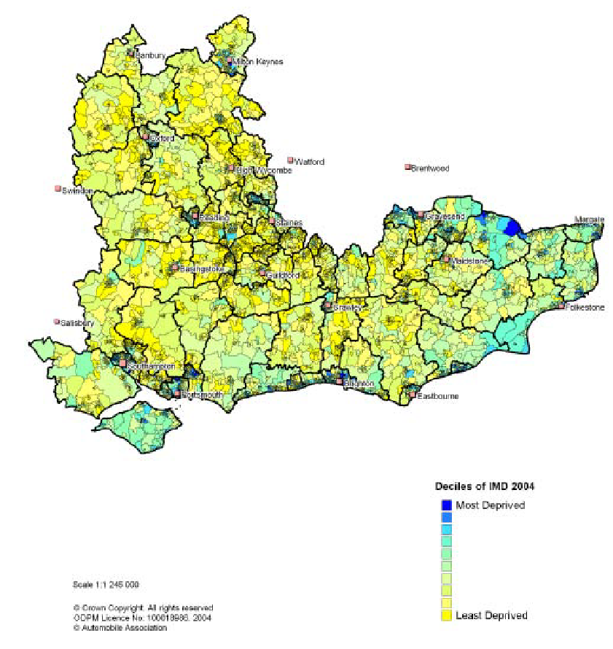
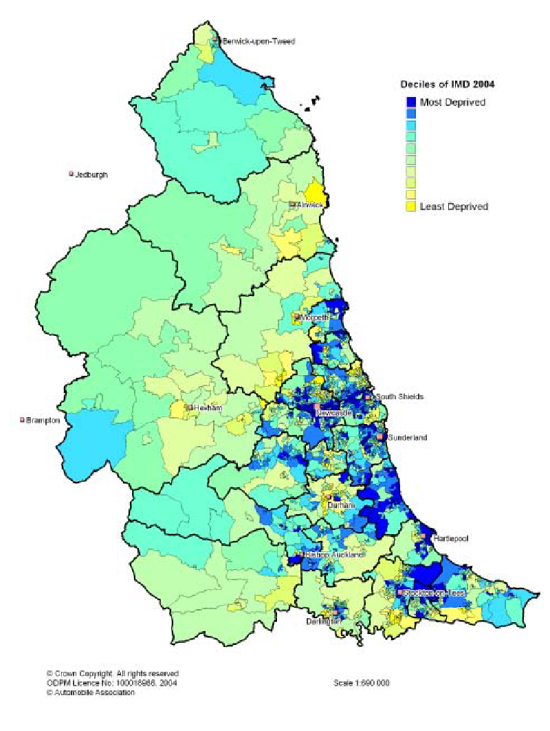
Deprivation - A Tale of two regions
Notes:
This slide shows both the S East Region and the N East Region, note the dark blue shading theses are the 10% of local areas that are most deprived the yellow are the 10% least deprived.

Slide 6
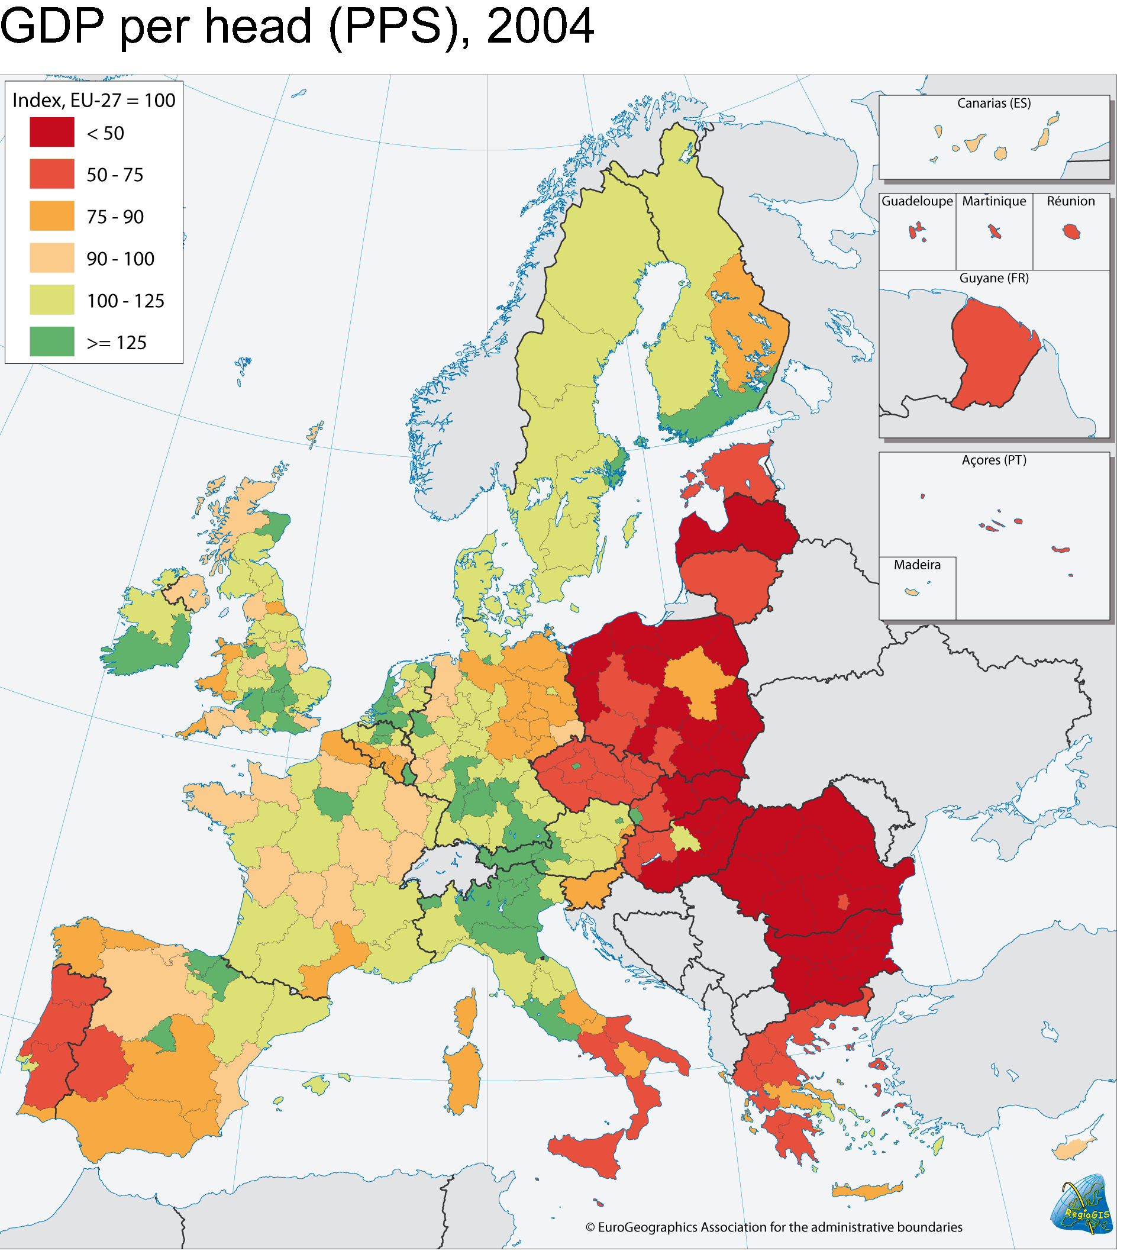
A European-wide problem
In the EU evidence of continuing disparities is made even more acute by inclusion of accession countries. In 2004, the top regions (with 10% of the EU population) had a GDP per head that was almost 5 times higher than that in the bottom regions (with 10% of the EU population).
Notes:
This slide shows that it is not just a problem in the UK but also in Europe. The graph shows GDP per-head throughout the NUTS 2 regions of Europe as an index based on the average GDP per-head for the 25 core nations of Europe.
The key aspect of EU regional policy is cohesion (its about reducing regional disparities) we will go deeper into this aspect of regional policy later.

Slide 7
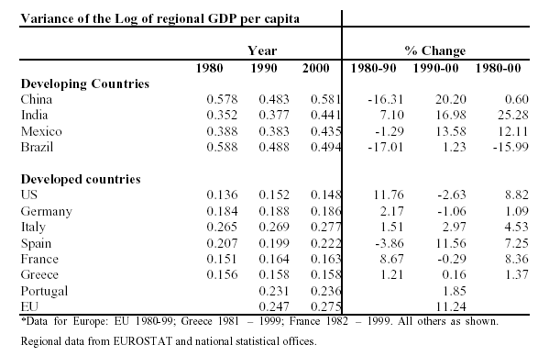
An international problem
Source: Andrés Rodríguez-Pose and Nicholas Gill, in their paper Is there a global link between regional disparities and devolution?
Notes:
The problem is not just confined to the UK or even Europe it is international.
What we are looking for is a lower figure as we move through time.
They look at whether or not devolution had helped reduce disparities across a number of countries. The Rodregeuz-Pose paper suggests that of all the countries they examined over the 20 year period only Brazil has experienced convergence whilst all the rest have diverged. In particular there has been strong divergence in Mexico and India.– but that said the gap between richest and poorest is still much wider than in the more developed countries such as the US, Germany and France.

Slide 8
The causes of economic disadvantage –
the economists perspective
Economic disadvantage does not arise for a single reason – nor is it necessarily the case that once a region is disadvantaged it will remain so forever.
Harris, R (1991), Regional Economic Policy in Northern Ireland 1945- 1988
Outcomes
High relative unemployment High outward migration
Low earnings Industrial stagnation
Causes of economic disadvantage
Structural Locational Technology and productivity
Other factors
The linkage between regional and national demand
Regional adjustment to economic imbalance
Harris suggests that in the absence of automatic adjustment there was a strong case for implementing regional policies in Northern Ireland in the 1950’s
Notes:
Causes - Structural − The local manufacturing stock was predominantly in sectors declining internationally and subject to intense overseas competition from emerging economies in the Far East and elsewhere. The main sectors were shipbuilding and textiles.
Location – NI is a peripheral region within both the UK and Europe. It is geographically distant from the centre of economic activity in the UK and Europe. As Europe turned inwards and UK became less dependant on the Empire for trade and raw materials so NI’s previous strengths turned to weaknesses.
Technology and productivity – The province had a low-technology industrial base, being reliant on cheap labour for its comparative advantage. This led to low levels of investment in capital stock and thus a lower productivity base than elsewhere in the UK. When even lower cost centres for labour opened up after the war NI found itself with both inefficient labour and worn out capital stock.
Other factors - The linkages between local and regional economies and national demand – with NI the local economy was relatively small therefore local demand was not always sufficient for the establishment of efficient sectors within the province. Thus a high proportion of local demand was met by exports from elsewhere in the UK. This in turn gives an adverse regional balance of payments.
Adjustment to economic imbalance – there were not automatic stabilisers. Also there was little opportunity to trade out of the adverse conditions because of the state of capital stock and the deskilling of the labour force through migration.

Slide 9
The causes of economic disadvantage –
Economic geographers perspective:
Manners et al (1980) Regional Development in Britain, pp 1 – 11
Regional changes conditional on: Evolution of consumer demand - It is not specifically about the rise of the service sector – it is about Changing consumer tastes, Openness, International markets and Technology.
Locational preference change - causes additional challenges: competition for land - slow growth & stagnation - permanent environment damage - Inability of inner cities to adjust.
Sant (1974), Regional Disparities
Examines different indicators and measures of regional disparities - cause of disparities - concludes that the problem is that the benefits of change are not distributed equally.
Notes:
Changing consumer tastes as an increased proportion of wealth is spent on services such as health, education, travel, entertainment, recreation and personal services.

Slide 10
The Dilemma
“… it is therefore possible for a region to find that there is no product it can produce which other regions cannot peoduce more efficiently. Moreover, there is nothing to prevent a region from remaining in an adverse balance of payments relationship with the rest of the country for an indefinite period of time …. (this) has a depressing effect on the economy in the same way as an excess of savings over investment, and will tend through the multiplier to produce regional depression and unemployment.”
McCrone, G (1969), Regional Policy in Britain Allen & Unwin, London, p80

Slide 11
The language changes
Economic development and economic regeneration
Economic development - national industrial policy on a regional or local scale - develop or protect industry - compensate for disadvantage - coerce business into a sub-optimal location. DEPENDENCY
Economic regeneration - assist areas and individuals - “its broken and needs fixing” - supply side focus - infrastructure - skills & training – R&D - entrepreneurial conditions and activity. INDEPENDENCE - SUSTAINABILITY

Slide 12
Grounds for policy - efficiency & equity
Efficiency issues
Optimal use of scarce resources - if under performing regions can be improved without adverse knock on effects to core regions the nation should benefit.
Development is uneven - no automatic adjustment mechanism
Putting the unemployed back to work - also has social dimension
Increased productive capacity Reduction of social cost
Spreading capacity Multiplier effects
Equity issues
Harmful political and social consequences
Dissatisfaction & resentment
Correlation between chronic unemployment & social deprivation
Net welfare gain
Notes:
Not necessary mutually exclusive

Slide 13
Are there different theoretical approaches?
Question 1. Are markets inefficient or is all the fault of vested interests?
Question 2 Are barriers to capital and labour migration insurmountable?
Free market approach
Problem - Inefficiencies, not enough entrepreneurs, the state is too big
Solution - Free up the market, minimal policy, target resources
Response - Neutralise unions, make U less attractive, assist migration
Criticism - Unions weak, switching, housing constraints, congestion
State intervention
Problem - Structural, lack of investment
Solution - Rebuild industrial base, involve government (at all levels)
Response - Inward investment, indigenous growth, public investment
Criticism - Wrong sort of investment, there is a weak small firm culture,
short-termism, high tax burden need to tackle competitiveness
Notes:
Barriers to capital and labour migration:
Firms have a preference for current certainty; - Small firms loose local input / output linkages; There are also significant barriers to labour migration.
Wages fail to respond to local market conditions because of:
Collective agreements; Minimum wage; Unemployment benefit; Easy access to benefits; Poor policing of benefits.
Switching – basic economic theory suggests that if the real wage is too high in a location firms will not move but switch to more capital intensive forms of production.

Slide 14
What have been the main phases
of regional policy? – Armstrong & Taylor
Pre 1939 - Moving workers to the jobs Industrial transference, aid to industry building new trading (industrial) estates
1945-50 - Emphasis on creating manufacturing jobs in development areas
1958-70 - Poor post war economic performance, overheating in London, policy gradually wound back up in mid 60’s, Interventionist golden age
1972-79 – Policy revival, but lack of mobile investment, high inflation
After 79 – Free market approach policy downgraded and switched to supply side objectives - New participants - EU, RDAs,
Local Authorities, Enterprise zones
Notes:
Virtual monopoly of government
Pre war Industrial Transference: facilitate the transfer of workers Special areas Act: taking “jobs to the workers”. Barlow Report: commitment to full employment
45-50 Post war Labour government loans and grants to firms + controls on the location of industry.
50-58 Policy on the back burner interference by government not encouraged
58-70 Wilson era (interventionist Keynesian) In the wake of the UK’s poor economic performance policy was re-activated mainly loans and location controls – loans for building and capital equipment as well as free depreciation – writing off investment against corporation tax.

Slide 15
Why was regional policy concentrated
on manufacturing?
Harris, R (1991),
Regional Economic Policy in Northern Ireland 1945- 1988 Ch 1
Reasons for concentrating on manufacturing
Competitive
Self sufficient and self reliant
Not tied to local demand
Dominates other sectors
Innovative
Expansive

Slide 16
Is the objective economic efficiency
or social inclusion?
Should be mutually reinforcing
Barlow report contained 3 objectives - not always reinforcing
Efficiency (competitiveness) driving force particularly since 1980
Switch to social inclusion evident since early 90s
Reasons income inequality
Growth in multiple deprivation
Arguments against social inclusion
Definition vague
National problem, national solution
Conflict between inclusion and competitiveness
Notes:
Three objectives in Barlow report
1. Reduce chronic unemployment in certain heavily depressed areas
2. Achieve a better balance in the geographical distribution of industry in order to alleviate congestion and over crowding in London
3. Achieve a better dispersion of industry for defensive and strategic purposes

Slide 17
Conclusion
Two reasons for using regional economic policy - but they may conflict
Two different ideologies - free market & state intervention
Policy has evolved in response to political and social difficulties
There is a question mark over whether manufacturing is still important
Social inclusion now a major focus of policy
Concerns
There has been a problem over the precise specification of objectives
Objectives need to be set in quantitative terms
Politicians fear that targets might not be achieved
Difficult to measure is the impact due to policy or natural occurrence
Policy drift may be setting in - lack of focus & fragmented effort

