Slide 1

Unemployment Disparities

Slide 2
RELOCE - Lecture 5b
Last lecture: - Inter regional labour migration
This lecture: - Unemployment Disparities
Aims
Examine why unemployment disparities persist
Look at types of unemployment
Discover who is likely to be unemployed
Examine the issue hidden unemployment
Objectives
To understand why regional economists study unemployment
To be able to identify the main issues
Notes:
Aims
Examine why unemployment disparities persist and why some regions and areas have had relatively high unemployment for decades.
Look at types of unemployment, frictional, structural, neo-classical and demand deficient
Discover who is likely to be unemployed, what are the characteristics of the unemployed are some people more likely to be unemployed than others?
Examine the issue hidden unemployment, do the official statistics give a clear indication of the problem?
Outcomes
To understand why regional economists study unemployment, and why policy makers have spent so much time, money and effort trying to eradicate it.
To be able to identify the main issues connected with unemployment, understand the reasons for continuing disparities and be able to appreciate the scale of the problem.

Slide 3
Important questions for economists
 | 1933 | 1999
North East | 127.4 (29.8%) | 156.5 (9.7%)
South East | 72.6 (17%) | 62.9 (3.9%)
Why do regional unemployment disparities occur and persist?
Why do some towns and cities have higher rates than their suburbs and rural hinterland?
What’s the link between unemployment and regional policy?
Notes:
P1. Table 10.2 in your notes shows that regional unemployment rates in January 1933 and January 1999 both as the prevailing rate at the time and as an index based on the UK average (in each year). As can be seen although there have been significant shifts for some regions London (below to above average)and Wales (still above average but not as bad) in general the southern regions are below and the northern regions above the national average in both time periods
P1. Armstrong and Taylor also suggest that unemployment is closely linked to social exclusion (see Table 10 .1), Unemployment is positively correlated with lone parent families, pupils eligible for school meals, pupils with zero GCSEs and the truancy rate, it is negatively correlated with higher qualifications and 5+ A-C grade GCSEs.
P2. Whilst a great deal is made about rural poverty, unemployment rates are still significantly higher in metropolitan areas than surrounding town and countryside – in Sept 2000 the rates for Knowsley and Ribble Valley were 8.1% and 0.8% respectively.
P3. Regional policy in the UK exists to try and combat regional economic disparities but it is one measure above all others that has been responsible for deciding whether or not areas qualify for assistance – regional (and local) unemployment rates.

Slide 4
Unemployment disparities exist within as well as between regions
Armstrong & Taylor find wide variations in unemployment in Europe
Similar situation in the UK wide fluctuations within regions
Was the recession of 1990-92 a turning point?
Same number of jobs lost in south as in the previous recession but less lost in north
Shake-out from unsustainable service sector boom in south
Service-sector employment boom more subdued in the north
North’s industrial base already slimmed-down and efficient
East Sussex 6.6% | Tyne & Wear 2.2%
Notes:
P1. Unemployment rates differ significantly between regions both in the UK and elsewhere A & T use data from 1995 to show that the highest percentage point variation in Italy is 19.9 the lowest in the Netherlands is 2.2 and the UK is in between at 6.3.
P2. More recent data for the UK shows the wide variation between local areas within regions note where the median observation lies.
P3. Is the situation changing? Article by Martin (1997) compares the effects of the last two recessions in the UK. He finds that the South was relatively harder hit than the North in the early 1990s. It was not that more jobs were lost in the South but less were lost in the North. The table shows the contrast in the percentage change in unemployment rates in East Sussex and Tyne and Wear. He gives three main reasons.
But he concludes that the longer-run pattern has not fundamentally changed because the recovery after 1993 has centred on the southern half of the UK in the same way that it did after previous recessions. He also stresses that the situation in the North may be far worse than the official figures suggest because people are more likely to withdraw from the labour market in the face of decreasing employment opportunities.

Slide 6
Why is the LM adjustment process so slow?
Wages are unresponsive to excess supply
National negotiations
Decentralised management functions
Mobility constraints
Employers caution
Minimum Wage
Proportion of small firms
Notes:
Economic theory suggests that L Mkts should adjust fairly quickly to excess demand or supply via the wage rate and thus eliminate unemployment. A & T suggest a number of reasons why L Mkts in the UK and Europe do not function as efficiently as those in the USA.
P1. TUs resist wage cuts - they represent employed not unemployed. Employers reluctant to cut wages (efficiency wage) because of effect on moral/productivity. Employers are also tied to wage contracts.
P2. UK applies in both the public and private sectors. Actual wages may be higher - incentive payments and bonuses - national structures impose significant rigidity.
P3. Profitability related wages - high wages paid to workers in areas with high U.
Breaks link between regional U and W and average regional wage rises.
P4. Without help towards the cost of training/relocation, labour force mobility is hampered and this slows down LM adjustment.
P5. Suggested that hiring and firing cost are high in the EU - Social Chapter –seen as an excessive burden by employers. Employers selective in recruitment some groups regarded as “unemployable” hence need for new deal.
P6. Minimum wage imposes floor – leads to leap-frogging to maintain differentials
P7. Proportion of small firms – greater flexibility, monitoring and cost conscious.

Slide 7
Types of unemployment
Frictional unemployment
Jobs available for unemployed
Takes time to match workers to jobs and jobs to workers
Levels high in boom low in slump
Some sectors experience high level of churning
Structural unemployment
Unemployment and vacancies coexist
Mismatch between skills and jobs
Reasons - technological change; changes in consumption; production transfer
Long-term chronic in slum re-training in boom
Notes:
Frictional unemployment, occurs when there are jobs for the unemployed (with the right skills) in the right locality. But it takes time to match workers to jobs, they may not accept the first job that comes along and employers are often seeking the “right” worker. The level of frictional unemployment is likely to be high in times of boom because the number of people quitting their jobs is higher as well as the number of new-entrants and re-entrants to the labour force (mainly because more vacancies are available). The opposite is the case in a slump when workers are reluctant to quit jobs and potential re-entrants may delay a return until the job situation improves. Some sectors experiencing high levels of workforce turnover (tourism is a classic case). This is sometimes referred to a labour force churning and areas with a high proportion of industry sectors prone to churning will exhibit high levels of frictional unemployment IOW.
Structural unemployment, unemployment and vacancies co-exist, but there is a mismatch between the types of jobs on offer and skills that the unemployed possess or the location in which the jobs are. The mismatch can occur because of changes supply side of the product market, technological changes may lead to different commodities being produced and/or different skills being required. Capital deepening - less labour required - skill composition increases more highly skilled labour may be required. On the demand side consumers may switch commodities with the result that plants may close, switch to alternative products that require different inputs. Structural unemployment tends to continue for a long period of time usually because the unemployed find it difficult to acquire new skills or move to an area that does require their skills. The situation is often chronic during periods of major structural change with slow growth and slack labour markets (e.g. economic turndown or recession) in periods of growth and tight labour markets the scarcity of labour will assist in re-training and higher real wages are more likely to induce migration. See study by Tomaney, Pike and Cornford (1999) into the effect of the closure of Swan Hunter.

Slide 8
Measuring frictional and structural unemployment
Unemployment/Vacancy ratio Portsmouth TTWA, Oct 2000
Structural
3.50
3.00
2.50
2.00
1.50
Frictional
1.00
0.50
0.00
Professional
Occupations
Occupations
Operatives
Craft/Related
Sales Occupations
Plant/Machine
All occupations
Other Occupations
Occupations
Service Occupations
Clerical/Secretarial
Professional/Technical
Personal/Protective
Managers/Administrators
Associate
Notes:
Note the graph shows the number unemployed by occupations divided by the number of occupational vacancies. Note that in Personal and protective services and Sales here are twice as many jobs available as workers to fill them. This is frictional unemployment. Whereas in Professional and Associated, professional and technical occupations there are three times as many people unemployed with these skills as there are jobs for them. This is structural unemployment in these occupations. Overall there is a balance between jobs and vacancies suggesting that overall, unemployment is frictional.

Slide 9
Neo classical unemployment
Real wages too high
Influenced by, unions, benefit levels, minimum wage
Solution neuter TUs, cut benefits, abolish minimum wage
Lower real,wages induces employers to take on staff, invest and increase capacity
Real wage
D
S
w₁
w*
D
S
n₁
n*
n₂
Demand for labour, supply of labour
Unemployment
Notes:
The Neo-classical explanation, argues that unemployment exists because the real wage is too high, over time migration will erode unemployment (see the classical model of migration Lecture 5a). Under this paradigm significant regional unemployment disparities exist in areas such as Merseyside because real wages are not allowed to fall to their market clearing level under the influence of high benefit levels, minimum wages and over powerful trade unions. If distortions in the labour market were removed, (i.e. trade unions neutered, benefits cut and the minimum wages abolished) the resultant lower real wage would induce employers to take on more staff and invest or increase their capacity in the region, on the expectation of higher returns to factors (labour).

Slide 10
Demand deficient unemployment
Severe decline in national demand
Transmitted to all regions
Unemployment reduced by increasing aggregate demand
Use regionally discriminating taxation and expenditure
D’
D
S
Real wage
w*
w₁
D’
D
S
n₁
n₂
n*
Demand for labour, supply of labour
Unemployment
Notes:
Demand-deficient (Keynesian) explanation, suggests that unemployment is a direct result of a decline in the national level of demand which is transmitted to all regions. Empirical evidence suggests that regional unemployment rates are highly correlated and that unemployment increases in all regions in slumps and declines in boom periods (although not always at the same rate). Using a simple labour market demand supply diagram it can be shown that an inward shift of the demand curve and a sticky real wage will decrease the number actually employed but maintain the number of people who wish to work. Keynesian economists therefore argue that the best way to combat unemployment is to raise the level of aggregate demand. To ensure that areas with the highest levels of unemployment benefit most from the upswing, they argue that regionally discriminating taxation and expenditure should be used (the former is not used in the UK but the latter has been used to a limited degree).

Slide 11
U - V relationship over time
Adapted from Armstrong and Taylor (2000) pp 183
Notes:
Armstrong and Taylor use a formal model to demonstrate the relationship, between unemployment and vacancies. This simple demand supply relationship although showing excess unemployment above the real wage (BC) and excess vacancies below it (GH) does not match empirical data where vacancies and unemployment coexist. They extend the model to demonstrate how this can be incorporated into the model to reflect the fact that vacancies and unemployment exist at the same time. By defining a realistic employment curve (EE) they are able to develop an unemployment - vacancy relationship which tracks the effect on both of an increase in demand for output at given wage levels or a fall in real wages at a given level of demand for output. In both cases it is predicted that there will be a decrease in unemployment and an increase in vacancies (see Armstrong and Taylor (2000) Figure 10.1). For example, at real wage W₂ vacancies = AB and unemployment = AC. Shifts in the employment curve (EE) will lead to corresponding movements in the unemployment - vacancy relationship, a leftward shift increases both vacancies and unemployment for each level of the real wage (assuming stable demand and supply functions). A rightward shift has the opposite effect. Research has suggested that the unemployment - vacancy relationship has been moving upwards and to the right (i.e. more vacancies and unemployment). Armstrong and Taylor give three reasons for this:
Structural shocks resulting in a mismatch between labour supply and demand ensure that there is more unemployment at each level of vacancy.
Reductions in the opportunity costs of being unemployed (benefit levels are too high and counter the incentive to search for work).
An increase in long-term unemployment, (the residual unemployed are less attractive to employers, they lack self-confidence and their skills gap widens with time.)

Slide 12
Characteristics of the Unemployed
Aged under 25 (particularly females)
Non white
Low educational attainment
Unskilled (males) Skilled & Partly-skilled (Fem)
Unmarried
In rented accommodation
Working in construction
No fixed job or occupation
Notes:
See Table 10.4 in your notes which summarises the work by Fieldhouse (1996). He uses a sample of anonymized records from the 1991 Population Census to show the individual, occupational and industrial propensities to unemployment against control variables. Those with a figure above 1 are more likely (than the control group) to be unemployed and those with figures below 1 are less likely. Control groups are aged 35-44, White, No higher qualification, Not married, No dependant children, owner occupier, born in the UK, Banking and finance sector and professional occupation.

Slide 13
Real levels of coalfield unemployment
DoE Registered
unemployment
161,300
Census
unemployment
178,300
Early retirement
22,200
Gov. Schemes
30,400
Real unemployment
318,600
Sick
87,700
Adapted from Fothergill and Beatty
Notes:
There is a growing body of evidence to suggest that the official unemployment statistics are only the tip of the iceberg. It is a fact that regional unemployment is in fact greater than it appears and there is the possibility that the propensity to register (as unemployed) may differ between regions. Not all persons searching for work are registered as unemployed (some will not be entitled to register others may be on government schemes) in addition some people will have temporarily withdrawn from the labour market but would take a job if one was offered (the discouraged worker). A study by Beatty and Fothergill (1996) of UK coalfield areas suggests that there are a number of reasons why the real rate of unemployment might be greater than the official rate:
1) Most of the changes in the administrative procedures (30+ since 1979) for registering as unemployed had the net effect of reducing the total U.
2) Many of those who had been unemployed were switched to other benefits such as sickness and invalidity benefit (it is suggested that as many as 66% of males leaving “the resister”, who did not go to jobs, switched benefits 1989).
3) A significant number of people made redundant in staple industries (coal, steel etc.) have received lump-sum pay-outs and/or have taking early retirement, others whose spouse is working may not qualify for benefits.
4) Those on the margins of the labour market who alternate between employment, unemployment and inactivity are often “underemployed” when in work (despite their desire to work full-time) and this is not accounted for in the official figures.

Slide 14
Unemployment and sickness
Extended study by Beatty and Fothergill published in 2000 in Regional Studies.
At the core of the theory is the notion that long-term sickness is widespread in the workforce.
Draws on the concepts of “hidden sickness”, the “queue for jobs” and hidden unemployment.
Based on empirical observations in UK and shows how job losses translate into higher recorded sickness.
They find that the process varies between locations.
Notes:
P1. The authors are from Sheffield many of you may have seen the film the “Full Monty”
P2. Some people hold down jobs despite disability or limiting long-term illness, some unemployed are also sick and others have withdrawn from the labour market on health grounds.
P3. When job losses occur people with ill health are often the first to go diverted away from unemployment to recorded sick, the less healthy tend to be treated similarly. So rather than unemployment causing ill health the argument is the other way round. There are also distortions over time as as the rules of entry to sickness benefit are tightened or relaxed
P4. Evidence suggests that long-term sickness rose from 0.6m to 1.9m between 1981 and 1998, at the end of the 90’s there were 2.5 sickness benefit claimants and 1.2m unemployment claimants. In some areas more than 20% of working age males claim sickness-benefit. But all through the period generally health has been improving.
P5. In areas where there are significant clusters of heavy industry occupational ill-health is high they argue that in these areas hidden unemployment is also high. This distorts regional and local comparisons. They map the UK to show significant clusters of hidden unemployment in South Wales, North East, North West and Central Scotland.

Slide 15
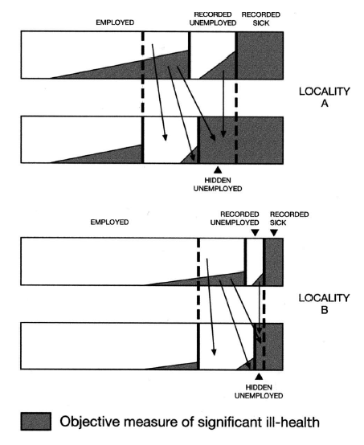
Source: Fothergill and Beatty, Fig 3, Regional Studies 34.7 pp622

Slide 16
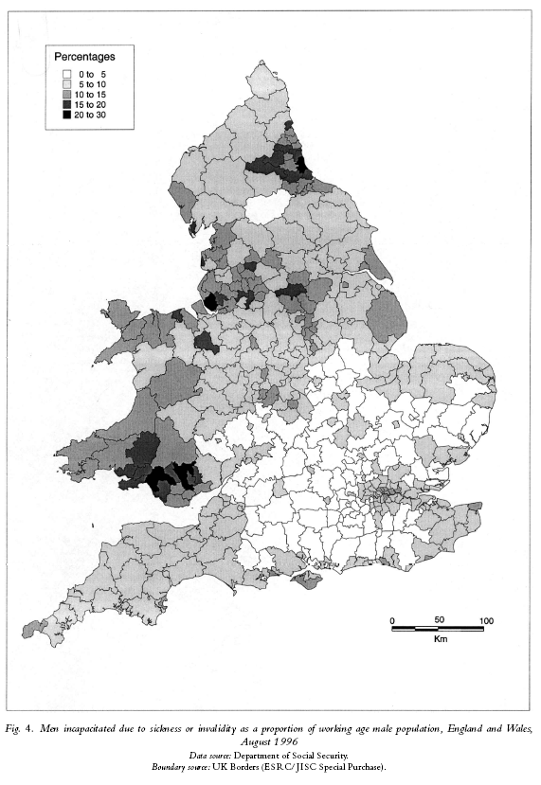
Note the dark shaded areas are predominantly areas dependant on heavy industry and coal
Fothergill and Beatty’s article is available on the “L” Drive

Slide 17
Conclusions
Important issue.
Supply-side economists suggest unemployment disparities could be reduced by increased labour market flexibility
Keynesian economists suggest difficult to reduce labour market frictions must manage demand spatially
Truth is out there somewhere between the two extremes
Concept of hidden unemployment seen as increasingly important in a tight labour market

