Slide 1

Introduction to Regional and Local Economics (RELOCE)

Slide 2
RELOCE - Lecture 1 part a
Aim - To introduce what the course is about
- Give general information about the unit
- Look at the programme & assessment criteria
- Explain some of the key terms
Objective - To ensure that you are familiar with the programme you are about to commence and have an overview of what regional economics is about

Slide 3
What is RELOCE all about?
The first part of the unit looks at how we examine sub-national economies the second part examines the application of regional and local economic policy in the UK and elsewhere.
Attempts to build on your previous study/skills & uses familiar concepts but directs them towards regional issues.
Helps you to improve your practical skills and shows how to present analysis in a clear and professional manner.
You will not need “special” skills but you must be prepared to engage in “deeper” learning.
Grades are good, if you work, similar to courses in other Universities, the course is continually evolving.

Slide 4
What will you do?
Evaluate main theories & techniques to investigate how economists look at economic behaviour below the national scale.
Review and reflect on the analysis of the effectiveness of regional and local economic policy
Examine empirical material & carry out your own research
What will you be expected to demonstrate?
Critical knowledge of theories
Application of tools
Analytical competence

Slide 5
Activities
Lectures – 2 hours per week – concepts, theories and outcomes with examples taken from the main books and contemporary articles. Notes available on-line via: the “L” drive. L:/pbs/LectData/Clarkd/RELOCE/Lecture notes.
Seminars – one every week – demonstrate how to analyse a local economy and explore a number of contemporary articles about how regional and local economic policy has evolved over time and is used in the UK and elsewhere. The second seminar is given over to a workshop. Notes via the “L” drive L:/pbs/LectData/Clarkd/RELOCE/Seminars.

Slide 6
Workload & reading
Expect to spend an average of about 12 hours per week on this unit (mostly loaded into the assessment).
Main course text – Regional Economics & Policy by Armstrong and Taylor published by Blackwell.
Wide selection of other books available from library
Number of relevant journals – reading lists provided with notes.
Extensive internet resources data and articles.

Slide 7
1st set of lectures
Why we are interested in sub-national economics
How we measure the local economy
Economic growth models
Location theory and business issues
Labour market issues
2nd set of lectures
The case for regional policy
The interventionist years
A return to neo-classical prescriptions
Local regeneration
Event-based regeneration

Slide 8

Programme – seminars
Introduction to coursework
Computer workshop
Economic overview, demographics & wealth
Industry structure and labour market
Comparing competitiveness
Formative Assessment
Lessons from the past - policy before 1979
Regional and trans national policy after 1979
Local regeneration and sustainability
Criticism of regeneration policy and future directions

Slide 9
Assessment
To ensure you can demonstrate you have achieved the specific learning outcomes of the course.
Coursework (50% of total) independent research into a given local economy (in UK) – output up to 2,500 word report into the comparative strengths & weaknesses of that local economy.
End of unit examination 2hr unseen paper answer two questions from six arranged in two parts A and B.
See handbook for assessment marking criteria.
Notes:
Stress the point about active learning.

Slide 10
Development Implies some sort of welfare gain
Blair (no not him) suggests an equity gain (on average or for the most disadvantaged)
But growth might be detrimental (screwdriver plants, importation, low skills and wages, profits repatriated)
Regeneration Suggests something needs fixing
Wide ranging economic action on social, economic and environmental conditions.
Integrated, holistic, planned, capacity building, jargon moving towards regeneration.
But would conditions have improved on their own without intervention, and is regeneration preventing market failure or preventing the market working
Notes:
Blair (1995) separates economic growth and development argues that growth can be beneficial or detrimental. New factory (screwdriver) - low wages, imported material and exported profits per cap incomes may actually fall – although income has grown the quality of life has fallen. Development implies that resident’s welfare is improving - on average – or the poorest are gaining most. – equity - recognises that community development is important. Regeneration suggests that something needs to be fixed. Roberts (2000) looks urban regeneration, - wide-ranging & integrated vision as well as action to make a difference to social and economic conditions.Regeneration more holistic than development. Capacity building rather than physical development and inward investment. SRB monies thus emphasis on regeneration particularly since mid 90’s.

Slide 11
Is it a pure science?
Macro level conditioned by the political economy - Interventionist, Free Market, Third way? (prescriptions tend to fit the ideology)
Micro level conditioned by the tools of micro economics – increasing demand for products improving quality and quantity of supply. (Policy makers may have to opt for second best)
Range of tools required to address problems - training & skills, education, mobility, quality of life, research and technology transfer & entrepreneurship
Notes:
Its not pure science. Conditioned by political ideology – rooted in political schools of thought policies also fit schools of thought. Hard or soft but build towards consensus that a range of policies needed – unemployment – demand and supply actions – investment & training.

Slide 12
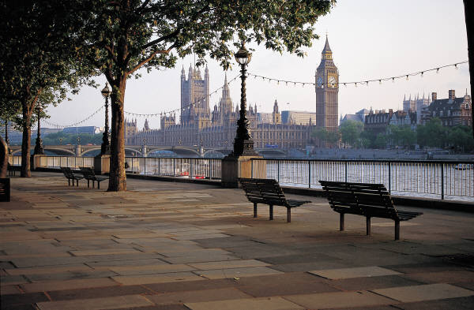
Why bother looking below the national level?
What might be the impact of an event? – what would be the impact of the closure of the University of Portsmouth? How far might it spread? What other sectors might be affected?
What is the ongoing value of an asset? – how many jobs are supported directly or indirectly? Does it have intangible benefits? What are its future prospects?
How are we performing? – is regional or local economic benchmarking important? Can we attract additional resources? Can we learn from best practice elsewhere?

Slide 13
Why is it important?
To Academics and Researchers – wishing to understand variations in living standards, productivity, trying to answer questions about why there is so much diversity
To Physical Planners – finding land for new homes, infrastructure, transport links, attracting inward investment, a key concern in recent years is how to achieve sustainable development.
To Governments and public policy makers – who need to track resource use, effectiveness of policy, impact on social cohesion, regional policy is the second largest portion of the EU budget.
To Industry and Commerce – likely structure of demand, supply chains, potential access to subsidy, a wide range of companies are interested in regional economic growth projections.
Notes:
Strong tradition in the academic community CLREA @ Portsmouth. For many groups detail is Important need to quantify impacts not enough to say that a closure will have a negative impact.
A&T suggest that economists are interested in: the special factors determining output and employment; why living standards differ; why productivity varies; what makes regions specialise; whether or not migration is driven be economic forces; why unemployment is endemic in some areas.
Planners: how much land is needed business; homes etc;will they need re-use land and upgrade infrastructure; likely congestion and degradation; encouraging growth and expansion.
Public sector: efficient use of scarce resources (health); social cohesion; narrowing the gap between leading and lagging regions; helping to release potential.
Industry: will the local market be as buoyant as the national economy? availability of inputs, costs of congestion; availability of help.

Slide 14

What is a Local economy?
Top down - sub-division of national space
Bottom up - aggregations of urban and rural space
Geographical sub-set of the national economy
Variety of economic and social experiences in a limited geographical space
Differentiated from surrounding areas by its’ characteristics
Boundaries driven by convention and custom
Notes:
A&T geographical sub-set of national economy from state to local authority.
McDonald again geographical definition but joins local and regional in the same definition.
All economic activity taking place in a defined area. Will look at all aspects of a local economy not just overall – labour markets, factor markets, productivity etc.
Temple depicts the regional and local economies graphically as a series of concentric circles with the local economy at the centre and the international economy at the extremity. She concedes that in both the UK and EU: “the definition of a region remains essentially complex and qualitative in many respects, influenced by convention and custom as well as by administrative convenience or even – sometimes – economic cohesion”
Definitions are very fluid there have been many changes over time with regional boundaries in the UK last changing in 1994.
Most common to use administrative boundaries for convenience and the fact that data is usually available at this level.

Slide 15
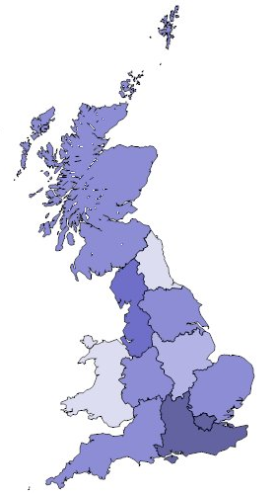
What functions are devolved to the regions (in the UK)
Gov regional offices
Regional development agencies
Physical planning
Local Government
EU Committee of the Regions
Celtic fringe degree of self-government
Notes:
Main Government departments work through regional offices - new regional development agencies will have a coordinating role but little direct spending powers
Health Care was organised on a regional basis (until advent of health trusts) and we may yet see partial return with the planned 9 super social service areas (in England)
Regional physical planning e.g. SERPLAN
Local government sometimes organises regionally e.g. North West Regional Association.
The EC use standard regions as a vehicle for resource redistribution; EC Committee of the Regions
Education and housing are not organised on a regional scale

Slide 16
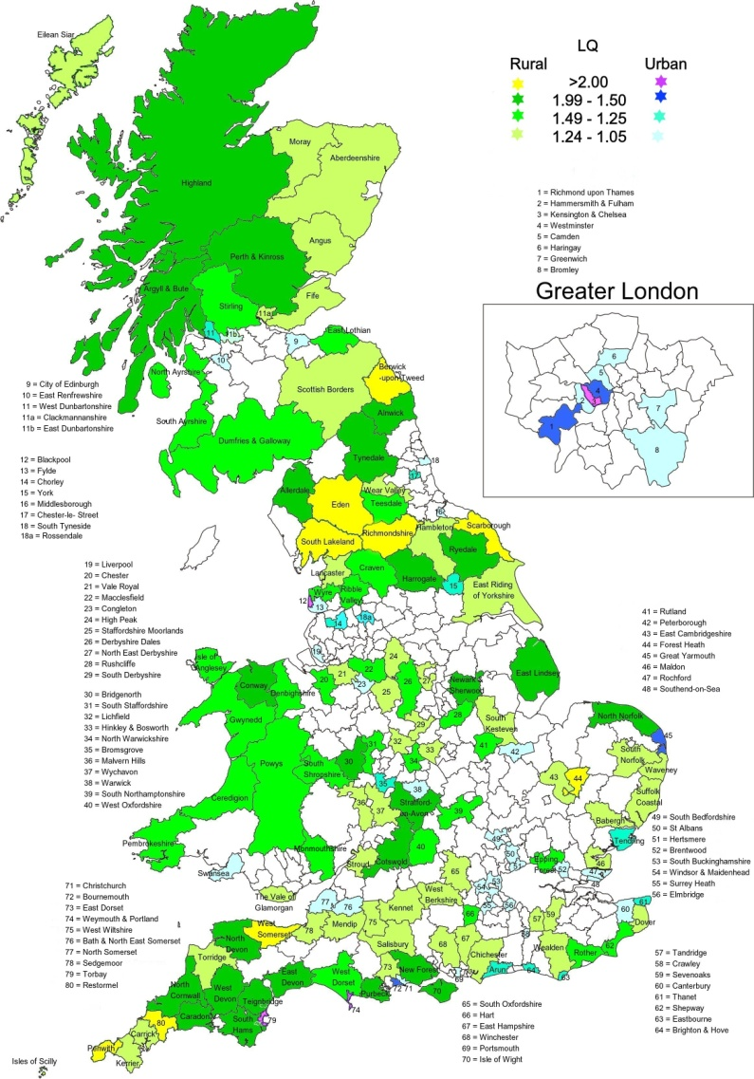
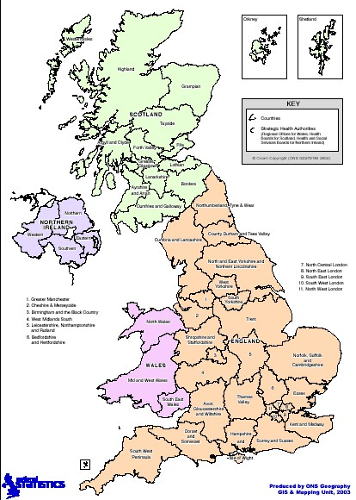

Slide 17
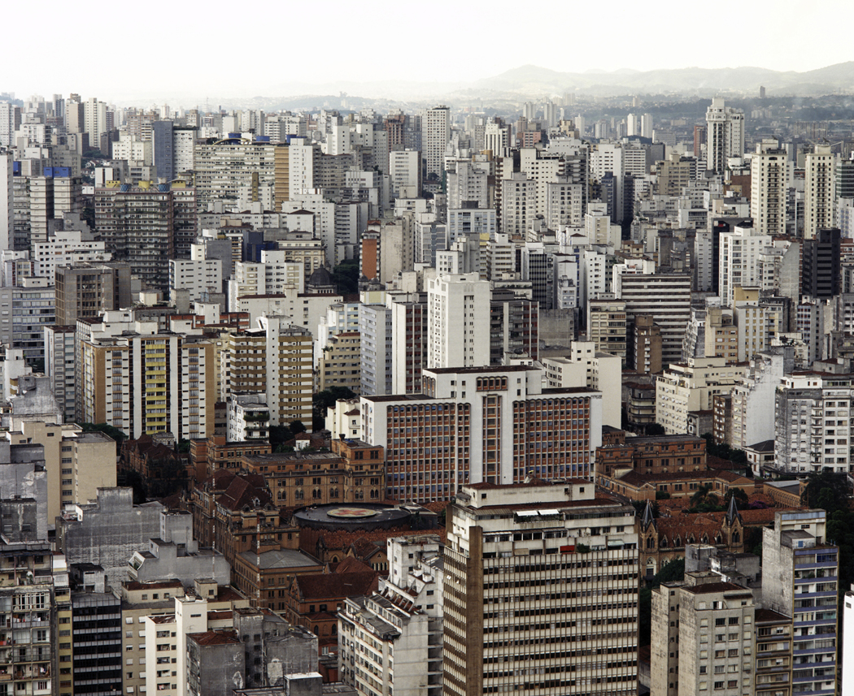
What are the distinctive features of a regional or city economy?
More “specialised” industrial structure.
More “open” - factors flow more easily because there are less barriers
Wealth and income may be “different”
Quality of life may be better or worse than the national average.
Workforce may be “different”
Notes:
It is assumed that relationships that apply in the national economy apply at local level – second best option regional dynamics are likely to be different – e.g. import content may differ productivity is unlikely to be uniform.
External trade is very important to the region there is less ability to exercise control e.g. consumption. Trade is more open at the local level many more firms will “export”.
Examples of specialisation include: finance; tourism; automotives and defence.
Factor flows are easier because: there are no tariff or trade barriers, cultural, defence or political barriers; distance to markets are less and L & K are more mobile within a country;
Regional incomes depend very much on external factors: Gov spending; taxes; wage determination; investment decisions.
How can we analyse the Local Economy?
By Looking at:
The Past - Using data to look at trends, relationships between variables, the effectiveness of policy and extrapolation.
The Present - Comparing and contrasting regional and local economies against “benchmarks”
The Future - Use economic modelling and forecasting to forecast output, employment, occupations etc.

Slide 18
What tools do we use?
Construct economic profiles to compare and contrast
Formulate and run econometric models
Carry out input-output analysis
Use cost benefit analysis
Examine primary evidence of attitudes and aspirations
Notes:
Profiles: Snapshot of area usually secondary (published) data but can be primary. Need a reference point possibly national economy. Often used in SWOT analysis.
Used in forecasting driven by clear assumptions that are based on extensive research of the interaction of key economic variables, interest rates, demand; looking for cause and effect.
Simulate shocks to a local economy and capture the full effect of a change by looking at the inter industry linkages how sectors buy from and sell to one another.
Compare and contrast policies or projects i.e. if public money is to be used to set up a new factory which of two or more rival bids gives the best return to the local economy.
Surveys are a way of obtaining detailed and up-to-date information about a local area or firms in it. May want to look at the attitudes of firms to certain policies or courses of action. Or to examine the outcomes of an initiative Dorset Workforce Evaluation.

Slide 19
Summary
Difference between development and regeneration (subtle)
Should be seen in the context of the political economy
It is relevant and has a number of end-users
The definition of regional and local economies are fuzzy
More difficult to analyse than a national economy
But can be analysed from a number of different perspectives
Makes full use of the economist’s toolkit
Next – Profiling the local economy

