Slide 1
Lecture 10b - The future and sustainability
Aims
To examine the anticipated future direction of regional and local economic regeneration.
To review some of the available literature on the subject
Outcomes
Have an awareness of the possible direction of policy in the years to come.

Slide 2
Regional policy base
Macroeconomic stability
Independence of the Bank of England
Prudent fiscal rules - only borrowing for investment over the long-run
Transparent framework for making decisions
Microeconomic reforms
Skills – life-long training and education
Investment – efficient capital market backed up by public investment
Innovation – development, diffusion and adoption of both technology and processes
Enterprise – low tax and regulation encouragement to take risks
Competition – to boost innovation, cut costs and improve quality

Slide 3
THE RDA’s
Each region has its’ own economic strategy to develop the region’s economy, to improve economic performance and enhance the region’s competitiveness.
The purpose of the RES is to address problems such as: unemployment, skills shortages, inequalities, social exclusion and sustainability.
Six government departments channel around £2billion per year into the RDA’s Single Budget over 90% from ODPM and DTI.

Slide 4
Total funding for RDAs
Source: HM Treasury 2005 Regional Funding Allocations

Slide 5
Total RDA Allocation by | £ million |  | £ million | £ million |  | Budget per Head (£)
 | 2008-09 |  | 2009-10 | 2010-11 |  | 2008-09
Advantage West Midlands | 296 |  | 294 | 212 |  | 55
East of England Development Agency | 132 |  | 135 | 108 |  | 23
East Midlands Development Agency | 161 |  | 160 | 131 |  | 37
London Development Agency | 346 |  | 375 | 326 |  | 46
North West Development Agency | 385 |  | 397 | 305 |  | 56
One NorthEast | 245 |  | 249 | 195 |  | 96
South East England Development Agency | 161 |  | 165 | 133 |  | 20
South West of England Regional Development Agency | 170 |  | 156 | 125 |  | 33
The RDA Single Budget represents only a fraction of the total investment within any region on economic development.

Slide 6
There is also some serious money going into investment
Source: HM Treasury 2005 Regional Funding Allocations

Slide 7
Each region’s RDA is given annual targets those for 2005/06 are typical.
Measure | Min target | Outcome
Number of jobs created or safeguarded | 83,165 | 111,372
Number of people assisted to get a job | 20,821 | 52,197
Number of new businesses created | 12,540 | 18,906
Businesses assisted in knowledge collaboration | 3,074 | 7,088
infrastructure investment levered in | £1,314m | £2,100m
Hectares of brownfield land reclaimed | 838 | 1,070
Number of people assisted in their skills development | 201,250 | 373,255
Source: DTI

Slide 8

Joined up thinking or strategy
Source: SEEDA

Slide 9
Grants – Selective - DTI
R&D Succeeding through innovation – Series of grants available to develop technology processes or ideas value up to £500,000 for firms of 250+ £20,000 for companies with <10 people.
Investigation of innovative ideas - help with consultancy < 250 people costs up to £12,000
Implementing best practice half the costs up to £5,000
Small firms loan guarantee up to £250,000 help for small firms lacking security
Regional investment up to 15% of cost of capital expenditure only available in assisted areas
Through Business Link there are a whole range of grants loans and help with consultancy and innovation
Notes:
R & D all areas

Slide 10
Urban Policy
Challenges
More households moving people back to urban areas
Q of life & equality of opportunity
Economic performance of cities
Environmental impact – sustainability
Measures
Land, design and property
Creation & sharing prosperity
Social policy delivery
Participation
Some progress on human capital and educational performance
Concern over short-term nature of programmes

Slide 11
EU policy
Concentration on cohesion and competitiveness now the main focus of policy
Concentration in Devon & Cornwall and West Wales and the Welsh Valleys.
Growth areas
Research
Transport and energy
Education & training
Competitiveness and innovation
Cohesion
CAP reduced by 3% on 2006 figure

Slide 12
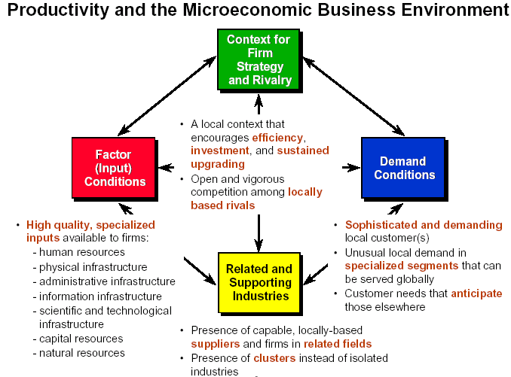
Clusters - the new drivers?
Source: Kitson
Criticism of Clusters
“Factors of production more important than networks” (Turok)
“Clusters are unlikely to be a panacea for regional or industrial development” (DTI)
“Competitive advantage wrapped in a different package” Kitson et al
Notes:
Builds on the work of Porter and Huggins

Slide 13
What works in Regional Development? CURDS
October 2006 study looking at international best practice
Commissioned by One North East
Examined policy in 8 city regions in Europe and Canada
Most were industrial cities with strong manufacturing base
Key lessons
Public leadership vital
Long-term sustained and evolving vision (evidence backed)
Tailored policy – regionally driven and bending national
Intervention – Business Dev; Science and technology; skills development; regional image; entrepreneurship.
Complementary programmes
Range of institutions involved in delivery

Slide 14
Critique of local economic development – Collins 2007
Two main roles of economic development attracting & retaining people and acquiring public and private investment.
Florida argues that cities to be competitive they need wealthy and well educated individuals – the creative class – this is better than whinging for business incentives.
Acquiring investment reveals a paradox for economic development staff – running a beauty and ugly contests in tandem.
Are there enough potential inward investment opportunities to justify the number of ED staff ? - Their ability to prevent exits is also questionable given their lack of bargaining power.
Given continuing disparities ,has regional assistance accomplished anything and might the money have been better spent?
The core role for local authorities should be maintaining the basics of reasonable urban living and this is unachievable then should quasi market solutions such as merger or takeover be considered?
Notes:
On the one hand attracting private investment requires positioning as a “superb urban environment” – on the other to attract public funds urban decay and deprivation need to be highlighted.

Slide 15
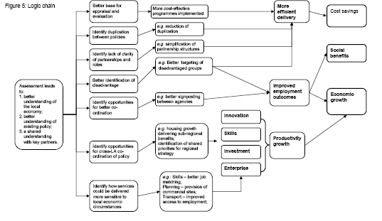
Sub-national economic development and regeneration
Prosperous places 2008

Slide 16
Conclusions
There has been change over the years but employment generation is still a major activity.
Currently major role for RDAs.
EU, regional and urban policy all stress importance of competitiveness.
Clusters seen by some as the new holy grail but are they a panacea for regional advancement.
The political parties have significantly different views.
Regional & economic local policy will continue – but in what form and at what scale?

