Slide 1
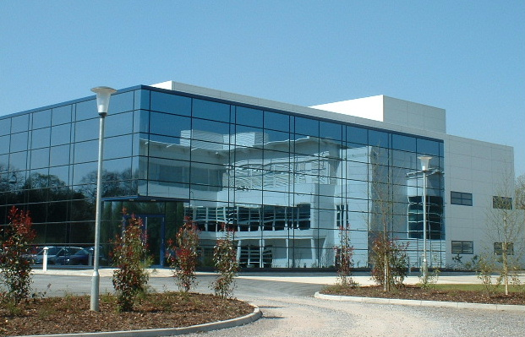
Industrial Location Theory
Reading ad material based on: Urban and Regional Economics, McCann, (2001),Chapters 1 & 2

Slide 2
RELOCE - Lecture 4a
Last week: Growth models & cumulative growth
This week: Industrial Location Theory and Regional Trade
Aims of this lecture
To investigate the economic rationale for firms selecting a particular location for their operations.
To look at how firms behaviour affects location decisions
To examine spatial distribution of activities
Objective
To be able to understand the rationale of site selection
Be aware of the spatial effect on markets of monopolies
To be aware of the reasons for clustering and dispersal

Slide 3
Importance of spatial considerations
Last session we concluded by discussing the benefits of localised and agglomeration economies
But what leads firms to locate where they do?
McCann (Urban and Regional Economics 2001) uses both a microeconomic approach to examine cities and a macroeconomic approach to look at regions.
Inputs – land labour and capital (technology and entrepreneurship)
Outputs – profits, wages and rent
Starts by examining capital investment and in particular the capital embodied in the firm.
Notes:
McCann concentrates on the capital investment angle of locating in a particular location in the first place, i.e. the capital embodied in the firm
Starts by looking at classical and neo-classical models specifically those by Weber, Moses and Hotelling each gives different insights into reasons for and consequences of industrial location behaviour.

Slide 4
Classical and neo-classical models
The Weber location production model
Single establishment – profit maximizer – price taker – perfect competition - 2 inputs single output – inputs = output
Critical factors m¹ m² m³; p¹ p² p³; M¹ M² M³; t¹ t² t³; K
Maximise profit by minimising total costs
M₃
d₂
K
d₃
d₁
M₁
M₂
Notes:
The Weber location model goes back to Laundhart in 1885 and was developed on by Weber in 1909.
The firm is viewed as a single establishment. Profit maximiser and price taker. It operates in perfect competition. The question is given a choice, where will the firm locate? The fairly obvious answer is where it will maximise its profits. The prices of capital, labour and land are assumed to be the same in each location.
The main components of the model are the locations of its raw material inputs M1 and M2 and its final market M3. K is the location of the firm. d1 and d2 and d3 are the distances over which the materials/ goods are shipped.
m weight in tonnes of material input goods 1 and 2 consumed by the firm and weight of output good m3 produced by the firm
p price per tonne of the input goods 1 and 2 at their point of production p3 is the price per tonne of the output good at the market location
t transport rates per tonne-mile for hauling input goods 1 and 2 and transport rates per tonne-mile for hauling output good 3
In the Weber location production model if input and output transport costs were the same for each unit and the costs and weights of inputs were also the same the firm would locate at the mid point of the triangle.

Slide 5
M3
Final Market
Output Transport Cost
M3
Final Market
M1
steel
M2
plastic
Input Transport Cost
M1
steel
M2
plastic
Notes:
However, if the transport costs were different, possibly because the weight or bulk of the inputs were different the firm would locate closer to the source of the input with more expensive transport costs.
McCann uses the example of car production with the two inputs plastic and steel. Steel is sourced from M1 and Plastic from M2. The red firm firm A uses equal weights of steel and plastic but because plastic is twice as bulky as steel its transport costs per tonne are double. Thus the firm locates closer to the source of plastic.
In the second example the car is made from 3 parts steel and one part plastic. So even thought the transport rates are the same the total quantity of steel being moved is 3 times that of plastic. Therefore firm B (blue locates closer to the source of steel.
A similar argument holds for output transport costs in the case used by McCann he cites firm A (red) is less output market orientated than B (blue) in that the weight of its output is lower that that of firm B. Uses the example of Chelsea Tractors and Minis which firm makes the tractors? (B)

Slide 6
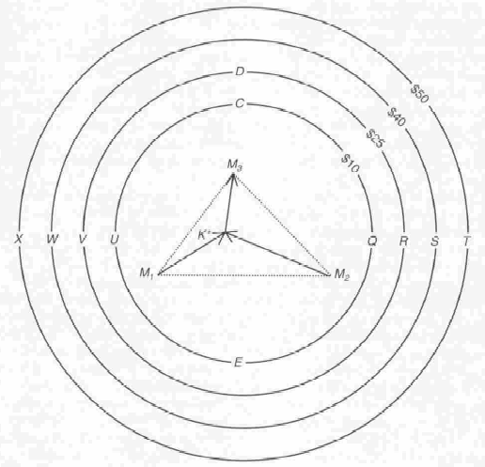
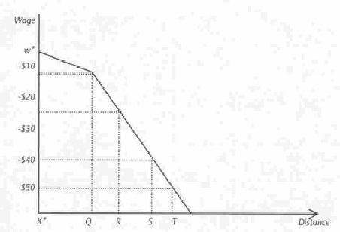
Example used by McCann
Distance-isodapane
equilibrium labour prices firm is indifferent between locations
Isodapane Analysis
Notes:
McCann moves on to Isodapane analysis, looking at the effect of moving from the optimum location in terms of transport costs K to locations further out where transport costs are higher.
To be worthwhile moving the firm would need to make savings in the cost of its other inputs (labour and land) greater than the additional transport costs. McCann hypothesises that if factor input costs at locations Q, R, S, T were $12, $20, $35 and $55 less than at K then the optimum location would be at T (see table).
He goes on to look at how much input factors would have to alter to make the firm indifferent between competing locations in this case input factor price falls would have to exactly match the increase in transport costs (see third diagram). The slope of the factor price curve is called the interregional equilibrium factor price gradient. (He uses labour as the example but it could as easily be rent)
There would be different gradients for each firm dependant on the mix of factor inputs and its individual costs of transportation.
McCann goes on to look at alternative locations for inputs and markets – (See Figue 1.6) use OHP
Model allows us to examine the factor price conditions under which an area becomes a more or less attractive location for investment and also to see how locational behaviour might change in response to factor conditions. But firms do not constantly move: because this also involves costs. However, the opportunity cost of moving could also be incorporated and this would make the equilibrium inter-regional wage gradient steeper

Slide 7
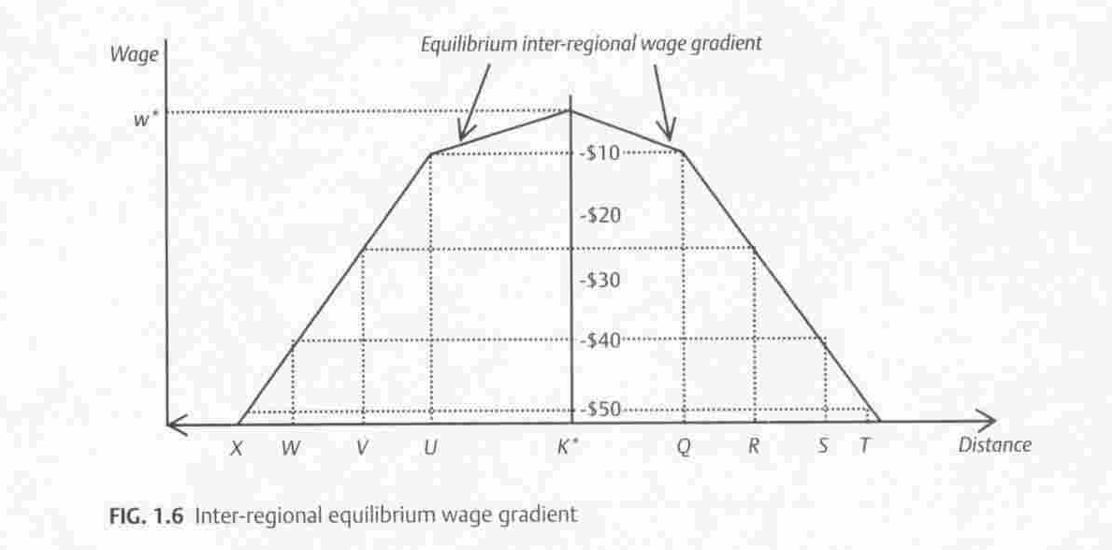

Slide 8
New suppliers and new markets
M₅
M₃
F
G
£50
£40
£25
K
M₁
M₂
M₄
Notes:
McCann goes on to develop the Weber model further by looking at what happens if new sources of inputs and new output markets are found.
Starts of from the previous isodaplane diagram and introduces the labour saving location F where the savings from labour costs outweigh the increased transport costs. Raw material input locations remain the same but the optimal location is outside the Weber triangle.
He then goes on to hypothesise that the firm identifies another source of raw material (Steel) at M₄ this is nearer to the optimal production location than M₁ thus saving some transport costs and thus increasing profit. This in turn implies that another Weber optimum location can be identified at G.
From this position the firm may choose to supply market M5 rather than M3 thus making further transport savings and again boosting profits. Alternatively it could supply both M3 and M5.

Slide 9
The Moses location-production model
Looks at the price ratio between inputs
Built from Weber Triangle
Can locate anywhere within specific distance from output market between L & J
The choice is then the combination of inputs
This allows the development of an envelope budget constraint
M3
Constant distance
L
J
M1
M2
m₁
Envelope budget
constraint
L
Output
Isoquant
J
q2
m₂
Notes:
Weber model assumes fixed relationship between inputs and outputs, but in reality firms will substitute in favour of the cheaper input. Moses bases his analysis on the Weber triangle but this time the location of the firm relative to its output market M3 if somewhere on a plane equidistant from M3.
The Moses model uses the standard microeconomic approach to show that if the costs of inputs are constant then a series of budget constraints can be constructed showing the relative price of transport between the two extreme possible locations where the firm might locate if it were still to be the same distance from its output market M3 points l and j. Anywhere along the budget constrains l and j are possible locations.
The isoquant denotes the possible combinations of inputs that are technically feasible, this gives us the optimum location, subject to the relative transport price of the two inputs. The conjunction of the output isoquant and the envelope budget constraint is the optimum location for the firm.

Slide 10
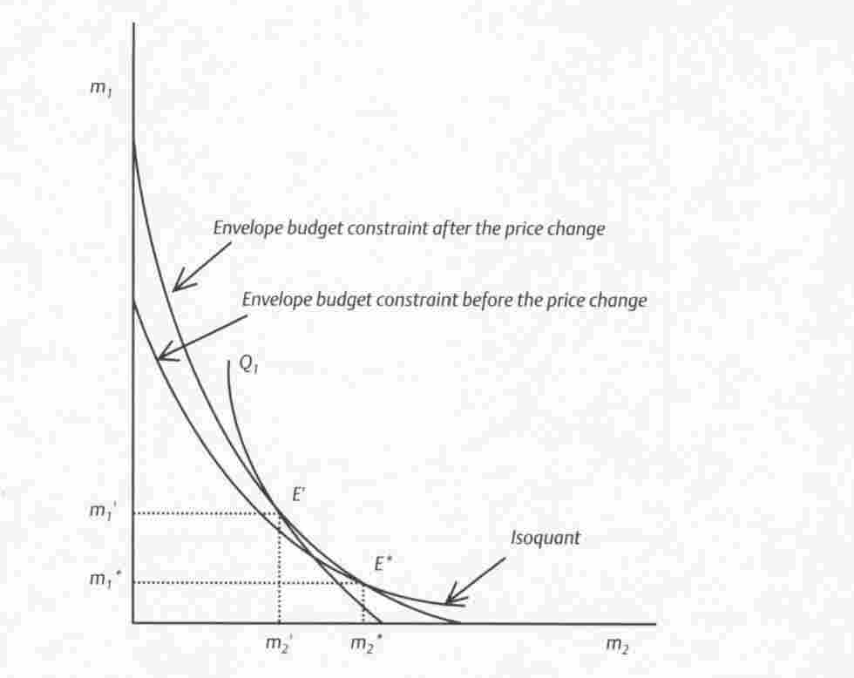
Predicts that input substitution will take place
The model also looks at returns to scale
Problems: market price plays no part; transport costs only small percent of total costs – solution look at total logistics costs
Notes:
McCann uses the example of a road building programme adjacent to M1 which has the effect of reducing transport costs this alters the shape of the envelope budget constraint. The firm is able to maximise its profit by substituting more of input M1 and by moving close to the source M1. This is conditional on the elasticity of substitution if it is high then the firm is more likely to substitute greater quantities of input M1 and move closer to its source.
Figures 1.13 and 1.14 show expansion paths The dotted lines are envelope budget constraints associated with higher levels of production and the solid isoquants the combinations of inputs associated with that level of output. In 1.13 the optimum input mix changes clearly in favour of input 2 and the location also nearer to the source of input 2. If it curved upwards it would be towards input 1.
If the expansion path is a straight line then the input mix and the location of the firm remain constant, this is the basic Moses result.

Slide 12
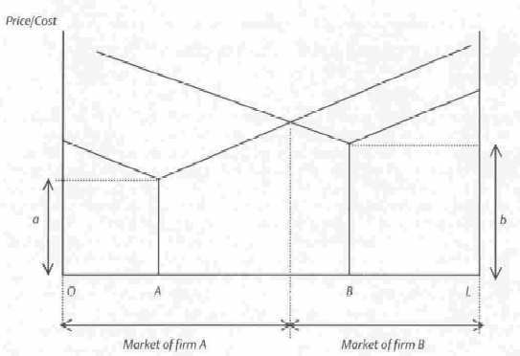
Spatial monopoly model
Space can confer monopoly power on firms
The lower transport and production cost are, the wider the monopoly area.
What if the firms move see Hotelling location game
Notes:
Assumes two firms producing an identical good located at A & B production cost is the vertical distance a & b. firm A is more efficient than B. Transport costs represented by sloping line as they move from the point of origin these costs increase. Consumers are assumed to buy from the cheapest source thus in OX they buy from Company A and in XL from company B. Despite the fact that firm A is more efficient in production the associated transport cost confer monopoly power on firm B in XL.
Two general rules apply
the greater the value of transport rates t_{a} and t_{b} the lower will be the fall in market area of the firm and the greater its monopoly power and ability to marginally increase price p_{a} or p_{b}.
b) The further apart the firms the lower will be the fall in market area of the firm and the greater its monopoly power for any marginal increase in the prices p_{a} or p_{b}.

Slide 13
Price/ cost
The Hotelling Location Game
Transport costs
Production costs
A
D
O
C
B
L
X
Market of A period 1
Market of B period 1
Market of A period 2
Market of B period 2
Market of A period 2
Market of B period 2
Notes:
If time go over to the Hotelling model of strategic behaviour briefly game theory above.
Initial position two firms identical cost structures share the market, both firms expect the other to remain in their current location. Firm A moves location close to B but still the same side as the previous location in order to gain market share. It is thus able to dominate the market leaving firm B with a reduced share. The strategy backfires however because firm B moves to the left of C giving it the major market share. This tit for tat strategy is played out until each firm is located close to X at this point both control half the market each. There have been no gains from moving.
OHP 7 welfare loss at edges gains at the centre from co-location (See Figure 1.18). 2nd part implications of being forced into price competition – firm B can either respond by lowering price further or moving out and surrendering part of the market (see Figure 1.19).
Hotelling paradox where firms essentially selling the same product cluster using non price competition such as packaging or appearance Hotelling suggests that prices will be driven down or firms will relocate to gain some monopoly power but we observe clustering in retail parks and city centres, Thus, suggesting non-price competition such as customer service, convenience, or offers .

Slide 14
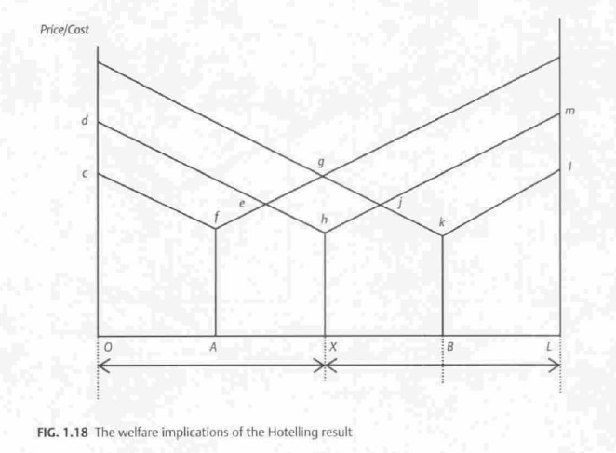
Gain
Loss

Slide 15
Hotelling suggests prices will be driven down if firms compete

Slide 16
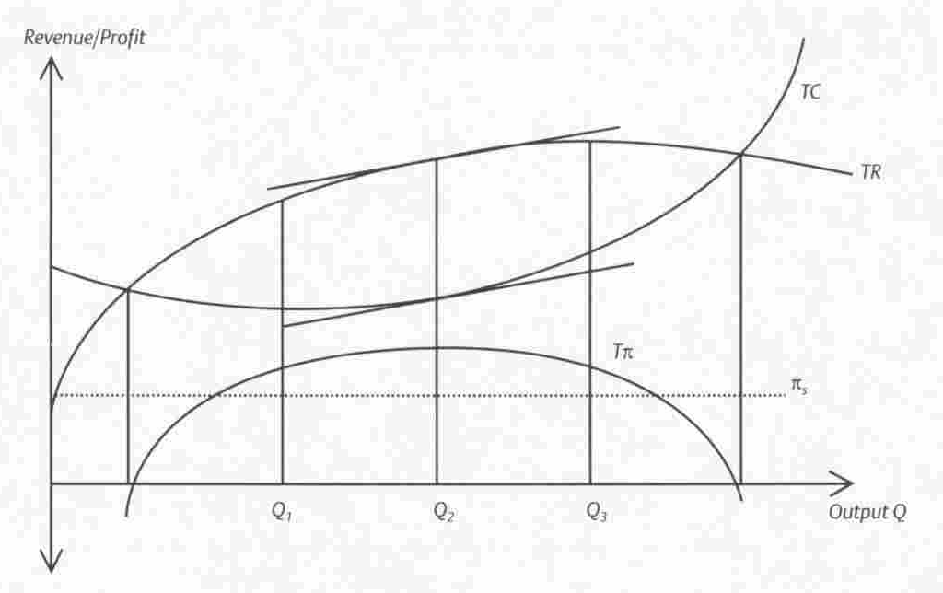
Total profit function firm might choose different output levels but only one is profit maximising

Slide 17
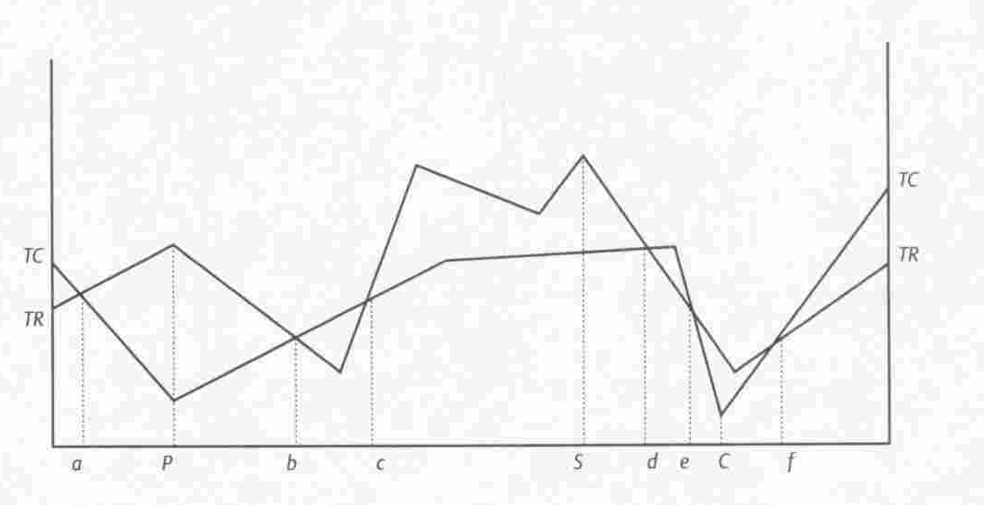
Behavioural theories of firm location
Firms make decisions to achieve goals other than profit maximisation
Revenue maximisation or other performance measures such as market share etc.
Alchian’s adoptive and adaptive environments
Notes:
In the Hotelling model maximisation of sales revenue and profits coincide. But what if firms costs of production or transportation vary with location as they do in the Weber and Moses models, sales and profit maximisation may not coincide. In modern firms profit maximisation is not always the prime goal because of the complex nature of the firm managers for instance may have different goals such as market share or revenue maximisation.
If the firm chooses to maximise profit it will locate at P.
It wishes to minimise cost it will locate at point C
If it wishes to maximise revenue it will locate at point S
But locational moves are not costless, firms will tend to maintain their location so long as profits are positive. Instead it will attempt to reorganise its factor allocations or price and non-price competition. Movement would be a last resort, given imperfect information and the attendant costs. The firm will only move if relocation costs were insignificant and spatial cost and revenue differences significant.
Read Alchian’s adoptive and adaptive environments it give an idea as to why firms tend to follow the leader in locational decisions. This is typified in Oligopoly situations but small firms will not more than likely they locate where their founders were resident. But subsequently they will look at the behaviour of market leaders and come to the conclusion that the optimum location is close to the local market leader.

Slide 18
Spatial distribution of activities
Will firms optimal location behaviour lead to clustering or dispersion?
Clustering bids up prices for factor inputs.
But the observed outcome is that clustering in urban environments allows firms to extract economies of scale. This also implies to agglomeration economies – external to firms – but internal to the group
Marshall – Information spill-over; local non-traded inputs; skilled local pool of labour.
Internal returns to scale; economies of localisation; economies of urbanisation
Notes:
In the case of returns to scale it is argued if all firms cluster then they will be competing for the same resources and bid up the price of input factors such as land and labour.
The alternative view is that because of clustering they achieve economies of scale through specialisation. Thus despite high factor costs their specialisation allows them efficiency gains which more than compensate for high factor costs. (all in one location?)
Agglomeration economies describe the benefits to all firms which are independent of the individual firm. Marshall identifies three sources of the economies of scale –
Information spillover – direct face-to-face contact either inside or outside the work context allows tacit information to be shared, this sharing of partial information allows firms greater knowledge of the market helping their ability to compete. Gives forms an information advantage over those outside – example the City of London
Local non-traded inputs provision of specialist inputs to a large group of firms the cost of setting these up are spread over a large number of potential customers making the average cost of the service low – alternatively they do not have to be transported in from a long distance away. Examples include the city with specialised law and software firms and Automotives with specialist testing firms. Also applies to infrastructure with cost spread amongst all players.
Local skilled labour pool allows for a reduction in labour acquisition costs – allows firms to increase their quantity of labour without the need for a wide search – allows the firm to acquire the required quality of labour that is trained and effective.
Internal economies of scale (within the firm or organisation usually large organisations might term this Fordism) suggest concentration of capital and labour in a single location example Bowing in Seattle
Localisation economies of scale accruing within a single industrial sector through supply linkages for example specialist supplies to the automotive sector in Birmingham – sources of Marshallian agglomeration are likely to be present.
Urbanisation – more than just the economies of scale through internal specialisation or input-output linkages includes the location of other service providers in the urban area which offer services which all or most firms use such as legal, real estate, education etc.

Slide 19
Other descriptions of clusters
Growth Poles – other firms exploit the advantage of proximity to a propulsive firm which increases their growth potential. But backwash effects.
The incubator model – diverse clusters of different industries and sizes act as superior incubators, because to the availability of a variety of local business services. But if a large firm dominates these may be internalised.
Product-cycle model – activities in separate locations according to the stage in the product lifecycle; early stage information intensive activities in central cities; mature production less specialised in low cost centres.
Porter Model – see next lecture
New industrial areas model – small innovative firms clustering together stressing the importance of formal and informal networks, area may also posses a leading university
Notes:
Growth Poles refer to key large firms sometimes referred to as propulsive firms. Their size acts as a magnate - size and innovation together are important. But the act of clustering bids up input prices and reduce efficiencies these are know as backwash effects in the growth pole literature
Incubator conditions are less likely to occur with a large dominant industry or firm because many of the business services are internalised by the large firm.
Product life cycle information intensive activities in central cities such as R&D and decision making relates to the early stage of the product life-cycle these benefit from agglomeration effects such as information spillover and highly skilled labour. Once a standard product is developed then a move to a low cost production location becomes more imperative. At this point firms may opt for dispersal of activities with R&D remaining close to or co-located with head office in order to maintain control over new products. Manufacturing location may well have transport cost considerations as well as factor inputs.

Slide 20
Industrial Dispersal
Firms producing a number of products with inputs from a number of sources are likely to be dispersed
Spatial price discrimination may be an element of spatial monopoly
Aggregate linkage analysis – higher the value/weight ratio further the distance shipped – weak - Alternatively high value specialised products only produced in small number of locations.
Reilly’s law of market areas – empirical observation - pull factor the relative attractiveness of retail location (size variety) inhibiting factor disutility of travel.
Conclusion that urban areas are locations for production or retail of high value goods.
Notes:
Spatial price discrimination refers to the practice of lowering prices in markets further out from the location of the firm – it is assumed that the firm has some local monopoly power, demand is elastic and market delivery price is a function of the haulage distance. Firm already has a cushion from its monopoly power locally and can afford to raise prices in order to cross subsidise consumers further out.
Aggregate linkage analysis weak in reality because of examples of low value agricultural produce shipped over large distances (New Zealand) and high value products shipped over short distances – within the EU. However there is evidence that specialised products are produced in a small number of locations – silicon chips where quality and reliability might be the driving forces. Low valued standardised products produced in many locations meaning that transport costs are lower.
Reilly’s law based on empirical observations that it is the pull of the size of the market that will attract customers from far away examples might include the mega shopping centres. Thus these areas will attract goods from a larger area and purchasers also from a wider area compared with smaller centres.

Slide 21
Conclusions
Weber model stresses the importance of location particularly minimisation of transport costs also suggests these may be offset by reduced factor costs.
Moses offers the insight that production and locational behaviour are intertwined.
Spatial monopoly power suggests that location affects the profitability of the firm whereas behavioural theories suggest that factors other than profit may be important.
Whilst clustering is mainly driven by economies of scale dispersion is likely where there is an element of local monopoly power or product specialisation.
Next lecture Inter-regional trade

