Slide 1


Regional growth the Neoclassical perspective

Slide 2
RELOCE - Lecture 3a
Last week: Multipliers, Econometric and I-O models
This week: Neoclassical and Keynesian regional growth models. This lecture
Aims
Examine the theory and construct of the Neo-classical growth model.
Review empirical research.
Examine the role of technological progress, look evidence of convergence and more recent developments.
Objectives
Be able to understand the methodology and describe the operation of the neo-classical growth model.
Be conversant with recent extensions to the basic model and research into regional economic convergence.
Notes:
Aims
To introduce students to the theoretical underpinning and construct of the Neo-classical growth model.
To explore some of the empirical research on the subject.
To examine the role of technological progress, explore evidence of regional economic convergence and recent developments to the theoretical models.
Objective
Students should be aware of the methodology underlining the Neo-classical growth model and be able to describe its operation in detail.
Students should be aware of the scale and scope of research into the Neo-classical growth model in the UK and elsewhere.
Students should be conversant with recent extensions to the basic model and research into the evidence of regional economic convergence.

Slide 3
Measures/indicators of Growth:
Growth in OUTPUT
Growth in OUTPUT PER WORKER
Growth in OUTPUT PER CAPITA
Different measures may give different perspectives of regional performance but usually measures are correlated.
Most appropriate measure may depend upon what is being measured e.g. for productive capacity use growth in output, for competitiveness use growth in output per worker
Notes:
Growth can be defined in a number of ways:
1. Growth in output
2. Growth in output per worker
3. Growth in output per capita
The measures can give quite different perspectives of a regions performance. But in general there is a high correlation between output growth and per capita growth - but a lower correlation between these two measures and output per worker. Armstrong and Taylor use EU data to demonstrate how growth rates have diverged over a 21 year period up to 96 in most of the major EU countries.
Which is most appropriate? - this depends on the purpose for which the measure is being used.
Output growth is used to indicate growth in productive capacity and its ability to attract capital and labour from other regions - (the South East and the Eastern regions are good examples in the UK)
Growth in output per worker is used to indicate changes in a region’s competitiveness (an example in the UK might be Wales which has improved its competitive position).
Growth in output per capita is used to indicate changes in economic welfare But - past growth attracts in Capital. Usually a capital intensive economy = a higher relative wage rate, attracts in skilled labour thus rising income and economic welfare.
Armstrong and Taylor concentrate on the output growth and competitiveness.

Slide 4
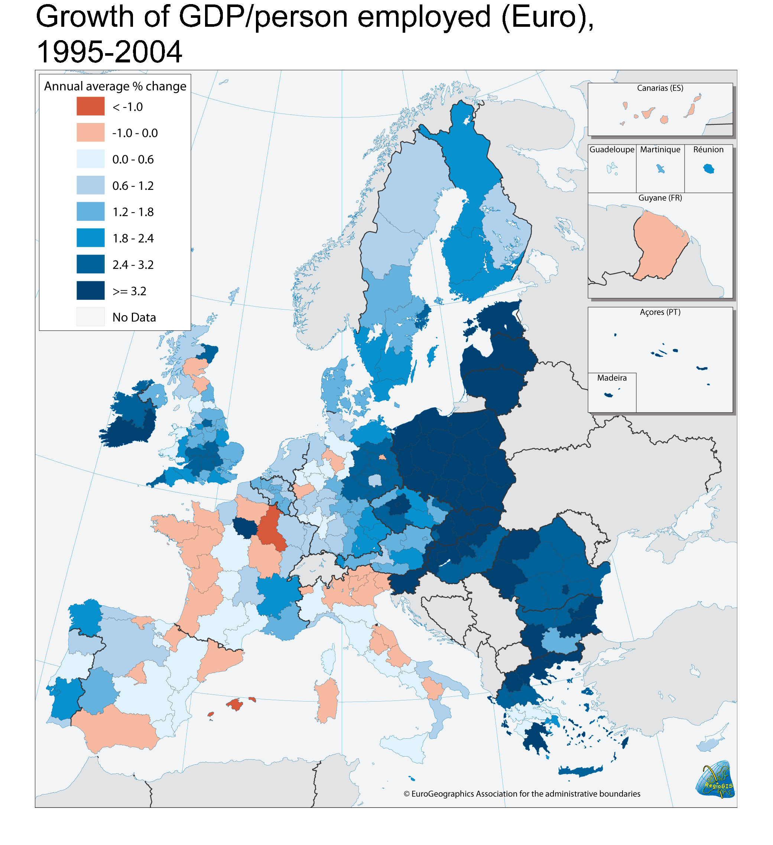

Slide 5
The Basic concept
Neo-Classical School: basic premise (DEMAND ADJUSTS TO SUPPLY)
Emphasis on the supply side characteristics of the growth process (supply-side driven)
Three key elements in the model; labour supply, capital stock and technical progress
Assumes efficient market allocation throughout
i.e. complete knowledge, agents are price takers, no barriers to mobility of factors
Therefore disparities are temporary and will disappear as the allocation (of factors) approach their pareto-optimal level.
Notes:
The Neo-classical school emphasises the role of labour supply, capital stock and technical progress.
Drawing on the assumption of efficient market allocation and viewing regional disparities (differences) in productivity as the result of gains from the reallocation of resources towards their pareto-optimal level. Emphasis is on the supply-side characteristics of the growth process - DEMAND ADJUSTS TO SUPPLY - expect flexible labour markets.
The Keynesian school stresses the role of demand. Particular emphasis is placed on the role of regional exports as the main engine of output growth. Emphasis is on the demand-side characteristics of the growth process - SUPPLY ADJUSTS TO DEMAND
A further extension of the Keynesian model is the principal of cumulative causation. (Once growth disparities occur they tend to become cumulative and self-perpetuating).

Slide 6
One Sector Neo-Classical Growth Model
Based on the Cob-Douglas production function (constant returns to scale), no technical change and output is determined entirely by capital and labour inputs, includes law of diminishing returns.
E
Conclusions
Y grows without limit as supplies of L and K increase
Y/L only increases with K deepening
When K/L reaches equilibrium point no further increase in rate of Y/L
Notes:
Start with an aggregate production function Y= f(K,L)
Where Y = real output. K = capital stock, L = labour force all with a t = time subscript
The model uses the Cobb-Douglas production function (relates output to factor inputs) and assuming constant returns to scale and perfectly competitive product and factor markets. Y=AKªL^{1-a} Where A = the parameter translating inputs into outputs & α + 1 - α = 1 (constant returns to scale)
In the second equation, there is a perfectly competitive economy with flexible factor prices and resources at their full employment levels, growth in output is given as y=ak+(1-a)l Where y = output growth (per time period) k = growth of capital stock l = growth of labour force. The constants α and 1 - α are the respective contributions of labour and capital inputs to aggregate output. See notes for derivation.
In the third equation, by subtracting the growth in the labour supply (l) from both sides of the equation gives rate of growth of output per worker y-l = a(k-l) Thus, output per worker can only increase if capital growth exceeds the growth of the labour supply. Output per worker can increase only if the capital/labour ratio increases - process known as capital deepening. This cannot continue indefinitely in the absence of technical progress since k like l suffers from diminishing marginal returns. (output per worker increases at a diminishing rate) see graph. At long-run equilibrium output, capital and labour are all growing at the same rate.

Slide 7
Output
per worker
Y/L
The same increase in output can only be achieved with increasing amounts of capital inputs after the equilibrium point it is just not worth it
Y/L*
K/L*
Capital per worker K/L

Slide 8
Inclusion of technical change
To bring more realism, the effect of technical progress on output growth is introduced
Technical knowledge is a separate element in the production function. K and L benefit equally from any technical progress that occurs
E*
E
Reasons for regional disparities in growth
Technical progress varies
k varies
l varies
Notes:
Inclusion of technical change:
In the first equation A is technical knowledge, it is independent of capital and labour inputs. It is assumed that technical progress increases smoothly over time (at a constant growth rate). Thus the Cobb-Douglas function can be extended by addition of the extra term.
In equation 2 g is the constant rate of technical progress per time period t. It is suggested that the impact of technical progress on output is oversimplified because it ignores the possibility that technical progress is likely to be built into new additions of capital stock as investment takes place and the labour force may acquire new skills, which also improve efficiency. Therefore, both labour and capital are not homogeneous. The inclusion of technical progress shifts the output per worker function upward, resulting in an increase in output per worker at each level of the capital/labour ratio.
In equation 3 again taking the growth in the labour supply (l) from both sides of the equation gives the rate of growth in output per worker. Even if capital stock and the labour force grew at the same rate, output per worker will increase providing the rate of technical progress exceeds zero.
The model suggests that regional disparities occur for 3 reasons
Technical progress may vary between regions
The growth of capital stock may vary between regions
The growth of the labour force may vary between regions

Slide 9
Output
per worker
Y/L
Increasing returns only due to technical progress
K/L*
Capital per worker K/L

Slide 10
Sources of growth and factor migration
Region’s output growth
Growth in capital stock
Growth in labour force
Technical progress
Investment by region’s residents
Net flow of capital into the region
Net in-migration of workers
Population growth
Inflow of technical knowledge from other regions
Investment in R&D and education
Regional wage relative to wage rate in other regions
Birth and death rate
Regional savings rate
Rate of return relative to the rate of return in other regions
Notes:
The important question is which regions are likely to grow fastest assuming factors are fully mobile? In the classical model areas with a high capital/labour ratio (highly developed) will have high wages and low yield on investment (anticipated output growth will be slower). This means that labour and capital are predicted to move in opposite directions.
Low wage regions attract capital but loose labour (capital/labour ratio expanding).
High wage regions attract labour but loose capital (capital/labour ratio declining).
Therefore, output per worker (productivity) is predicted to grow faster in low wage regions than high wage regions. However, it is not possible to say with any certainty if output growth is higher or lower in low wage areas because it will depend on the speed at which factors are flowing (capital in and labour out).
The other variable is technical progress, the expectation is that this would be highly mobile between regions. Evidence suggests that some regions are innovation leaders but the process of diffusion is complex with not all innovations flowing outwards at the same rate. Information on new processes flows more quickly than information about new products because the latter are protected by patents.
It is anticipated that regions with low technology would gain rapid productivity improvements by exploiting the technical gap between themselves and the high tech areas. However, evidence suggests that the technology gap does not necessarily spur productivity improvements.

Slide 11
Factor flows predicted by the classical model
Labour
Poor region initially
low level of K
high level of L
Rich region initially
high level of K
low level of L
Capital

Slide 12
Evidence that technical progress offers explanations
Borts & Stien; Ghali et al; Hulten & Schwab.
Harris & Trainor
The skill level of the region's workforce; The flexibility of the region's workforce
The proportion of small plants in a region; A catch-up effect of productivity growth in the unionised sector
Notes:
The evidence to support this is not strong, Armstrong and Taylor cite the early work of Borts and Stein who used data from 1919 to 1957 to test the assumptions that labour moves to high-wage states and capital to low-wage states the empirical evidence suggested that the model be rejected.
Paradoxically Ghali et al found that labour and capital were responsive to inter-state differences in factor pricing. Work of Hulten and Schwab who estimated the importance of technical progress, capital stock and labour force growth for 9 regions in the US suggests that the higher output growth of sunbelt regions as opposed to snowbelt regions was mainly due to growth in the labour force and to a lesser extent capital stock, the residual (which includes technical progress) played almost no part which suggests that it is diffused fairly evenly.
Armstrong and Taylor quote the work of Harris and Trainor investigating the rate of technical progress in an attempt to explain regional growth disparities in the UK. They looked at two time periods 69-78 and 79-91 Annual growth was twice the rate in the 2nd period. There are alternative explanations for this, on the one hand market driven regional policy is more effective or on the other there is a lag between regional policy implementation and its effect on productivity growth. However they conclude that factor productivity not only varies between regions but also between industry sectors. Factors found to be significant determinants of growth include:
The skill level of the region's workforce
The flexibility of the region's workforce
The proportion of small plants in a region
A catch-up effect of productivity growth in the unionised sector.

Slide 13
Endogenous Growth Theory
What causes technological progress
Entrepreneurs sell ideas because of the profit incentive, thus entrepreneurship is endogenous
Technical knowledge is attached to workers
Depends on number of workers & stock of knowledge
How do regions catch up with technology leaders?
Depends on how far they are behind
Cheap to copy existing technology, expensive to create new
Socio-economic infrastructure crucial
Notes:
A&T argue that the classical model does not explain what causes technological progress (TP) in the first place, they use endogenous growth theory to do this.
Point 1. Entrepreneurs can make a profit by producing and selling ideas. Thus, economic growth can become endogenous (profit incentive) and a regions technological frontier is pushed outwards.
Point 2. The basic neo-classical model (with technological growth) is amended so that rather than TP being separate and increasing at a constant rate it is attached to the workers themselves. This gives a "knowledge adjusted" workforce.
Point 3. Thus, technical knowledge will increase over time and its rate of growth depends on: (1)The number of workers in the knowledge industry & (2) the existing stock of knowledge. The production of knowledge function also suffers from diminishing returns, thus the growth in new ideas is proportional to the rate of growth of people in the knowledge industry. If population grows rapidly then so do new ideas and productivity likewise increases.
The EGT explains growth in the world economy, a catch-up model is used to see the relationship between lagging and leading regions.
Point 4. TP of a region will depend on how much it lags behind the most advanced regions. The model argues that the further away a region's technology is from the most advanced region the faster will be it's TP.
Point 5. Underpinning this argument is the fact that it is relatively cheap to copy existing technology but expensive to create completely "new" technology.
Point 6. Providing the socio-economic infrastructure is amenable to market forces then output per worker in lagging regions will grow at a faster rate than in the leading regions, implying that in the longer term convergence occurs.
In the long-run however; lagging regions have a lot of catching up to do and; the incentive to invest may vary between regions (unstable areas are less likely to attract investment).

Slide 14
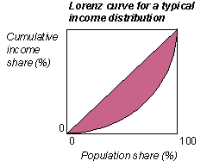
Convergence of regional per capita incomes
β (beta) convergence when poor regions grow faster than rich.
σ (sigma) convergence is a measure of per capita income inequality
Long-run β occurs very slowly 2% p.a.
Some country’s regions converging faster than others
Spillover effects
Notes:
Neo-classical model predicts that over the long-run disparities in per capita income will disappear, because capital will flow from high to low wage regions and labour in the opposite direction until such time as the returns are equal and there is no incentive to move. Further, poor regions will benefit from technological catch-up.
Point 1. A&T distinguish between two types of convergence beta and sigma: β (beta) convergence occurs when poor regions grow faster than rich. There is a negative relationship between growth of per capita income and level of per capita income at the start of the period.
Point 2. σ (sigma) convergence is a measure of per capita income inequality between regions at any given point in time. Convergence occurs when the dispersion of per capita income falls over time.
Point 3. Empirical evidence (Barro & Sali-i-Martin) suggests that over the long-run beta convergence occurs but that it is very slow, around 2% per annum - they say it will be many years before partity between East & West Germany.
Point 4. Regional convergence is not uniform across developed countries, a study of European and other OECD countries suggest convergence has been faster in Sweden and the UK than countries such as Italy and Greece. The rate of regional economic convergence in China has been extremely rapid since the opening up of China to foreign trade and FDI.
Point 5. Rey and Montouri suggests that spillover effects may affect the rate of convergence with neighbouring regions benefiting from the strong growth of a region through the linkages in trade and the labour market.
Overall the evidence suggest that the neo-classical model is correct in predicting that convergence in per capita output will occur but that the rate is very slow.

Slide 15
Extending the model
Embodied technical progress is exogenous
Disembodied technical progress is endogenous
Notes:
The new extension to the neo-classical growth model is based on the notion that the reason disparities in productivity persist in the long run are that capital and labour technology are not completely mobile between regions.
Not only does new technology enter the productive system through capital stock but it is also attached to human capital. It is not enough to have technological development embodied in new capital stock what is also required is the ability to absorb and use the new technology. It is thought that a region's institutional environment is crucial to exchange and creation of new ideas. If there is a geographical concentration of highly educated and motivated people then the transfer and ideas and knowledge is much more rapid. It is therefore the institutional environment that drives disparities in regional productivity.
Theorists distinguish between embodied and disembodied technical progress. Embodied technical progress is exogenous in that it is already built into capital goods, disembodied technical progress is endogenous (home grown) because it is independent of the capital stock with which it combines to produce output.
Typically, knowledge rich regions specialise in creative activities and high level service activities, knowledge poor regions specialise in routine activities depending heavily on cost competitiveness for their place in world markets.

Slide 16
Weaknesses of Neo-classical approach
Investors and workers are assumed to be perfectly informed
Factor prices are not particularly flexible in practice
Failure to recognise the importance of demand factors both internal and external
Notes:
Serious weaknesses in the neo-classical approach.
Although the neo-classical models give an insight to the significance of the growth factors in a regional economy and the effect of interregional factor mobility it still suffers from some serious weaknesses.
Point 1. Investors and workers are assumed to be perfectly informed about factor prices in all regions and to respond to regional differentials by migrating to achieve the best rate of return. In reality they are not and there are serious constraints to reacting to factor differentials.
Point 2. The assumption that interregional movements of L & K will automatically remove factor price differentials is weak. Factor prices are not particularly flexible in practice (especially in the short-run), therefore the adjustment mechanism fails to operate effectively.
Point 3. There is a serious failure to recognise the importance of demand factors on regional growth. Regions experiencing rapid growth in demand for their output are more attractive locations for investment and draw more K & L from other regions. In addition, it is argued that the growth process is cumulative and this helps to explain why regional growth disparities remain entrenched.

Slide 17
But using a two sector model (export growth) the previous findings are reversed
Labour
Region A
in which demand
for the exported
good increases
Region B
Capital
Notes:
Cappello suggests that a two sector export growth model helps to explain why both factors flow to the rich region.
Each region has two sectors industrial and agriculture
Disequilibria in the Regional BOP is offset by private capital movements
Perfect competition in the goods market the domestic good subject to local demand supply.
Capital is only used in industrial
Constant returns to scale
Remuneration of the product factors at their marginal productivity
Equality between cost of production factors and the value of the marginal product.
The equilibrium is disturbed via an exogenous shock demand for goods from the rich region increases – the price of the good rises – positive impact on the marginal product of factors – thus a relocation of factors occurs
Capital stock increases in rich region because external capital is attracted by higher rate of return – labour demand also increases to service demand and the value of the marginal product of labour increases.
Labour is attracted from agriculture and the poor region because returns to labour are higher.
Backwash effect on agriculture increases demand for its good

Slide 18
Conclusions
Neo-classical model provides a framework and predicts that while capital deepening is taking place productivity will increase but only up to the equilibrium point.
There is a need to include technical progress but the rate of technical progress may vary between regions.
If factors are mobile regions that will grow fastest are those where they obtain the best return.
Endogenous growth theory suggests a knowledge adjusted workforce – lagging regions are predicted to catch-up with leaders - but not fully.
Some evidence of convergence but the process is slow
Weaknesses with theory – information, adjustment, the role played by demand

