Slide 1

Teaching Interpretive Sessions
Alvin Birdi and Christian Spielmann
www.economicsnetwork.ac.uk

Slide 2
Rank importance of skills
https://www.polleverywhere.com

Slide 3
How well are economics graduates equipped with these skills?
https://www.polleverywhere.com

Slide 4
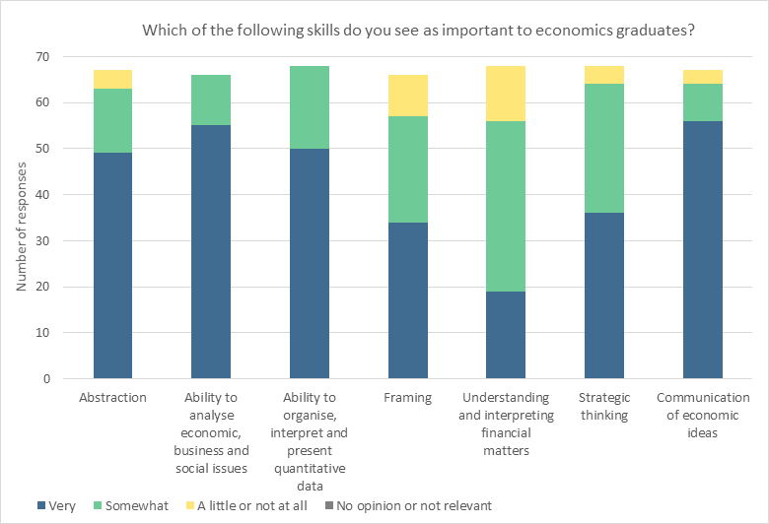

Slide 5
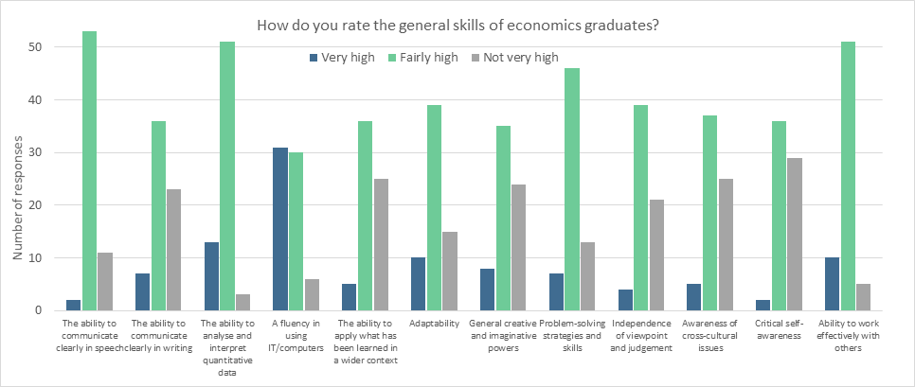

Slide 6
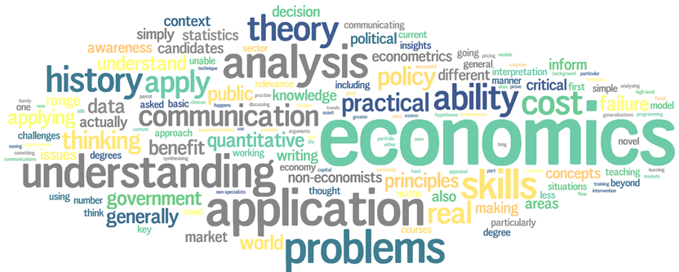
Skills and Knowledge in Need of Further Development
Notes:
Outcome of poll everywhere and discussion:
Once we have understood the technicalities (be it model, data, narrative argument) how do we focus on criticality and interpretation.
We seem to do ok in the first but not so much in the second.
This session: How do we design lessons and how to teach teach this criticality based on DATA, MODELS or analytical narrative? Could be small group, could be large group.

Slide 7
Hedonic valuation of the perceived risks of nuclear power plants
Stefan Boes a,∗, Stephan Nüesch b, Kaspar Wüthrich c
Abstract: We use the 2011 Fukushima accident to evaluate the impact of the perceived risks of nuclear power plants on apartment rents in Switzerland. Using online advertisements over 12 years and a difference-in- differences approach, we find a 2.3% price discount after the accident for apartments near nuclear power plants.
Notes:
Let’s apply this to an actual example.
Explain what the paper does.

Slide 8

Notes:
DIGRESSION / GO OF ON A TANGENT
Who is that? Romeo and Juliet
What’s good about it? It’s a great story
What makes a great story?
Narrative structure with obstacles.

Slide 9
How to frame your teaching session?
The opening
Think – Pair -- Share
Notes:
Using the topic and think of a start in the narrative.

Slide 10
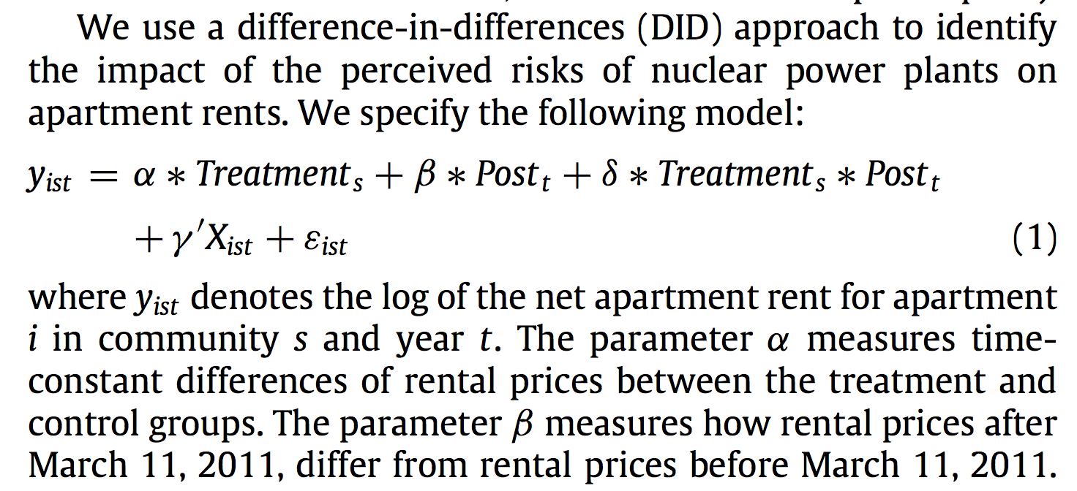

Slide 11
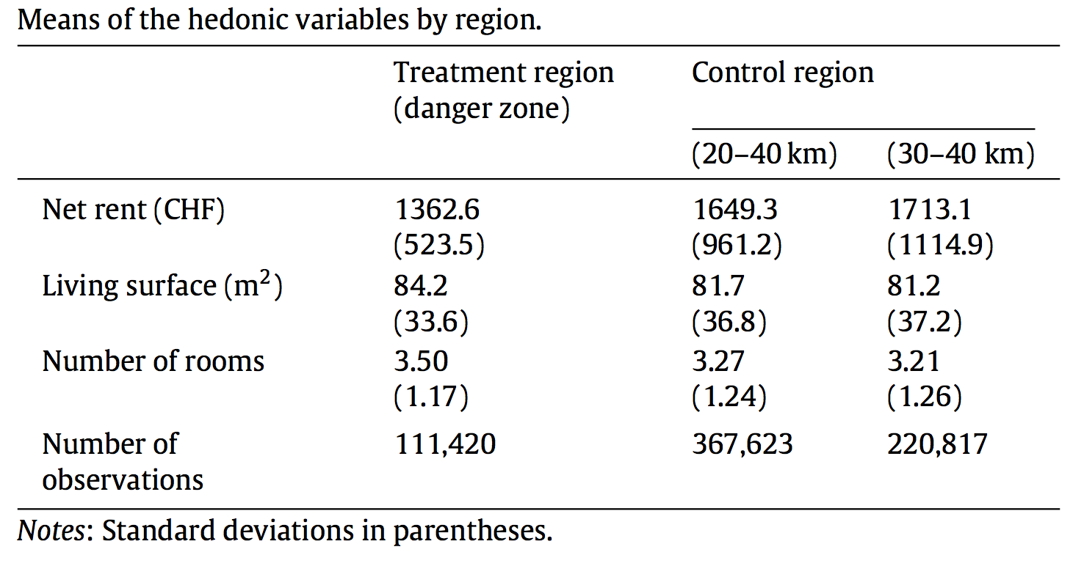

Slide 12
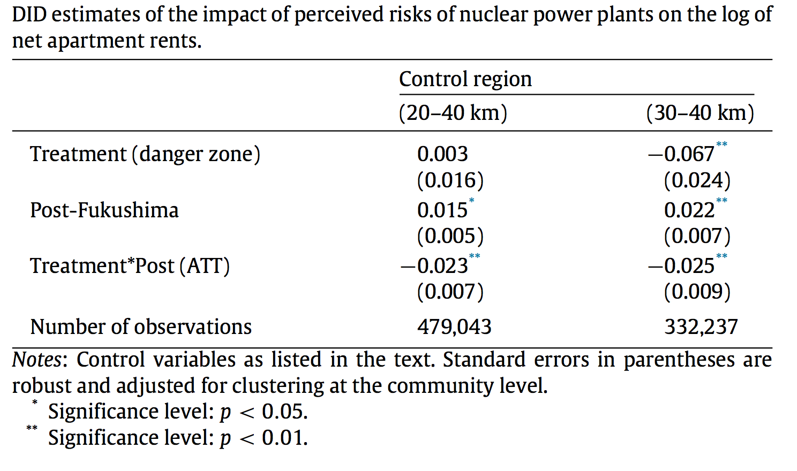

Slide 13
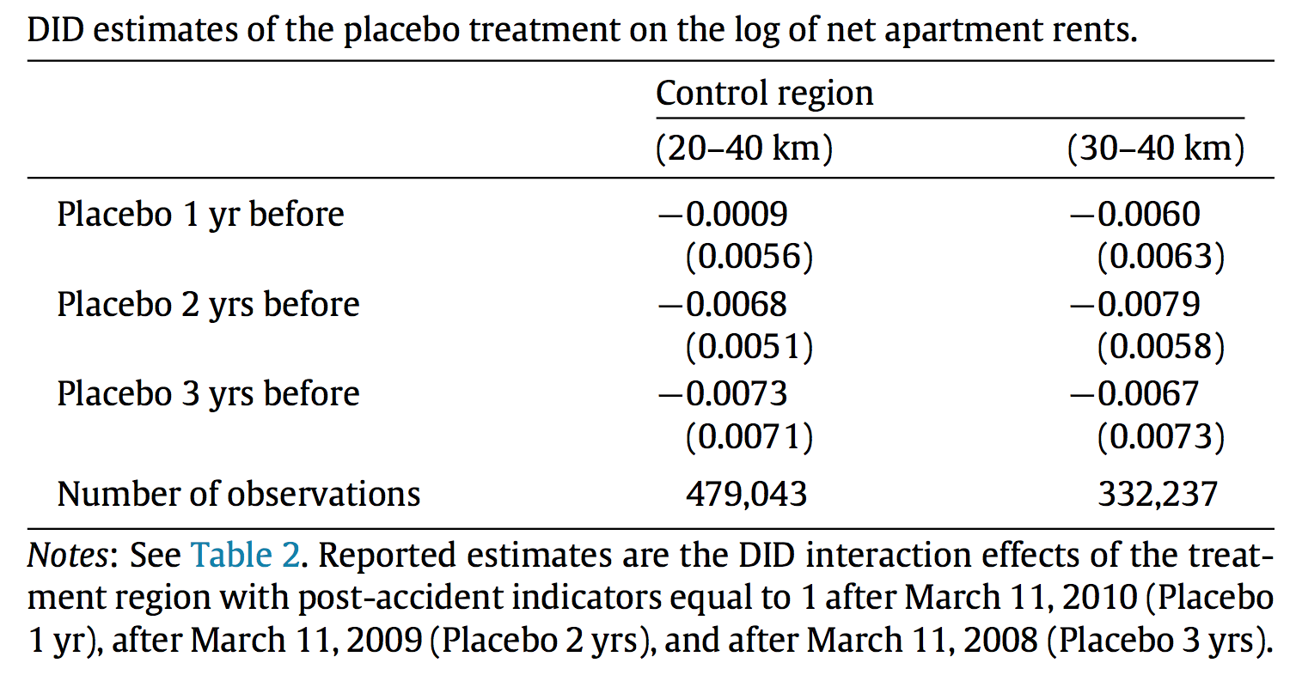

Slide 14
How to frame your teaching session?
(2) What aspects of this analysis would you like students to reflect on and how would you guide students through this journey
Think – Pair -- Share
Notes:
Using the topic and think of a start in the narrative.

