Slide 1

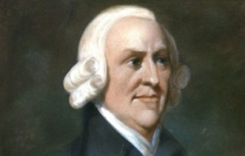




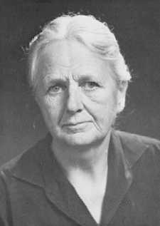
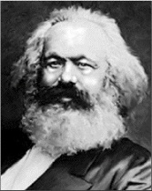
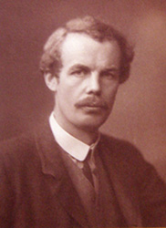
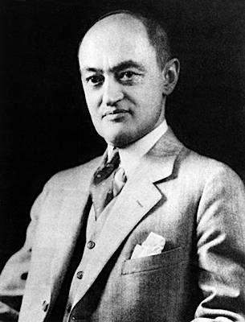
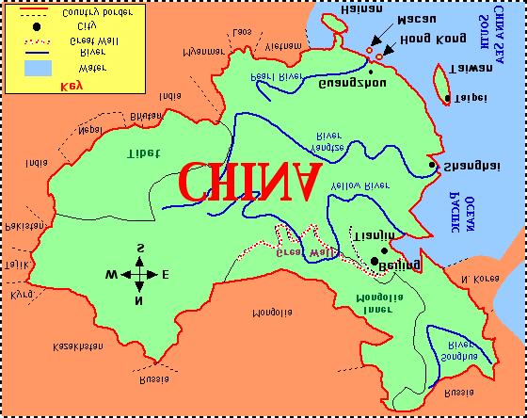
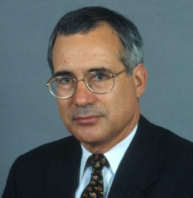
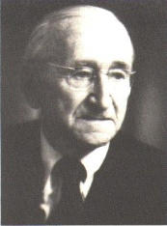
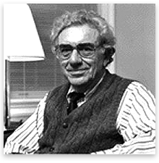
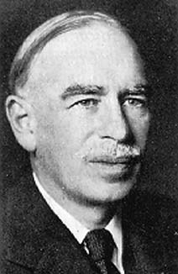


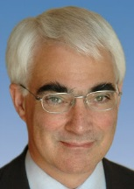
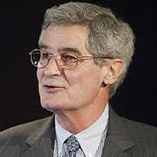
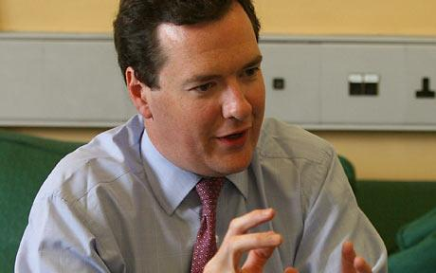




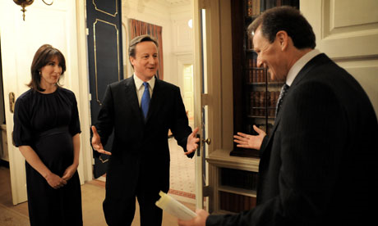

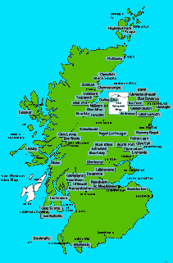
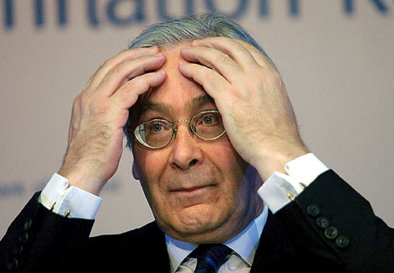
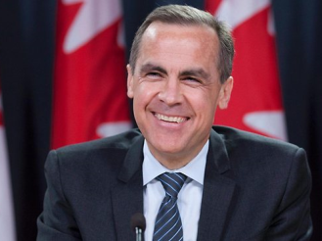

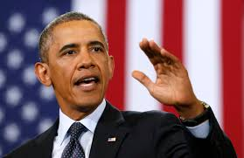
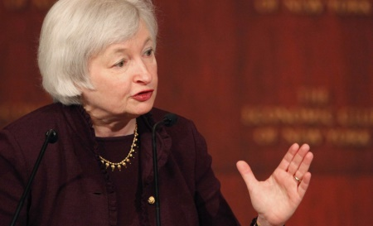

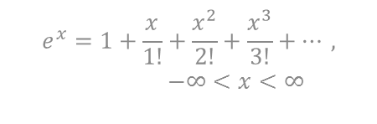
$ £
Practitioner skills for
economists
Andy Ross
Ex-Deputy Director GES
€
¥
MV≡PY
WR≡Y
Y ≡E
MV≡PT

Slide 2

How an academic entering government feels

Slide 3

Old Joke
‘Politicians make decisions without any evidence, businessmen make decisions on incomplete evidence and academics never make a decision as there is never enough evidence’.

Slide 4

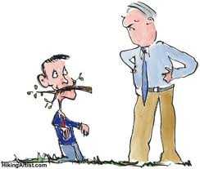

A generalisation: academics are prized by their peers
for rigour and professional practitioners are prized by their employers
for their relevance.

Slide 5


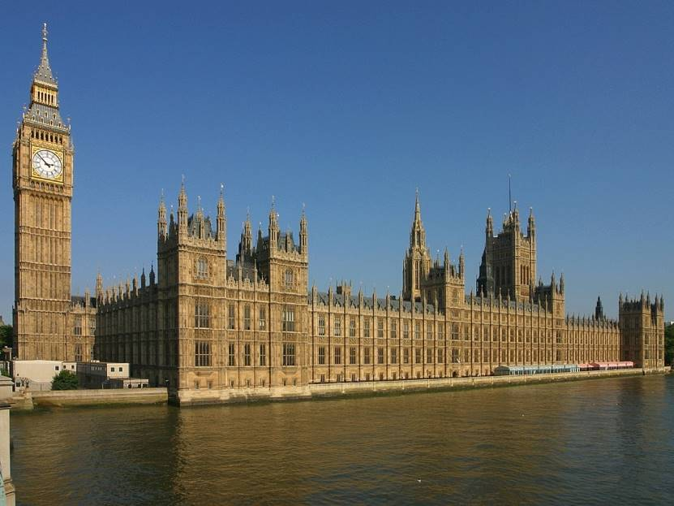
Rigour
Relevance

Slide 6
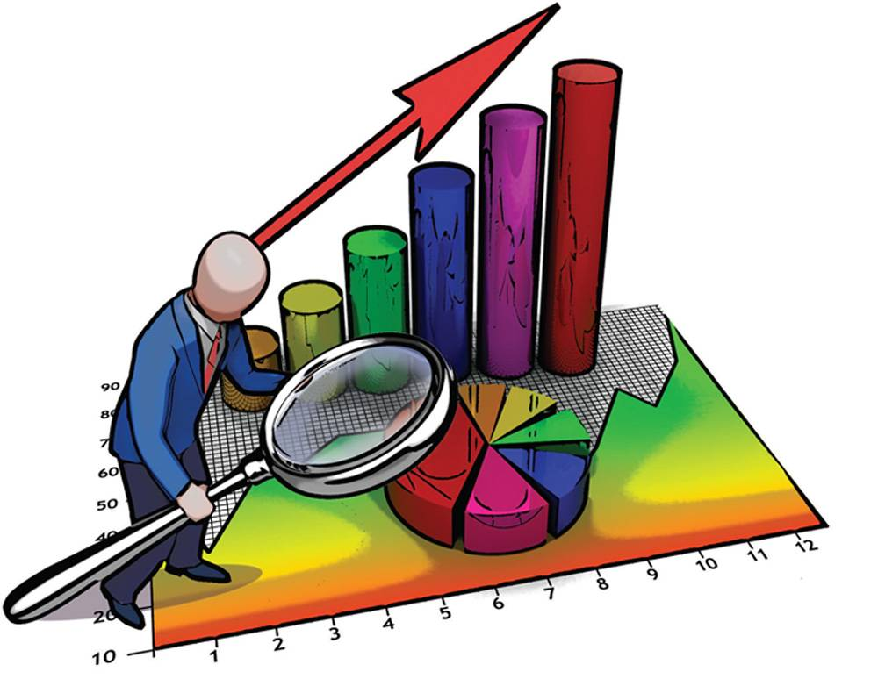
For practitioners maths is less important than insight & data skills

Slide 7
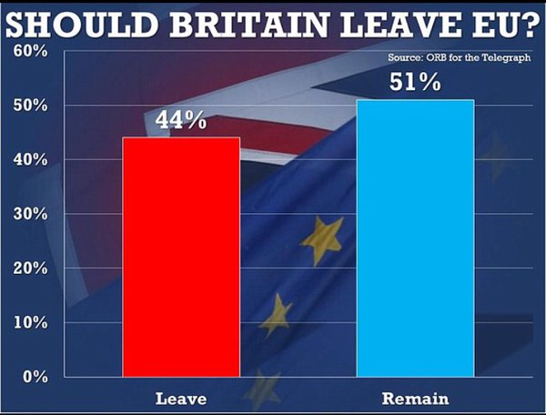
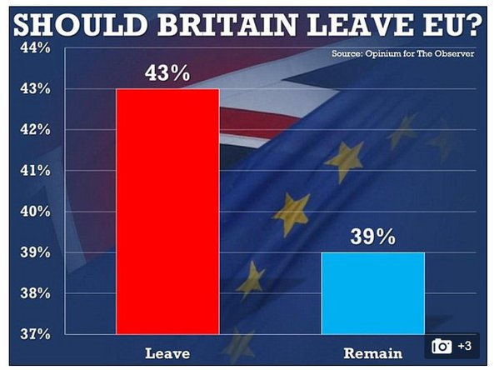
PRO-BREXIT: Truncating the Y Axis
From the Daily Mail

Slide 8
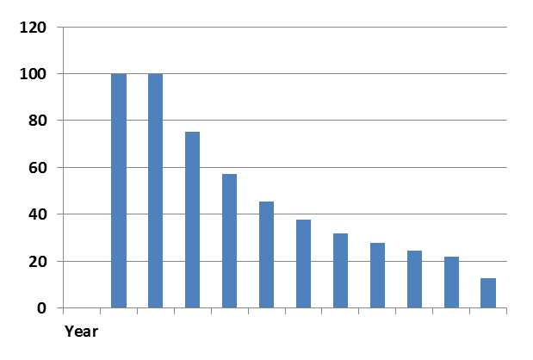
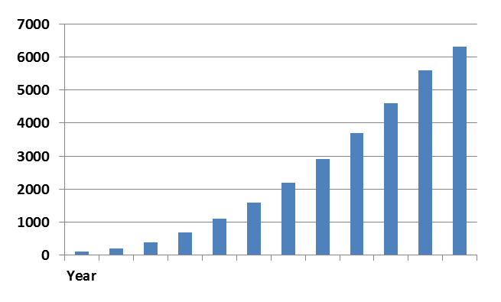
Uncontrolled expansion or growth petering out?
Total
100
200
400
700
1100
1600
2200
2900
3700
4600
5600
6300

Slide 9
Any good analyst can find facts to support a case
tablehttp://www.supportingevidence.com/Health/Life_expectancy_v_alcohol_consump_by_country.html
Country | Annual alcohol consumption (Litres) per capita over 15 years of age | Life expectancy at birth (years)
Turkey | 1.5 | 71
Poland | 8 | 75
UK | 11 | 78.5
France | 14 | 79

Slide 10
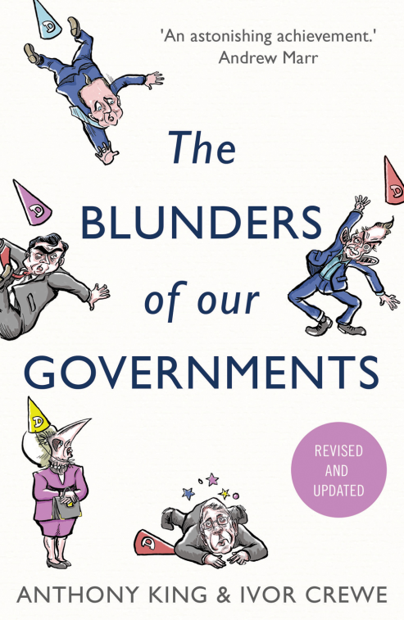
Just being an economist is not enough in government
Policy economics must take account of far more than economics.

Slide 11
QAA Subject Benchmarks: Employers of economists value:
Well evidenced reports and conclusions that further their interests
Communicating complexity simply
History, examples and case studies
Critical judgement to evaluate context, proportionality and awareness of limitations
Synthesis
- So practise pluralistic perspectives and inter-disciplinary analysis
Notes:
What I will be talking about

Slide 12


What have GES done in the past year?
Production of Briefing Material 75 %
Policy Advice 70%
Evaluation of Policy 53%

Slide 13
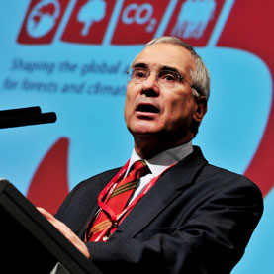
So good communication is vital
To convince people they need
to understand what you are saying
Lord Stern

Slide 14

To Non-economists it looks like:
The First Law of Economics:
For every economist there exists an equal and opposite economist
The Second Law of Economics:
They are both wrong

Slide 15

“The economist who tells the decision maker that ‘it is all very difficult and uncertain’ is not much help and will soon find themselves not invited back”
Vicky Pryce
http://www.instituteforgovernment.org.uk/sites/default/files/publications/The%20dismal%20science.pdf

Slide 16
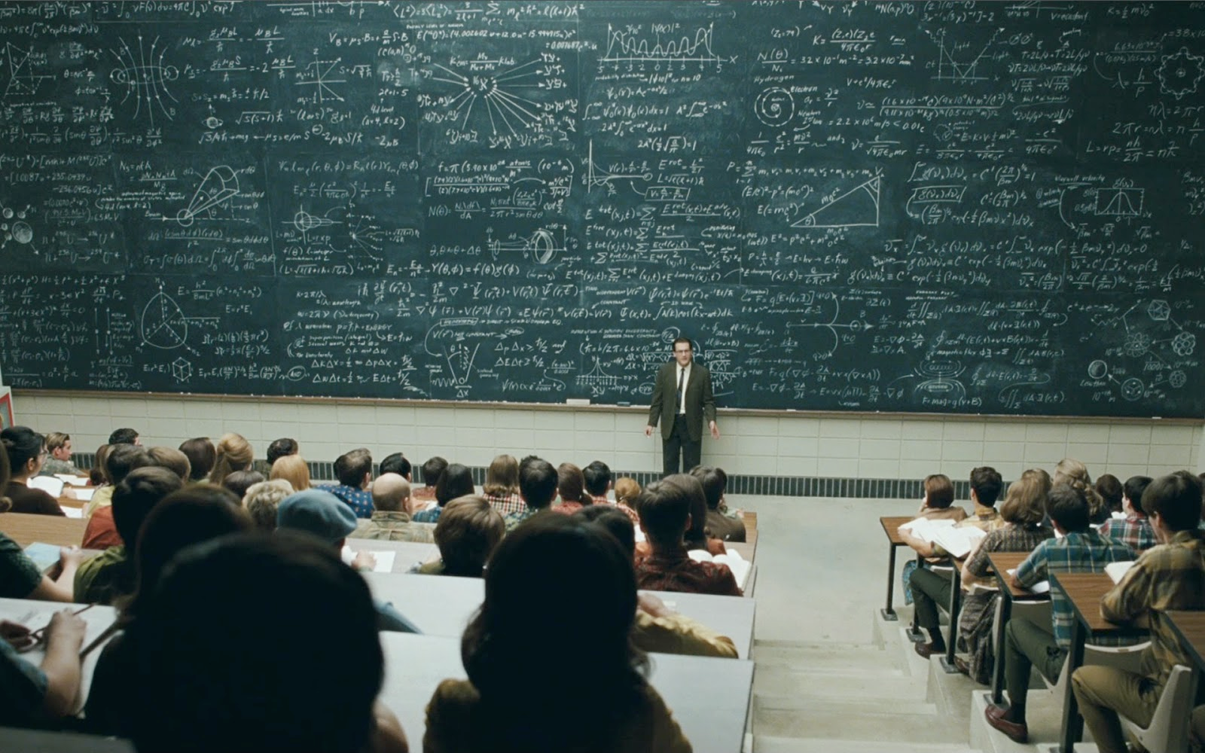
Make it appropriate for the target audience

Slide 17

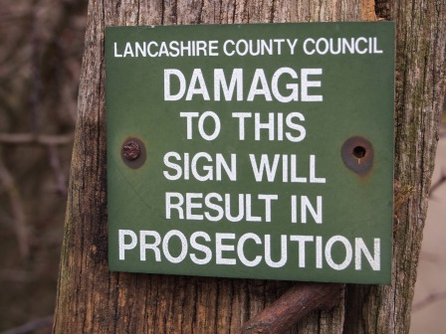
Compelling language & ‘Agency’

Slide 18

Subject to normal statistical error

Slide 19
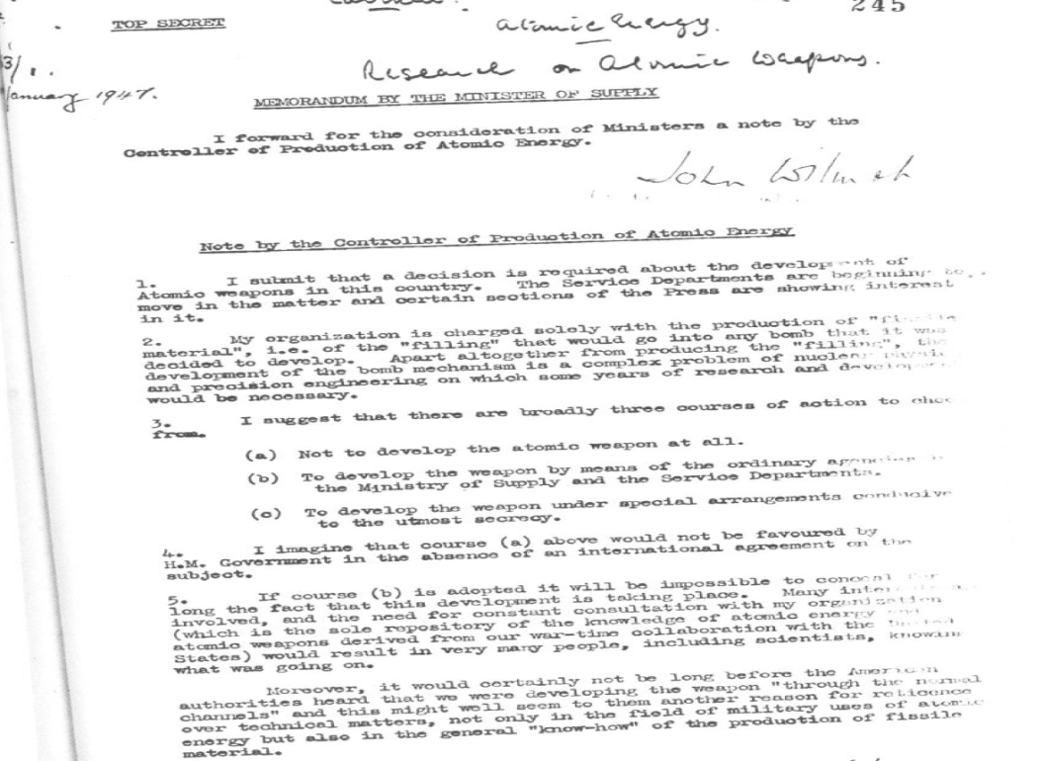
Actual brief for the Development of the UK Atomic Bomb- the whole thing!

Slide 20
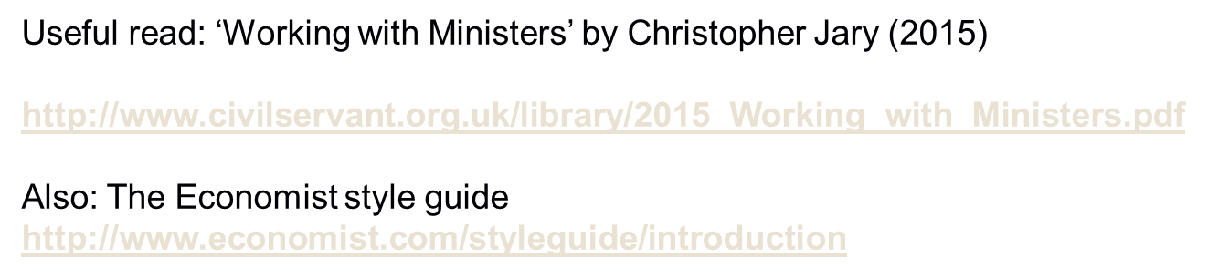

Slide 21
Take a basic concept Pareto-efficiency
or?

Slide 22
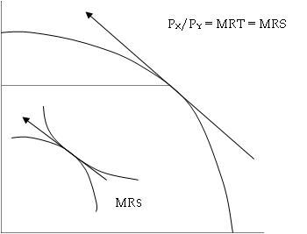
Combining consumption, production and allocative efficiency
Or?

Slide 23
FFWT: For policy purposes:
If all markets are perfectly competition and consumers rational, with no externalities, public goods or market failure connected with uncertainty, then the resulting equilibrium would be Pareto-efficient.
‘Deviations’ from this, equity, rationality nudges and paternalistic/ethical considerations, are used to ‘justify’ micro-economic interventions
Or?

Slide 24

In classical liberal philosophy: In Plain English
The idea is: Well-informed individuals are the best judge of their own welfare and will transact with each other until all mutual advantage has been gained. Then the only way left to gain is at the expense of another- but that infringes property rights.

Slide 25

A non-Pareto improvement

Slide 26
Mismatch with employers’ needs?
GES frequency of use 2012
Synthesising Evidence 84.4%
Cost-benefit analysis 68 %
Analysis involving maths 53.2%
Econometric analysis 51.5%
Game Theory 15 %
The usual university prioritisation
Analysis involving maths
Econometric analysis
Game Theory
Cost-benefit analysis
Synthesising Evidence

Slide 27
An academic ‘Problem’
As in Blume, Brandenburger and Dekel (1991), (ìLexicographic Probabilities and Choice under Uncertainty,Econometrica5 9, 61-79) let Ω denote the set of states, C the set of (pure consequences) and P the set of objective lotteries over C, while acts are mappings from Ω into P. A constant act is an act such that x (w) = x (w’) for all w, w’ ϵ Ω
(a)Explain why the ranking of constant act determines the expected utility function? (Take the theorem of expected utility for objective probabilities for granted.)

Slide 28
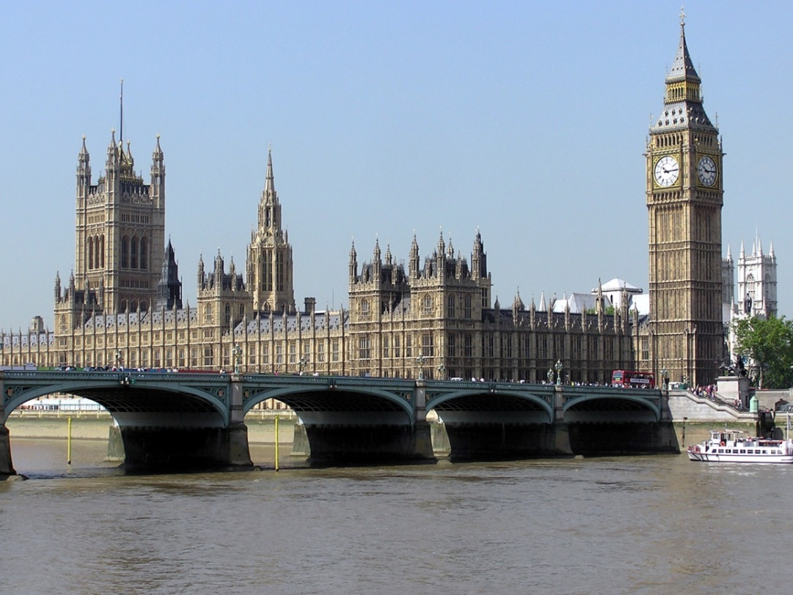
In government economics is about dilemmas not lemmas
Andy Ross

Slide 29
In business and government
Knowing a model/technique is not as important as knowing its limitations

Slide 30
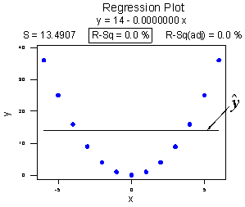
Functional Form Errors

Slide 31
Simple Examples of Model Limitations
Price
S
Typical A-level answer:
A Food Health scare e.g. eggs, beef etc
D1
Quantity

Slide 32
National Minimum Wage?
W/P
Unemployment
S
D
L

Slide 33

Immigration?

Slide 34
Data Errors: Foreign Owned UK Firms are more productive than UK firms so encourage Foreign Direct Investment?
UK
Foreign
Multi-national

Slide 35
‘If all regions had grown at just the average rate then overall UK growth would have been higher’
Why did a government economist recommend that this sentence be removed from a Minister’s briefing?

Slide 36
Practise applying economics to
Why no petrol stations in the middle of cities?
Why lights in fridges but not freezers?
Why are males more interested in casual sex?
Why a smoking ban and not Coase?
We are richer but NHS is ‘unaffordable’?
What does obesity say about utility max?
How much should we value future generations?
How often do economists change their minds?

Slide 37
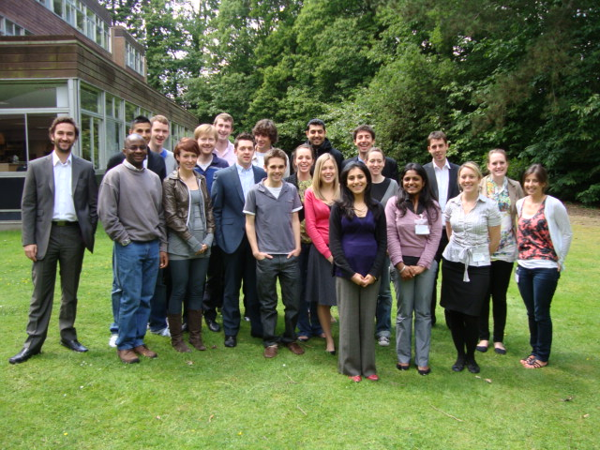
What SUCCESS looks like!
GES
GOVERNMENT ECONOMIC SERVICE
Making economists better
Making better use of economics

