Slide 1

Problem Based Learning
New Lecturers Workshop 2013
Manchester, 19th October 2013
www.economicsnetwork.ac.uk

Slide 2
Deeper learning
Greater retention of knowledge
Student centred approach
Transferable skills
Key features
Research
Knowledge application skills
Learning by doing
The process
PBL
PartialPBL
Approaches
Microeconomics
Frank Forsythe
Examples
Full
PBL
Economic Growth
Issues?
Statistics
Resources

Slide 3
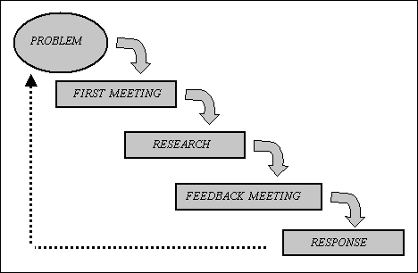
PBL: the process
Teacher
Kick start Learning process
Task/Problem
Containing some unknown elements
Feedback
Group
response
Student Groups
Some more details…?

Slide 4
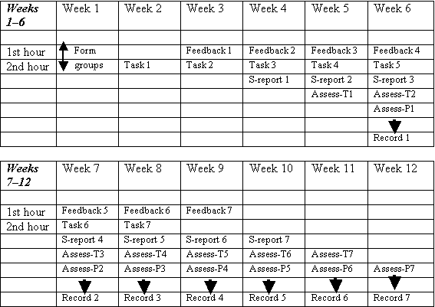
Microeconomics: Frank Forsythe

Slide 5
The Economic Growth Module (link to resources on EN website)
Final year undergraduate module
Taken by about 40-50 students
Mainly economics students but also taken by business students with required prerequisites
Assessment: 50% coursework, 50% unseen exam
3 hours of weekly contact time (2 hours whole class teaching; 1 hour IT workshop)

Slide 6
Module’s structure
Traditional lecture and seminar approach only in first two weeks of semester
From week 3 onwards students work in small groups of 4-6 people
Each group appoints a group leader and a minute taker. Notes of meetings are recorded and supplied to lecturer
4 tasks to be completed during the semester drive the learning process
3 tasks make up the final coursework while the fourth task feeds into the final exam
Groups are required to work about three weeks on each task

Slide 7
Structure of learning
Week | Activity
Week 1 | Lecture on Fundamentals of Economic Growth IT Workshops
Week 2 | Lecture on Solow Model IT Worshops
Week 3 | Groups start working on Task n. 1 IT Workshop
Week 4 | Groupwork on Task n. 1 IT Workshop
Week 5 | Groups 1, 3 an 5 present results of Task n. 1
 | Groups start working on Task n. 2 IT Workshop
Week 6 | Groupwork on Task n.2 IT Workshop
Week 7 | Groups 2, 4 and 6 present results of Task n. 2
 | Groups start working on Task n. 3 IT Workshop
Week 8 | Groupwork on Task n. 3 IT Workshop
Week 9 | Groups 7, 8, 9 and 10 present results of Task n. 3
 | Groups start working on Task n. 4 IT Workshop
Week 10 | Groupwork on Task n. 4 IT Workshop
Week 11 | Groupwork on Task n. 4 Submission of Coursework (Tasks n.1, n. 2 and n. 3)

Slide 8
Assessment
Coursework includes 3 tasks
Grade determined through a combination of tutor and peer evaluation
Final examination
Based on task 4. This task is research based and in the exam, the students are asked to report on the research results
For example, exam based on article ‘Growth Diagnostics’ by Hausmann et al. and students were asked to replicate analysis with respect to a given country

Slide 9
Issues in implementing PBL
The role of the lecturer….
Designing the task(s)….
Structuring the assessment....

Slide 10
The role of the lecturer
Module design: key to the effectiveness of PBL is a careful design of the learning activities
Facilitator : stimulate discussion without providing answers
Feebdack: provides regular feedback throughout the year
Groups management: intervenes in issues concerning the working of groups

Slide 11
Designing a Task/Problem
When designing a task, one should first be aware of the learning activities that students will perform when tackling the task and, secondly, try and visualise (and thus eliminate) possible difficulties that may arise in the process
Design tasks that are consistent with the learning outcomes specified for the module and to ensure that the learning outcomes intended are actually realised
A number of difficulties may arise that prevent students from realising intended learning outcomes (availability of resources, adequate supply of material etc.)
Steps in designing the task/problem
Determine the form of the PBL environment
Focus on target learning outcomes
Determine the learning activities associated with the task
Presenting the task to students

Slide 12
Assessment
Tasks provide the opportunity for both formative and formative assessment
All responses by PBL groups must, at the very least, receive formative feedback
Students could be asked to perform various types of tasks: report, presentation, poster, competition (University Challenge), project management etc.
Link between tasks and assessment creates incentives for work
Problems in group work can be limited with a clear reward and punishment system and peer evaluation
If final examination is held, it should be structured around the principles of PBL (research, independent work etc.)

Slide 13
Implementing PBL – discussion
Would you consider implementing PBL in your own teaching? If so, what would be your concerns? If not, why?

Slide 14
Year 1 Statistics
Traditional set up: lectures and classes
Projects that underpin learning
Long-run aim: place the projects at the centre of the learning and structure learning around similar projects
The average length of a human hug
Spreadsheet and Data in Economics
The QM Consumer Price Index
The proportion of youngsters with a driving licence
Spreadsheet and Data in Economics
A survey of books expenditures
The Barclays Bicycle Hire Scheme
Dodging fares on the Paris metro
What is the average height of students on the module?

Slide 15
Thanks for listening!
Any questions?
www.economicsnetwork.ac.uk

Slide 16
Spreadsheets and Data in Economics
Queen Mary University would like to acquire a better understanding of how much students spend on textbooks every year. The University is particularly interested in whether there are differences in students’ expenditure across gender, disciplines and year of study. The University believes that:
On average, female students spend more than male students;
On average, students enrolled on ‘hard-science’ subjects (e.g. physics, engineering) spend more on textbooks;
On average, year 3 students are more likely to spend more than year 1 and 2 students.
You have been hired by the University to carry out some market research and to report on evidence about students’ expenditures on textbooks.
How would you go about carrying out the research and address the issues raised by the University?
Produce a clear and well designed research plan, carry it out and prepare a report with detailed evidence about the students’ pattern of expenditure.
Briefly comment on the issues concerning statistical analysis that have been raised by this coursework.

Slide 17
Literature on PBL available on the Economics Network Website
*Case study: Using Problem Based Learning (PBL) to teach Industrial Economics, John Sedgwick (2009) <http://www.economicsnetwork.ac.uk/showcase/sedgwick_pbl.htm> * Case Study: Using Problem Based Learning (PBL) to Teach Economics, Frank Forsythe (2009) <http://www.economicsnetwork.ac.uk/showcase/forsythe_pbl.htm> * Case Study: Teaching Structuralist Economics Using Problem Based Learning and Weblogs, Stephen Kinsella (2008) <http://www.economicsnetwork.ac.uk/showcase/kinsella_pbl.htm> * Case study: Problem-Based Learning and Ecological Economics, Heather Witham and Andrew Mearman (2008) <http://www.economicsnetwork.ac.uk/showcase/witham_ecological.htm> * Problem Based Learning tasks in Economic Growth, Guglielmo Volpe (2007) http://www.economicsnetwork.ac.uk/archive/volpe_pbl

Slide 18
* Introducing PBL to a first-year curriculum, Frank Forsythe (2007) <http://www.economicsnetwork.ac.uk/dee2007/presentations/forsythe_pbl.ppt> * Introducing Problem-Based Learning to a First-Year Curriculum, Frank Forsythe (2006-7) <http://www.economicsnetwork.ac.uk/projects/mini/forsythe_pbl.htm> * Developing a PBL course in Economics: a sceptic's diary, Judith Piggott (2006) <http://www.economicsnetwork.ac.uk/showcase/piggott_pbl4.htm> * Our Experience with Problem-Based Learning, Judith Piggott and Andy Kilminster (2005) <http://www.economicsnetwork.ac.uk/projects/mini/pbl0905.htm> * Case Study: Promoting Problem-Solving Based Independent Learning in Macroeconomics, David McCausland (2001)
http://www.economicsnetwork.ac.uk/showcase/causland_pbl.htm

Slide 19
* Developing critical reasoning skills as a foundation for the first year core curriculum, Judith Piggott (2004-5) <http://www.economicsnetwork.ac.uk/showcase/piggott_pbl4.htm> * Developing a PBL course in Economics: a sceptic's diary (implementation), Judith Piggott (2004) <http://www.economicsnetwork.ac.uk/showcase/piggott_pbl3.htm> * Developing a PBL course in Economics: a sceptic's diary (part two), Judith Piggott (2003) <http://www.economicsnetwork.ac.uk/showcase/piggott_pbl2.htm> * Developing a PBL course in Economics: a sceptic's diary (part one), Judith Piggott (2002) <http://www.economicsnetwork.ac.uk/showcase/piggott_pbl.htm> * Handbook Chapter on PBL, Frank Forsythe, 2002 <http://www.economicsnetwork.ac.uk/handbook/pbl/> * Case Study: Using Problem Based Learning and a Business Game in Teaching Managerial Economics, Pierre Picard (2002) <http://www.economicsnetwork.ac.uk/showcase/picard_pbl.htm> * Case Study: Using Problem Based Learning in Teaching Economics, Peter Pierpoint (2001) <http://www.economicsnetwork.ac.uk/showcase/pierpont_pbl.htm>

Slide 20

How long does the average human hug last?
According to recent research the average human hug lasts three seconds. Information and details about this research can be found, among others, through these links:
The Telegraph article
Dundee University Press Release
You are asked to carry out some inferential statistics to test whether the average human hug lasts three seconds.

Slide 21

What is the proportion of 17-20 year olds without driving licence?
According to a recent survey, the proportion of British 17-20 year olds that hold a driving licence has continued to fall year on year over the past two decades. While nearly half of 17-20 year olds had driving licences twenty years ago, only 35% do now. This issue received some public attention recently and an article was published in a recent edition of the Guardian newspaper:
http://www.guardian.co.uk/uk/2012/feb/26/economy-young-car-coach-train
According to the article: “The number of 17-year-olds taking the driving test has continued to fall year on year, as many of them deal with the loss of their education maintenance allowance coupled with a steep rise in university tuition fees”. Hence, it might be possible to speculate that the proportion of 17-20 year old University students with a driving licence might be even smaller than the national percentage.
You are asked to carry out some inferential statistics to test whether the proportion of 17-20 year old University students with a driving licence is smaller than the national average.

Slide 22
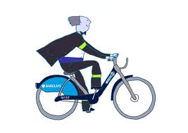
How long are bicycles hired for (on average) on the Barclays London Bicycle Hire scheme?
Two years ago London introduced the Barclays London Bicycle Hire scheme that gives people the opportunity to hire bicycles from various docking stations in London. The scheme intends to promote the use of bicycles in London as a way to reduce traffic, congestions and to improve people’s fitness.
The scheme is designed to favour the use of the bicycles for a short period of time, usually less than 60 minutes. In fact, the first 30 minutes are free and it costs £1 to hire the bike for the first hour. The cost sharply increases to £4 for the first hour and a half and £6 for up to two hours.
More information about the scheme can be found from the following website:
http://www.tfl.gov.uk/roadusers/cycling/15150.aspx
You are asked to use inferential statistics to estimate the average length of bicycle hire.

Slide 23
Fare dodgers take Paris Métro for a ride with insurance pots against fines
The Paris Métro system is one of the most high-tech in the world but it is proving no match for fare dodgers who are beating it with a wheeze from the 17th century.
Enterprising free-riders are paying into low-cost insurance funds that reimburse their fines if they are caught without tickets....
The self-styled mutuelles des fraudeurs, usually bands of friends, colleagues or students, remain small-scale but the RATP, the Paris transit authority, is losing an estimated €80 million (£70 million) a year to those who leap the turnstiles.
The mutuelles, of which there are said to be more than a dozen, depict themselves as radical leftists or libertarians who are fighting for free public transport.
“We all pay €7 a month to a common fund which is used to refund members who are fined,” Frédéric, a 22-year-old student, told the newspaper Le Parisien. “At the end of the year there is only about €3 left in the fund.”
...Fraudsters get away because the Métro has relatively few staff, compared with the London Underground. Dodgers are only caught if they run into one of the roving teams of inspectors.
There are 968 inspectors on the whole Métro, tram and bus system. Although they often wear plain clothes and hide around the corner, this is not enough to deter fraudsters.
Daily Métro users are subjected to checks only about once every six weeks and expert dodgers say they can usually avoid the inspectors anyway....

Slide 24

Key features of PBL
PBL involves learning through tackling problems
It is a student-centred system whereby students, working within small groups, generate the information necessary to respond to, or solve, a specific problem or task
The problems are used as a tool to achieve both the required knowledge base and the skills to ‘solve’ them. The basis of PBL is that students learn by doing
A particular feature of PBL is that it helps develop in students both subject-specific and transferable skills
Subject-specific skills are developed directly through problem design, while transferable skills are developed indirectly via the PBL process itself

Slide 25
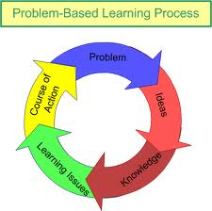
Approaches to PBL
When implementing a PBL environment, one may adopt a ‘partial’ or ‘full-format’ model
In a ‘partial’ PBL environment, formal lectures are retained and PBL is used to organise the weekly tutorial sessions in support of lectures
In a ‘full-format’ PBL environment, there are no lectures and the learning environment is driven entirely by PBL methodology

Slide 26

Research on PBL
Relative to conventional lecture-based methods in which information is transferred from teacher to student, the research literature suggests that:
PBL fosters a deeper approach to learning
PBL promotes more versatile studying methods and PBL students are more likely to use the library and library resources to study.
PBL develops greater knowledge retention and recall skills.
PBL students tend to exhibit stronger knowledge application skills
From a teacher perspective, PBL appears to be a very satisfying method of teaching.

