Slide 1

Teaching Small Groups
www.economicsnetwork.ac.uk

Slide 2
[I] The first tutorial
http://www.theatlantic.com/education/archive/2013/11/lectures-didnt-work-in-1350-and-they-still-dont-work-today/281514/
www.economicsnetwork.ac.uk

Slide 3
The first tutorial
http://www.theatlantic.com/education/archive/2013/11/lectures-didnt-work-in-1350-and-they-still-dont-work-today/281514/
www.economicsnetwork.ac.uk

Slide 4
[II] Learning in small groups
http://www.theatlantic.com/education/archive/2013/11/lectures-didnt-work-in-1350-and-they-still-dont-work-today/281514/
www.economicsnetwork.ac.uk

Slide 5
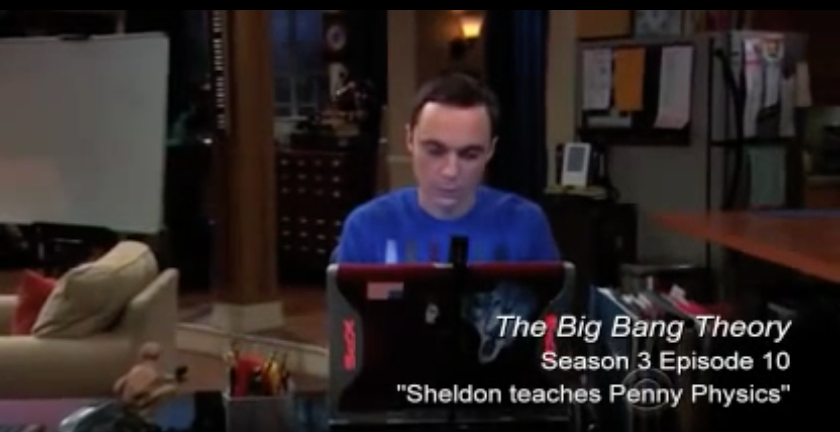
Why Sheldon sucks at teaching
https://www.youtube.com/watch?v=AEIn3T6nDAo
www.economicsnetwork.ac.uk

Slide 6
The ‘not-to-do’ list in teaching
http://www.theatlantic.com/education/archive/2013/11/lectures-didnt-work-in-1350-and-they-still-dont-work-today/281514/
www.economicsnetwork.ac.uk

Slide 7
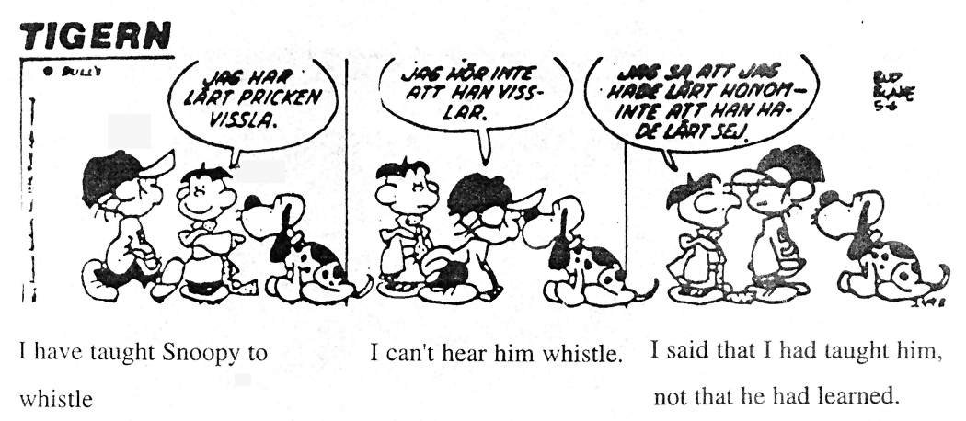
Teaching outcomes
I've taught
Snoopy to
whistle
I can't
hear him
whistle
I said that I'd
taught him, not that
he'd learned
http://www.theatlantic.com/education/archive/2013/11/lectures-didnt-work-in-1350-and-they-still-dont-work-today/281514/
www.economicsnetwork.ac.uk

Slide 8
Learning
Average Retention rates
Practice by doing
5%
Discussion Group
10%
Reading
20%
Teach Others / Immediate Use
30%
Listening to Lecture
50%
75%
Demonstration
95%
Audio-Visual
www.economicsnetwork.ac.uk
Notes:
Task: Match RHS (Lecture, Reading, Audio/Visual, Demonstration, Discussion, Practice, Teach others)
Explain: Introduce Active versus passive learning and constructivist learning
Say: Problem with large class-rooms ➔ Small class rooms are the ideal environment to make engaged student-led learning happen.
Reality: Going through problem sets etc.

Slide 9
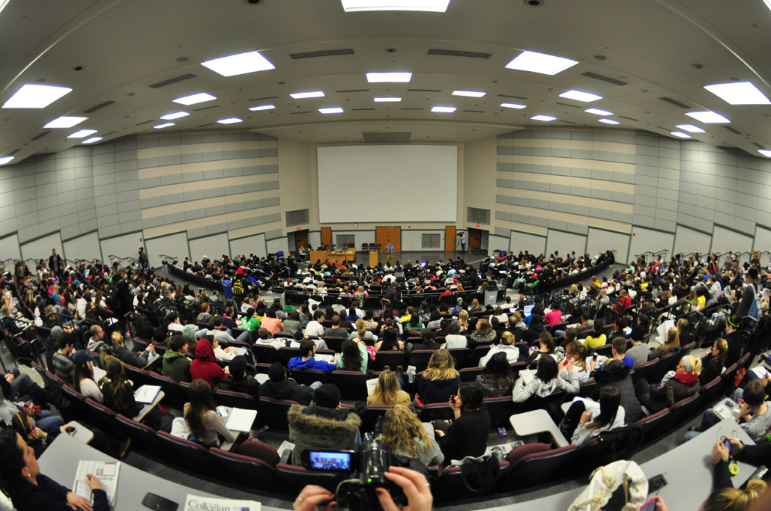
The lecture: large versus small
www.economicsnetwork.ac.uk

Slide 10


The lecture: large versus small
www.economicsnetwork.ac.uk

Slide 11
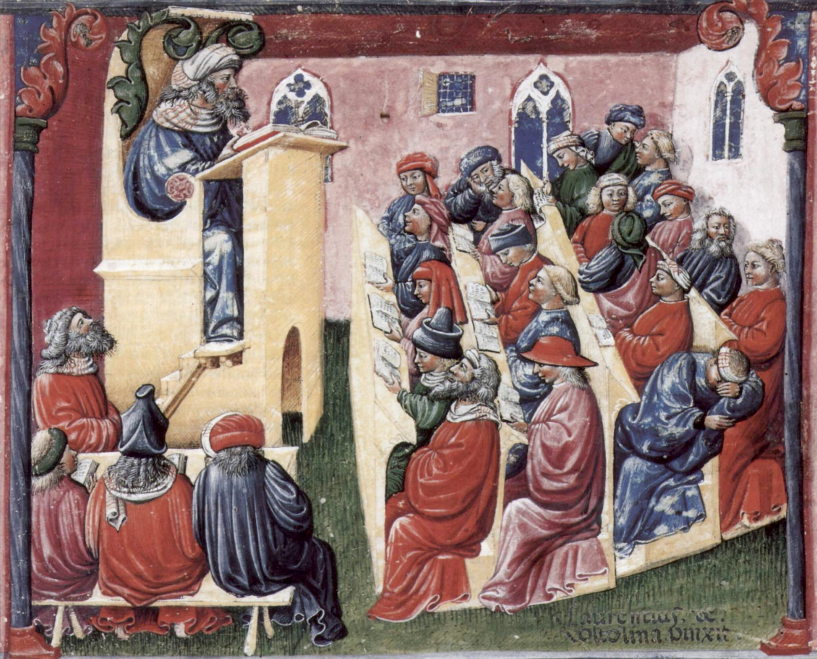
The lecture
http://www.theatlantic.com/education/archive/2013/11/lectures-didnt-work-in-1350-and-they-still-dont-work-today/281514/
www.economicsnetwork.ac.uk
Notes:
-- The model of ‘lecturing’ is very old
-- Refer to the 5 percent remembering
-- Here we see 20-25 students and the teaching mode is pretty traditional lectures
-- One asleep already
-- Similar picture in large room teaching sessions

Slide 12
The lecture
http://www.theatlantic.com/education/archive/2013/11/lectures-didnt-work-in-1350-and-they-still-dont-work-today/281514/
www.economicsnetwork.ac.uk
Notes:
-- The model of ‘lecturing’ is very old
-- Refer to the 5 percent remembering
-- Here we see 20-25 students and the teaching mode is pretty traditional lectures
-- One asleep already
-- Similar picture in large room teaching sessions

Slide 13

The lecture with small groups…
http://paulread.net/demand-high-exeter/
www.economicsnetwork.ac.uk
Notes:
But even in small

Slide 14
[III] The Student(s!)
http://www.theatlantic.com/education/archive/2013/11/lectures-didnt-work-in-1350-and-they-still-dont-work-today/281514/
www.economicsnetwork.ac.uk

Slide 15
The lecture
www.economicsnetwork.ac.uk

Slide 16
How do we learn?
Every student is different!
In what aspect?
  Language skills
  Ability
  Learning Styles
  Background knowledge
  Specific learning disabilities
  Enthusiasm
  Motivation
  Culture
www.economicsnetwork.ac.uk

Slide 17
How do we learn?
Which of these differences do we need to adapt our teaching to?
  Language skills
  Ability
  Learning Styles
  Background knowledge
  Specific learning disabilities
  Enthusiasm
  Motivation
  Culture
www.economicsnetwork.ac.uk

Slide 18


Motivational Differences
www.economicsnetwork.ac.uk
Notes:
Surface v Deep Learner,
who should we cater for. In a way both, but ensure you demand and enforce a minimum expectation of prior knowledge
Can you motivate the surface Learner to want to understand? You are also a coach and motivator

Slide 19
[IV] Active Learning Strategies
http://www.theatlantic.com/education/archive/2013/11/lectures-didnt-work-in-1350-and-they-still-dont-work-today/281514/
www.economicsnetwork.ac.uk

Slide 20
Interaction in seminars
Introduce interactive techniques that exploit:
  Varied student abilities and backgrounds
  Encourage participation
  Transferable skills
Job-market skills!
  Confidence
  Ability
  Motivation
  Performance
  Employment prospects

Slide 21
Brainstorming experience
What is your experience in small group teaching? What has worked! What are the challenges?

Slide 22
Interactive seminars
Problem-based learning
  Maastricht University
  http://www.economicsnetwork.ac.uk/showcase/forsythe_pbl
Case studies, current affairs
  http://www.economicsnetwork.ac.uk/handbook/casestudies/1
Games, experiments
  http://www.economicsnetwork.ac.uk/themes/games
Flipped classroom
  http://www.economicsnetwork.ac.uk/sites/default/files/Ashley/Ralf%20Becker%202.pdf
www.economicsnetwork.ac.uk

Slide 23
Other active learning strategies

Slide 24
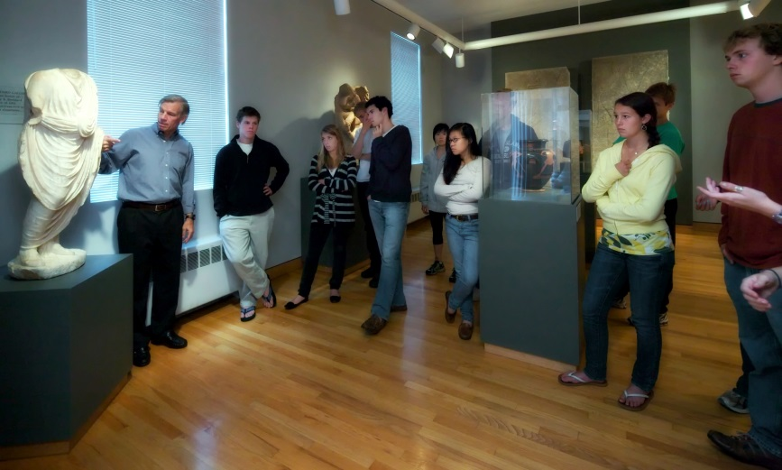
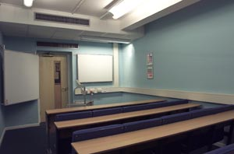
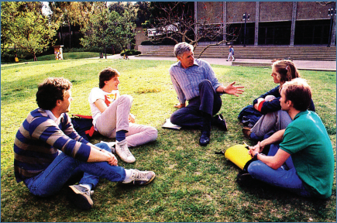

Engaging environments
www.economicsnetwork.ac.uk

Slide 25

Storytelling
http://www.hotflick.net/pictures/996/big/fhd996RNJ_Claire_Danes_003.html
www.economicsnetwork.ac.uk

Slide 26
[V] The Perfect Seminar
http://www.theatlantic.com/education/archive/2013/11/lectures-didnt-work-in-1350-and-they-still-dont-work-today/281514/
www.economicsnetwork.ac.uk

Slide 27
Know your class
Class composition
Initial tests
Taking in homework
Content guided by students
Confidence
www.economicsnetwork.ac.uk

Slide 28
Who are your students?
Different backgrounds and goals
Increase in international students
Fees – students as customers
Reluctance – quantitative subjects
www.economicsnetwork.ac.uk

Slide 29
Expectations
Role of seminars
Extent of preparation for seminars
Follow up work after seminars
Expectations of homework, presentations
Participation in seminars
www.economicsnetwork.ac.uk

Slide 30
Seminar content
Ask preliminary questions
Worksheets
Student presentations
Links with assessment
Activities
  Students marking each other’s work
  Filling in gaps
  Games/experiments
In-class informal quizzes
www.economicsnetwork.ac.uk

Slide 31
Top tips for exercises
Keep notation consistent and explain it
Make steps in the reasoning explicit
Use questions to guide students through the reasoning
Provide intuition – plan examples/ask students to find examples in advance
Identify possible pitfalls or cases – anticipate areas of difficulty
Link material taught to the lectures
Try and offer ‘the bigger picture’
www.economicsnetwork.ac.uk

Slide 32
Never...
Skip parts of explanations
Rush (but keep an eye on the clock)
Hide errors
Follow do’s and don’ts lists... look for what works for you!
www.economicsnetwork.ac.uk

Slide 33
Always...
Adapt room layout
Introduce yourself
Plan ahead but stay flexible
Contextualise and structure material
Encourage participation
Make the most of your experience and enjoy it!
www.economicsnetwork.ac.uk

Slide 34
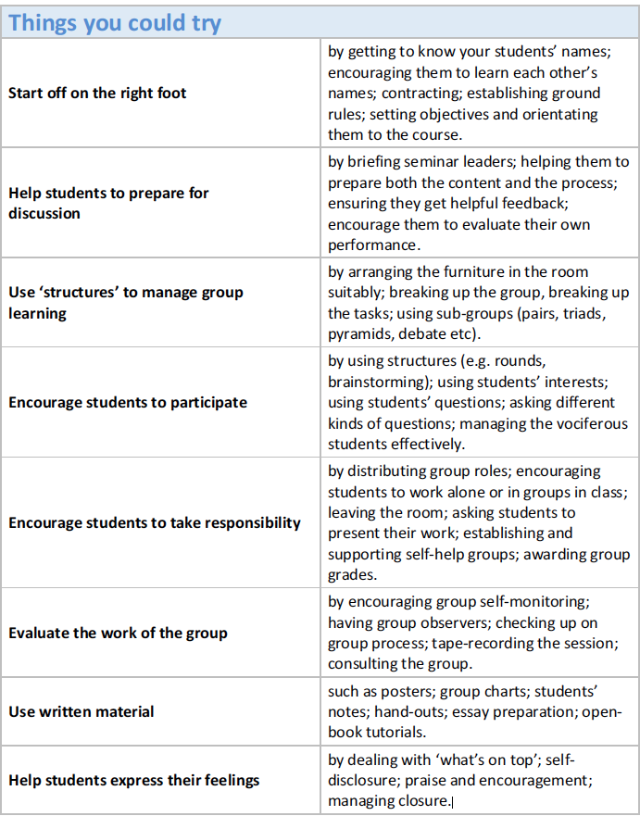
Toolbox

Slide 35
Getting more inspiraction
www.economicsnetwork.ac.uk
www.core-econ.org
http://dirkmateer.com
…

Slide 36
[V] Analyse Feedback
http://www.theatlantic.com/education/archive/2013/11/lectures-didnt-work-in-1350-and-they-still-dont-work-today/281514/
www.economicsnetwork.ac.uk

Slide 37
Student feedback
“Tutor could be better qualified. Sometimes got stuff wrong!”
“The seminars were dire and I don't feel they benefited my learning at all and at some point even just lead to more confusion over the subject.”
“The tutorials - relate the questions more to the test questions so that we would be better prepared for the tests”
“I felt that the tutorial questions often are very different to test questions.”
“longer seminars, we normally don't have time to do all the work in the seminars”
“the class teacher does not cover all questions during the class! Classes should last longer!”
“I do not see the point in coming to the class: the teacher just goes through the solutions with no value added.”
“More assistance with essay writing techniques and skills in answering exam questions.”
“I can just go through the solutions what is the point of just writing down some mathematical equations/solutions with no explanation of its meaning!?”
“Tutorials can sometimes feel like we haven't progressed anywhere, maybe give them more structure” “In my opinion tutorials should not be only about tutorial questions provided by lecturer. Tutorial preparations were not really demanding.”
www.economicsnetwork.ac.uk
Notes:
These are the comments from the emails. I put some of them into the slides to discuss…
Maybe just let them read it… then remind them about the tool box, then go back to the comments and discuss: WHAT’s the reason/problem → What to do?
The seminars were somewhat dire and I don't feel they benefited my learning at all and at some point even just lead to more confusion over the subject
Tutor could be better qualified. She sometimes got stuff wrong
Letting people know that practice questions are available, although perhaps this was my fault for not fully reading through the coursepaper
The tutorials - relate the questions more to the test questions so that we would be better prepared for the tests
longer seminars, we normally don't have time to do all the work in the seminars
More assistance with essay writing techniques and skills in answering exam questions.
If we were better prepared for what to expect in the test, I felt that the tutorial questions often are very different to test questions.
Perhaps there could be some more advanced tutorial questions for those who wish to extend their knowledge beyond the basics of the course.
Tutorials can sometimes feel like we haven't progressed anywhere, maybe give them more structure
In my opinion tutorials should not be only about tutorial questions provided by lecturer. Tutorial preparations were not really demanding.
1) it looks as if there is not much communication between lecturer (module organiser) and class teacher. Often the class teacher is unaware of the progress made on the module or of what and how some material has been taught in the module;
2) I do not see the point in coming to the class: the teacher just goes through the solutions with no value added. I can just go through the solutions myself by downloading them from the VLE, I do not need to go to class;
3) the class teacher does not cover all questions during the class! Classes should last longer!
4) what is the point of just writing down some mathematical equations/solutions with no explanation of its meaning!?

Slide 38
Lecturer’s feedback
“My students don’t engage in the class. I ask a question and nobody wants to answer.”
“My students don’t prepare the material before class, which means my whole seminar plan does not work out anymore.”
“My students don’t hand in their
coursework.”
“I have to give too much written feedback”
“The course organiser does not give
me any guidance on what to teach”
“The course organiser does not give
me any guidance on what to teach”
“The course organiser gives me material of quality or no answer guides”
www.economicsnetwork.ac.uk
Notes:
Something on how to make students talk, on how to make students do prepare the tasks, how to make students hand in coursework etc.

Slide 39
[VI] Do it yourself
http://www.theatlantic.com/education/archive/2013/11/lectures-didnt-work-in-1350-and-they-still-dont-work-today/281514/
www.economicsnetwork.ac.uk

Slide 40
Small Group Teaching
Topic: Positive externalities, Market Failure
and Policy.
Design a small group
session (as course coordinator)
Teach small group
session (as lecturer / GTA)
Design a small group
session (college tutorial, individual teaching)
www.economicsnetwork.ac.uk
Notes:
Any other suggestions for a topic?
Split group and let them think about
A teaching guide for a TA
How to run the session on it

Slide 41
What’s your next innovation
www.economicsnetwork.ac.uk
Notes:
After reflecting on small group teaching sessions, what’s your
next small group teaching innovation??

