Slide 1
Large Group Teaching
Ralf Becker* and Alvin Birdi#
*The University of Manchester, #The University of Bristol, Economics Network

Slide 2
In preparation, please log on to the web using a mobile phone/device
visit www.rwpoll.com
Session ID: uomrb (lower/upper case)
Don’t enter details, just click Continue

Slide 3
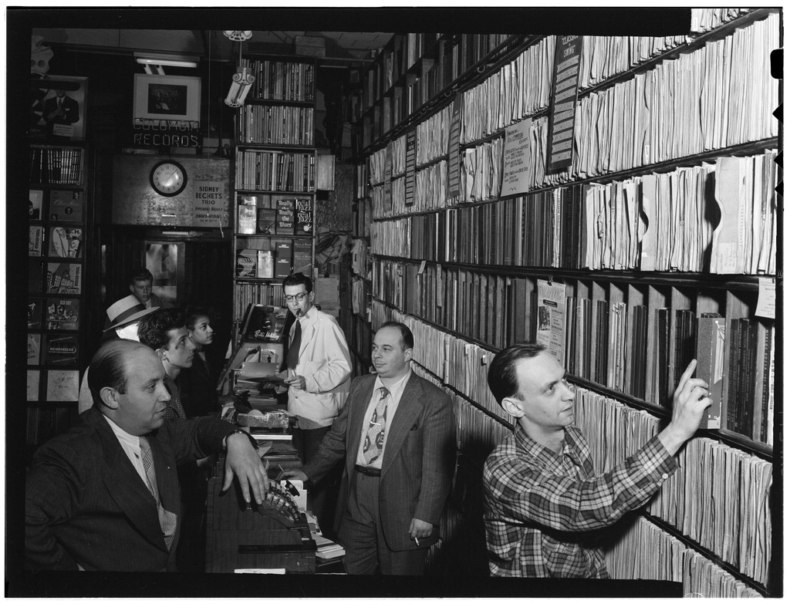

Slide 4
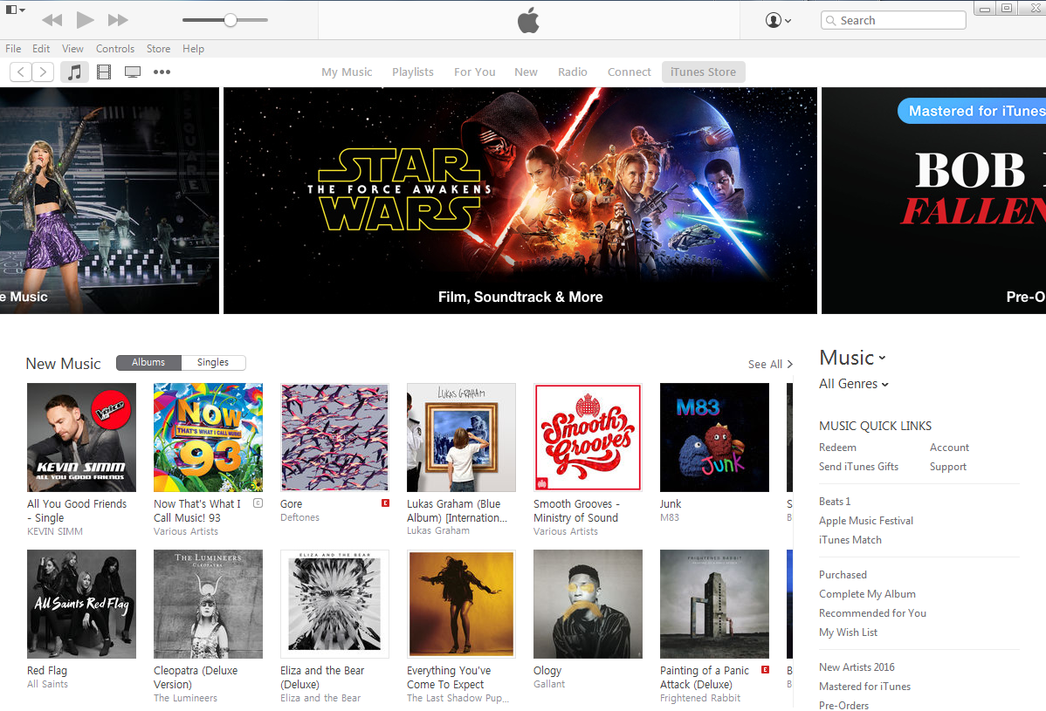

Slide 5
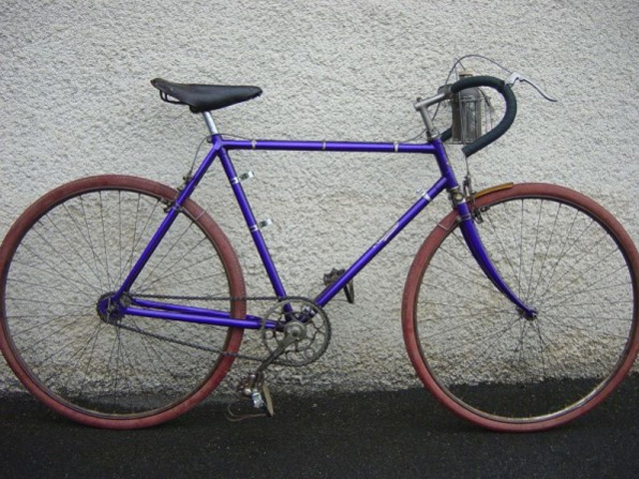

Slide 6
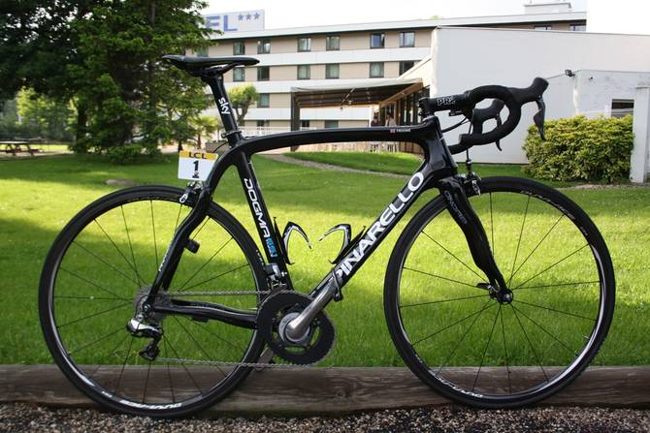

Slide 7
Should new technology change the way we teach?
^{Or}
^{What’s the use of Lectures?*}
^{Or}
^{Lecturing in the age of MOOCS}
* Donald A. Bligh, July 1971

Slide 8




MOOCs
MOOCS don’t have class contact

Slide 9
What do we want to achieve with a course unit?
Facilitate student’s (independent) learning
Memorise information
Extract principles and underlying meaning
Integrate new with previously acquired knowledge
Enable students to apply their knowledge in a new context
Source: University of Manchester, Manual of Academic Procedures

Slide 10
What tools do we have?
BUT, all rely on
students engaging
with these!
Lectures
Tutorials/Seminars
Reading
Coursework/Groupwork
Online quizzes
Podcasts
Online Clips
Peer Assisted Study Schemes
Tech enabled

Slide 11

Do not use the Lecture content as a definition of the course unit syllabus!
And make sure that students understand this!

Slide 12
Think about the entire learning process not only the lecture!
What is best achieved by lectures?
What best by other tools?
Restrictions:
School guidelines on how many lectures and tutorials you should put up
Convention/Student expectation and work pattern
Your workload

Slide 13
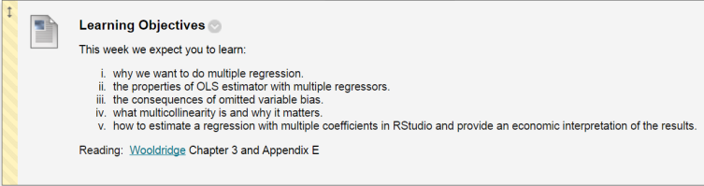
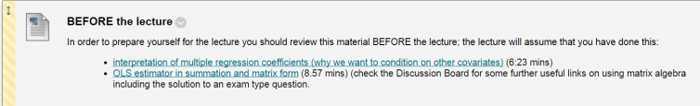

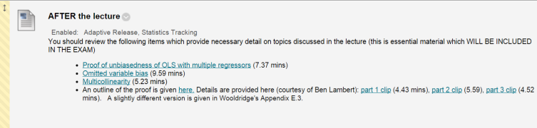
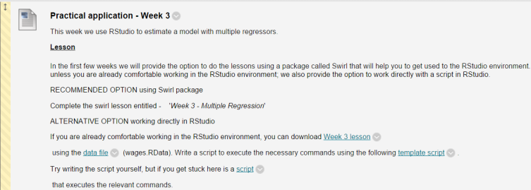
The Learning Journey - an example week

Slide 14
The Learning Journey - an example week

Slide 15
The Learning Journey - an example week

Slide 16
The Learning Journey - an example week

Slide 17
The Learning Journey - an example week

Slide 18
“Outsource” part of the (examinable!!!!) material away from lectures (either before or after)
personally often to online clips, but could be reading or podcasts or other things as well
Very introductory exposition
Long and tedious (but important) arguments
Proofs
This gives more time in lectures for:
More complex/subtle material
Extended Examples
Discussion
Staff/Student and Student/Student interaction (e.g. quizzes)

Slide 19
Reflection Question
What would happen to students in a Year 1 (age 5) classroom if you dropped a disruptive student in that classroom. In your mind compare these students to a group of students that is similar in all other respects.
When you think about the consequences, think about the long-run, 4-8 years hence, consequences.

Slide 20
Long-run educational outcomes of students who had a disruptive student in their midst in year 1, compared to their peers,
Improve
Don’t change
Worsen

Slide 21
Turn to one of your neighbours (ideally someone who answered differently) and try to convince that student of your opinion.

Slide 22
Long-run educational outcomes of students who had a disruptive student in their midst in year 1, compared to their peers,
Improve
Don’t change
Worsen

Slide 24
Source:
Jan Bietenbeck (2015)
http://papers.ssrn.com/sol3/papers.cfm?abstract_id=2684279

Slide 25

Student behaviour

Slide 26
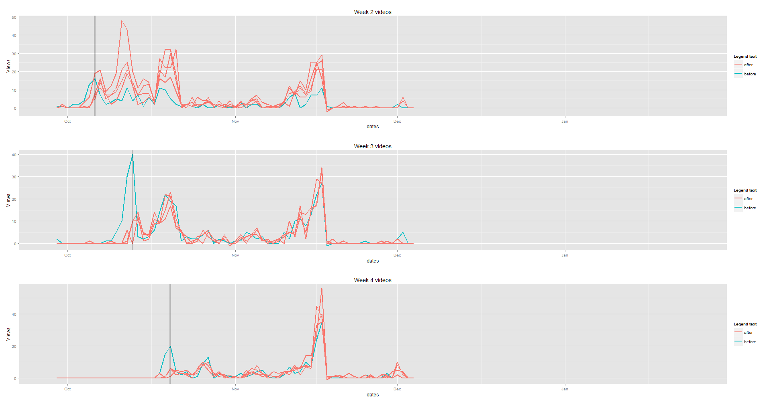
Student behaviour

Slide 27
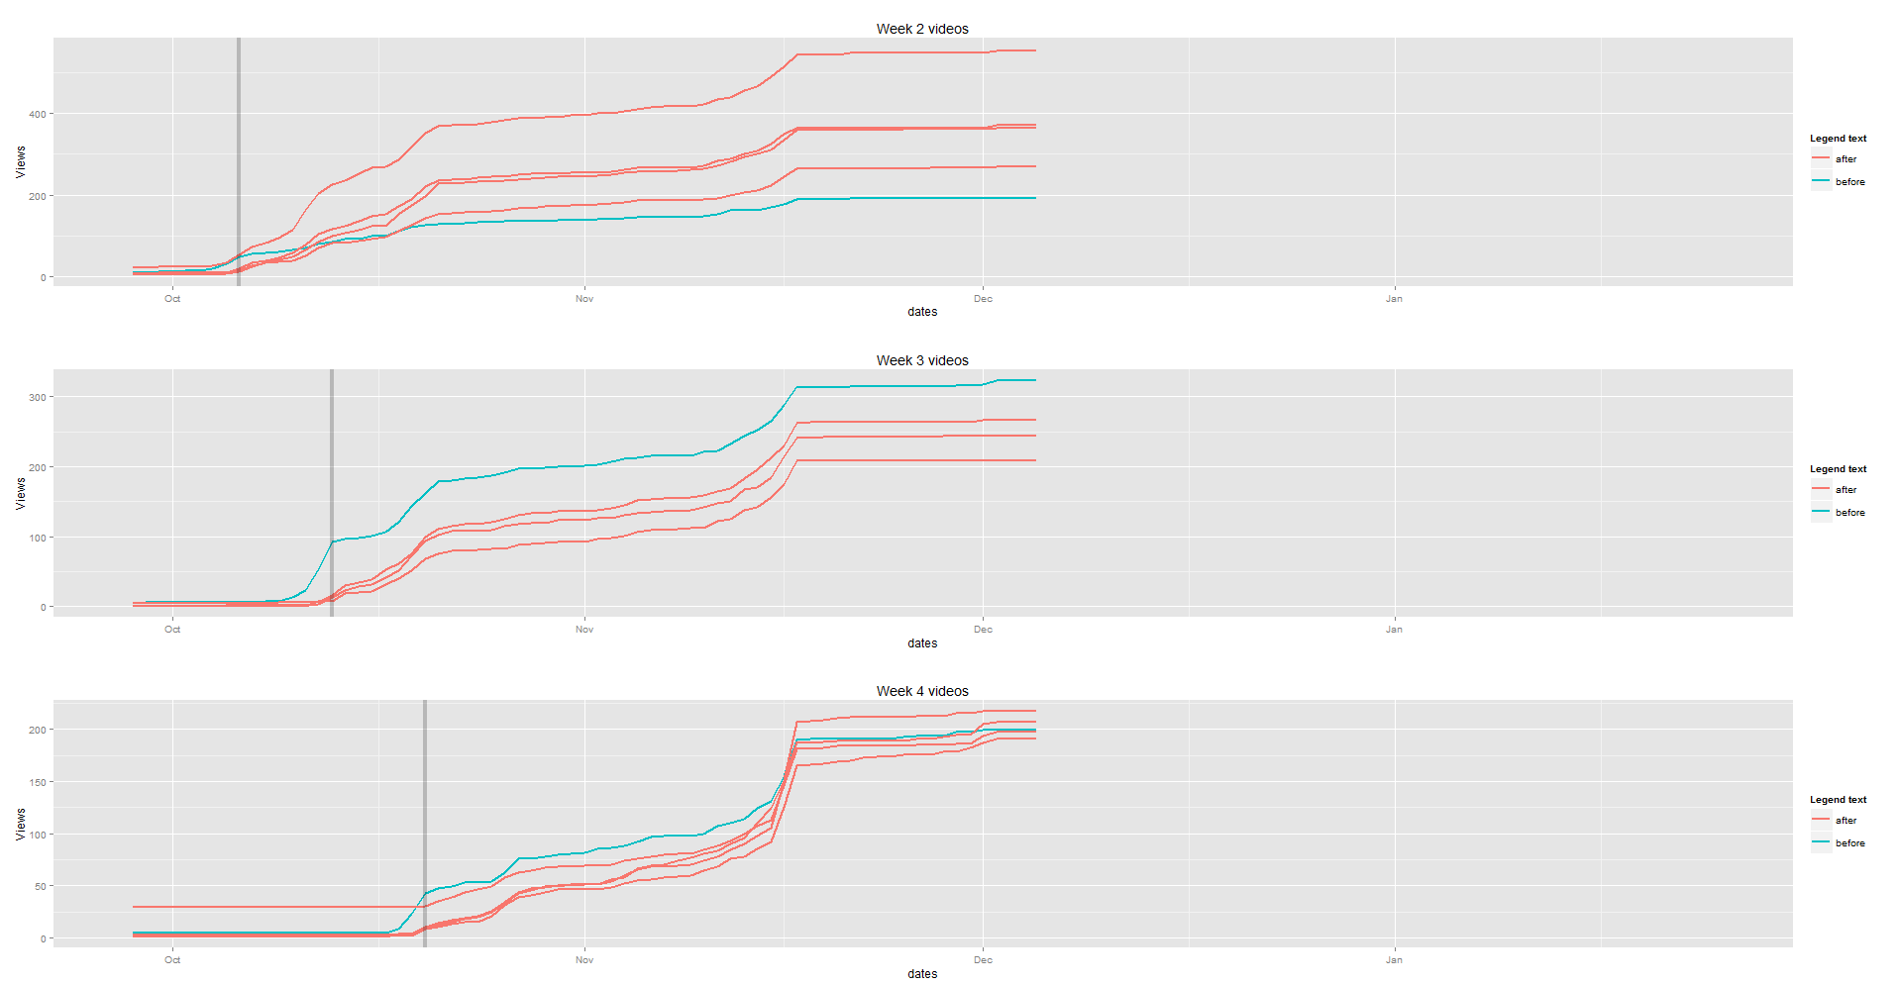
Student behaviour

Slide 28
Your role in influencing Student behaviour

Slide 29
Who has the primary responsibility for teaching students the right study behaviours? Which statement best represents your view?
This is the student’s own responsibility
Students should come well prepared from High School
Study skills should be taught in the first year at University
Each course unit should teach their own relevant study skills

Slide 30
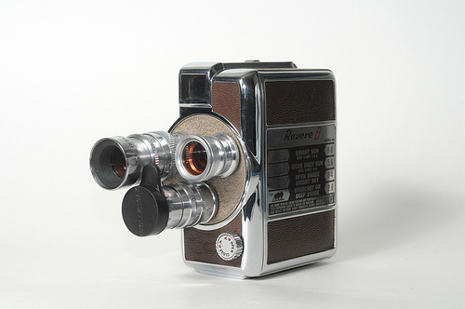
Online Clips

Slide 31
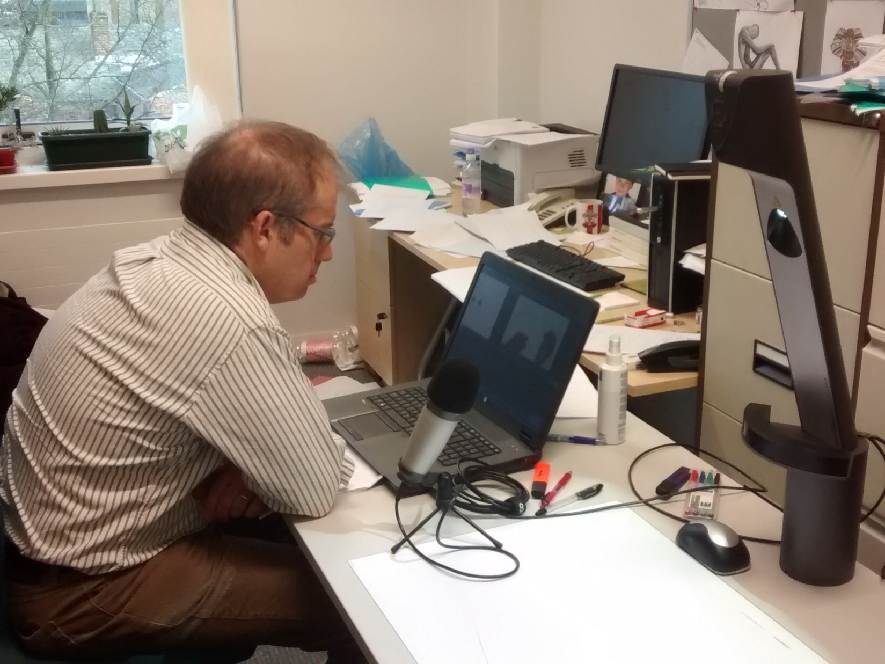

Slide 32
How I use Online Clips
To move complex lecture material out of the lecture theatre
To ask students to prepare for lectures
Also for
Flipping tutorial classes
Work through some worked examples (e.g. past exam paper question)

Slide 33
Complex Lecture Material

Slide 34


Slide 35
Additional lesson from MOOCs:
Produce shortish clips
Finish with short question to allow students to test understanding

Slide 36
Some final thoughts on large group teaching
Check out your lecture theatre
Embrace your nerves
Start your lecture with an overview
End your lecture with an overview
Use interactivity (lecturer – student or student – student) when this makes sense
Make sure students know what else they need to do
Ensure that lectures aren’t the only place where you communicate with students

Slide 37
Enjoy …
… and look like you do!

Slide 38
Further thoughts
Enrol in a MOOC
Question why you are doing things
Links to more detailed presentations on:
What is Class contact for?
Making quant tutorials work! DOs and DON'Ts of classroom inversion
Example clips:
Ralf Becker on YouTube
Khan Academy

