Slide 1

Designing Economics Modules and Programmes
Edmund Cannon
(University of Bristol)
and
Guglielmo Volpe
(Queen Mary University of London)
www.economicsnetwork.ac.uk

Slide 2

Designing modules or programmes
Programmes = Degrees
Strategic choice of department
Typically you have to fit within the dept’s decision
Modules = Units
Optional or compulsory?
You may inherit a unit or design one from scratch
www.economicsnetwork.ac.uk

Slide 3
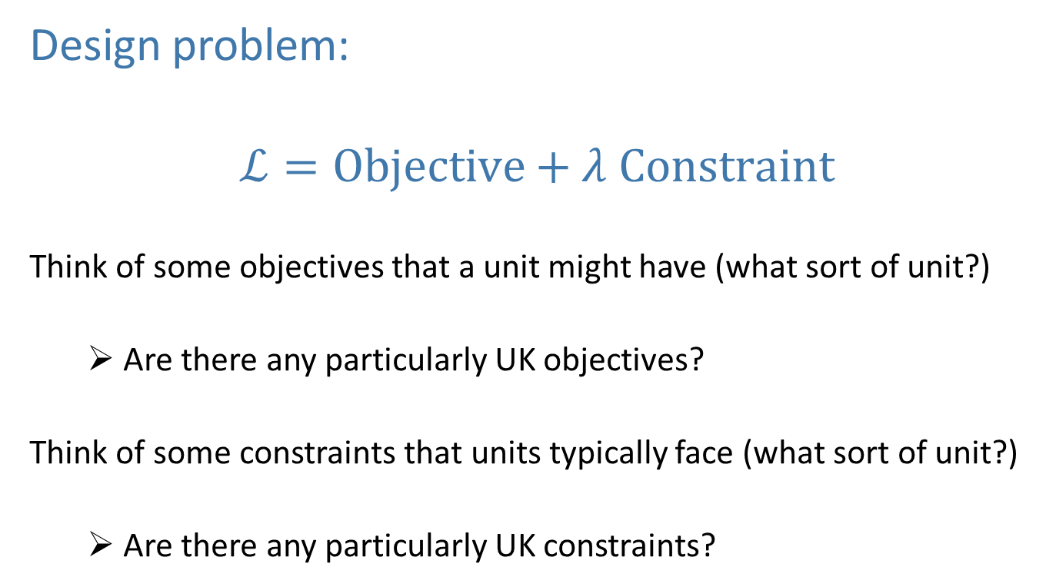
Designing units
Design problem:
$$ℒ=Objective+λ Constraint$$
Think of some objectives that a unit might have (what sort of unit?)
Are there any particularly UK objectives?
Think of some constraints that units typically face (what sort of unit?)
Are there any particularly UK constraints?
www.economicsnetwork.ac.uk

Slide 4
Unit/module objectives
www.economicsnetwork.ac.uk

Slide 5
Unit/module objectives
www.economicsnetwork.ac.uk

Slide 6
Unit/module constraints
www.economicsnetwork.ac.uk

Slide 7
Unit/module constraints
www.economicsnetwork.ac.uk

Slide 8
Recognising constraints on the design of modules or programmes
External constraints
The Quality Assurance Agency
The Competition and Markets Authority
The market
External examiners
Institutional (university) constraints
Corporate themes
Resources
Departmental constraints
Fitting within degree / programme
Student ability
Resources
www.economicsnetwork.ac.uk

Slide 9
Designing Modules
from
Module Specification (the law!)
Learning outcomes
Content
Skills
Attributes
Broad syllabus
Teaching methods
Assessment strategy
Constructive alignment
Audience
Entry requirements/Pre-requisites
Teaching methods: passive versus interactive
Contact time
Teaching technologies
VLE materials
Methods of formative and summative assessment
Weightings of summative assessments
Timing of assessments
Documentation required
Transferable skills
Beyond the first year
to
Module design and handbook
www.economicsnetwork.ac.uk

Slide 10
Backward planning
What are the aims and objectives of the unit?
What are the intended learning outcomes (ILOs)?
How to assess the ILOs?
How will the students learn the ILOs?
How do the tutors (and other resources) facilitate the learning?
Is it possible to build in evaluation of the effectiveness of the unit?
www.economicsnetwork.ac.uk

Slide 11
Forward planning
What content will be taught?
What skills / ability / knowledge do the students already have?
What resources are available?
How much time (n.b. not resource) is available?
What is the ideal; what is possible?
Don’t just repeat last year!
www.economicsnetwork.ac.uk

Slide 12
Departmental constraints (i) Resources
Students’ ability / time is a (limited) resource
Cognitive load (depth v. breadth)
Assessment load (quantity, type)
Continuous assessment versus one final assessment
Coordination of deadlines with other units
Staff time is a limited resource
Time needed for marking and feedback – possibly most important issue in teaching
www.economicsnetwork.ac.uk

Slide 13
Departmental constraints (ii) Curriculum
Where does this unit fit into the big picture?
Units before, alongside, after
Dept’s aim for its graduates
Issues
Overlap, repetition
Coverage: is there a balanced diet?
Curriculum (CORE or traditional?)
Consistency (notation, nomenclature)
www.economicsnetwork.ac.uk

Slide 14
Designing Programmes
Purpose of programme
Overall learning outcomes
Fitting with existing programmes
Colleagues support
Market research
Demand for programme
Competitor analysis
Making the case for the new programme
Entry requirements
Coordination of modules (and colleagues)
New and existing modules
Pre-requisite structure
Teaching methods
Coordination of assessments
Range of assessments
External examiners
Direct entry students, student exchanges, placements
Structuring the programme
Alignment with programme’s learning outcomes

Slide 15
Designing Modules: The ‘Little Things’
Notify the library of references
Notify the university bookshop of texts
Handouts (every week, first week, never?)
Circulate tutorial/seminar work to tutors in advance
How and when to circulate solutions to tutors/students
Revision classes
Room bookings
Turnitin
Work samples
Office hours
Resources in classrooms
Contacting students
www.economicsnetwork.ac.uk

Slide 16
Unit review
Use university requirements constructively
Checklist
Note mistakes and problems (in writing) as they happen.
How do you know what worked?
Talk to tutors and discuss what worked and what needs change.
Is there a problem with another unit (diplomatic feedback possible?)
www.economicsnetwork.ac.uk

Slide 17
Edmund’s perspective
Staff have a tendency to spend too much time:
Writing lecture slides and material
Thinking about content
Talking to (or at) students
Staff have a tendency to spend too little time:
Thinking about delivery
Listening to students
Thinking how to enable students to work on their own
www.economicsnetwork.ac.uk

