Slide 1
Lectures -
What is Class contact for?
Ralf Becker
The University of Manchester

Slide 2
Big Class Contact - Outline
Context
Current practice
Staff/Student Views
What is the problem
What we should do
  A personal “manifesto”
  Role of online clips
Your own thoughts

Slide 3
Are MOOCS a threat?
I don’t think that MOOCs will replace Brick and Mortar Universities
But caused me to rethink the role of lectures, which they don’t use.
But why not use what they do well ourselves?
We need to use the asset we have (potential of face to face teacher-student and student-student interaction) better

Slide 4
Current Practice
Basically unchanged
Should it change? (Record shop or Bicycle?)
Lecture introduces topics
  Topic motivation
  Technical/Formal things
  Limitations
  Some examples
Students are given additional readings
Followed up-by tutorials
Mostly used as first contact with new material. (Just as textbooks are written with that in mind).

Slide 5
The Lecturer’s View
Why do student’s come to Lectures?
Responses from 36 FT Teaching Staff in Economics, The University of Manchester

Slide 6
The Student’s View
Why do student’s come to Lectures?
Responses from 143 Year 1 and 209 Year 2 Students of Statistics and Econometrics, The University of Manchester

Slide 7
Are these good reasons to have lectures?
Lecturer explains well (yes, but would probably explain well in an online clip as well)
Material not covered in any other way (no, this is really “blackmail” to come to lecture)
Gives week a structure (well, very expensive way to do that)
Test understanding (excellent reason for the small percentage of students who come prepared)
Meet other students (indeed a good reason and good use of peers, but what is the lecturers role?)

Slide 8
The Student’s View
Why do student’s miss Lectures?
Responses from 143 Year 1 and 209 Year 2 Students of Statistics and Econometrics, The University of Manchester

Slide 9
Summary so far
If they attend, then because …
Lecturer explains well,
Students think it is the only way material is accessible, …
But please not before 11am

Slide 10
What’s the problem?
Why are standard lectures sub-optimal?
Speed of delivery (variety of student needs)
Inability to return to delivery (unless lecture capture)
Big logistical effort (timetabling, room requirements, transport)
These can be addressed by online clips / textbooks / online resources. As demonstrated by MOOCS and Khan Academy.

Slide 11
What do we want to achieve with class contact?
The somewhat radical view:
Activities which benefit from teacher-student or student-student contact
Use our comparative advantage. Lecturers are often expert in areas, hence use lecturers for the more subtle points not the delivery of the standard material)
Anything else can be delivered cheaper and more flexibly in other ways (reading, online clips, assessments, tutorials, PASS, etc.)

Slide 12
How to use face to face contact
Small group contact is excellent (e.g. inverted classroom) …. But expensive
Large group contact? What to do?
Certainly not abolish it! (check with Student Union and your Dean!) - For University a cheap way to deliver contact hours
We need to think about what a lecture delivers better than any other vehicle (small group teaching, self-study, online clips, etc.)

Slide 13
My “manifesto”
To convince you that the alternative “material delivery” possibilities allow us to re-evaluate how we deliver material to students and what we can do in lectures
 | Lectures | Reading | Online / Supported Self Study
So far | Main Material delivery vehicle (examples where possible) | Used to supplement Lecture Material (alternative expositions) or for Reading intensive subjects (e.g. Economic History) | Online quizzes
Better ? | Extensive examples / illustrations; Feedback on understanding | Used to supplement Lecture Material (alternative expositions) or for Reading intensive subjects (e.g. Economic History) | Main Material delivery vehicle
1
2
3
2/3
2/3
1

Slide 14
Online Clips
I think that much of what we currently do in Lectures can be better delivered/explained through Online Clips
Online clips are great for
  explaining complicated/formal matters
  allowing students to slow down and speed up
  being available all across the term
  Incorporating software work/demos
  Incorporated MC Questions
But considerable up-front investment
Requires clear understanding by students that online delivery is integral to course and needs to be consumed weekly

Slide 15
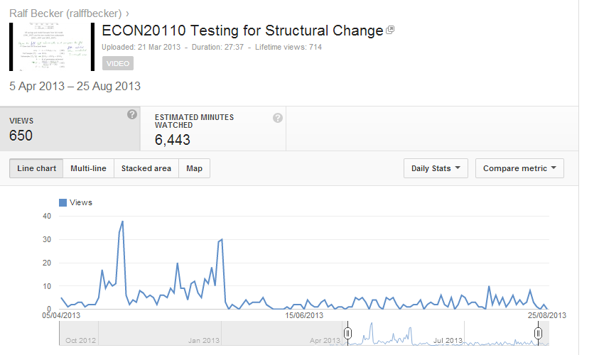
How are online clips used?
Lecture
Exam
Resit-Exam

Slide 16
What to do in lectures?
Very much depends on your course unit and your students
Activities that are interactive
  Perhaps slow walk through example
  Discussion of empirical applications
  Link from theory to reality
  Clicker Sessions
  Classroom experiments
Focus on intuition, not technicalities (if the latter are important part of syllabus think whether online clips may be more useful or if textbooks do a good job)
And more than anything else, BE ENTHUSIASTIC, motivate students to want to learn more

