Slide 1
The UKPSF and the HEA Fellowship scheme
Ros O’Leary

Slide 2
Overview of the HEA Fellowship and the UKPSF
Explore what you might include in your application / your institutional assessment

Slide 3
Overview
Higher Education Academy (HEA)
national body for enhancing learning and teaching in higher education (HE)
UK Professional Standards Framework (UKPSF)
A nationally-recognised framework for benchmarking success within HE teaching and learning (Funding Councils, NUS, Universities UK etc)
Mapped to the HEA Fellowship scheme

Slide 4
HEA Fellowships
4 categories:
Associate Fellow
Fellow
Senior Fellow
Principal Fellow

Slide 5
HEA Fellowship scheme
Uses the UK PSF to recognises HE teaching and learning knowledge and experience
Increasingly is a requirement of employment in HE
Many institutional new lecturer, GTA/preparing to teach programmes accredited to the scheme
This Economics Network training can be used to exempt parts of institutional training/ to support your institutional training
EN workshops endorsed by the RES, SES

Slide 6
UK Professional Standards Framework
Core Knowledge
K1 The subject material
K2 Appropriate methods for teaching and learning in the subject area and at the level of the academic framework
K3 How students learn, both generally and within their subject/disciplinary areas
K4 The use and value of appropriate learning technologies
K5 The implications of quality assurance and quality enhancement for academic and professional practice and a particular focus on teaching
Area of Activity
A1 Designing and planning learning activities and/or frameworks of study
A2 Teach and/or support learning
A3 Assess and give feedback to learners
A4 Develop effective learning environments and approaches to student support and guidance
A5 Engage in CPD
Professional Values
V1 Respect individual learners and diverse learning communities
V2 Promote participation in higher education and equality of opportunity for learners
V3 Use evidence-informed approaches and the outcomes from research, scholarship and CPD
V4 Acknowledge the wider context in which HE operates recognising the implications for professional practice
Notes:
Descriptor 2 – successful engagement/knowledge across all

Slide 7
Associate Fellows
an early-career researcher with some teaching responsibilities (e.g. PhD student, graduate training assistant, contract post-doc)
new to HE teaching, have a limited teaching portfolio or teach part-time

Slide 8
Fellows
an early-career academic
in a subject-specific role with substantive teaching and learning responsibilities
an experienced academic, relatively new to UK HE. You’ll be in a role with sometimes significant, teaching-only responsibilities.

Slide 9
Senior Fellows
You’ll have an established record relating to teaching and learning and management/leadership of specific aspects of teaching provision. You are likely to lead, or be a member of, established academic teams. You may be:
an experienced member of academic staff with significant responsibility for leading, managing or organising programmes for subjects/disciplines
an experienced subject mentor or someone who supports those new to teaching
an experienced member of staff with departmental or wider teaching/learning support advisory responsibilities within your institution

Slide 10
Applications
 | Descriptor 1, HEA Associate Fellow | Descriptor 2, HEA Fellow | Descriptor 3, HEA Senior Fellow
Length | 1,400 words | 3,000 words | 6,000 words
Format | 2 areas of Activity (from the UKPSF, 700 words each ) | All 5 Areas of Activity (from the UKPSF) | Account of professional practice (reflection on experience) 2 case studies focusing on particular areas of experience, at least one focusing on impact beyond own teaching (all UKPSF dimensions, including areas of activity demonstrated)
Focus of narrative | Own practice | Own practice | Impact on own, and other colleagues’ practice across teams, department and/or institution

Slide 11
What is reflection?
Reflection on your practice involves the process of deeply thinking about your actions, experiences, feelings and values. It also involves critically analysing this thinking in order to learn and plan changes to your practice.
Typically we do this by asking ourselves the following questions:
What did I do?
How did I do it?
So what? (what have we learnt)
What changes/improvements can I make?
Notes:
Reflecting upon your teaching, and acting upon this reflection is a key principle of the PGCAP.

Slide 12
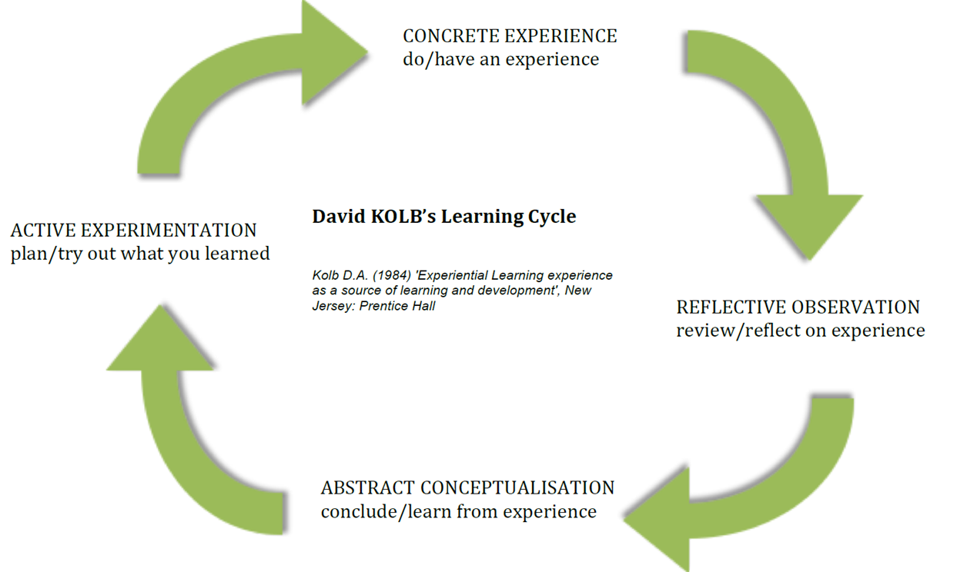

Slide 13
CPD
Associate Fellow: Successful engagement, where appropriate, in professional development activity related to teaching, learning and assessment responsibilities
Fellow: Successful engagement in continuing professional development in relation to teaching, learning, assessment and, where appropriate, related professional practices
Senior Fellow: Successful engagement in continuing professional development in relation to teaching, learning, assessment, scholarship and, as appropriate, related academic or professional practices.

Slide 14
Pedagogic Research
Associate Fellow: Relevant professional practices, subject and pedagogic research and/or scholarship within the above activities
Fellow: Successful incorporation of subject and pedagogic research and/ or scholarship within the above activities, as part of an integrated approach to academic practice
Senior Fellow: Successful incorporation of subject and pedagogic research and/or scholarship within the above activities, as part of an integrated approach to academic practice.

Slide 15
Scholarship of T&L
Engagement with the scholarly contributions of others on teaching and learning.
Reflection on one's own teaching practice and the learning of students within the context of a particular discipline.
Communication and dissemination of aspects of practice and theoretical ideas about teaching and learning in general and teaching and learning within the discipline.
Martin, E., Benjamin, J., Prosser, M., and Trigwell, K. (1999). 'Scholarship of Teaching: A Study of the Approaches of Academic Staff'. pps. 326-331 in Improving Student Learning: Improving Student Learning Outcomes. C. Rust (ed.). Oxford

Slide 16
Key resources
HEA Fellowship site:
https://www.heacademy.ac.uk/professional-recognition/hea-fellowships
The Handbook for Economics Lecturers
http://www.economicsnetwork.ac.uk/handbook/
International Review of Economics Education
http://www.economicsnetwork.ac.uk/iree
Ideas Bank
http://www.economicsnetwork.ac.uk/showcase

Slide 17


Slide 18


Generating ideas
Using the UK PSF:
Think about some likely examples/case studies where you can demonstrate your engagement with the areas of activity

Slide 19
Key resources
HEA Fellowship site:
https://www.heacademy.ac.uk/professional-recognition/hea-fellowships
The Handbook for Economics Lecturers
http://www.economicsnetwork.ac.uk/handbook/
International Review of Economics Education
http://www.economicsnetwork.ac.uk/iree
Ideas Bank
http://www.economicsnetwork.ac.uk/showcase
Developments in Economics Education 2015
http://www.economicsnetwork.ac.uk/dee2015

