Slide 1
Large Group Teaching
Alvin Birdi and Michael Reynolds
Economics Network
Universities of Bristol and Leeds

Slide 2
https://www.youtube.com/watch?v=kBdfcR-8hEY

Slide 3
This is the first lecture. After how many minutes does Sandel begin interacting with the audience?
5 minutes
20 minutes
1 minute
Trick question – not at all

Slide 4
How many slides does Sandel use in the first 24 minutes?
Rank | Responses
1 | 6
2
3
4
5
6 | Other

Slide 5
Sandel’s lecture
Pacing
Structure
Gesture
Interaction
Visual aids

Slide 6
“My lecture was a complete success, but the audience was a failure” – Anon
“Some people talk in their sleep. Lecturers talk while other people sleep” – Albert Camus

Slide 7
“When I give a lecture, I accept that people look at their watches…
…but what I do not tolerate is when they raise it to their ear to see if it has stopped
– Marcel Archard

Slide 9
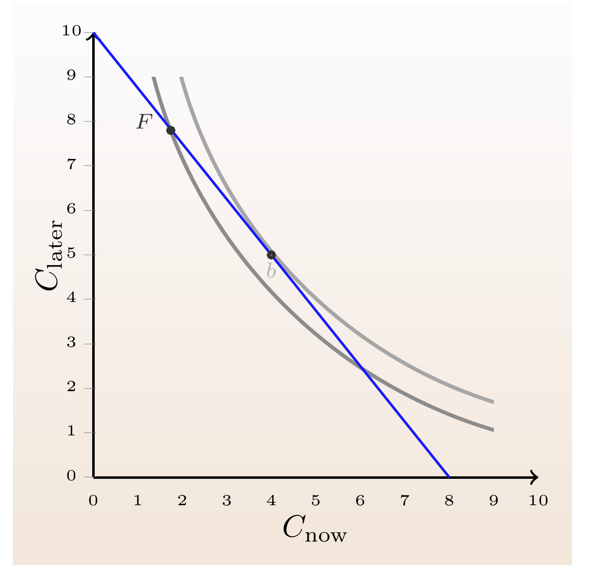

Slide 10


Slide 11
Attention and Memory
Attention – sensory signals -short term memory 5-9 items, 20 seconds on average
Needs conceptual development (coding) to pass into long-term memory
Correlative urges.
The Spacing effect.
Ruhl, Hughes, Schloss (1987) find pauses increase retention (three two-minute breaks).
Hartley and Davis (1978) 70% information from first 10 mins and 20% from last 10 mins.

Slide 12
Whirlwind tour of theory
Behaviourism – techniques, processes. (Skinner, Pavlov). “Cut into bits and feed”
Note ILOs and competency models based on this.
Constructivism – Piaget. “Learner-centered”. Emphasises continuity between from lay and disciplinary knowledge.
Social constructivism – Vygotsky, Bruner
Carl Rogers (1983) – “facilitator”

Slide 13
(Dr. Ramnarayan Manipal University)
The Lecture
Uninterrupted, rambling exposition of apparently irrelevant trivial information delivered in a sleep-inducing monotone for one hour.

Slide 14
Lecturers
Obfuscator
Regurgitator
Facilitator
(Dr Ramnarayan)

Slide 15
Causes of Lecturalgia
Lecture objectives unclear
Disorganised
Too much information
Lack of engagement with audience
(Dr Ramnarayan)

Slide 16
Lecturing
“The core purpose of a great lecturer is not primarily to transmit information.”
Richard Gunderman (The Atlantic Jan 2013)

Slide 17
“To this end, other techniques, such as assigning a reading in a textbook or distributing an electronic copy of the notes, can be equally effective. The real purpose of a lecture is to show the mind and heart of the lecturer at work, and to engage the minds and hearts of learners.”

Slide 18


Slide 19
Inspire
Influence
Inform

Slide 20
“What I don’t cover in the lecture will be covered in the exam”

Slide 21
Questions?

Slide 22
References
Astin, A. (1993). What matters in college: Four critical years revisited. Josey-Bass.
Barnett, R.(1990). The Idea of a University. Open University Press.
Biggs, J (1987) Student Approaches to Learning and Studying. Hawthorn, Vic: Australian Council for Educational Research.
Bonwell, C. and J. Eison (1991). “Active learning: creating excitement in the classroom”. ASHEERIC Higher Education Report No. 1. George Washington University.
Entwistle, N (1981) Styles of Learning and Teaching; an integrated outline of educational psychology for students, teachers and lecturers. Chichester: John Wiley.
Entwistle, N. (2009). Teaching for Understanding at University. Palgrave.
Entwistle N.and Ramsden, P. (1983). Understanding Student Learning. London: Croom-Helm.
Ford, M. (2010). “Critique in Academic Disciplines and Active Learning of Academic Content”. Cambridge Journal of Education 40:3 pp.265-20.8
Marton, F. and Säljö, R. (1976) "On Qualitative Differences in Learning — 1: Outcome and Process". British Journal of Educational Psychology 46: 4-11.
Marton, F. and Säljö, R. (1976) "On Qualitative Differences in Learning — 2: Outcome as a function of the learner's conception of the task". British Journal of Educational Psychology. 46: 115-27.
Mayer, R (2004). “Should there be a three strikes rule against pure discovery learning?” American Psychologist, 59:1 pp.14-19.
Prince, M (2004). “Does Active Learning Work? A Review of the Research”. Journal of Engineering Education 93(3) 223-231.
Rogers, C. (1983). Freedom to Learn for the 80s.
Ruhl, K., C. Hughes and P. Schloss (1987). “Using the pause procedure to enhance lecture recall”. Teacher Education and Special Education 10 pp. 14-18.

