Slide 1







Update as of March 2015 www.core-econ.org
Since September 2014, 10,000 registrations for CORE
Pilots in the classroom (for economics majors, non-specialists, social science / liberal arts, master of public policy; with and without calculus)
UCL, Bristol, Southampton
Sciences Po (in French translation)
University of Siena (in Italian translation)
University of Chile, Universidad de los Andes (in Spanish translation)
UMass Boston, Dartmouth College
Masters in Public Policy: SIPA Columbia University; CEU Budapest
University of Sydney
University of Cape Town
Azim Premji University, Bangalore (in English; Hindi translation in progress)
Forward planning includes:
KCL, Warwick, Birkbeck
Toulouse School of Economics (implementing from autumn 2016)
New Economics Teaching workshops introducing CORE & other innovations
University of Chile, November 2014
Lahore University Management School, December 2015 (in collaboration with the IEA)
Economics Network from late 2015
Major funders:
Support from:

Slide 2
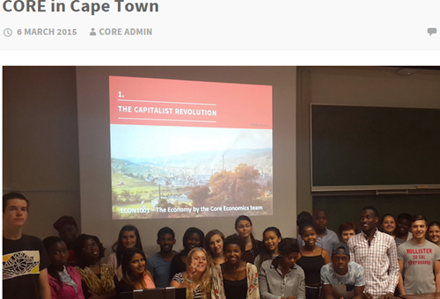

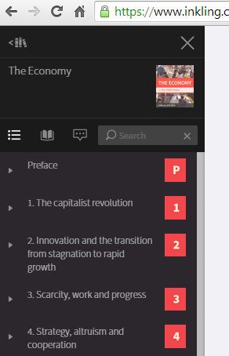


CORE production process
25+ academics participated in writing the 21 units
Review:
students
teacher-users
subject experts (e.g. Stern, Schor on U18; Blanchard on U14; Lane on U16, Crafts, Temin on U2, U17)
potential users – anonymous via EN (also last June)
workshops (as in Santiago in November)
Revision of ebook – beta autumn 2015; The Economy 1.0 autumn 2016
Ancillary materials – ‘how to teach’ guides, slides, MCQs, problems, games, simulations
‘How to teach’ workshops in collaboration with EN

Slide 3
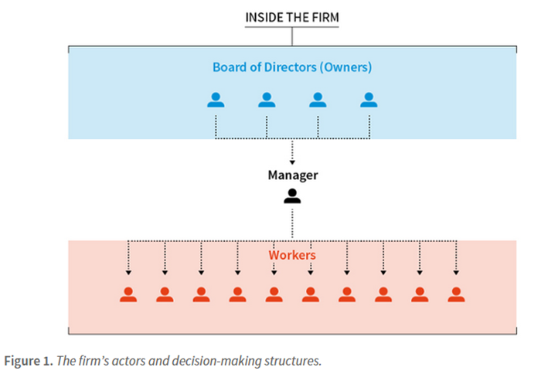
Complementarity between new topics & new tools
We cannot introduce new topics – innovation & wealth creation, instability, inequality, environmental sustainability – without teaching new tools
Tools new to Intro – incomplete contracts, innovation rents, beliefs affect prices, non-self-regarding preferences – make it possible to teach the new topics
Avoids the appearance from nowhere of ‘information problems’, or ‘credit crisis’ at the end of the book or in a box
Avoids a raft of ad hoc assumptions when macro topics are introduced – ‘sticky this’ or ‘sticky that’
How to do it?
Motivate all concepts with empirical evidence
Teach strategic interaction before price-taking
Teach the firm as a social organization before the market
Teach firms setting wages and prices before competitive markets

Slide 4
Complementarity between new topics & new tools
Knowing why labour and credit contracts are inherently incomplete, students
never think of the labour and credit markets as the same as the market for shirts and
are soon using these labour and credit markets in their micro-macro modelling to understand instability and inequality as well as unemployment
New tools – say game theory or information economics – and new topics – say the financial crisis or climate economics – are not a set of disconnected ‘extras’ that the lecturer might get to if there is time
The new topics and tools are not more difficult;
they are not taught because they ‘came later’

Slide 5
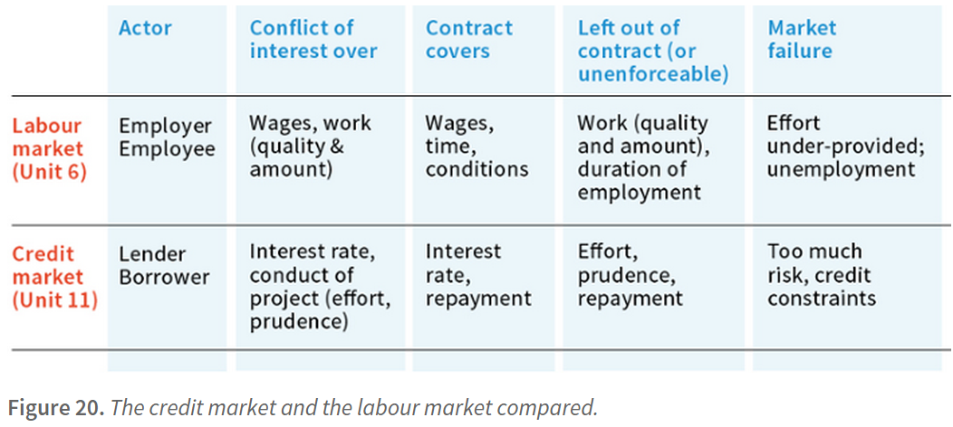
… and between micro and macro
Repeated use of this ‘new micro’ toolkit in macro topics – students acquire the habit of iterating between micro & macro

Slide 6
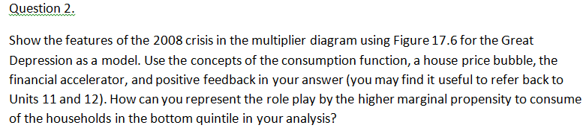
This week’s assignment in UCL ECON 1001
Apply the tools to 100 years of economic history from the Great Depression to the financial crisis …

Slide 7

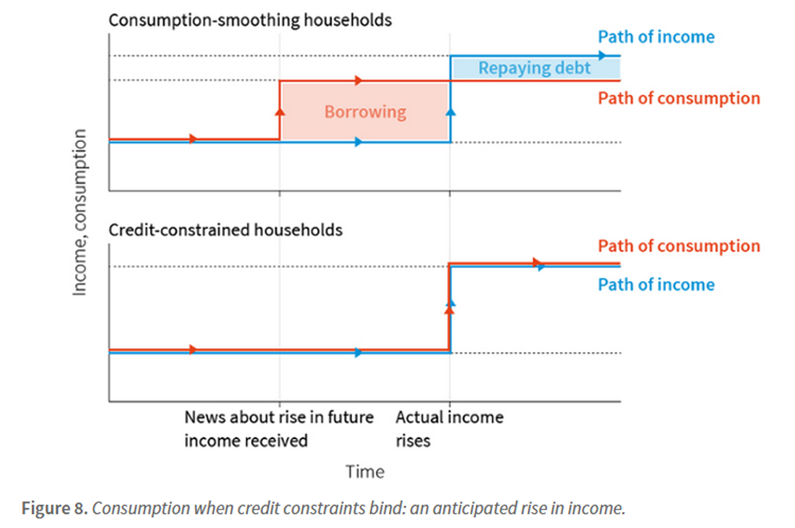
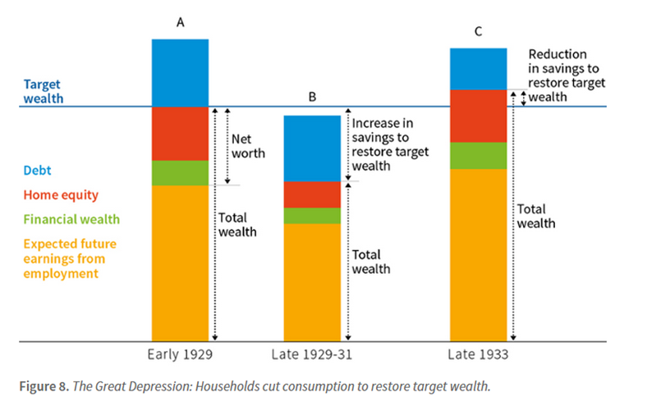

The foundations: forward-looking behaviour
is combined with household balance sheets … to analyze the Great Depression
Early 1929 Late 29-31 Late 1933

Slide 8
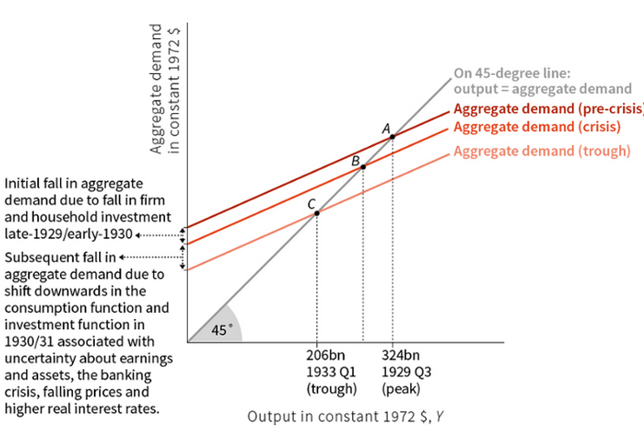
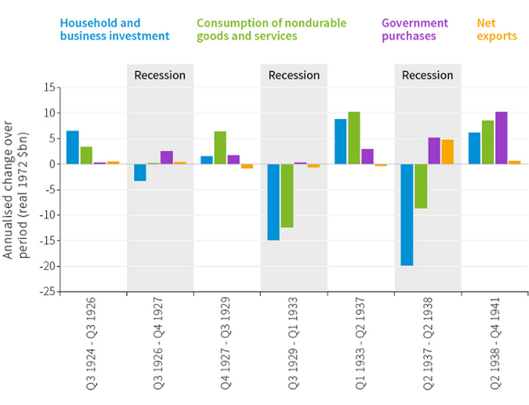
… and linked to the macro model and data
Great Depression

Slide 9
Figure 24. The financial crisis: Housing boom, household debt and house price crash
B
Debt
A
Increase
in target
wealth
C
Debt
Target
wealth
Debt
Home equity
Increase in savings to restore target wealth
Home equity
Net
worth
Financial wealth
Financial wealth
Expected future earnings from employment
Total
wealth
Expected future earnings from employment
Home equity
Total
wealth
Expected future earnings from employment
Total
wealth
1980s
1990s-2006
2008-09

Slide 10
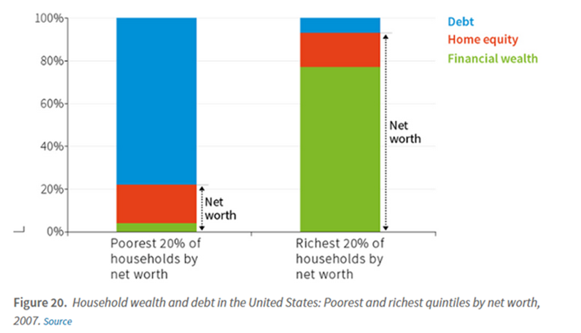
This week’s assignment in UCL ECON 1001
Figure 17.20
Household wealth and debt in the US: poorest and richest quintiles by net worth, 2007

Slide 11
Challenges
What we have learnt (from the pilots):
students like it!
initial student expectations – ‘is this economics?’ ‘why the stories?’ ‘why the history?’
student behaviour – adjusting design of lectures to the fact that they read the unit before the lecture
teachers know/use the models but we need practice at teaching them to Intro students
the lectures have a key role to play in creating the links / highlighting the repeated use of the same tools
games in class (250+ students), clickers work very well with this course
using MCQs in class (clickers), in weekly quizzes, in exams is possible with this material but we need to build a bigger question bank
Coordination with other Year 1 courses
at UCL, Malcolm Pemberton & Nick Rau have written the Leibniz maths supplements for CORE
working to achieve closer integration with the maths for economics courses, the stats and the applied courses

Slide 12
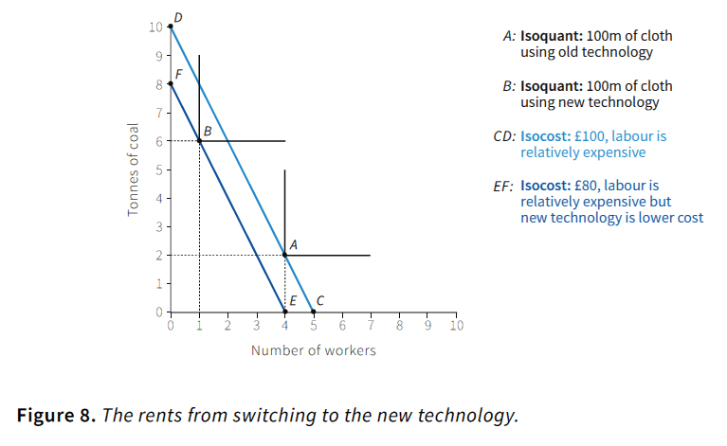
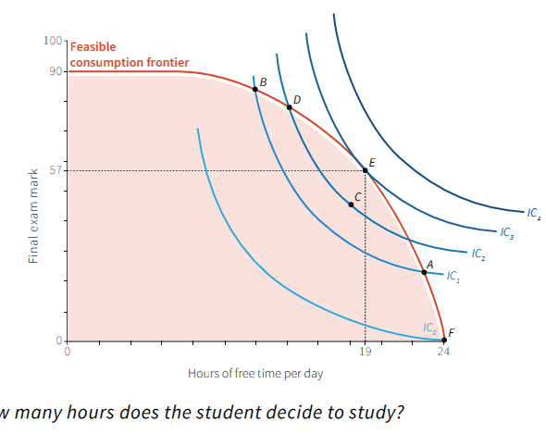
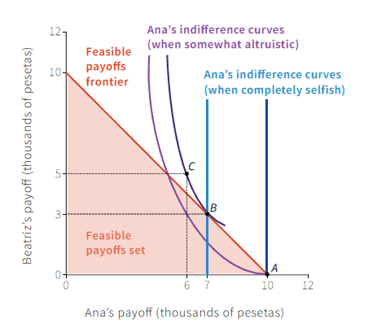
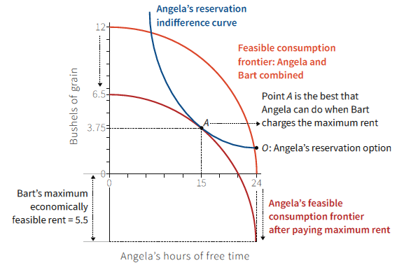
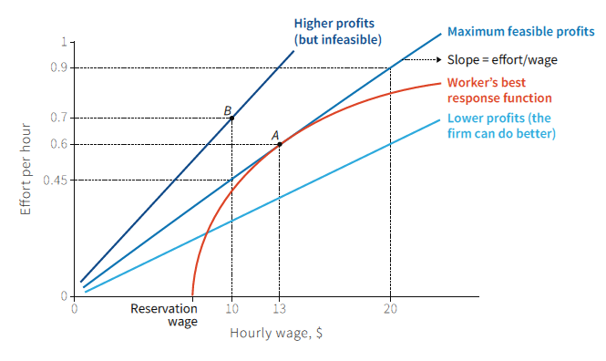
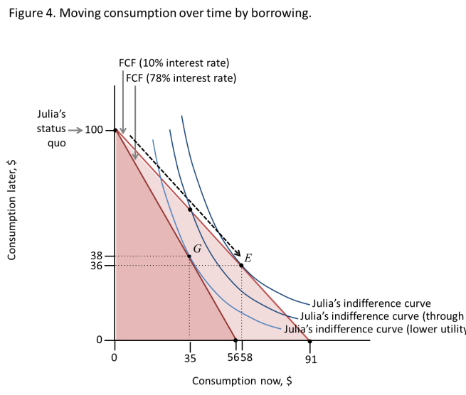
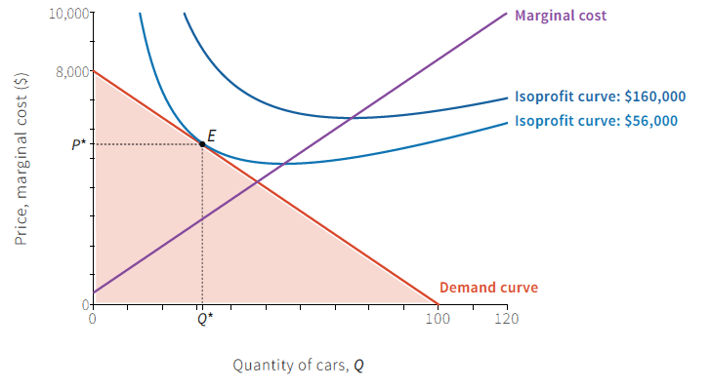
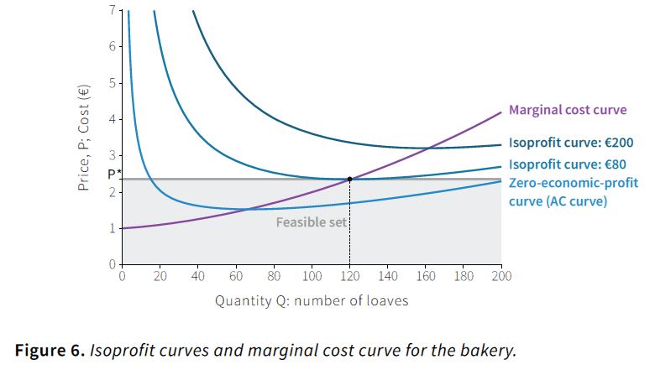
Lecturer shows connections
Feasible set, opportunity cost, trade-offs to model
Schumpeterian innovation
Power & institutions
Altruistic preferences
Wage and price setting firms
Borrowing, lending & wealth
Macro policy maker
…

Slide 13
Challenges
Implications for the rest of the core – the intermediate courses
students will demand more empirical relevance and policy applications in their more advanced courses
at UCL, micro (Martin Cripps, Ian Preston) foresee no problems in adapting their courses – use more case studies
at UCL, macro – allows us to modernize the intermediate course to integrate the financial system – students will be better prepared on entry to second year
some teachers of third year applied options have noted they will need to adjust as the new cohort arrives (some have used some CORE material in courses this year)

Slide 14
Production process
25+ academics participated in writing the 21 units
JOIN US
pilots
reviews
workshops
funding
Review:
students
teacher-users
subject experts (e.g. Stern, Schor on U18; Blanchard on U14; Lane on U16, Crafts, Temin on U2, U17)
potential users – anonymous via EN (also last June)
workshops (as in Santiago in November)
Revision of ebook – beta autumn 2015; The Economy 1.0 autumn 2016
Ancillary materials – ‘how to teach’ guides, slides, MCQs, problems, games, simulations
‘How to teach’ workshops in collaboration with Economics Network

