Slide 1
Assessment and Feedback

Slide 2
Types of assessment
Two main types
  Assessment of learning (summative)
  Assessment for learning (formative)

Slide 3
Why assess?
Reasons to assess include:
  Provide evidence that students have met the learning outcomes
  Validate standard of performance
  Monitor and feedback on progress
  Identify those needing support
  Feedback into teaching

Slide 4
NSS assessment & feedback questions
8. The criteria used in marking have been clear in advance
9. Marking and assessment has been fair
10. Feedback on my work has been timely
11. I have received helpful comments on my work

Slide 5

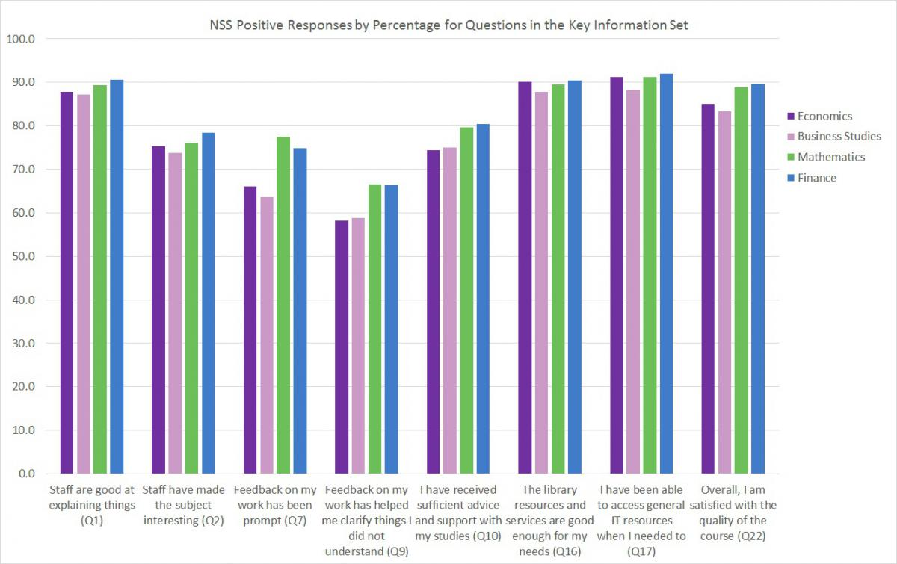
National Student Survey

Slide 6
Feedback
“There was no communication, for example if we had written an essay, it would be good [to have] just one sentence and maybe a small explanation on why you got the mark plus one sentence on how you could improve it.”
  Economics Network Student Survey 2012

Slide 7
Some more feedback comments
“Because of the office hour system, I have been able to get almost unlimited feedback on my work. Legendary lecturers such as ??? will give all the time we want on reading work we have done, and giving detailed feedback, as well as long discussions of the material at our convenience.”
“[…] feedback on these has been very poor and gives almost no feedback on how to improve.”
(NSS feedback)

Slide 8
Do you?
Formatively assess students
Give feedback individually
Give feedback to the whole student group
Use peer assessment
Use self assessment

Slide 9
Before they start
Increase students’ understanding of feedback and manage expectations
  Discuss what feedback is with students, and how and when they get it
  Be clear about criteria (ensure students have and understand their assessment criteria)
  Provide feedback comments from previous cohorts before the assignment is due
  Ask class to provide feedback on an (anonymous) sample of work previous cohorts and make time to discuss this

Slide 10
Exercise – Marking-up
Adam Ozanne example (go to 10:30min)

Slide 11
Submission
Involve students in dialogue
For student completion | For staff completition
These are the areas of my work that I think are good, for the following reasons:
Please comment on the following areas of my work:
I want to improve on this next time:
The mark I think this deserves is:

Slide 12
Giving Feedback
Don’t just add adjectives: “good”, “imprecise”
Be constructive: “To get a higher grade you should have …”
Be polite but honest!
Consider giving fast group feedback after marking a sample. “Most students missed to discuss …”
Be as fast as you can (Department deadlines?)

Slide 13
After
Seek feedback on your feedback
  Do you schedule time to discuss feedback?
  Ask students to identify examples of feedback comments they found useful and that might help in future tasks

Slide 14
Useful links
Phil Race’s compendium on writings on assessment
http://phil-race.co.uk/most-popular-downloads/
Re-Engineering Assessment Practices http://www.reap.ac.uk/reap/nss/index.html
Economics Network themed assessment page http://www.economicsnetwork.ac.uk/themes/assessment
Economics Network Assessment Question Bank http://www.economicsnetwork.ac.uk/qnbank/

