Slide 1
Assessment and Feedback

Slide 2
Types of assessment
Two main types
  Assessment of learning (summative)
  Assessment for learning (formative)

Slide 3
Why assess?
Reasons to assess include:
  Provide evidence that students have met the learning outcomes
  Validate standard of performance
  Monitor and feedback on progress
  Identify those needing support
  Feedback into teaching

Slide 4
NSS assessment & feedback questions
“The criteria used in marking have been made clear in advance”
“Assessment arrangements and marking have been fair”
“Feedback on my work has been prompt”
“I have received detailed comments on my work”
“Feedback on my work has helped me clarify things I did not understand”

Slide 5

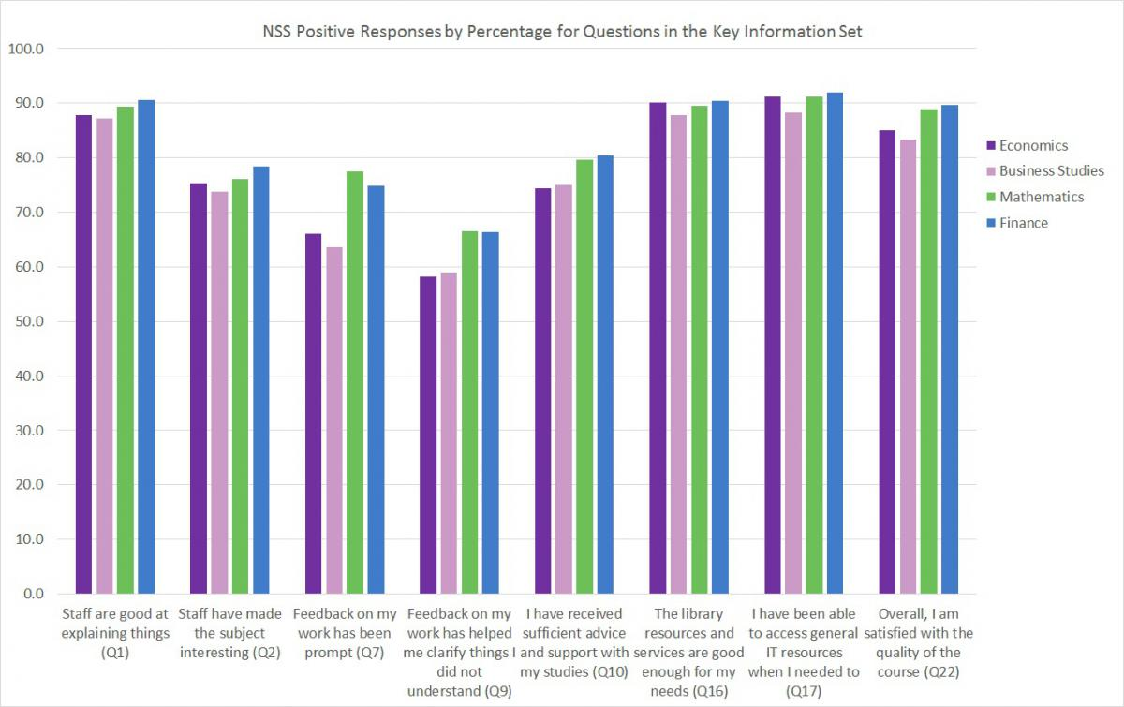
National Student Survey

Slide 6
Feedback
“There was no communication, for example if we had written an essay, it would be good [to have] just one sentence and maybe a small explanation on why you got the mark plus one sentence on how you could improve it.”
  Economics Network Student Survey 2012

Slide 7
Some more feedback comments
“Because of the office hour system, I have been able to get almost unlimited feedback on my work. Legendary lecturers such as ??? will give all the time we want on reading work we have done, and giving detailed feedback, as well as long discussions of the material at our convenience.”
“[…] feedback on these has been very poor and gives almost no feedback on how to improve.”
(NSS feedback)

Slide 8
Do you?
Formatively assess students
Give feedback individually
Give feedback to the whole student group
Use peer assessment
Use self assessment

Slide 9
Before they start
Increase students’ understanding of feedback
  Discuss what feedback is with students, and how and when they get it
  Be clear about criteria
  Provide feedback comments from previous cohorts before the assignment is due
  Ask class to provide feedback on an (anonymous) sample of work previous cohorts and make time to discuss this

Slide 10
Essays – Feedback Sheets
Show example of feedback sheet

Slide 11
Exercise – Marking-up
Adam Ozanne example

Slide 12
Submission
Involve students in dialogue
For student completion | For staff completition
These are the areas of my work that I think are good, for the following reasons:
Please comment on the following areas of my work:
I want to improve on this next time:
The mark I think this deserves is:

Slide 13
After
Seek feedback on your feedback
  Do you schedule time to discuss feedback?
  Ask students to identify examples of feedback comments they found useful and that might help in future tasks

Slide 14
Feedback for yourself!
“Tutor could be better qualified. Sometimes got stuff wrong!”
“The tutorials - relate the questions more to the test questions so that we would be better prepared for the tests”
“I felt that the tutorial questions often are very different to test questions.”
“The seminars were dire and I don't feel they benefited my learning at all and at some point even just lead to more confusion over the subject.”
“longer seminars, we normally don't have time to do all the work in the seminars”
“the class teacher does not cover all questions during the class! Classes should last longer!”
“I do not see the point in coming to the class: the teacher just goes through the solutions with no value added.”
“More assistance with essay writing techniques and skills in answering exam questions.”
“I can just go through the solutions what is the point of just writing down some mathematical equations/solutions with no explanation of its meaning!?”
“Tutorials can sometimes feel like we haven't progressed anywhere, maybe give them more structure” “In my opinion tutorials should not be only about tutorial questions provided by lecturer. Tutorial preparations were not really demanding.”
www.economicsnetwork.ac.uk

Slide 15
Your Feedback to Lecturer
“My students don’t prepare the material before class, which means my whole seminar plan does not work out anymore.”
“My students don’t hand in their
coursework.”
“I have to give too much written feedback”
“The course organiser does not give
me any guidance on what to teach”
“The course organiser does not give
me any guidance on what to teach”
“The course organiser gives me material of quality or no answer guides”
“My students don’t engage in the class. I ask a question and nobody wants to answer.”

Slide 16
Useful links
Phil Race’s compendium on writings on assessment
http://phil-race.co.uk/most-popular-downloads/
Re-Engineering Assessment Practices http://www.reap.ac.uk/reap/nss/index.html
Economics Network themed assessment page http://www.economicsnetwork.ac.uk/themes/assessment
Economics Network Assessment Question Bank http://www.economicsnetwork.ac.uk/qnbank/

