Slide 1
Assessment and Feedback

Slide 2
Types of assessment
Two main types
  Assessment of learning (summative)
  Assessment for learning (formative)

Slide 3
Why assess?
Reasons to assess include:
  Provide evidence that students have met the learning outcomes
  Validate standard of performance
  Monitor and feedback on progress
  Identify those needing support
  Feedback into teaching

Slide 4
Marking approaches
Criterion referenced marking – marks specifically linked to assessment criteria
Norm referenced marking – compared to other students in the cohort
Positive marking – give credit for ‘right’ answers and/or well argued points
Negative marking – subtract marks for ‘wrong’ answers and/or poor arguments

Slide 5
On-line v manual marking
On-line
Formative assessments
Multiple choice tests
Essays via Turnitin
Open book examinations
Benefits
Automated marking
‘Cut and paste’ comments
Manual
Tutorial/seminar papers
Essays
Closed book examinations
Benefits
More personalised feedback
Ensuring it is the student’s own work

Slide 6
NSS assessment & feedback questions
“The criteria used in marking have been made clear in advance”
“Assessment arrangements and marking have been fair”
“Feedback on my work has been prompt”
“I have received detailed comments on my work”
“Feedback on my work has helped me clarify things I did not understand”

Slide 7

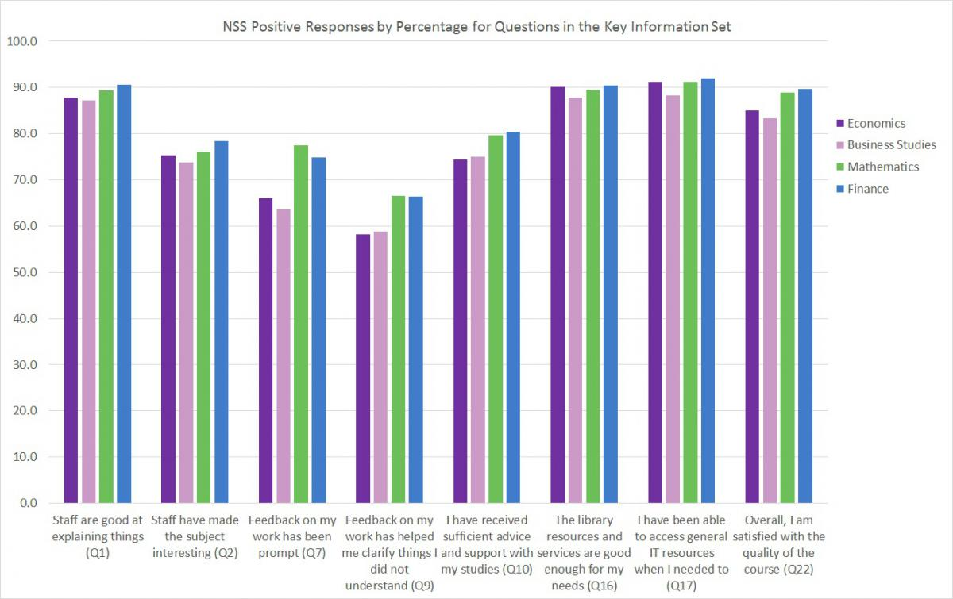
National Student Survey

Slide 8
Feedback
“There was no communication, for example if we had written an essay, it would be good [to have] just one sentence and maybe a small explanation on why you got the mark plus one sentence on how you could improve it.”
  Economics Network Student Survey 2012

Slide 9
Some more feedback comments
“Because of the office hour system, I have been able to get almost unlimited feedback on my work. Legendary lecturers such as ??? will give all the time we want on reading work we have done, and giving detailed feedback, as well as long discussions of the material at our convenience.”
“[…] feedback on these has been very poor and gives almost no feedback on how to improve.”
(NSS feedback)

Slide 10
Do you?
Formatively assess students
Give feedback individually
Give feedback to the whole student group
Use peer assessment
Use self assessment

Slide 11
Before they start
Increase students’ understanding of feedback
  Discuss what feedback is with students, and how and when they get it
  Be clear about criteria
  Provide feedback comments from previous cohorts before the assignment is due
  Ask class to provide feedback on an (anonymous) sample of work previous cohorts and make time to discuss this

Slide 12
Submission
Involve students in dialogue
For student completion | For staff completition
These are the areas of my work that I think are good, for the following reasons:
Please comment on the following areas of my work:
I want to improve on this next time:
The mark I think this deserves is:

Slide 13
After
Seek feedback on your feedback
  Do you schedule time to discuss feedback?
  Ask students to identify examples of feedback comments they found useful and that might help in future tasks

Slide 14
Useful links
Phil Race’s compendium on writings on assessment
http://phil-race.co.uk/most-popular-downloads/
Re-Engineering Assessment Practices http://www.reap.ac.uk/reap/nss/index.html
Economics Network themed assessment page http://www.economicsnetwork.ac.uk/themes/assessment
Economics Network Assessment Question Bank http://www.economicsnetwork.ac.uk/qnbank/

