Slide 1

Assessment and Feedback
Jon Guest
(Aston Business School)
Christian Spielmann
(University of Bristol)
A controversial “cheating prevention tool” used at a Thai University employed a white paper headband with two large pieces of paper attached to the sides, preventing students from peeking at their neighbor’s answers. (https://www.chiangraitimes.com/international-student-assessment-reort-exposes-thailands-failing-education-system.html)

Slide 2
ACTIVITY
How do we assess?

Slide 3
ACTIVITY
Why do we assess?

Slide 4
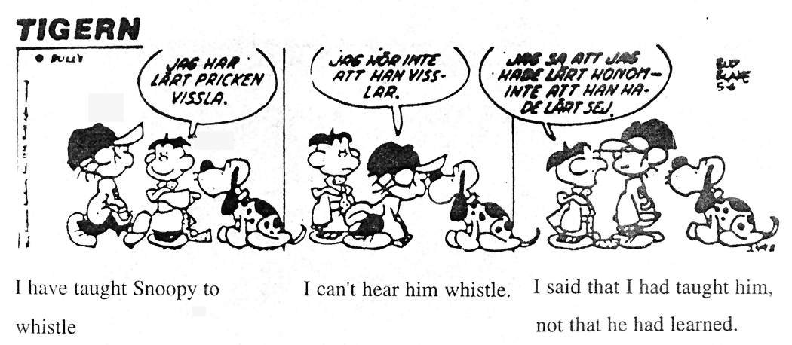
Assessment OF Learning
I've taught
Snoopy to
whistle
I can't
hear him
whistle
I said that I'd
taught him, not that
he'd learned

Slide 5
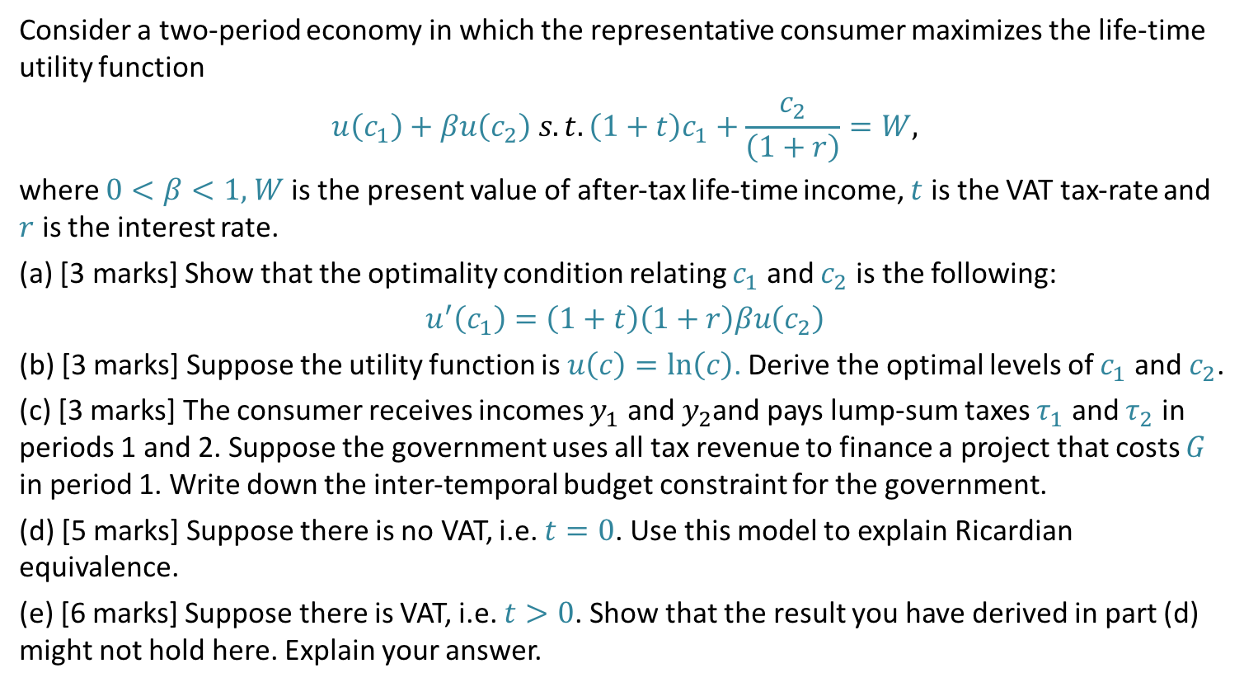
What Assessment?
Consider a two-period economy in which the representative consumer maximizes the life-time utility function
$$u\left(c_{1}\right)+βu\left(c_{2}\right) s.t. \left(1+t\right)c_{1}+\frac{c_{2}}{\left(1+r\right)}=W,$$
where $0<β<1,$ $W$ is the present value of after-tax life-time income, $t$ is the VAT tax-rate and $r$ is the interest rate.
(a) [3 marks] Show that the optimality condition relating $c_{1}$ and $c_{2}$ is the following:
$$u^{′}\left(c_{1}\right)=\left(1+t\right)\left(1+r\right)βu\left(c_{2}\right)$$
(b) [3 marks] Suppose the utility function is $u\left(c\right)=ln\left(c\right)$. Derive the optimal levels of $c_{1}$ and $c_{2}$.
(c) [3 marks] The consumer receives incomes $y_{1}$ and $y_{2}$and pays lump-sum taxes $τ_{1}$ and $τ_{2}$ in periods 1 and 2. Suppose the government uses all tax revenue to finance a project that costs $G$ in period 1. Write down the inter-temporal budget constraint for the government.
(d) [5 marks] Suppose there is no VAT, i.e. $t=0$. Use this model to explain Ricardian equivalence.
(e) [6 marks] Suppose there is VAT, i.e. $t>0$. Show that the result you have derived in part (d) might not hold here. Explain your answer.

Slide 6
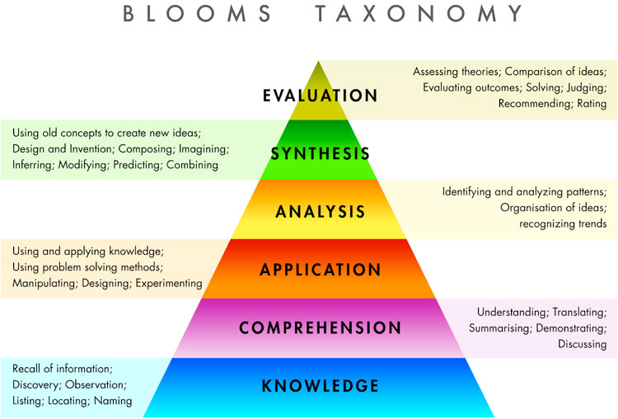
Designing Assessment: Bloom’s Taxonomy
Discuss:
What are appropriate
assessment modes for
different parts?

Slide 7
Checking that learning outcomes are met
Discuss: How to assure consistency
among many markers TAs?

Slide 8
Assessment FOR Learning

Slide 9
Effective assessment for learning
  Sadler (1989): should enable students to…
    develop a shared understanding with the tutor of what a ‘good’ piece of work looks like
    identify weaknesses in their own work – recognise the ‘gaps’ between their own work and the standard.
    to take appropriate actions to close any gaps

Slide 10
Developing a shared understanding?
  “It is difficult for teachers to describe exactly what they are looking for, although they may have little difficulty in recognising a fine performance when it occurs. Teachers’ conceptions of quality are typically held, largely in unarticulated form, inside their heads as tacit knowledge”. (Sadler, 1989, p.54)
  Problem both ex-ante and ex-post

Slide 11
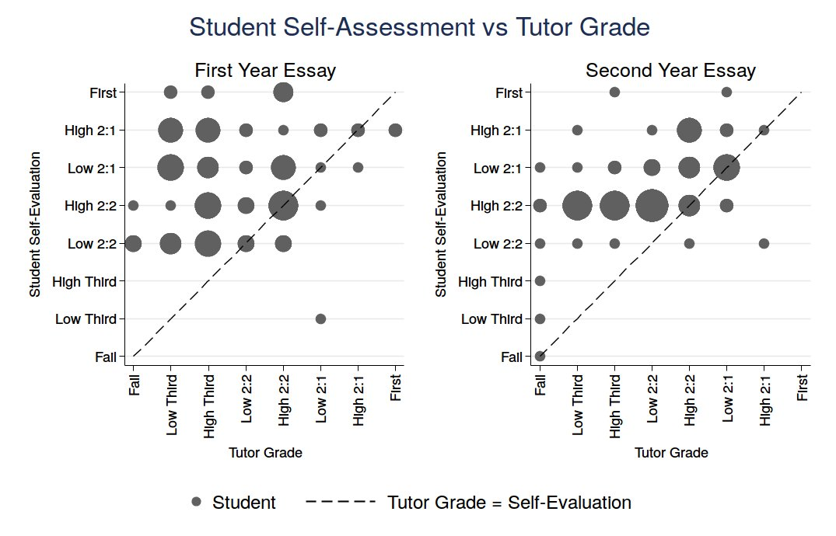
Guest J. and Riegler R. ‘Learning by doing: Do economics self-evaluation skills improve’, International Review of Economics Education, 24 (2017), pp. 50-64.

Slide 12
How effective is feedback
  How effective did you find the feedback you received as a student?
  “For many students feedback seems to have little or no impact despite the time and effort put into its production”. (Sadler, 2010, p.535)

Slide 13
Some potential issues
  Timing
  Balance of strengths and weaknesses
  Tone and phrasing
  Alignments between summative and formative
  How big is the gap?
  Is it developmental
    Relevance of comments for future work
    What guidance can you provide

Slide 14
Giving feedback: Optimality?
Q9. Feedback on my work has been timely
Q10. I have received helpful comments on
my work
Speed of returning feedback
Quantity/quality of feedback

Slide 15
How big is the gap?
  ‘Not enough critical analysis’
  ‘The assignment lacks clarity and logical coherence’
  ‘The answer did not focus on the question in enough detail’
  What are right amounts?

Slide 16
Relevance of comments for future work
  “Of the analysed feedback containing guidance, most comments were specific to that particular piece of work – as if the student had presented a draft that could be re-submitted” Weaver (2006, p. 388)

Slide 17
Guidance on how to close the gaps
  What specific guidance/advice can you give students to help them close any gaps?

