Slide 1
Lessons from The Big Bang Theory
The First class …
Sheldon Cooper - Introduction to his students – YouTube
Big Bang Theory: Teaching Advice
Managing Expectations
www.economicsnetwork.ac.uk

Slide 2

Interactive classes
The ideal class?
www.economicsnetwork.ac.uk

Slide 3

Constructive alignment
Intended learning objectives
Assessment tasks
Learning and teaching activities

Slide 4
Learning
Average Retention rates
Practice by doing
5%
Discussion Group
10%
Reading
20%
Teach Others / Immediate Use
30%
Listening to Lecture
50%
75%
Demonstration
95%
Audio-Visual
Source: NTL Institute of Applied Behavioural Science
www.economicsnetwork.ac.uk
Notes:
Task: Match RHS (Lecture, Reading, Audio/Visual, Demonstration, Discussion, Practice, Teach others)
Explain: Introduce Active versus passive learning and constructivist learning
Say: Problem with large class-rooms ➔ Small class rooms are the ideal environment to make engaged student-led learning happen.
Reality: Going through problem sets etc.
GATEWAY INTO DEEPER LEARNING

Slide 5
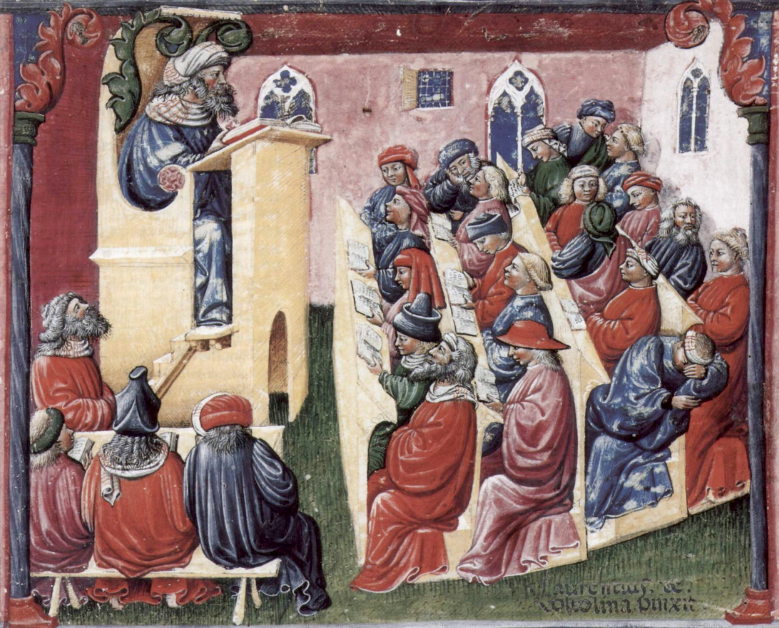
Small group ‘lecturing’
http://www.theatlantic.com/education/archive/2013/11/lectures-didnt-work-in-1350-and-they-still-dont-work-today/281514/
www.economicsnetwork.ac.uk
Notes:
-- The model of ‘lecturing’ is very old
-- Refer to the 5 percent remembering
-- Here we see 20-25 students and the teaching mode is pretty traditional lectures
-- One asleep already
-- Similar picture in large room teaching sessions

Slide 6
How do we learn?
Every student is different!
In what aspect?
Language skills
Ability
Learning Styles
Background knowledge
Specific learning disabilities
Enthusiasm
Motivation
Culture
www.economicsnetwork.ac.uk

Slide 7
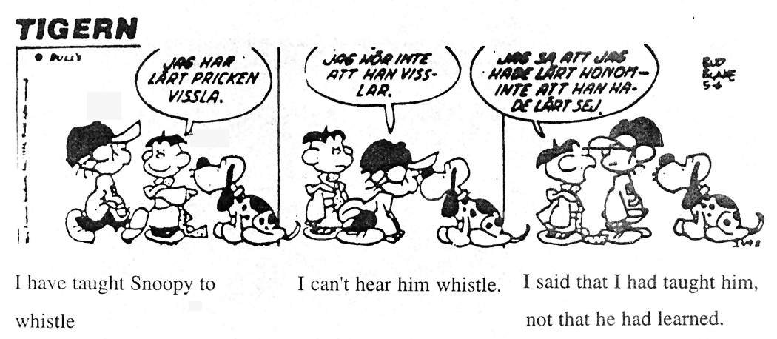
Teaching outcomes
I've taught
Snoopy to
whistle
I can't
hear him
whistle
I said that I'd
taught him, not that
he'd learned
www.economicsnetwork.ac.uk

Slide 8
Active Learning Strategies
www.economicsnetwork.ac.uk

Slide 9
Interaction in seminars
Introduce interactive techniques that exploit:
Varied student abilities and backgrounds
Encourage participation
Transferable skills
Job-market skills!
Confidence
Ability
Motivation
Performance
Employment prospects

Slide 10
Interactive seminars
Problem-based learning
Maastricht University
http://www.economicsnetwork.ac.uk/showcase/forsythe_pbl
Case studies, current affairs
http://www.economicsnetwork.ac.uk/handbook/casestudies/1
Games, experiments
http://www.economicsnetwork.ac.uk/themes/games
Flipped classroom
http://www.economicsnetwork.ac.uk/sites/default/files/Ashley/Ralf%20Becker%202.pdf
www.economicsnetwork.ac.uk
Notes:
Constraints of methods you can apply to make class room experiments , constraints of interaction
Equity between seminar groups is important

Slide 11
Task
Constraint Optimisation
GTA’s have many constraints with respect to the framework provided by the module leader.
Can you think of ways how to make classes more interactive, i.e. quantitative classes?
Notes:
1. Students are prepared:
Ask what question was most difficult, let every group work on it,
Small group discussion (2-5 students)

Slide 12
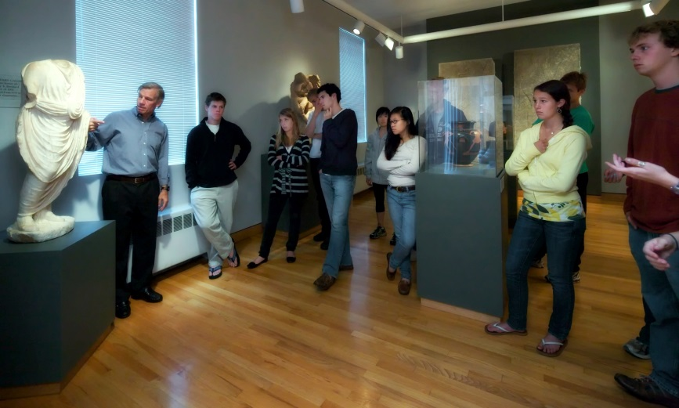
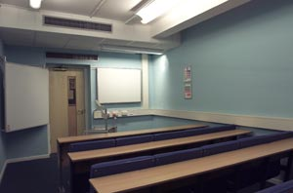
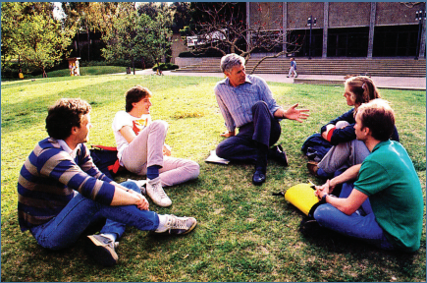

Engaging environments
www.economicsnetwork.ac.uk

Slide 13
Top tips for exercises
Keep notation consistent and explain it
Make steps in the reasoning explicit
Use questions to guide students through the reasoning
Provide intuition – plan examples/ask students to find examples in advance
Identify possible pitfalls or cases – anticipate areas of difficulty
Link material taught to the lectures
Try and offer ‘the bigger picture’
www.economicsnetwork.ac.uk

Slide 14
Never...
Skip parts of explanations
Rush (but keep an eye on the clock)
Be afraid to acknowledge what you don’t know
www.economicsnetwork.ac.uk

Slide 15
Always...
Adapt room layout
Introduce yourself
Plan ahead but stay flexible
Contextualise and structure material
Encourage participation
Make the most of your experience and enjoy it!
www.economicsnetwork.ac.uk

