Slide 1
Assessment and Feedback

Slide 2
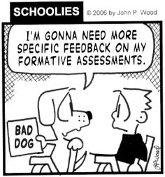
Assessment and Feedback
“There was no communication, for example if we had written an essay, it would be good [to have] just one sentence and maybe a small explanation on why you got the mark plus one sentence on how you could improve it.”
Economics Network Student Survey 2012

Slide 3
Reasons to assess and give feedback
NSS assessment & feedback questions
Provide evidence that students have met the learning outcomes
Validate standard of performance
Monitor and feedback on progress
Identify those needing support
Feedback into teaching
“The criteria used in marking have been made clear in advance”
“Assessment arrangements and marking have been fair”
“Feedback on my work has been prompt”
“I have received detailed comments on my work”
“Feedback on my work has helped me clarify things I did not understand”

Slide 4
Formative versus summative ?
Summative = assessment OF learning
determines what students have learned
Formative = assessment FOR learning
helps student to learn (learning by doing)
(Diagnostic)
helps teaching staff to see how teaching is going
N.B. recent tendency to blur distinction between summative and formative assessment (or scrap formative assessment).

Slide 5
Feedback
Many students do not read, engage with or act upon the feedback we provide.
NSS suggest that students are less satisfied with the feedback they receive than any other aspect of their learning experience in higher education
How can we make students read and engage with feedback?

Slide 6
Improve students’ expectations
Discuss what feedback is with students, and how and when they get it
Be clear about criteria
Use official marking/grade criteria
Provide feedback comments from previous cohorts before the assignment is due
Ask class to provide feedback on an (anonymous) sample of work previous cohorts and make time to discuss this
Ask students about the strength of their work.

Slide 7
UK Marking Scale – in our own words…
Degree Class
 | 90 - 99 | future Nobel prize winner
 | 80 - 89 | As clever or more clever than you
First | 70 - 79 | Very good student
Upper Second (or 2.i) | 60 - 68 | Good student: OK to go on to MSc or good job Quite clever and works hard
Lower Second (or 2.ii) | 50 - 58 | Mediocre student Quite clever or works hard (but not both)
Third | 40 - 48 | Weak student but seems to have learned something, albeit not much
Pass | 30 - 38 | Fail
 |  | Catastrophic fail

Slide 8
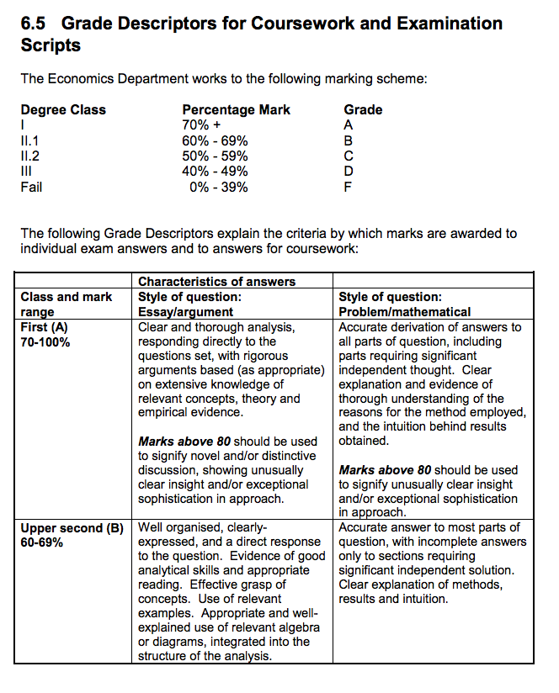
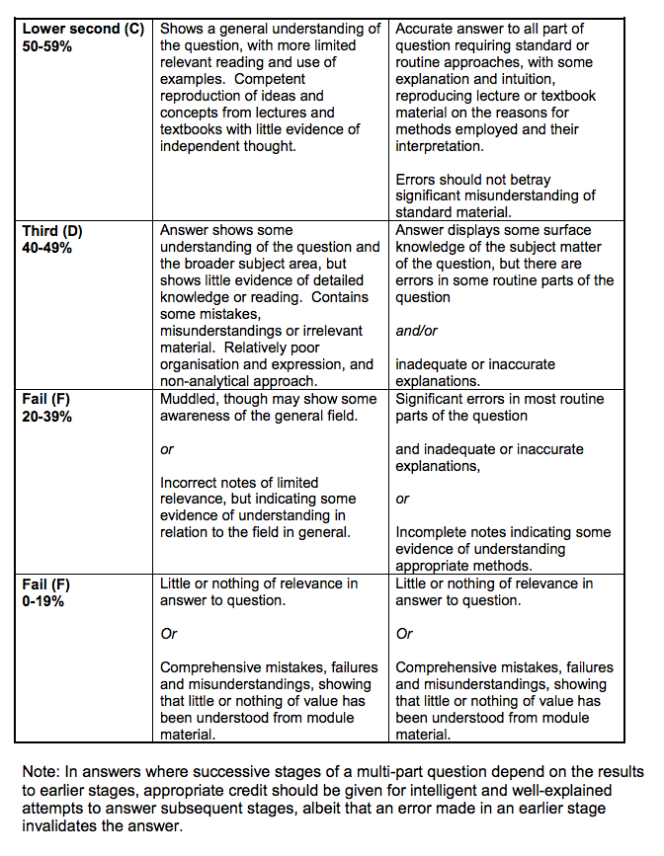
Example from UCL Undergraduate Handbook.

Slide 9
Good feedback practice (Gibbs and Simpson 2004)
Timely (2-3 weeks)
Individual
Constructive and “feed-forward”
Prioritised and manageable
Realistic
Honest
Group feedback valuable for common errors (and time-saving)

Slide 10
Simple ways of improving written feedback
The language we use
Where we write the comments
The balance between strengths and weaknesses
The tone and phrasing
Reference to learning outcomes.

Slide 11
1. The Language we Use
Students find it difficult to understand comments because we write them in (a) the specific disciplinary language of the subject and (b) the terminology of Bloom’s taxonomy i.e. synthesis, analysis, evaluation.
Big issue for 1st year students.
Avoid excessive and unexplained use of academic jargon.
Remember comments are for the students to understand
Tip: Always remember you are writing feedback comments for the students to act upon rather than another academic such as the external examiner.
Notes:
The external examiner’s job is to judge how useful the students will find the feedback you have provided.
“Demonstrates a detailed, systematic, in -depth, theoretically informed knowledge base, with some appreciation of the provisional nature of knowledge. “
Good understanding and application of theory

Slide 12
2. Where do we write comments?
In-text comments and notations facilitate understanding of students in comparison to given feedback only at the end of the essay.
Ferguson (2011): 1 or 2 word feedback is completely useless – try to avoid.
Trade-off: detailed comments vs time
Online marking can help
Tip: Explain three or four areas for improvement in detail rather than providing brief comments on a large number of points.

Slide 13
3. The balance between strengths and weaknesses
Motivate students to take appropriate actions to deepen their learning.
If comments only focus on weaknesses and fail to identify any strengths students are likely to ignore feedback.
Tip: Always try to find something positive to say otherwise there is a danger the students will take no notice of any of the feedback

Slide 14
4. The tone and phrasing
Students are more likely to engage with feedback comments if they:
are constructive and avoid using harsh language or being over judgmental
stress the normality of making mistakes in the learning process
place greater emphasis on the importance of effort over academic ability
Example:
“This is wrong/incorrect – you do not understand this concept”
“This is a common error. Many students find this concept difficult the first time they study it, but the majority obtain an in-depth understanding after a prolonged period of study and go on to do well in future assessments”

Slide 15
5. Reference to learning outcomes
Feedback is more effective when it refers to the learning outcomes and assessment criteria for that particular piece of work.
There is also evidence that it is not common practice.
Tip: Make sure you carefully re-read the assessment criteria and intended learning outcomes before reading the assignments and providing feedback.

Slide 16
Feedback on Feedback?
Do you schedule time to discuss feedback e.g. in the next class?
Ask students to identify examples of feedback comments they found useful and that might help in future tasks
Ask students what they want feedback on.

Slide 17
DO IT YOURSELF

Slide 18

How would you mark the following student answer?
671
+ 143

