Slide 1


The Economics of Health Systems
Health Economics Unit
Globalization and Health 2:
Health Worker Migration
John Ashmore
10 July 2009
UNIVERSITY OF CAPE TOWN
Notes:
This lecture was originally for UCT’s Masters in Health Economics (MPH) students taking the Economics of Health systems module. The course was run by the Health Economics Unit (HEU), located in the School of Public Health. John Ashmore (jdashmore@gmail.com) is a PhD candidate in the HEU studying doctor retention in South Africa. He previously studied at SOAS in London.

Slide 2
Lecture Plan
Health Economics Unit
Outline the Human Resources for Health (HRH) ‘crisis’ in Africa and South Africa
Introduce some key concepts to examine some models on the impacts of migration
Critique through political economy lens
UNIVERSITY OF CAPE TOWN
Notes:
This lecture outlines arguments surrounding health worker migration, which is entangled with what is known as the Human Resources for Health (HRH) Crisis in Africa. The lecture focuses on the African and South African situation in particular.

Slide 3
i. First, and most important
Health Economics Unit
Readings should be critically engaged with, asking questions like:
Who wrote them?
Why were they written?
When were they written?
This is because issues like globalization and migration are
SOCIAL ISSUES, not scientific fact. Therefore ideological!
e.g. Ask these questions for WHO’s World Health Reports
UNIVERSITY OF CAPE TOWN
Notes:
The lecture promotes MPH students, many of whom have little or no social sciences background, to engage critically with readings. This is to introduce mainstream economics as well as political economy lenses onto HRH issues, and realize that there is a big difference between the sciences and the social sciences.

Slide 4
ii. Intro to questions of ‘Globalization’
Health Economics Unit
Jenkins (2004), a definition for present purposes:
Globalization is “a process of greater integration within the world economy through movements of goods and services, capital, technology and (to a lesser extent) labor, which lead increasingly to economic decisions being influenced by global conditions [emphasis added]”
i.e. the emergence of a global marketplace.
The six trillion dollar question:
Globalization as a substitute for development??? (Rodrik 2005)
China and India vs. Africa – globalization ‘good’ in which contexts?
Is globalization ‘good’ or ‘bad’?
UNIVERSITY OF CAPE TOWN
Notes:
Understanding globalization and how we conceive it is key to understanding the HRH debate. Globalization involves the movement of labor, including medical professionals, but is also a much wider debate of which HRH is a part. Those who tend to think of globalization as ‘good’ can be essentially thought of as those who think the movement of goods, capital, technology and labor etc. makes the world richer and more prosperous. Those who think the opposite tend to believe that at the very least, many people lose out through processes of globalization. So the question becomes – who is benefiting from globalization, and what are its developmental implications? These questions must also be asked with regard to health worker migration…

Slide 5
1. The HRH ‘crisis’ in Africa
Health Economics Unit
Is there (or is there not) an African HRH crisis? Why?
Crisis:
Anand and Baernighausen (2004): Found significant cross-country correlation between under-5 mortality and health worker density
Narasimhan et al. (2004): HRH are ‘backbone’ of any health system, and health ‘mix’ important – e.g. radiologists, specialists
In WHR 2006 it was noted that Africa carries 24 per cent of the global disease burden, yet has only 3 per cent of health workers and 1 per cent of health care expenditure
No crisis:
Migration often seen to be good for global welfare
Knowledge networks, remittances and ‘backward linkages’
The ‘crisis’ is a construction in its current form – HIV rollout etc.
UNIVERSITY OF CAPE TOWN
Notes:
This slide outlines the arguments for and against there being an HRH crisis in Africa. This leads on from the previous slide because those who believe there is a HRH crisis in Africa tend to believe that globalization and the current system of capitalist economic expansion carries at least some harmful effects – such as the lack of doctors and nurses in Africa who migrate. This argument focuses around the worsening inequality that results from HRH migration. Those who would question the ‘crisis’, which came to the fore after the WHO released it’s 2006 report saying there was a crisis, tend to emphasize other arguments. For instance, the benefits of migration may outweigh the negatives because, for example, if a doctor migrates from sub-Saharan Africa to the USA, she might pick up more skills there, send some of the money she makes home, invent a new way to help humanity, and then return to her country to use her new knowledge beneficially. These are classic pro-globalization arguments. One could also argue that the ‘crisis’ as it is now known, may be a construction, in that it is only a crisis since people have realised there are not enough health care professionals to roll out antiretroviral drugs in Africa, but that this is hype given that the benefits of migration may outweigh the costs. This could also be seen from the other perspective, however, in that there has always been a crisis, but it is only now coming to the fore. Already we are beginning to see that one’s perspective and ideology on social issues matters, and it is not as ‘objective’ as one might hope.

Slide 6
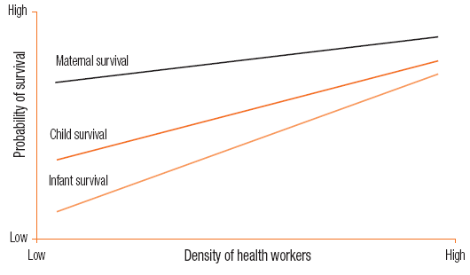
Outlining the crisis: HRH matters!
Source: WHR 2006
Notes:
Evidence is now presented from a number of sources that there is a crisis. The above figure notes that health care is particularly important for the survival of infants, children and mothers, who need more medical attention than the rest of the population.

Slide 7
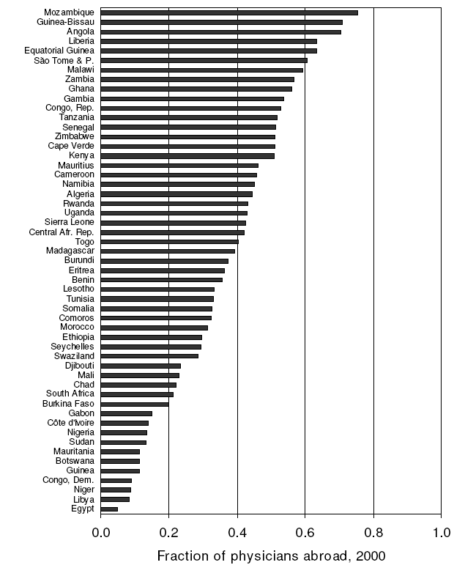
The African situation
Clemens and Pettersson (2008), ‘New data on African health professionals abroad.’
Figure shows that in nearly half of all African countries, over 40% of doctors born there now live outside their countries’ borders. Similar results for nurses.
Clemens and Pettersson note data is poor and not standardized, but these are best comparative figures there are.
Notes:
The migration of health care professionals seems to be at least one part of why there is an HRH problem in Africa.

Slide 8
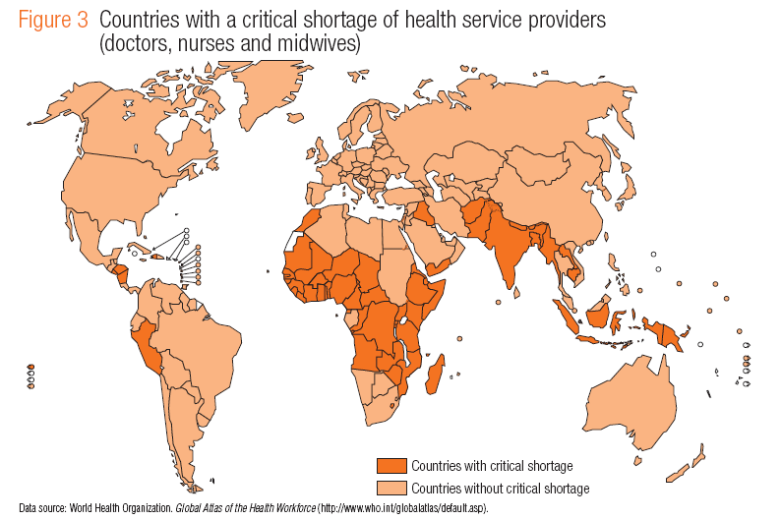
High population
Worst affected
Source: WHR 2006
Notes:
Sub-Saharan Africa in particular has very few health workers compared to other regions of the world.

Slide 9
Intra-country matters (source: Global Atlas, see www.who.int/globalatlas)
 | Total health spending per capita (2002, international dollars) | Total health workers per 10,000 population (1995-2003) | GNI per capita PPP, international dollars (2003)
USA | 5,274 | 125 | 37,610
UK | 2,160 | 75 | 28,350
Spain | 1,640 | 67 | 16,990
Argentina | 956 | 36 | 3,650
South Africa | 689 | 46 | 2,780
Brazil | 611 | 26 | 2,710
Botswana | 387 | 27 | 3,430
Namibia | 331 | 31 | 1,870
Uganda | 77 | 1 | 240
Senegal | 62 | 4 | 550
Mozambique | 50 | 3 | 210
Malawi | 48 | 3 | 170
Rwanda | 48 | 2 | 220
Notes:
This slide further introduces the African/South African situation. It shows how few health care professionals are in Sub-Saharan Africa. South Africa, however, a middle income country, has relatively many health workers, as well as income and expenditure on health. This is for instance why it was baffling that South Africa was not able to react more swiftly to the HIV epidemic there. But the picture is misleading, because there is an unequal distribution of health care workers between public and private sectors in South Africa, with the latter containing 60% of doctors for instance to care for 15% of the population. Migration and retention can thus be seen as big issues for South Africa, even though it is relatively rich.

Slide 10
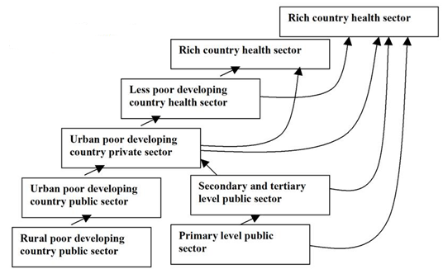
The ‘global carousel’ (Huddart and Picazo 2003)
from Paradath et al. 2003
Notes:
This model shows the trend of health worker migration – from poorer to richer regions and countries. Thus in the next slide we can see that South Africa, a middle income country, both receives and loses health workers in the complexity of international health worker migration.

Slide 11
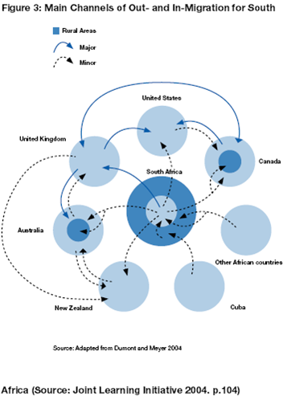
South Africa as part of global carousel (IOM 2007, from JLI 2004)
Migration is complex even within countries
Out-migration of health workers in SA six times level of in-migration in 2003.
Trend: Almost all migration to small number of countries
Notes:
Yet more are leaving South Africa than arriving. This is due to a number of factors, including the fact the SA Department of Health has not wanted to make it easy for people from less developed countries to immigrate because of the ethical implications. HRH also emigrate to a small number of countries, due to for instance colonial ties and language constraints, as well as income disparities.

Slide 12
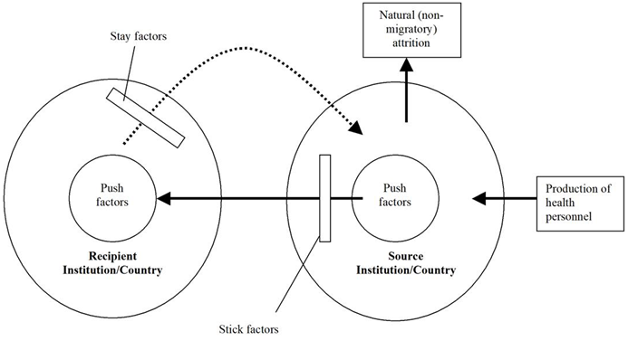
2. Why migrate: the ‘push-pull’ model
Health Economics Unit
CONTEXT
STAY
PULL
PUSH
STICK
Adapted from Paradath et al. 2003. Also see WHR 2006
UNIVERSITY OF CAPE TOWN
Notes:
We can thus see that there are a number of ‘push’ and ‘pull’ factors to migration, whether it be from rural to urban, public to private, or poor to rich countries or locales. ‘Stay’ factors keep people from going back (e.g. having children enrolled in school), and stick factors stop them from migrating in the first place (e.g. cultural affinity)

Slide 13
Push and pull factors
Health Economics Unit
PUSH (Source locations) | PULL (Destination locations)
Low wages ($$) Lack of job satisfaction Job associated risks HIV Work risk Burden of workload Lack of career/training opportunities ‘Exogenous’ factors: crime, war, oppression, children’s future, wage compression, privatization. | High wages ($$) Better work environment Safer working conditions Career or training opportunities ‘Exogenous factors’: Ageing populations, land of milk and honey, diaspora networks
INTERRELATED
STICK | STAY
Morale Social/cultural values Family and kinship ties There’s no place like home | Lack of awareness of job opportunities back home Reluctance to disrupt new lifestyle patterns
UNIVERSITY OF CAPE TOWN
Notes:
These factors can all be termed ‘endogenous’ or ‘exogenous’ (essentially meaning within our push-pull modelling or outside its scope). Things like crime and war are pretty difficult to control, and are hard to affect with policy, whereas low wages etc. can be. Trends of privatization can also for instance be seen as exogenous, though it is important to recognize their role in the HRH crisis, and to try to tackle them. This is why South Africa is currently debating reforming its highly inequitable health system, much like the US has from time to time. Push and pull factors are closely related, as for instance if the wage is higher in another environment then the wage must be less desirable in the source location. Governments and policymakers who want to affect migration must look at changing the push, pull, stick and stay factors if they aim to change people’s motivations for leaving. This is obviously easier or at least more straightforward with endogenous factors than exogenous, but again that is not to detract from their importance. It is worthwhile noting that it is very hard to afford the wage increases health workers deserve in Africa (though this is obviously a big generalization), and so changing people’s work environments so they are more satisfied in their work for other reasons, may be a worthwhile and realistic path to pursue. This all assumes of course, that there really is a big HRH crisis!

Slide 14
Recap
Health Economics Unit
What we’ve looked at:
There may or may not be a health worker crisis
There is good evidence that there is a problem
Why health workers are migrating, and the dynamics of that migration in Africa and South Africa
A lot depends on what we believe about globalization
What now?
Introduce some concepts, then look at impact in more detail
UNIVERSITY OF CAPE TOWN
Notes:
The next section will introduce some more economic concepts to help us understand how economists conceptualize the IMPACTS of globalization and HRH migration, because this attends to the question of whether there really is a crisis or not.

Slide 15
3. Key concepts 1
Health Economics Unit
i. Simple comparative advantage – David Ricardo
Imagine 2 countries, one endowed with a lot of low skilled labor, and
another with endowments of high skilled labor…
What would you expect them to specialize in?
X and Y are the only products in the world; A = tech.; L = labor
Y = Ay Ly X = Ax Lx [production functions]
Now assume * represents the only other country from yours…
If Ay/Ax > Ay*/Ax* You will specialize in Y domestically (e.g. agriculture in Africa and industry in Europe)! Workers will migrate.
UNIVERSITY OF CAPE TOWN
Notes:
The concept of comparative advantage is basically that if one region has more of one productive input than another, it will likely specialize in whatever that productive input is good at producing. We can think of the West having for example a comparative advantage in industry, and it therefore making sense that industry would agglomerate or accumulate there. In the context of health, we can also think of the West having a comparative advantage relative to Africa, and thus lots of Africans emigrating to the West because there are better opportunities there. The same could be said of rural vs. urban contexts and so on – why do you think we have cities?

Slide 16
Key concepts 2
Health Economics Unit
ii. Pareto efficiency
Pareto efficiency is a fundamental principal of economics which stipulates:
You can make someone better off as long as you don’t make anyone else worse off.
This is a rarity in reality. So the assumption was ‘rescued’ by the so-called ‘Kaldor-Hicks’ or ‘Potential Pareto’ criterion :
If a person is made better off by another being made worse off, this is fine so long as she is sufficiently better off to compensate the other person.
Whether compensation happens was left out of economics, as the decision was seen as too political and not ‘objective’ enough.
UNIVERSITY OF CAPE TOWN
Notes:
Pareto efficiency is a unique ethical position taken by economics – that it’s okay to make one person richer if nobody else becomes poorer. This is rare in reality of course, so economics even went one stage further in order to try to maintain its ‘objectivity’…(see above).

Slide 17
Key concepts 3: Political economy
Health Economics Unit
20th Century according to an economist:
Keynesian model increased government spending, ending the Great Depression
Monetarist model replaced Keynesian model following overextended state and striking, oil shocks etc. – as money supply had more rapid effects
20th Century according to a political economist:
Models are political and ideological, and require historical context
Keynesianism linked to ideology of welfare state, monetarism linked to neoliberalism
UNIVERSITY OF CAPE TOWN
Notes:
All you need take out of this slide is that economics tends in the mainstream to concern itself with ‘objective’ models, while political economy recognizes that those models are products of their time, history and ideology. You do not need to know what Keynesianism and Monetarism are, interesting though it is. Note that my economics undergraduate degree taught me the first version, and I came to learn the second later on.

Slide 18
4. Models of impact
Health Economics Unit
Robinson (2007) notes that in modeling the net effects of HRH migration, it is exteremely important whose welfare we look at:
The Internationalist models (Johnson 1965; Grubel and Scott 1966) focus on global welfare. Global welfare increases through migration as health workers are more productive in richer countries (think comparative advantage)
This is linked to positive spillovers (externalities) like:
Increased scientific discoveries, which benefit everyone
Remittances and trade to developing countries
Knowledge being gained and returned to developing countries through ‘knowledge networks’
Which outweight negative spillovers like:
Loss of taxes and spending from the economy
Loss of productivity among colleagues left behind
UNIVERSITY OF CAPE TOWN
Notes:
The next few slides take us through Robinson’s reading (the most important to this class), which notes that our outlook on the impacts of health worker migration depends on our outlook on globalization. Some people (Internationalists) believe there are greater benefits to health workers migrating than there are costs, and thus construct economic or mathematical models, which can be thought of as caricatures, that show this. These models depend critically on the concept of comparative advantage, but more importantly from a political economy perspective, on one’s ideology.

Slide 19
Political economy critique
Health Economics Unit
The internationalist models are ideological and pro-globalization:
Grubel and Scott say trying to retain health workers goes against the idea of the ‘the free international flow of human capital’. Goes against efficiency.
Johnson said you can’t try to stop people from migrating because that goes against potential pareto efficiency
What would internationalists suggest for Africa?
UNIVERSITY OF CAPE TOWN
Notes:
Potential Pareto efficiency also has a large impact on what we think we can do about an HRH crisis, if indeed we believe there is one. If the world is benefiting more from people migrating than it is losing out, who are developing countries to stop them? How can we stand in the way of efficiency? As noted, in ethical terms this is a highly debatable point, never mind the fact that the true costs and benefits of migration are very little understood, and the way that models are applied, even if they are theoretically objective, is going to in one way or another be very political, and not just economic. Thus economics is open to accusations of purporting to be objective while it is not.

Slide 20
Models of impact 2
Health Economics Unit
Nationalist models look instead to the negative impacts on sending countries (see Bhagwati and Hamada 1974; Mackintosh 2007).
They thus focus on the redistribution that occurs from poor to rich countries. i.e. more concerned with equity.
A 0.1% increase in UK’s nurses = 40x greater loss to
Zimbabwe (IOM 2007)
Training costs lost for UK foreign doctors = ₤2bn; if look at earnings, far bigger than foreign aid (Mackintosh 2007)
Is this perspective ideological?
What would nationalists recommend?
UNIVERSITY OF CAPE TOWN
Notes:
On the other hand we can see that the so-called ‘nationalist’ models are also pretty ideological. They are much more concerned with equity, and the impacts on developing countries from health worker migration that were pointed to earlier (rather than any potential benefits to developed countries and the world, which may well also exist). Note, however, that many of the supposed benefits are dependent on for instance knowledge being easily transferrable from rich countries to poor countries. This is questionable with international property rights laws as they are – remember the case where the drug companies took the South African government to court for wanting to import generic HIV drugs? Read more in Robinson.

Slide 21
Conclusions thus far
Health Economics Unit
Critical reflection on who, why and when important
Globalization good or bad from different perspectives, and so is health worker migration
More evidence needed on HRH issues in context
Political economy, mixed methods etc. may help us better understand the debate (think purpose-driven vs. theory-driven research)
No matter what perspective, African HRH systems need strengthening
UNIVERSITY OF CAPE TOWN
Notes:
And so we have seen how health worker migration is a complex issue, and one’s perspective on it depends on one’s ideology and views of globalization. This has highlighted that one must read critically and not just take economics and social issues lightly, and that much more evidence is needed on HRH issues to inform better policy. This shouldn’t just come from economic models and analyses, but also from mixed methods which also involve talking to people to draw out some of the nuances of situations, such as how health workers interpret why they are migrating. This is ‘purpose-driven’ research, i.e. trying to solve a social issue, rather than just confirm what everyone else before you has presumed without reflection. It is an exciting area to get into, and for instance my research looks at doctors who have more than job, and why this happens and whether it can be used as a policy tool to retain doctors (e.g. as they may become more motivated by doing extra work they enjoy). Finally, it is worth noting that whatever perspective one has, it is difficult to see that African HRH systems don’t need strengthening after decades of decline and stagnation, and with the HIV pandemic as it is right now. I could spout more evidence of why I believe there is also a genuine crisis, but I can also say as a political economist that I think it is the right thing to do, and at least I acknowledge this to be my ideology. But I would not take all this too far of course, because I really do think there are a lot more costs than benefits to health worker migration, because not everything is measurable, and that countries should be compensated as Mackintosh says in the previous slide. This is particularly given the history of exploitation in Africa. I am merely saying that it is possible to put an argument in many ways, and that one must be careful of disciplines and papers that claim that their research is somehow free from ideology when they are dealing with inherently social rather than scientific issues. That means my approaches are in themselves of course ideological to some degree, but at least they are not based only on previous economistic assumptions, set outside of reflexive, historical analysis.

Slide 22
What can be done?
Health Economics Unit
Example strategies to combat HRH migration and shortages:
Economic strategies | Uganda, Botswana, South Africa – increased pay. Free housing in high need areas ‘Bonding’ – public service for government loans Only short term solution though – systemic issues.
Worker conditions strategies | Swaziland: nurses given psychosocial support, HIV prophylaxis and palliative care where necessary Malawi: task shifting to lighten workload AMREF using mobile technology to train nurses
HRM strategies | Assessing national distribution of health workers Recruiting more rural doctors (or black doctors?) Dual practice? Supportive, trustworthy, available HR management
(Similar list in IOM 2007)
UNIVERSITY OF CAPE TOWN
Notes:
So I don’t want to leave you without any kind of thoughts on what can be done. A lot is being tried, and in South Africa for instance doctors have recently received a 15% pay increase, even though they had to strike to finally receive it after many promises. In a number of contexts too, tasks such as prescribing HIV medicines are being successfully shifted to less skilled workers to give doctors and so on more time for work they are uniquely qualified for. Each circumstance requires different initiatives, however, and different motivational tools are needed to keep different health workers. For instance, health workers who are mothers have different priorities than those who are single. And those in rural areas will probably be more interested in getting more social interaction and training opportunities than someone working in a city. The readings go through some of these issues in greater detail.

Slide 23
…
Health Economics Unit
Thank you, and goodnight!
UNIVERSITY OF CAPE TOWN

