Slide 1


EN Virtual Symposium
Teaching & learning in a blended world
Ralf Becker (University of Manchester), Caroline Elliott (University of Warwick), Iain Long (Cardiff University), Dimitra Petropoulou (LSE), Mario Pezzino (University of Manchester), Steve Proud (University of Bristol), Mike Reynolds (University of Leeds), Christian Spielmann (University of Bristol)

Slide 2
Breakout rooms
Discussion boards (Ralf)
Large online groups (Mike and Steve)
Managing teaching workloads (Dimitra and Iain)
How to talk to colleagues about the benefit of blended learning (Caroline)
What will work best face-to-face? How to complement face-to-face and online? (Mario)

Slide 3

Blended Learning or the Student Journey
3 ways

Slide 4
Blended Learning – Week X
 | Mon | Tue | Wed | Thu | Fri | Weekend
VLE | Video (1h) Reading (1h) |  |  | Video (1h)
Large Group Session |  | Review & QA (1h) |  |  | Review & QA (1h)
Small Group Session |  |  | Tutorial (1h)
Discussion Board |  |  |  |  |  | Check Qs (0.5h)
Guided Self-Study |  |  |  | Reading (1h)
Study Group |  |  |  |  | Meet Group (1h)
Assessment Activity |  |  |  |  |  | Do weekly quiz (1h)
Overall: 9.5h/Week

Slide 5
Blended Learning – Week X
New Content
First Exposure
Online videos (2h)
Reading (1h)
Learning / Revisions / Practice
Review and Q&A Sessions (2h)
Tutorial (1h)
Study Group (1h)
Reading (1h)
Discussion Board (1/2h)
Assessment
Online Quiz (1h)

Slide 6
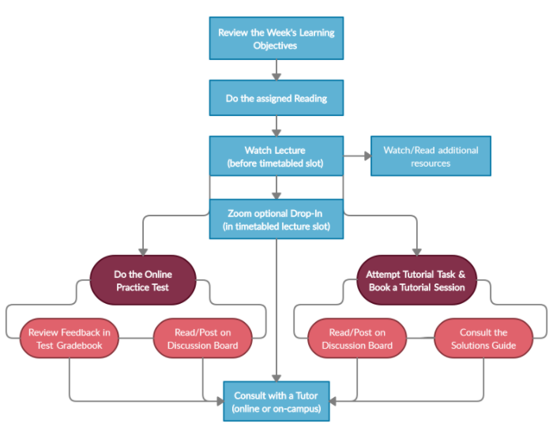

Slide 7
Source: Survey of large Year 1 unit, University of Manchester, 105 responses (out of 900), Ralf Becker
Context: All content delivered through asynchronous material. Live big group sessions to tackle questions raised by students

Slide 8
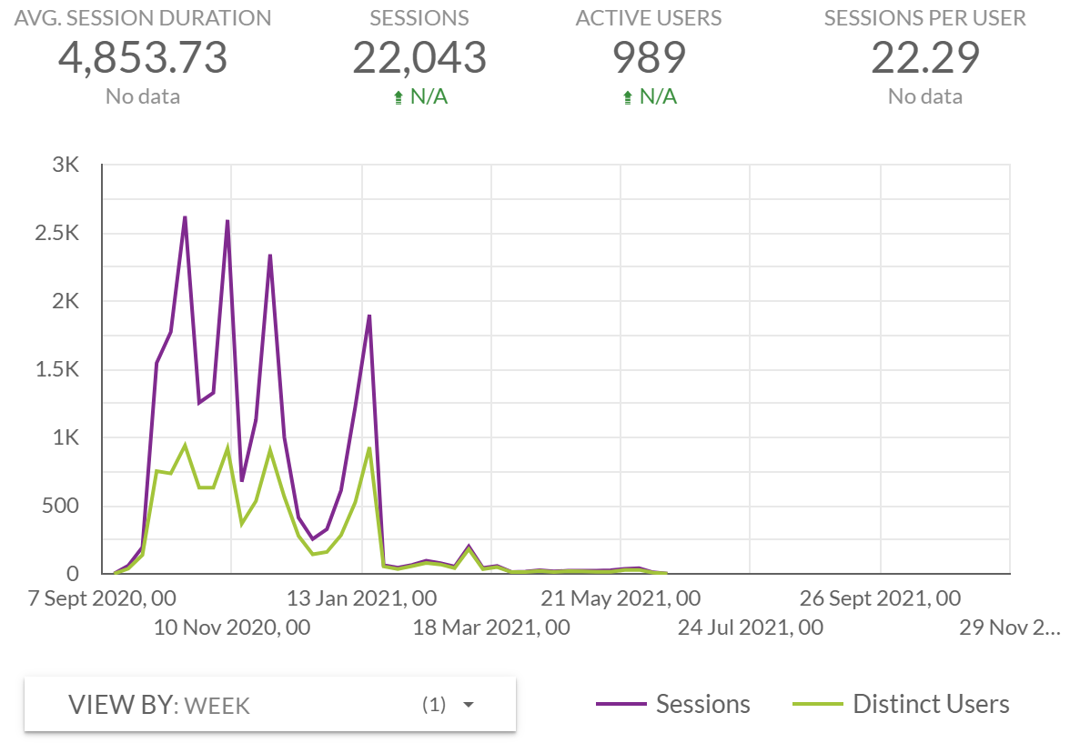






Source: Mobius, DigitalEd
Context: All content delivered through asynchronous material. Live big group sessions to tackle questions raised by students

Slide 9

Top Tips for Online Large Lectures
Caroline Elliott, University of Warwick
&
Dimitra Petropoulou, LSE

Slide 10
Top Tips for Interactive "Textbooks"
Mix media (mainly reading and video)
Think carefully where your careful narrative and whiteboard work is most important -> produce videos for that
Introduce short exercises often, after every sensible content chunk
Scaffold exercises. Present worked examples - start with basic elements, then move to more complex questions
Introduce material to stretch students (label it as such: "If you are aiming for grades 80+ you are expected to know this sort of stuff" - make sure students understand marking criteria)

Slide 11
Top Tips for Online Large Lectures
Join the lecture early, chat to students and ask them to turn their cameras on, even if just for these informal conversations. Refer to them by name!
A student-led module YouTube playlist can be a great community builder – play music as students join online.
Think of and announce a clear structure for the session with different elements.
Plan how students will engage and explain how you expect them to use the technology.
Incentivise/gauge engagement with asynchronous content by asking questions/quick polling at the start of the lecture.
Very quick polling of students can be achieved by asking them to use ‘thumbs up/down’ or short one word answers in the chat.

Slide 12
Top Tips for Online Large Lectures
A mix of slides and other digital media can be effective:
  Digital whiteboard e.g. Notability on an iPad
  Home-use visualiser e.g. IPEVO
Encourage some students to turn on their cameras so you can focus on some faces.
Encourage students to post comments/questions in the chat – but plan and announce how these will be addressed, and factor into time planning.
Consider compiling questions (e.g. through Padlet) during or in advance of the lecture – upvoting can help you prioritise; have a back-up plan in case none posted.

Slide 13
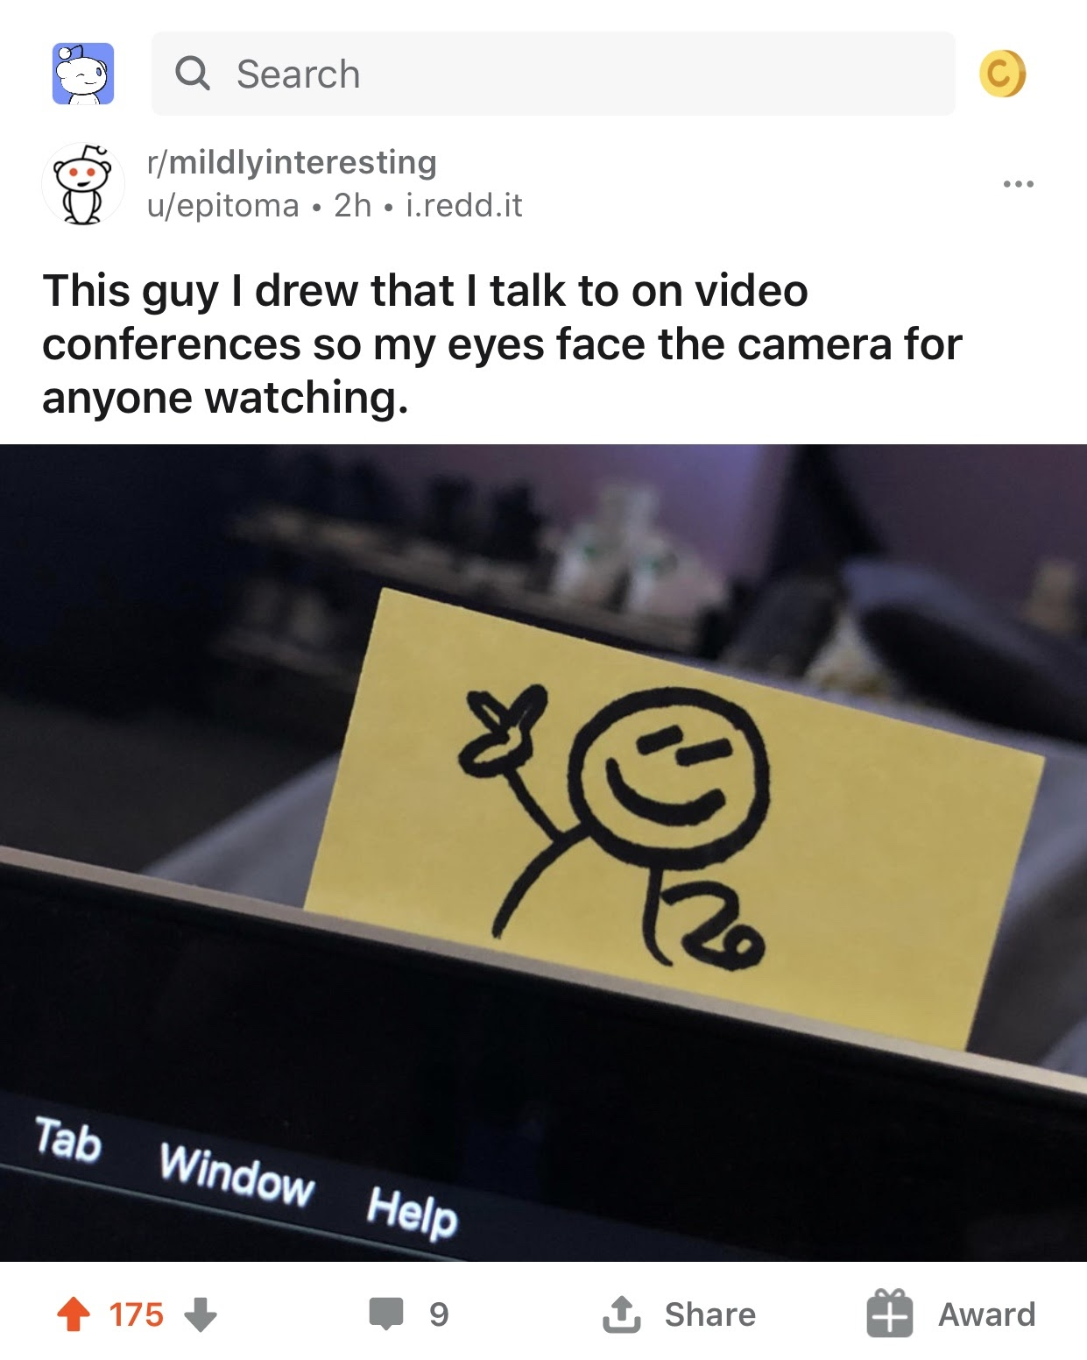
Top Tips for Recorded Lecture Content
It doesn’t need to be perfect – remember you can pause! Re-filming is rarely worthwhile.
Locate ‘natural breaks’ in your slides to split content into smaller segments
Consider embedding a short task(s) for students during/after watching the video.
Make your videos reusable – avoid dates etc.
If you struggle without an audience, pin a photo of a face or even a smiley-face near your camera!

Slide 14
Co-teaching during COVID19
Christian Spielmann
University of Bristol

Slide 15
What we mean by co-teaching
Why co-teaching worked during the pandemic
Why co-teaching will work in the future
How to make co-teaching work

Slide 16
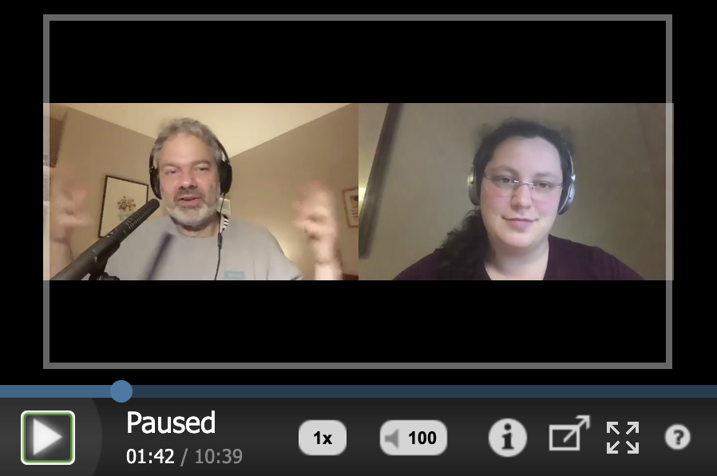
What we mean by co-teaching

Slide 17
Why co-teaching worked during the pandemic

Slide 18
Why co-teaching will work in the future
Socratic method stimulates critical thinking (deeper learning)
Scaffolding thought processes
Taking a student perspective
Dynamic, flexible, constructivist approach
…

Slide 19
How to make co-teaching work
Know your co-teacher and agree on how you are happy to interact
Have a lesson plan, sketch your performance and take on roles
(it’s not just a friendly chat which you find interesting – it’s a
performance for the student)
Use dialogue to emphasize, clarify and to stimulate thought processes
If online, keep both speakers visible unless one covers a larger part.
Listen to your co-teacher and agree on signals during conversation
Evaluate your performance after each session

Slide 20
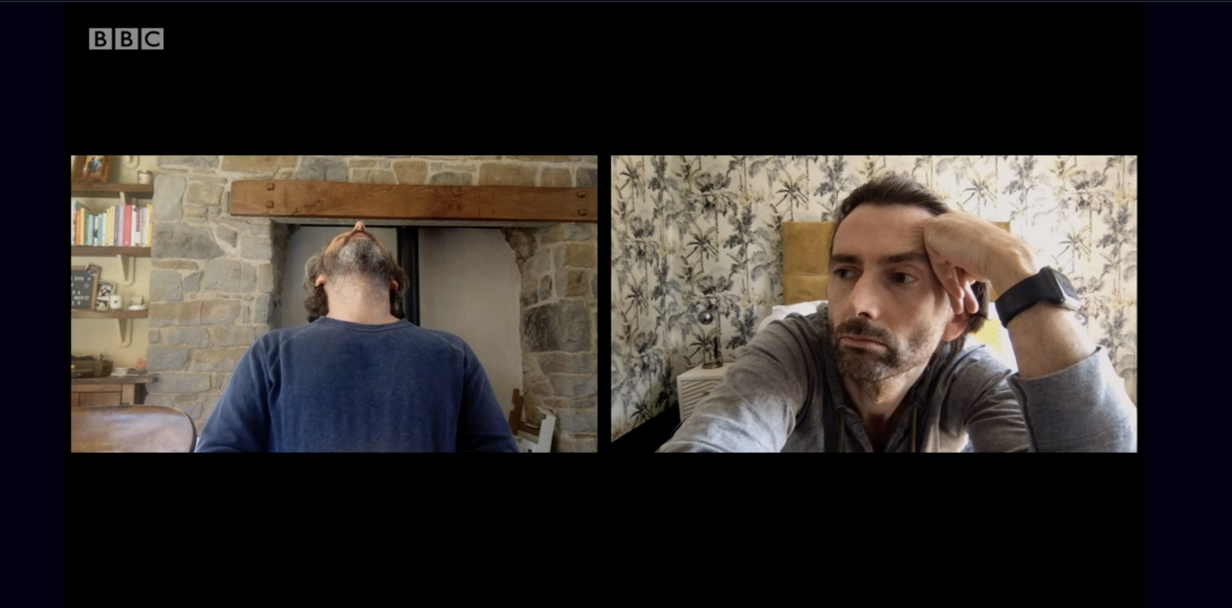

Slide 21

Managing Student Expectations
Reflections from the Pandemic
Iain Long
New(ish) Director of UG Economics Programmes
Cardiff University/Prifysgol Caerdydd

Slide 22
What is the issue?
There is a trade-off between the speed and scale of adoption of different teaching techniques and the ease with which we manage student expectations and anxieties.

Slide 23
Reflections from 20/21
A transparent, collaborative process between stakeholders.
Acknowledge uncertainty and that everyone is struggling.
Needs more constant attention.
Messaging must be clear, consistent and persistent.
Colleagues need support to meet student expectations.

Slide 24
What helps?
Transparent module structure.
  Weekly module maps.
Not more, just different.
Highlight the benefits of blended learning.
Reduce intra- and inter-module heterogeneity in delivery.
Keep talking:
  Traditional forums, but also develop new ones.
  Regular discussions with colleagues.

