Slide 1

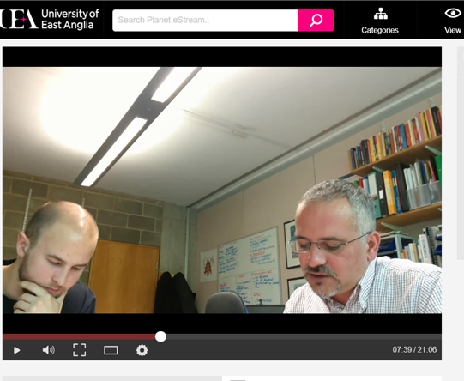
From Essay to Evaluative Conversation
Unlocking the power of viva voce assessment
for undergraduates
Fabio R. Aricò
F.Arico@uea.ac.uk
Economics Network
Virtual Symposium 2020

Slide 2

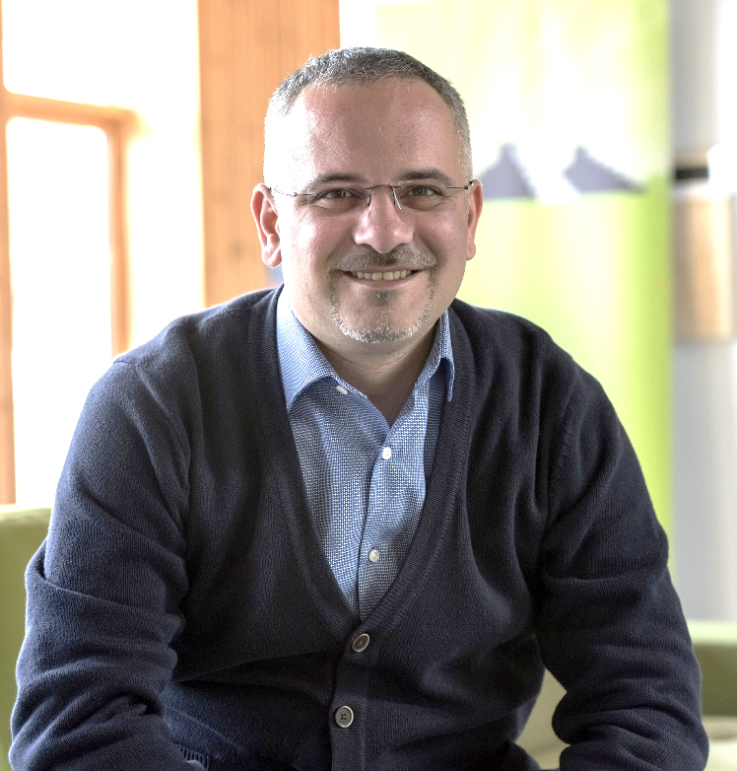
YOUR PRESENTER
Fabio Aricò
UK National Teaching Fellow
Professor of Higher Education and Economics
Director of Learning, Teaching, and Quality
School of Economics – UEA, Norwich, UK
Research fields
Higher Education policy and practice
Oral Assessment
Self-Assessment and Academic Self-Efficacy
Twitter: @FabioArico

Slide 3

OUTLINE
Introduction to viva voce assessment
and wider context
Implementing viva voce assessment:
my experience
Evaluation: preliminary results
Post Covid-19 arrangements

Slide 4
Introduction to viva voce assessment and
wider context

Slide 5

POSITIONING
I am Italian and I trained at an Italian University
Backward:
Teaching practice in Italy was more didactic
Forward:
For the majority of disciplines, every final exam
is composed of a written + viva voce component
I strongly believe we should make better use of viva voce assessment.

Slide 6

VIVA VOCE ASSESSMENT
Uncommon Stray (2001) – Traditional shift from oral to written exams in UK
Hounsell et al. (2007) – Why is it not used at UG level?
Few examples: Nursing (Davis & Engward, 2018), Dentistry (Ganji, 2017),
Business Studies (Pearce & Lee, 2009), Education (Carless, 2002),
Mathematics (Iannone & Simpson, 2012)
Unresearched Dobson (2008) – not conceptualised in literature
Needed EconomicsNetwork Surveys (2018-20)
→ communication to non-economists
→ creativity and imaginative ability

Slide 7

VIVA VOCE ASSESSMENT
INDIVIDUAL EVALUATIVE
PRESENTATION CONVERSATION
A presentation is not a viva voce – power dynamics are different
Authenticity → what could be closer to a job interview?
Reflect on where you want to position your assessment.

Slide 8
Implementing viva voce assessment:
my experience

Slide 9
HISTORY of ECONOMIC THOUGHT
Context: UG Year 2 optional module, popular with PPE students
Enrolment: 70 (2017-18), 50 (2018-19), 25 (2019-20), 40 (2020-21)
Delivery: lectures (reading and commenting original texts)
seminars (more readings, ideally student-led)
Content: Petty, Smith, Ricardo, Marx, Bentham, Mill & Marginalists, Hayek & Austrians, Keynes, Friedman, McCloskey, Sudgen
Challenges: non-technical, so tests and exams are pointless
want to develop critical thinking, ability to discuss,
see the bigger picture, express through different media.
(embedding employability in the curriculum)

Slide 10
ASSESSMENT DESIGN
1 (30%)
group video presentation
using different media to communicate
2 (40%)
individual
critical essay
developing research and critical skills
3 (30%)
individual evaluative conversation
engaging in discussion -
interview skills
feed-forward
engaging students process, not end-point
Carless & Boud (2018)
Winstone & Carless (2019)

Slide 11
HOW TO DO IT? Evaluative Conversation
1. Block time-slots according to need
2. Set shared Excel with time-slots, linked to VLE
3. Students book their conversation slot, email to confirm
4. Evaluative Conversation: 15-20mins + 10 minutes to write feedback
- recording on laptop camera and microphone
- 1st part discussing essay feed-forward, 2nd part on entire syllabus
- taking notes + marking crib + marking rubric agreed with students
5. Upload recording and marking crib/rubric on
VLE add short feedback sentence and final mark.

Slide 12
HOW TO DO IT? Evaluative Conversation
Making Rubric co-created with students and reviewed periodically
(simplified senate scale)
Response to Feedback discussing the essay feedback
Critical Ability depth of knowledge
links across theories
Flexibility and Responsiveness breadth of knowledge
Exposition Clarity and Quality using appropriate jargon
Confidence attitude during conversation

Slide 13
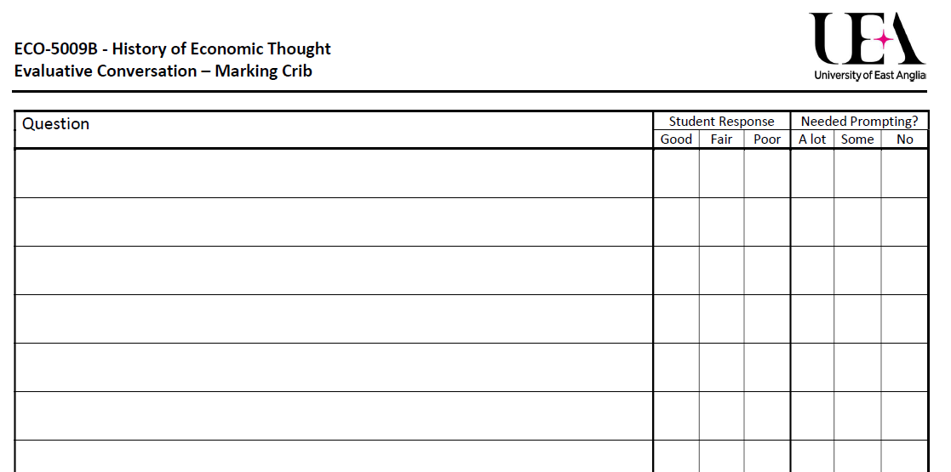
HOW TO DO IT? Evaluative Conversation

Slide 14
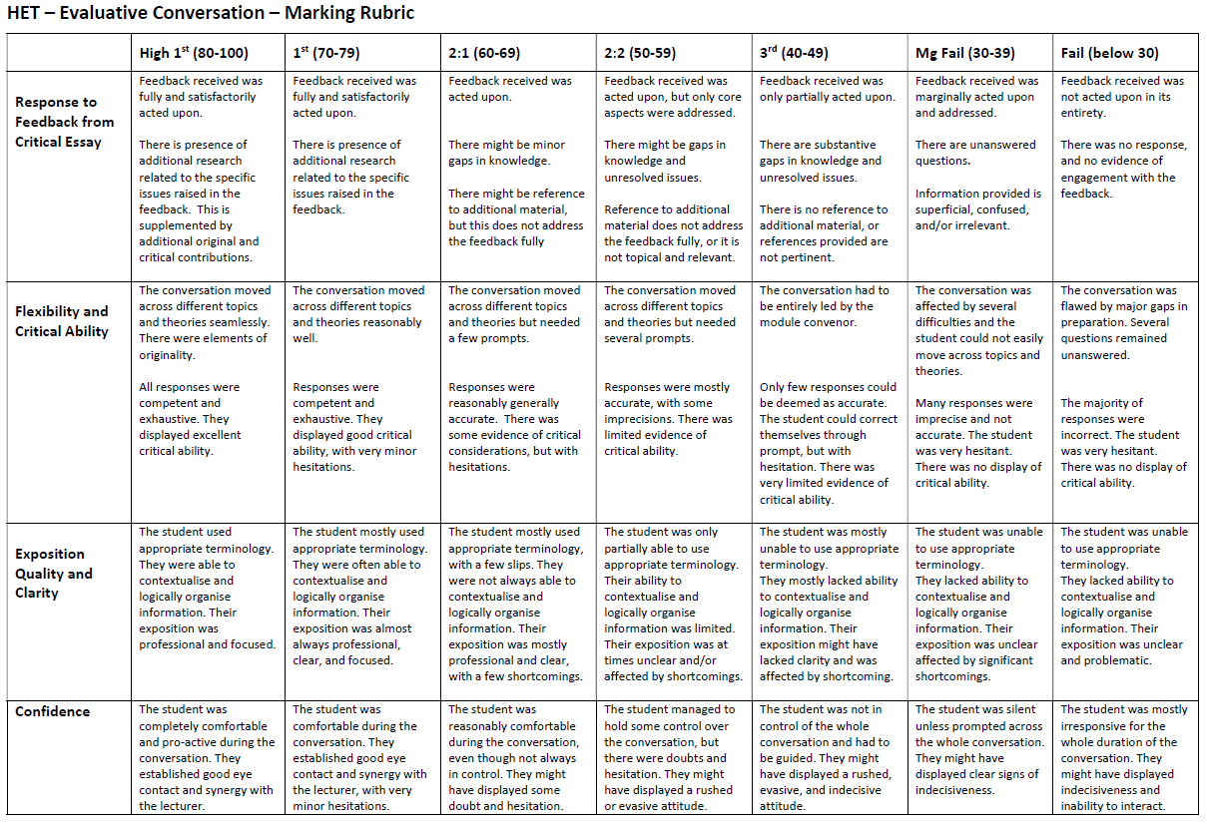
HOW TO DO IT? Evaluative Conversation

Slide 15
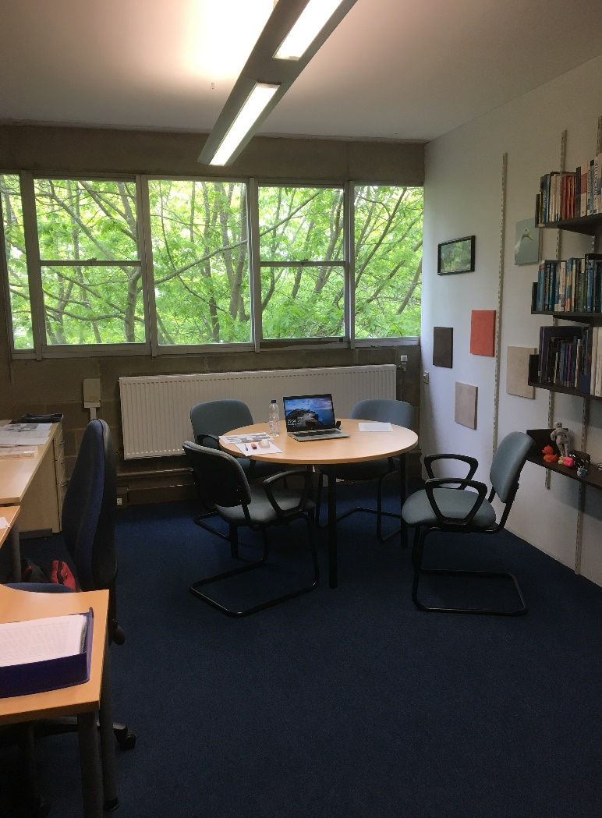
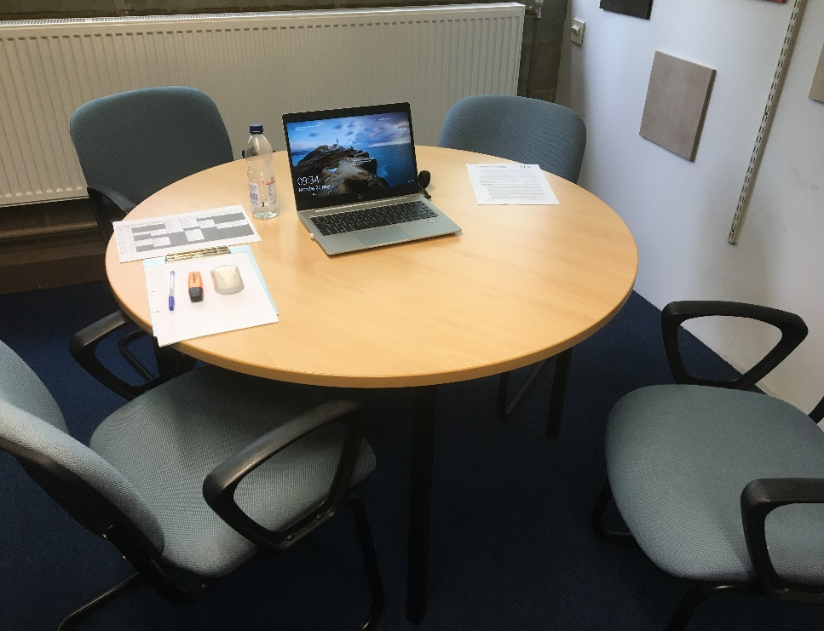
RE-FRAMING THE ASSESSMENT SPACE
School of Economics
my office

Slide 16

RE-FRAMING THE ASSESSMENT SPACE
In a socially-distanced world transferring Evaluative Conversations online was very simple
2019-20 meetings booked on Zoom and recordings uploaded on the VLE
I found that students felt more at ease not being physically present in the room with me
Discussing the essay feedback could be done sharing the essay document on screen
Evaluative Conversations are hardly subject to risk of plagiarism.

Slide 17
QA and FAIRNESS – risk management
Viva voce assessment are recorded and uploaded on VLE. They are accessible by students, marker, moderator, external examiners
Marking-Crib and Marking-Rubric keep the process consistent
There are risks to students, but also benefits to skill-development
→ strive to achieve balance
Viva voce assessments are much harder to plagiarise.
From this perspective, we are preventing bias!
There is unconscious bias, but there is also goodwill and partnership
→ we need to be brave, we need to teach students to be brave.

Slide 18
SCALABILITY
How to adjust this process for large classes?
Consider shortening the time of each viva. We can extract a lot of information within 3-5 minutes.
Consider focusing on commenting diagrams and data.
Consider online/offline conversations
How to obtain consistency across different markers?
calibration is much better than moderation (AdvanceHE)
assess first 5 conversations as a team
use marking tools such cribs and rubrics with explicit criteria
cross-evaluate (e.g. 5mins with each markers rather than 10mins with one)

Slide 19
Evaluation:
preliminary results

Slide 20
REFLECTIONS
Evaluative conversations allow for a personal experience.
I dedicated time to each one of my students.
I adapted to them, rather than they adapting to me.
Managing and assessing Evaluative Conversation It might seem a daunting task, but it does not take any longer than marking an essay.
It is a stimulating and interesting experience too.
The use of rubrics allows me to preserve consistency in marking.
Quality Assurance protocols can be respected seamlessly.

Slide 21
QUOTES FROM STUDENTS
I really enjoyed having a follow-up assessment on the critical essay. It gave more meaning to both the essay the EC, as opposed to the usual dumping of concern/knowledge following a submission.
The conversation approach helped to trigger memories which I wasn't confident that I had.
I enjoyed the essay writing process as I chose a topic that I found interesting. I also liked the evaluative conversation, as it has improved my ability to take criticism and respond to it.
I had left my preparation until later than recommended. [?] I was not confident in my ability to perform . Also, I was stressed before beginning but Fabio's relaxed behaviour and casual talk calmed me down.
What I prepared most was not what I was asked about.
It was harder than I expected because you asked a lot of stuff outside the essay feedback.

Slide 22
Developments and
Plans post Covid-19

Slide 23
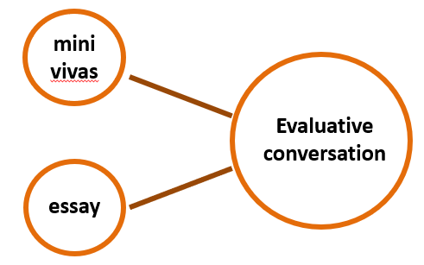
HOW TO TRAIN STUDENTS TO VIVAS?
Eureka moment: assessment is the embed training in
driver of learning scaffolded assessment
H2O model
skills
knowledge

Slide 24
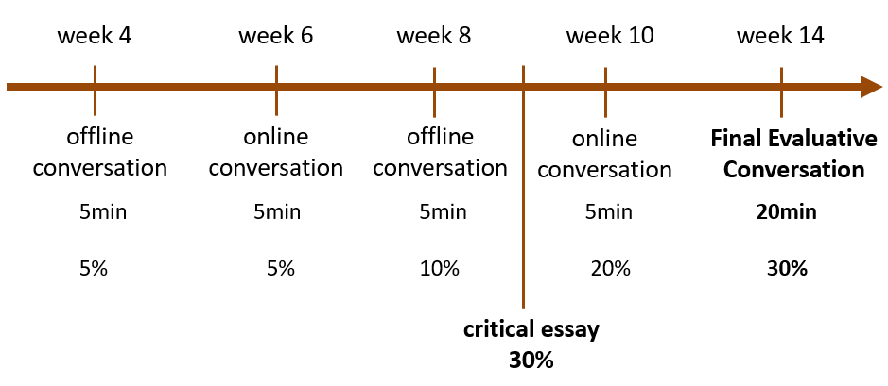
HOW TO TRAIN STUDENTS TO VIVAS?

Slide 25
RE-FRAMING THE ASSESSMENT SPACE
In a socially-distanced world transferring Evaluative Conversations online was very simple
2019-20 meetings booked on Zoom and recordings uploaded on the VLE
I found that students felt more at ease not being physically present in the room with me
Discussing the essay feedback could be done sharing the essay document on screen
Evaluative Conversations are hardly subject to risk of plagiarism.

Slide 26
REFERENCES -1-
Carless, D.R. 2002. The 'Mini-Viva' As A Tool To Enhance Assessment For Learning. Assessment and Evaluation in Higher Education, 27 (4), pp. 353-363.
Carless, D., and Boud, D. 2018. The Development of Student Feedback Literacy: enabling uptake of feedback. Assessment & Evaluation in Higher Education, 43 (8), 1315-1325.
Davis, G., and Engward, H. 2018. In Defence Of The Viva Voce: Eighteen Candidates’ Voices. Nurse Education Today, 65, 30-35.
Dobson, S. 2008. Theorising The Academic Viva In Higher Education: the argument for a qualitative approach. Assessment and Evaluation in Higher Education, 33 (3), 277-288.
Ganji, K. 2017. Evaluation Of Reliability In Structured Viva Voce As A Formative Assessment Of Dental Students. Journal of Dental Education, 81 (5), 590-596.
Hounsell, D., Falchikov N., Hounsell, J., Klampfleitner, M., Huxham, M., Thompson, K. and Blair, S. 2007 Innovative Assessment Across the Disciplines: An Analytical Review of the Literature. York: Higher Education Academy.

Slide 27
REFERENCES -2-
Iannone, P., and Simpson, A. 2012. Oral Assessment in Mathematics: implementation and outcomes. Teaching Mathematics and Its Applications, 31, 179-190.
Linderbaum B.A., and Levy P.E. 2010. The Development and Validation of the Feedback Orientation Scale (FOS). Journal of Management, 36 (6), 1372-1402.
Pearce, G., and Lee, G. 2009. Viva Voce (Oral Examination) As An Assessment Method: insights from marketing students. Journal of Marketing Education, 31 (2), 120-130.
Sadler, R. 2010. Beyond Feedback: developing student capability in complex appraisal. Assessment & Evaluation in Higher Education, 35 (5), 535-550.
Stray, C. 2001. The Shift from Oral to Written Examination: Cambridge and Oxford 1700–1900. Assessment in Education: Principles, Policy & Practice, 8 (1), 35-50.
Winstone, N., and Carless, D. 2020. Designing for Student Uptake of Feedback in Higher Education. Routledge.

