Slide 1


Facilitating interactive teaching
Ralf Becker ralf.becker@manchester.ac.uk

Slide 2
Lectures are over-rated! and under-utilised!
This is my thesis.
Notes:
Lectures are over-rated!
Lectures are over-rated!

Slide 3
What do we want to achieve with a course unit?
Facilitate student’s (independent) learning
Memorise information
Extract principles and underlying meaning
Integrate new with previously acquired knowledge
Enable students to apply their knowledge in a new context
Source: University of Manchester, Manual of Academic Procedures

Slide 4
What tools do we have?
Lectures
Tutorials/Seminars
Reading
Coursework/Groupwork
Online quizzes
Podcasts
Online Clips
Peer Assisted Study Schemes

Slide 5
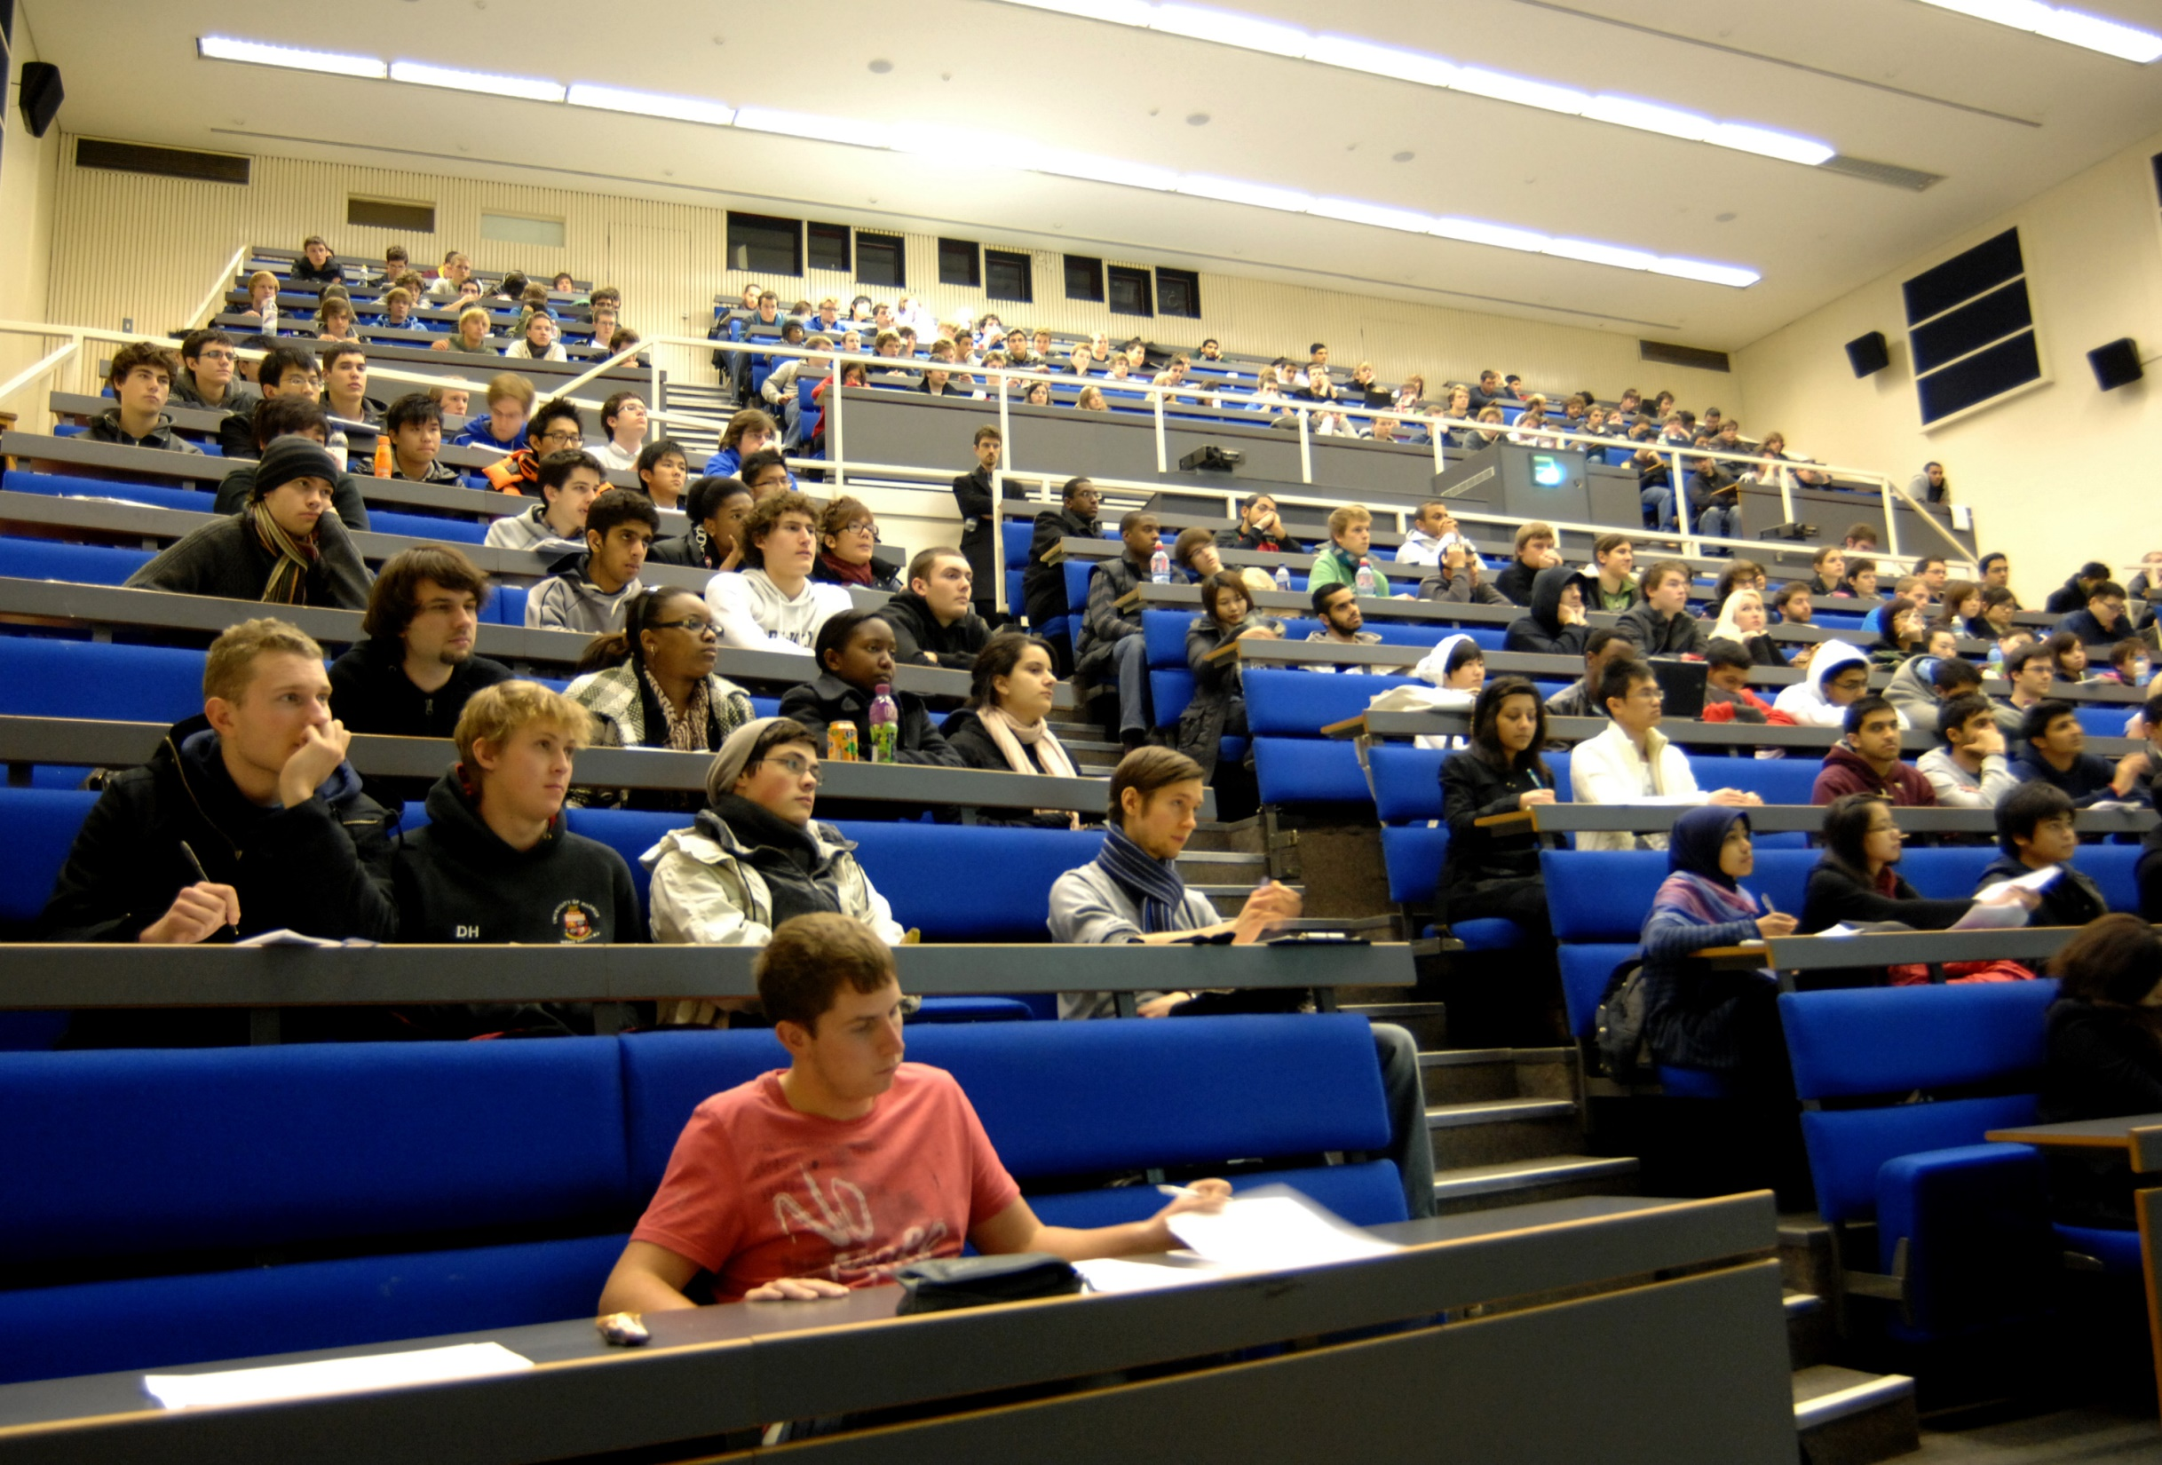

Slide 6
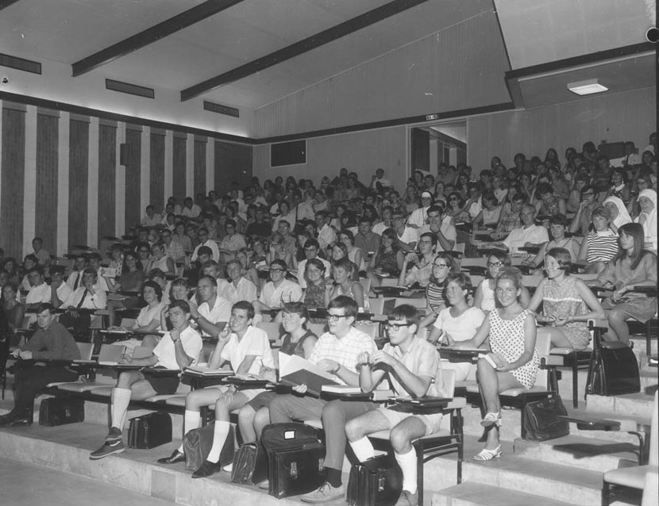

Slide 7
What does typically happen in a lecture?
Main vehicle to convey material
Mostly done by the lecturer presenting
Extra reading and tutorials to supplement that material
Coursework to deepen knowledge (often on a particular aspect of the material)

Slide 8

Do not use the Lecture content as a definition of the course unit syllabus!
And make sure that students understand this!

Slide 9
What has changed?
Technology
Virtual Learning Environments (Moodle, BB, Canvas)
In-class voting systems
Video recording facilities
Lecture Podcasts
Competition (e.g. MOOCS)
Material (demand for more application focus)
Understanding of Learning
www.economicsnetwork.ac.uk

Slide 10
Technology
Ease at which content can be presented outside the lecture
Reading (textbooks, blogs, newspapers, any other internet sources)
Podcasts (audio recording)
Lecture Capture
Videos published online (e.g. Khan Academy)
www.economicsnetwork.ac.uk

Slide 11
Understanding of Learning
(Deep) knowledge is constructed not passed on
Students aim to integrate new material with existing knowledge and real life experiences
May have to overcome existing mental models which is likely to require:
some element of active learning
student’s motivation to learn
The aim: Engage more students into this type of learning
Lit: good summary by Steve Draper (Glasgow)

Slide 12
Active Learning
Students actively engage with material / challenge their preconceived understanding
Motivated students will typically do this by fully engaging with extra reading/tutorial questions/coursework and reading beyond the expected
Can happen in different settings (but typically doesn’t happen in a traditional lecture)
Why not?
Aim: By moving elements of active learning into the classroom we can perhaps engage more students into activities that facilitate deep learning
Lit: Meta analysis of active learning in STEM, Freeman et al., PNAS, 2014

Slide 13
Challenges
How can we create space in the lecture?
What should we do in the lecture?
www.economicsnetwork.ac.uk

Slide 14
Think about the entire learning process not only the lecture!
What is best achieved by lectures?
What best by other tools?
Restrictions:
School guidelines on how many lectures and tutorials you should put up
Convention/Student expectation and work pattern
Your workload
www.economicsnetwork.ac.uk

Slide 15

The Learning Week

Slide 16
Your VLE

Slide 17

Your role in influencing
Student behaviour and motivation
Notes:
This is where it pays to have space in the lecture for advanced subtle material as that is more likely to enthuse students. You can link to research more easliy.
Finish this slide saying that whatever you do, you are likely to use some form of slides and hence, in the next section we will look at aspects of actual presentations.

Slide 18
“Outsource” part of the (examinable!!!!) material away from lectures (either before or after)
personally often to online clips, but could be reading or podcasts or other delivery means as well
Very introductory exposition
Long and tedious (but important) arguments
Proofs
This gives more time in lectures for:
More complex/subtle material
Extended Examples
Discussion
Staff/Student and Student/Student interaction (e.g. quizzes, small practice questions)

Slide 19
Some practical hints Discussion Board
A well-run discussion board can help with student engagement
Requires seeding with information at the beginning
Expectation that students show effort
Encourage other students to answer/comment
allow anonymous posts
We started using Piazza.com
Notes:
RB: Should mention that, of course, other programmes exist.
Something on whether you can “get away” with no slides at all?

Slide 20
Some practical hints for lectures
Assumption: You have created time in the lecture. Students know that non-lecture material is examinable!
Aim: To increase student engagement in lectures
Start lecture with short quiz on material you asked students to read/watch since last lecture
Give students a few minutes to get started on a problem
www.economicsnetwork.ac.uk
Notes:
RB: Should mention that, of course, other programmes exist.
Something on whether you can “get away” with no slides at all?

Slide 21
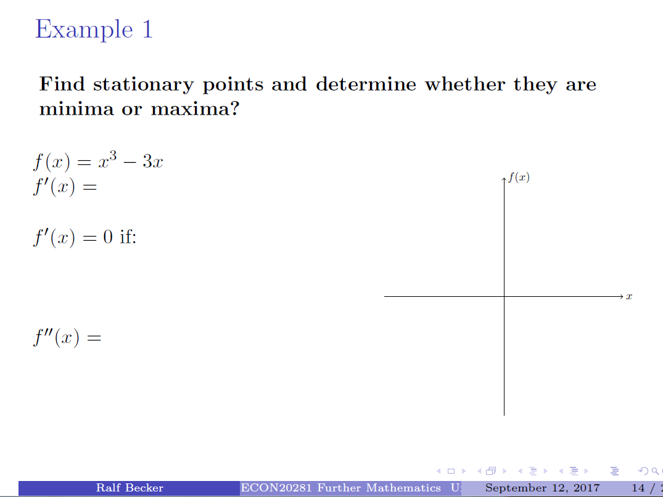
Notes:
Will bring a hardcopy of this slide and hand write some stuff on it if the room allows switching to document camera.

Slide 22
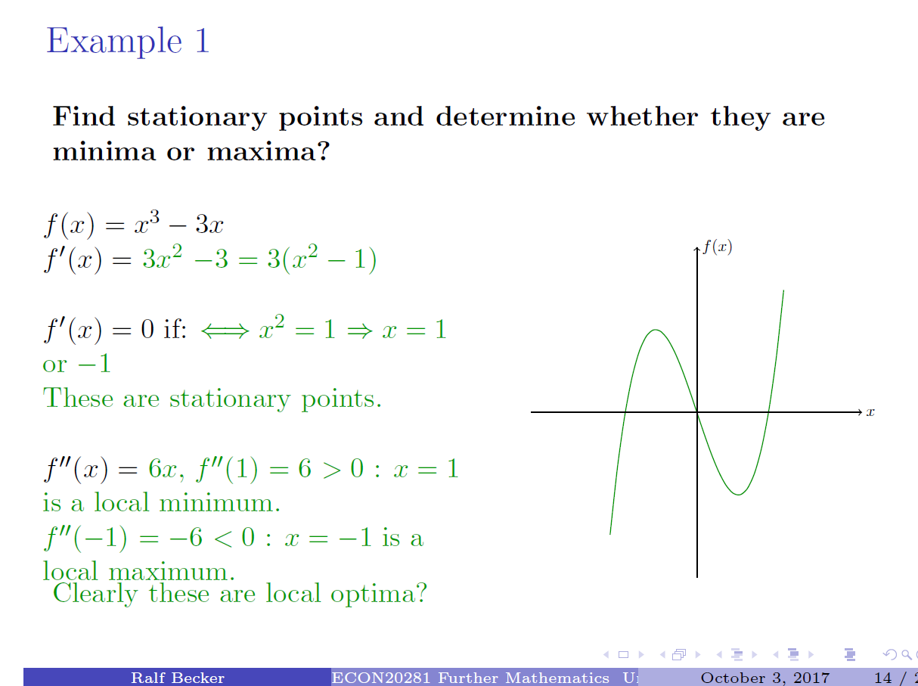

Slide 23




Lecture Notes productivity tip
In Latex:
In PowerPoint:

Slide 24
Some practical hints for lectures
Let students discuss
Ensure that students take notes (if not why?)
Underline/circle/highlight
Leave deliberate gaps
Produce graphs on the paper
Tell them: “I see only a few of you think that this is important enough to note down.”
Do use lectures to tell students how you expect them to study.
www.economicsnetwork.ac.uk

Slide 25
Some practical hints
Be incentive compatible If you asked students to read stuff between lectures … don’t cover the material again in the lecture
Tell students why you do things that may be unpopular (like not giving solutions)

Slide 26

Gradual changes
Think what is working well
No need to change everything at once
Think about how delivery and assessment work hand-in-hand

Slide 27
Summary
What is your comparative advantage?
What is it you enjoy?
Think more about student’s learning
Don’t allow students to be passive (all the time)
Be a coach!

