Slide 1
Activating Economics Teaching
Ralf Becker (University of Manchester)
Alvin Birdi (University of Bristol and Economics Network)
Cloda Jenkins (University College, London)
Humberto Llavador (Universitat Pompeu Fabra)

Slide 2
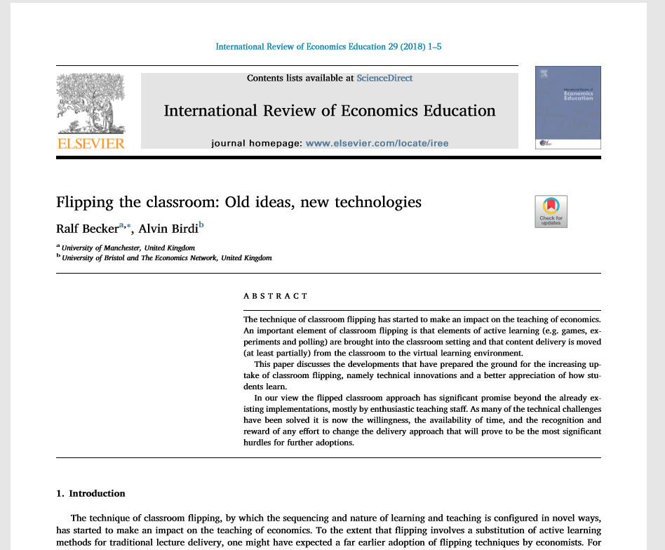

Constructivist vs expositional teaching
How do we know it works?
Metastudies rather than individual RCTs (Prince 2004 in Jnl Engineering Education; Freeman et al 2015 in PNAS; Becker and Birdi 2018 IREE Special Issue on Flipping)
Notes:
-We don’t have clean RCTs because 1) cannot randomise treatment and control; 2) teacher effects (i.e. treatment not applied consistently) 3) outcome measures not clear (attainment, motivation etc) 4) student efficiencies taken elsewhere (e.g time saved used in leisure etc)
-Freeman et al look at 225 studies and looked at attainment

Slide 3
Some Difficulties in activating economics
Fixed cost investment (developing videos, quizzes, activities etc)
Fear of failure and risk averseness (Lauren Herckis, Carnegie Mellon)
Content is not independent of pedagogy
There is no space in the curriculum

Slide 4


The Example of CORE
(4 principles)
www.core-econ.org

Slide 5
CORE 1 Eliminate redundant content
IS-LM AS-AD
Marginal productivity model of labour markets
[perfect competition]
Fundamental theorems of welfare economics
P1 Irrelevance to the immediate purpose is demotivating
Notes:
Some content is not useful for students. What to leave out is a fundamental starting point for understanding. Nothing is more confusing to students than having to think why something is in the lecture that doesn’t seem relevant.

Slide 6
CORE 2: Increase empirical and active content
200+ datasets included
Doing Economics companion text
Classroom games included for many chapters
cf Raj Chetty course (www.opportunityinsights.org/course)
P2 Economics is blessed with active content. Use it in class.
Notes:
It so happens that economics is blessed with content that is “active”

Slide 7
CORE 3 Prioritise a problem (cf research)
E.g.
Ch 2: Why UK GDP growth first?
Ch3: What did workers do with higher wages? Was Keynes right?
Ch4: Why is climate emissions growth so hard to control? [public goods game]
Ch5: Why is there so much inequality?
P3 Sequence matters (cf. the importance/neglect of narrative: R. Shiller AEA presidential address 2017)

Slide 8
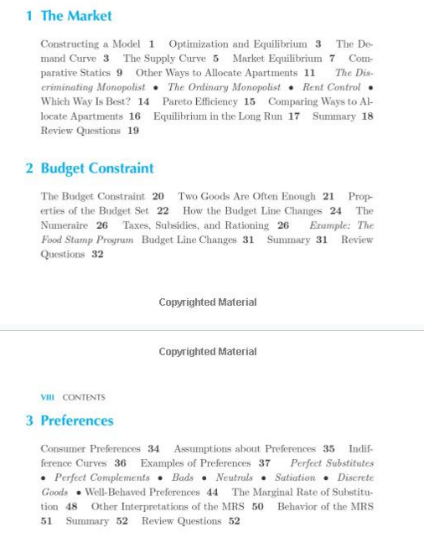


Slide 9
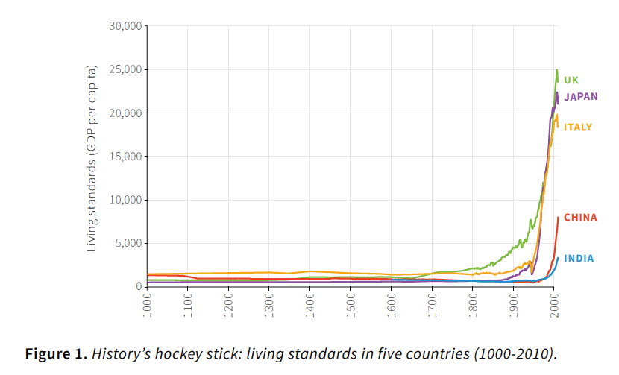

  Where to begin a course?
the great divergence

Slide 10
CORE 4: Export non-active content and make it complementary to activity
Don’t cover material in lecture that students are supposed to read
Make the lecture activities dependent on pre-lecture work
Use diagnostics [polls, quizzes] to test student preparedness for lectures
P4 Use material in appropriate teaching contexts
Notes:
What to do with content that is not conducive to activity

Slide 11
Unit 4
Preparation for flipped class
COMPLEMENTARY MATERIAL
Play the public goods game well before reaching this unit and record the results. Use the fun aspect.
Then: preparation
Read about climate change – why did Montreal succeed while Kyoto and Paris have had so many problems?
State of the fisheries: Huxley Fisheries Exhibition
Notes:
This is the complementary material

Slide 12
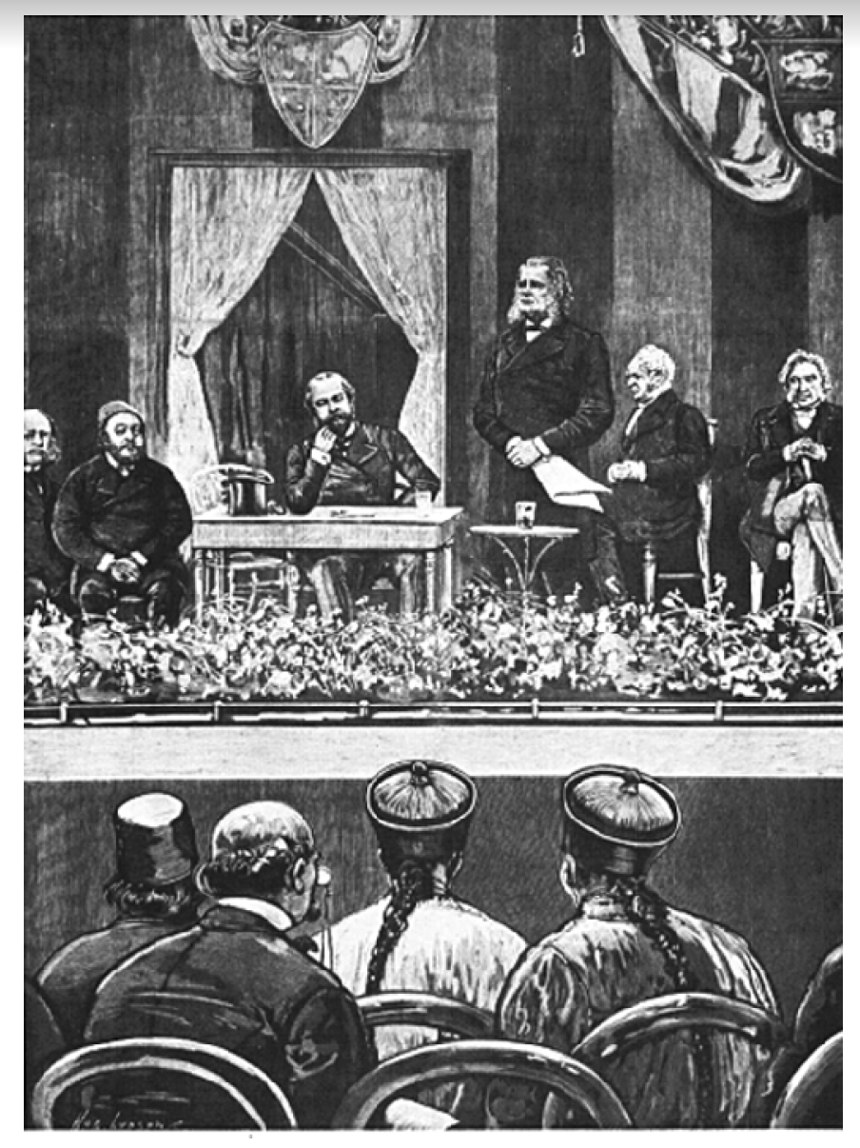

Slide 13
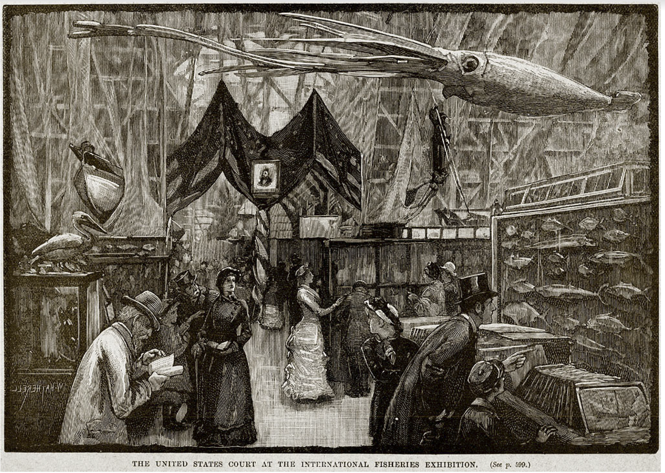

Slide 14
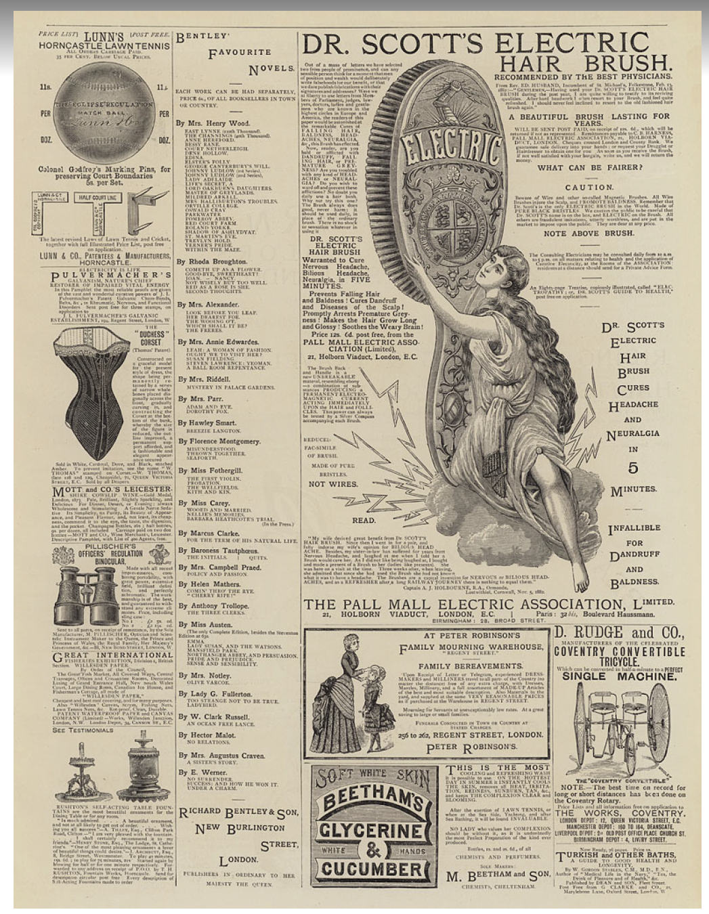

Slide 15
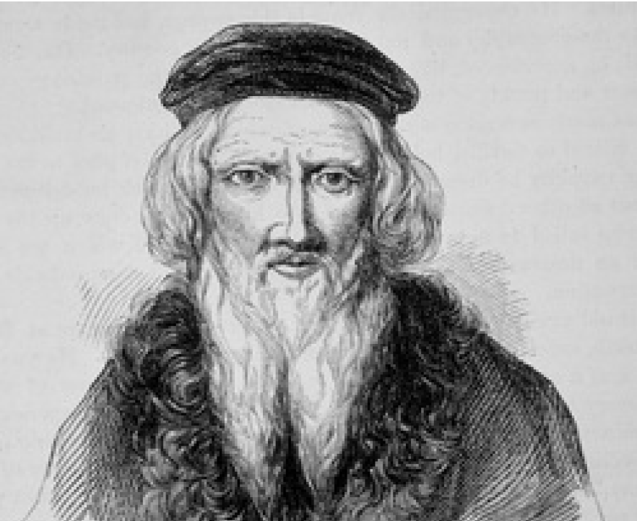
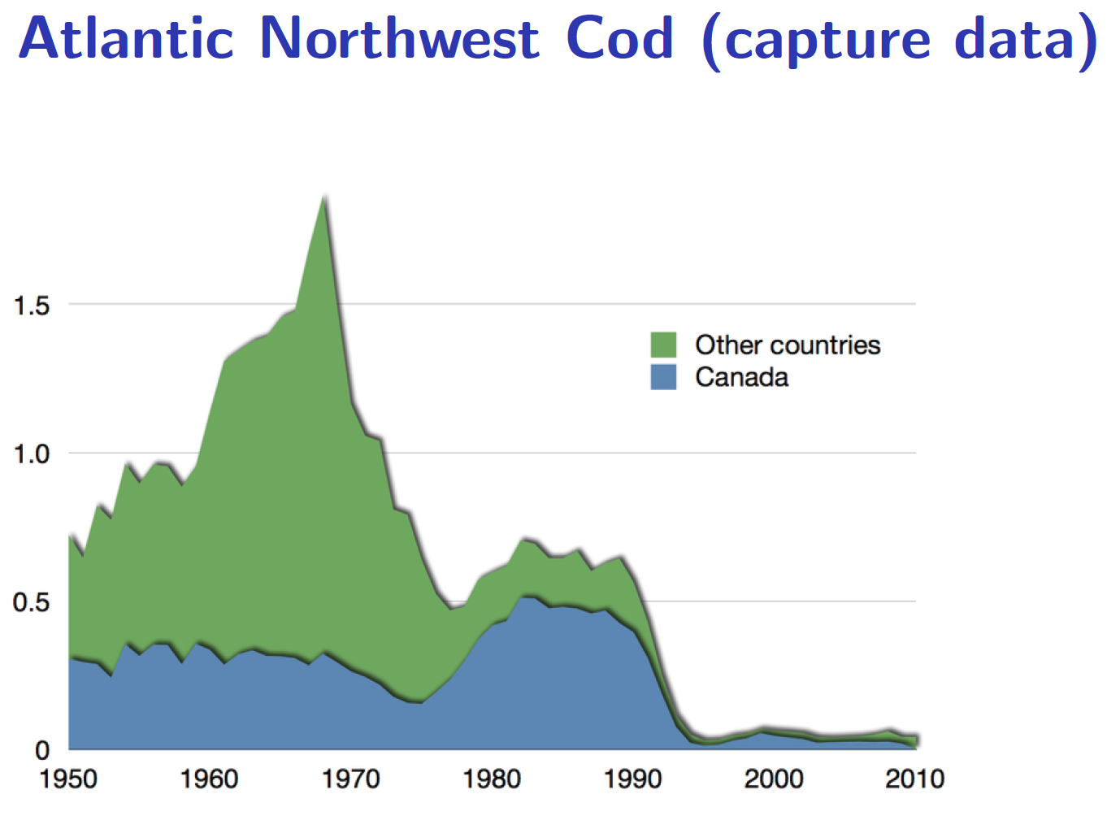
THE PROBLEM
“the sea there is full of fish that can be taken not only with nets but with fishing-baskets” (John Cabot c.1450-1499)

Slide 16
Unit 4: “Lecture”
ACTIVE LECTURE/WORKSHOP
Lecture:
Look at game data, work out Nash mechanics, compare with invisible hand game. What does this mean for human behaviour and human motives?
Now look at the students’ results and international evidence.
Altruistic preferences, reciprocity, ultimatum games etc

