Slide 1
Problem-based Learning
Opportunities for Economics education
DEE 2019, Tim Burnett (t.burnett@Warwick.ac.uk)

Slide 2
“It is helpful to remember that what the student does is actually more important in determining what is learned that what the teacher does.”
- Shuell (1986), p.429

Slide 3
Outline
The problem with existing teaching methods
What do we want from students?
Constructive alignment and how PBL can help?
The PBL process
Structuring, scaffolding
Some examples

Slide 4



Look familiar?
In what way does this look like the world of employment, or higher level study in Economics?
What is this training students to do?

Slide 5
The issue with ‘conventional’ learning
A lecturer-centred learning approach
Lecturer is the ‘sage on the stage’
Tests ability of students to memorise what they are being told
Content-heavy learning outcomes, assessed using conventional assessment techniques (essays, exams)
Students learn by what they do…

Slide 6

The ‘Tinkerbell’ effect
“If we teach students to solve enough specific examples then they’ll magically be able to apply this to solve new abstract examples”

Slide 7
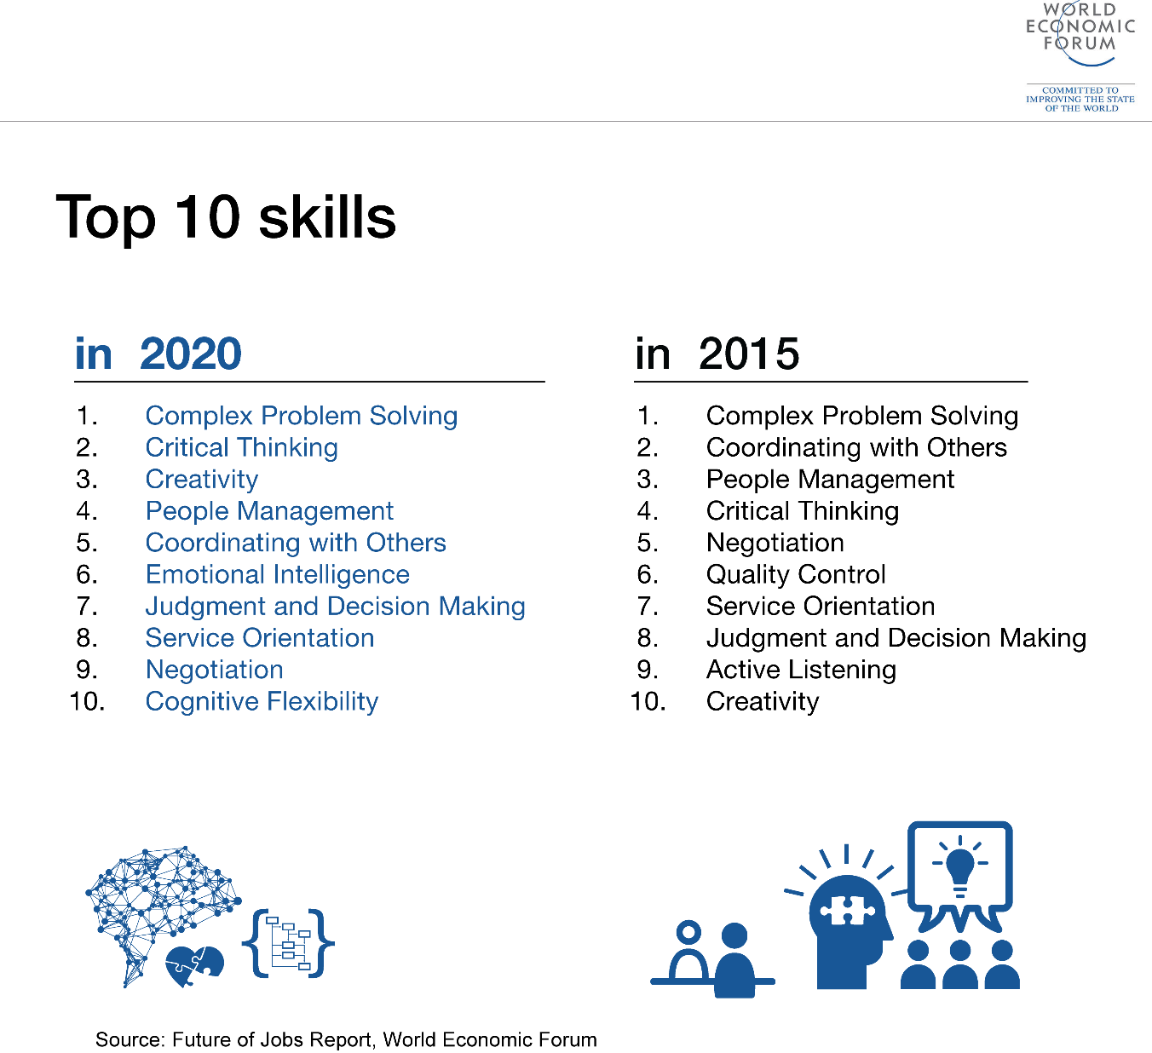
What do we want from students?
If students learn by doing, in what way does the way that we teach encourage these type of skills?

Slide 8
The PBL process: Overview
Specifically aims to overcome the issues of large lectures
Pioneered in teaching medicine…
PBL learning primarily takes place in small-class setting
Emphasises self-directed research on the part of students
Intrinsically constructivist

Slide 9
The PBL process: Process
Students in groups are issued with a ‘stimulus’?
Stimuli can be scenarios, case studies, news stories which feature a ‘problem’ (problems are often not really problems in the traditional sense, more they are things we don’t understand fully)
Ultimately the ‘problem’ can be broken down into some sub-issues which you want students to investigate
Problems should be relatively complex so as to require students to undertake research
In groups students should identify the issues they need to address in order to understand the ‘problem’ (very abstract at this stage, I know)
As a group they divide research responsibilities and conduct self-directed study in order to answer the research task they were set
The group reconvenes and synthesises the individual research findings of the different members in order to understand the problem

Slide 10
The PBL process: Process
Stimulus
Discussion
Allocation of research within group
Self-directed research
Synthesis
Debrief

Slide 11
The PBL process: Benefits
Active learning which requires continuous student engagement
Develops comprehension and understanding, not just knowledge
Genuinely trains students to understand how to approach
Develops team-working, communication, public speaking,
Constructively aligns with higher-level Intended Learning Outcomes and programme-level graduate and employment skills

Slide 12
The PBL process: The role of the tutor
PBL tutors need to evolve in their role from ‘sage on the stage’ (didactic, provider of information) toward ‘guide on the side’
Encourage students but don’t instruct – the key is that students search for the answer without interference
Ask critical questions
Debriefing is important but it’s important not to get into “if you’d done it this way” – instead ask students to reflect on their outcomes and maybe ‘prod’ them into specific approaches they might have employed (“did you consider this approach?”) and encourage discussion – students learn from each other
Don’t feel guilty about not explaining in minute detail things to students – help students understand that this approach is for their own benefit (either through intrinsic motivation to be a good academic, or instrumentally it’ll help them get a job)

Slide 13
The PBL process: Common issues
We need to be sure that students learn X, Y, and Z:
Anxiety about content absorption is common; but remember that just because you tell a student something, doesn’t mean they’re going to remember it
You are equipping students with skills to find answers, not be told – students are smarter than we think, but we frequently fail to challenge them
Lazy group members/lack of participation:
It’s important to learn (as a tutor) how to encourage students to participate
Student expectations:
It may be necessary to help students

Slide 14
The PBL process: Structuring and scaffolding
You have some specific content you want students to learn about and can’t trust students to research that content on their own?
Designate one member of each group as a moderator who will ask their group specific questions, which will guide their thinking
Set specific reading that you want the students to explore for answers
Create frameworks for how you would like students to present their findings

Slide 15
Are there never any taught classes?
Not entirely…
There might be skills-based classes which equip students with some competencies:
Stats/econometrics
Mathematical methods
Computer lab sessions
This might require coordination between modules
It’s rare to see these types of subjects taught via PBL (but watch this space…)

Slide 16
Getting started
Quick and easy:
In tutorials, don’t ask students to reproduce variations on models you’ve covered in lectures (you’re teaching them how to solve models, not economics, and you’ve already told them this once – give them some practice questions to do in their own time if you feel guilty)
Instead consider asking students to explain a specific stimulus and maybe debrief at the end

Slide 17
Getting started
More involved:
Consider tutorials as the primary teaching environment, not a place to practice what students have been told in lectures
Consider entire module overhaul – perhaps begin with an elective where students are more specifically interested in the topic (modules around issues like Applied Micro, Regulation and Competition where students have a pre-existing toolkit may be good candidates)

Slide 18
Some inspiration
https://www.maastrichtuniversity.nl/education/why-um/problem-based-learning

