Slide 1

Online resources for traditional classrooms – student use and outcomes
Silvia Dal Bianco and Parama Chaudhury
UCL Economics and CTaLE
September 2019
Notes:
Our paper is about this How and why VLEs for optimising students’ outcomes
Our thanks go to Dean of Social and Historical Sciences ENHANCING THE STUDENT EXPERIENCE
SMALL GRANTS
And to Soumya Kourana who provided execellent RAssistance

Slide 2
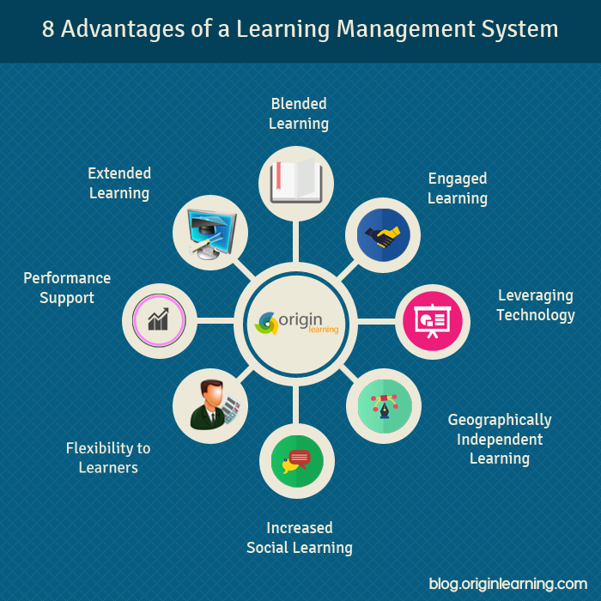
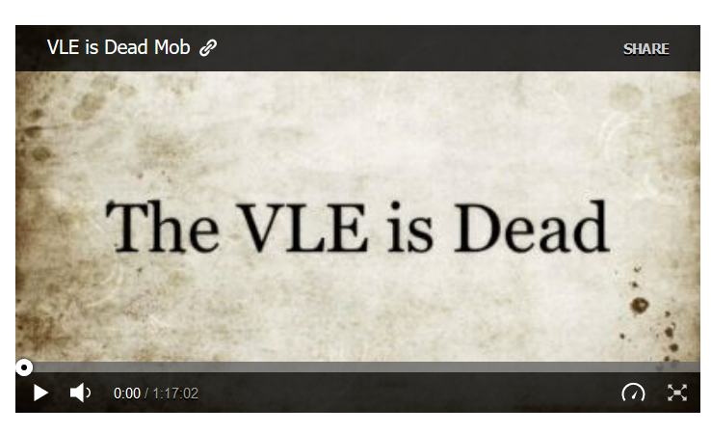
https://elearningstuff.net/2009/09/09/the-vle-is-dead-the-movie/
https://elearningfeeds.com/8-advantages-of-a-learning-management-system/

Slide 3


Slide 4

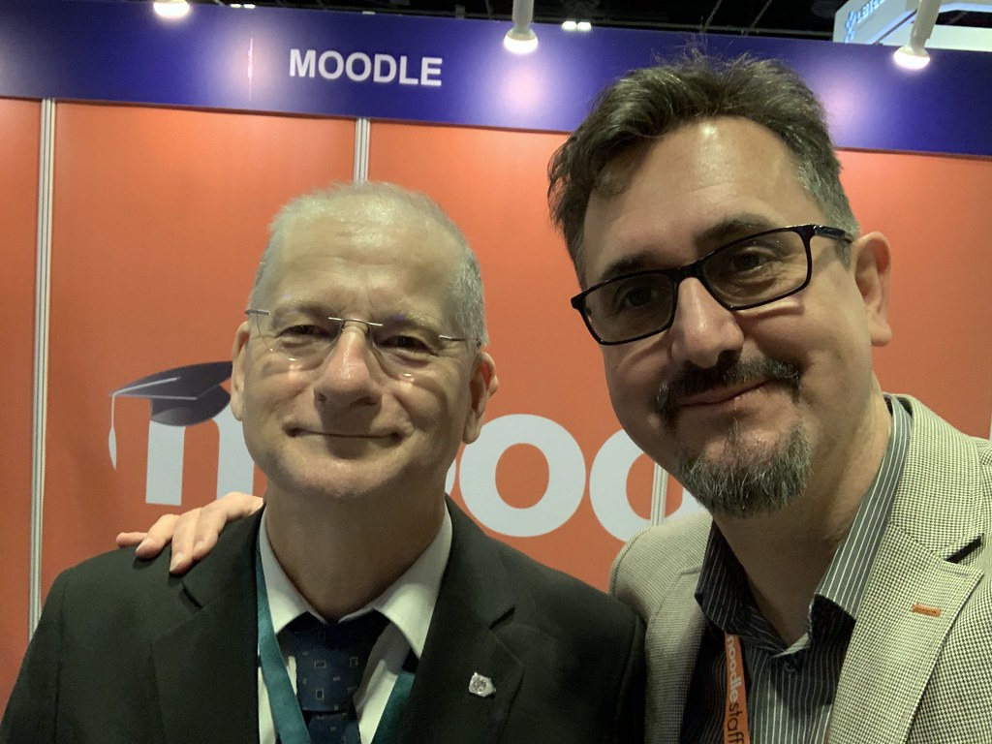
Images from Creative commons
Notes:
Martin Dougiamas is the creator of Moodle. The first release happened in 2002
Tom Worthington. A computer programmer who led a movement for increasing web-accessibility for physically impaired people.
As a child Dougiamas lived for some years in the desert of Western Australia, Kalgoorlie where he studied at home and through materials dropped off by aeroplane. His family moved to Perth and he attended West Balcatta Primary School and Balcatta Senior High School in the city's northern suburbs. In an interview in 2010 he said that this unusual educational experience perhaps prepared him for developing an Internet-based learning platform.^{[8]} Later, while studying for a master's degree and PhD at Curtin University, Australia, Dougiamas began developing the set of online tools that would become Moodle.
Moodle (acronym for modular object-oriented dynamic learning environment) allows for extending and tailoring learning environments using community-sourced plugins.
Moodle was originally developed by Martin Dougiamas to help educators create online courses with a focus on interaction and collaborative construction of content, and it is in continual evolution. It has hundreds of millions users worldwide

Slide 5
Why: Want to find out whether we are using the VLE “optimally”
How do students perceive our use of the VLE and how does this compare with their actual use of the VLE?
Is there any relationship between use of VLEs and academic outcomes?
How:
Study student reports of attitudes and actions via focus groups (10 attendees)
Study usage data to identify patterns and how they correlate to academic outcomes
So What:
Identifying implicit biases in VLE design
Implications for VLE design to be shared across institution
Notes:
OUP: A Virtual Learning Environment (VLE) is a system for delivering learning materials to students via the web. These systems include assessment, student tracking, collaboration and communication tools.
Interesting work to check and to improve: https://www.researchgate.net/publication/254020050_Student_feedback_experience_and_opinion_using_Moodle
On the next step of the project, on how we intend to implement it: The effectiveness of the template and the guidelines will be evaluated
in two ways – first with surveys of students and lecturers to measure their satisfaction with Moodle design
based on these resources, and secondly with an analysis of the academic outcomes of different types of
Students who use these Moodle pages.
Aims:
what we do: we engage in a set of activities aimed at understanding how (data and econometrics) and why (focus group) students use resources on VLE [ a key dimension in this context is student/lecturer interaction: see the forums] Understanding how students and lecturers interact with these portals
Why we do: identify guidelines to help lecturers design an effective e-learning environment for different kinds of students// design of VLEs for optimising learning outcomes
How we do:
1) Student reviews of Moodle pages for modules they are taking, run in conjunction with the Economics Society. This has been done for ECON0002 (name the Module) and in the future Next step of the project This will be done across a selection of modules across all years of the undergraduate programme.
2) Focus group with students who have experience e-assessment to understand how this fits in with the wider e-learning environment
4) Working with the Digital Education team at UCL to correlate the use of particular e-learning tools and services to student outcomes.
Next step of the project: long term aim developing best practice in terms of e-learning environments
Next operative steps:
3) Focus group with lecturers to understand their aims in providing e-resources and more generally the
design of their Moodle page.
build a set of departmental template Moodle pages and an interactive online guide which lecturers can use to create their own e-learning design according to their needs and student characteristics.
3) Build a set of departmental template Moodle pages and an interactive online guide which lecturers can use to create their own e-learning design according to their needs and student characteristics.
Motivation 1
Context: VLE what the literature says: Resources
Wide spectrum of resources, re-usable resources, interactive resources (Knight, 2004)
Enables Flipped Education: learner-centered, students choose the resources (Caliskan and Bicen); lectures can be tailored to hit specific targets (Myzuka, 2015)
Improves accessibility (Amado-Sierra, 2010) and inclusivity (McLuoghlin, 2000; 2001)
Channels through which VLEs affect students’ outcomes
On-line communities, developing a sense of belonging (Paloff and Pratt, 1999)
Delivering instructional material and facilitate communication (McGill and Hobbs, 2006)
Active use of VLE improves retention (Wolff et al. 2013)

Slide 6
The project: “E-learning and e-assessment synchronization: new evidence from Economics at UCL”
Aim: develop guidelines for the design of VLEs for optimizing learning outcomes
Methodology: set of activities for understanding how and why students use resources on VLE as well as on how students and lecturers interact with these portals
Activities:
1) Student reviews of Moodle pages for modules they are taking, run in conjunction with the Economics Society. This has been done for “Economics”, ECON0002
2) Focus group with students who have experience e-assessment to understand how this fits in with the wider e-learning environment
3) Working with the Digital Education team at UCL to correlate the use of particular e-learning tools and services to student outcomes
Motivations:
The importance of e-learning as a complement to in-class contact hours is increasing
Moodle pages across UCL differ widely in terms of design and content
Results:
Fgn
Dnb;dn
Next steps towards the development of best practice in e-learning environments (Long term aim)
1) Students reviews of Moodle pages, across a selection of modules across all years of the undergraduate programme
2) Focus group with lecturers to understand their aims in providing e-resources and more generally the design of their Moodle page
3) Build a set of departmental template Moodle pages and an interactive online guide for lecturers
Notes:
OUP: A Virtual Learning Environment (VLE) is a system for delivering learning materials to students via the web. These systems include assessment, student tracking, collaboration and communication tools.
Interesting work to check and to improve: https://www.researchgate.net/publication/254020050_Student_feedback_experience_and_opinion_using_Moodle
On the next step of the project, on how we intend to implement it: The effectiveness of the template and the guidelines will be evaluated
in two ways – first with surveys of students and lecturers to measure their satisfaction with Moodle design
based on these resources, and secondly with an analysis of the academic outcomes of different types of
Students who use these Moodle pages.
Aims:
what we do: we engage in a set of activities aimed at understanding how (data and econometrics) and why (focus group) students use resources on VLE [ a key dimension in this context is student/lecturer interaction: see the forums] Understanding how students and lecturers interact with these portals
Why we do: identify guidelines to help lecturers design an effective e-learning environment for different kinds of students// design of VLEs for optimising learning outcomes
How we do:
1) Student reviews of Moodle pages for modules they are taking, run in conjunction with the Economics Society. This has been done for ECON0002 (name the Module) and in the future Next step of the project This will be done across a selection of modules across all years of the undergraduate programme.
2) Focus group with students who have experience e-assessment to understand how this fits in with the wider e-learning environment
4) Working with the Digital Education team at UCL to correlate the use of particular e-learning tools and services to student outcomes.
Next step of the project: long term aim developing best practice in terms of e-learning environments
Next operative steps:
3) Focus group with lecturers to understand their aims in providing e-resources and more generally the
design of their Moodle page.
build a set of departmental template Moodle pages and an interactive online guide which lecturers can use to create their own e-learning design according to their needs and student characteristics.
3) Build a set of departmental template Moodle pages and an interactive online guide which lecturers can use to create their own e-learning design according to their needs and student characteristics.
Motivation 1
Context: VLE what the literature says: Resources
Wide spectrum of resources, re-usable resources, interactive resources (Knight, 2004)
Enables Flipped Education: learner-centered, students choose the resources (Caliskan and Bicen); lectures can be tailored to hit specific targets (Myzuka, 2015)
Improves accessibility (Amado-Sierra, 2010) and inclusivity (McLuoghlin, 2000; 2001)
Channels through which VLEs affect students’ outcomes
On-line communities, developing a sense of belonging (Paloff and Pratt, 1999)
Delivering instructional material and facilitate communication (McGill and Hobbs, 2006)
Active use of VLE improves retention (Wolff et al. 2013)

Slide 7
What the literature says about the use and benefits of VLEs:
Design→ Teachers self-expression (da Silvera and Selbach, 2017) and “no nos”
Provision of wide spectrum of resources, re-usable resources, interactive resources (Knight, 2004) →increase retention (Wolff et al. 2013), improve marks (Podgorelec and Kuhar, 2011)
Forums→ On-line communities, developing a sense of belonging (Paloff and Pratt, 1999)
facilitate communication (McGill and Hobbs, 2006)
Practice quizzes for preparation→ positive support for learning, helpful for revision, boosting students’ motivation (Berrais, 2014; Cohen and Sasson, 2016)
Past exam papers → improved accessibility (Amado-Sierra, 2010)
Online Feedback→ higher grades, increased levels of motivation and confidence (van Koll and Rietz, 2016).
Notes:
On the effects of on-line feedback on learning: https://files.eric.ed.gov/fulltext/EJ1125100.pdf
Superinteresting piece of work: http://www.eejournal.ktu.lt/index.php/elt/article/view/708
https://ieeexplore.ieee.org/abstract/document/6402181
Teachers’ self expression
https://www.sciencedirect.com/science/article/pii/S1045926X16300313
No nos
https://www.blackboardopenlms.com/2014/02/20/top-ten-moodle-course-design-no-nos/
On the effects of on-line feedback on learning: https://files.eric.ed.gov/fulltext/EJ1125100.pdf

Slide 8
Design/Layout/Resources

Slide 9
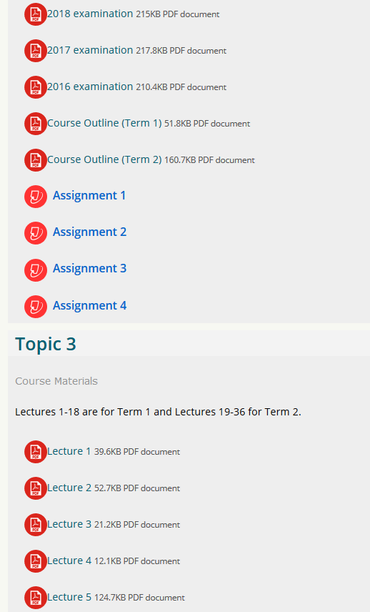
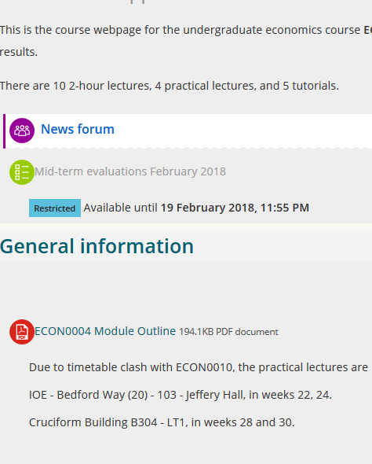
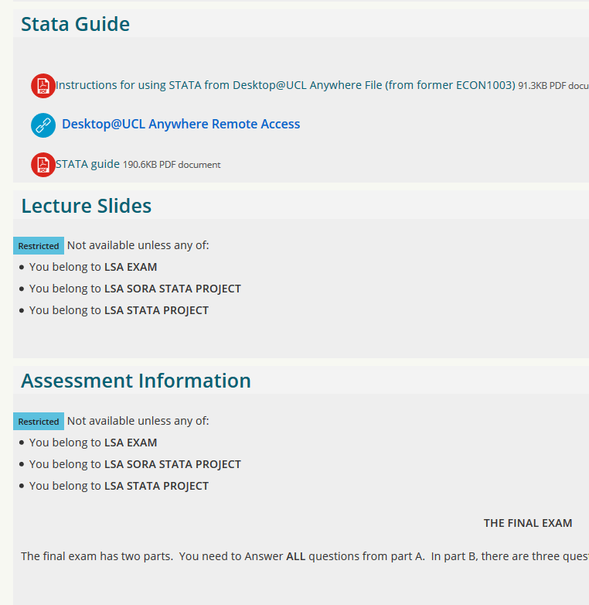
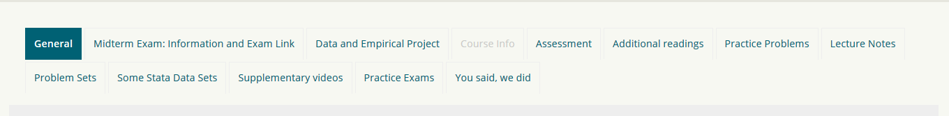
Notes:
Focus group:
Like more resources not less, even if not used
Like tabs not lists
Like fewer tabs/or organised by task
We have Soumya’s analysis of the 1st year Moodle page. It is in dropbox, the file is called Moodle pages assessment_Soumya. I have enclosed it in the next slide. The document opens if we click on it.

Slide 11
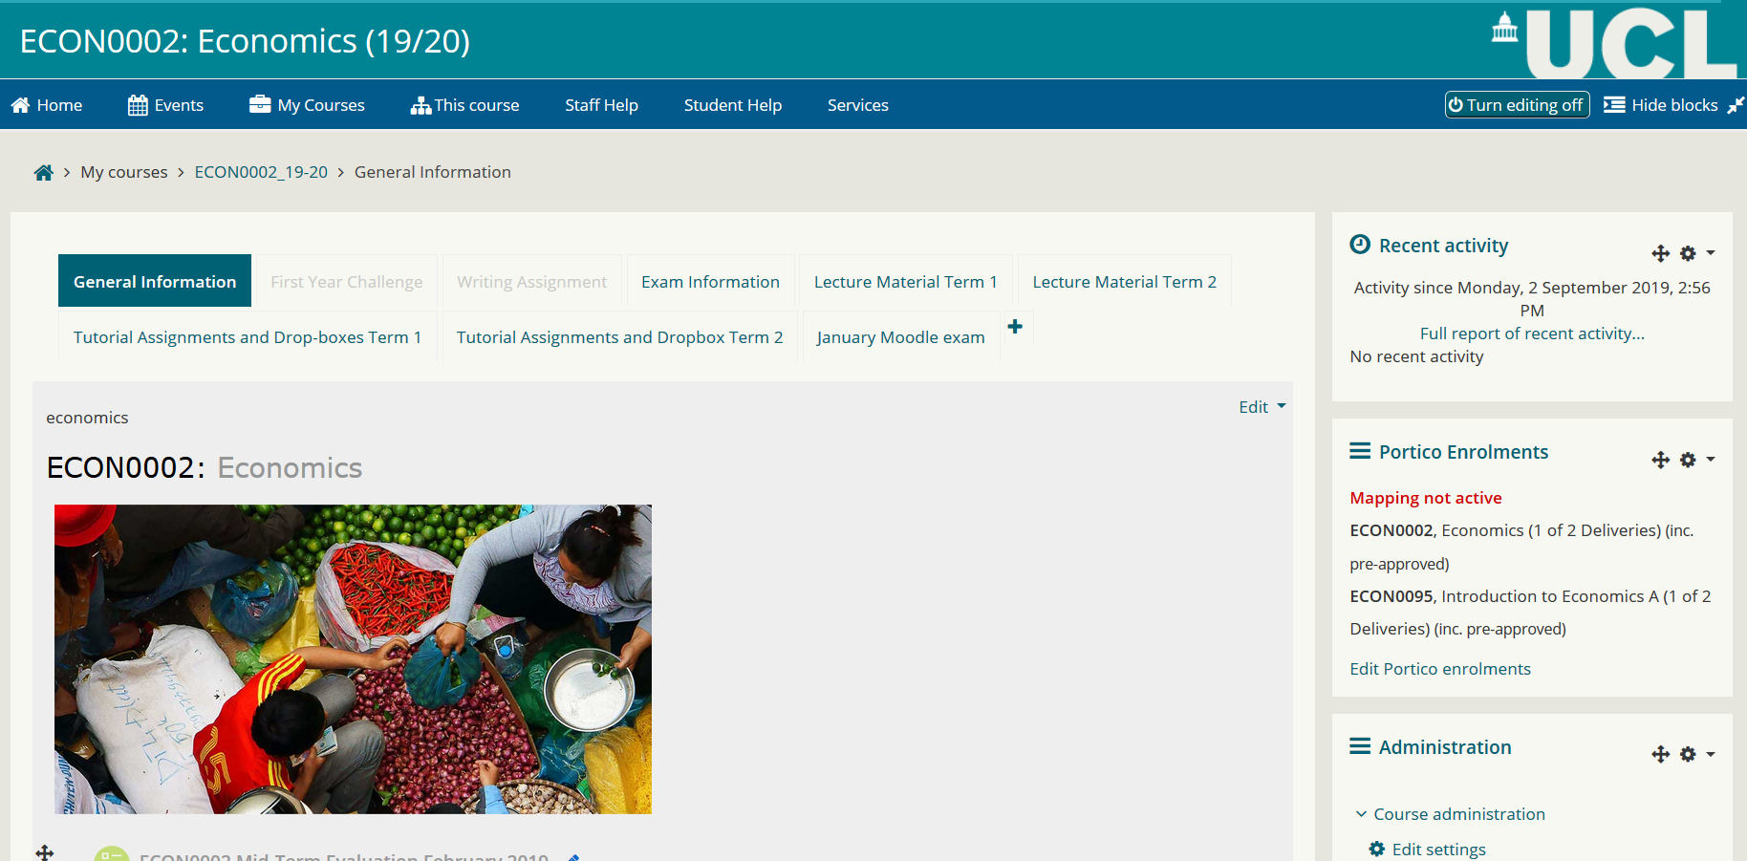
Notes:
Soumya assessment of ECON0002 Moodle page
-arranged into tabs (such as ECON005) but not ECON004 and ECON0010
-Lecture material and prework is provided before each lecture, each week (unlike all the others)→ this is enabled within the Moodle page
-Moodle enabling feedback provision, by tutors for assignments; self-assessment through model answers (ECON002 and ECON004 do that not the others)
-Midterm assessment resources:
January moodle exam:
Practice quizzes 1-4
Answers and explanations
Q&A forum
This is the only module doing Q&A forum entirely dedicated to In-term assessment
-Past exam papers and model answers, all modules do that
-Additional reading provided by all modules

Slide 12
Usage of online resources

Slide 13
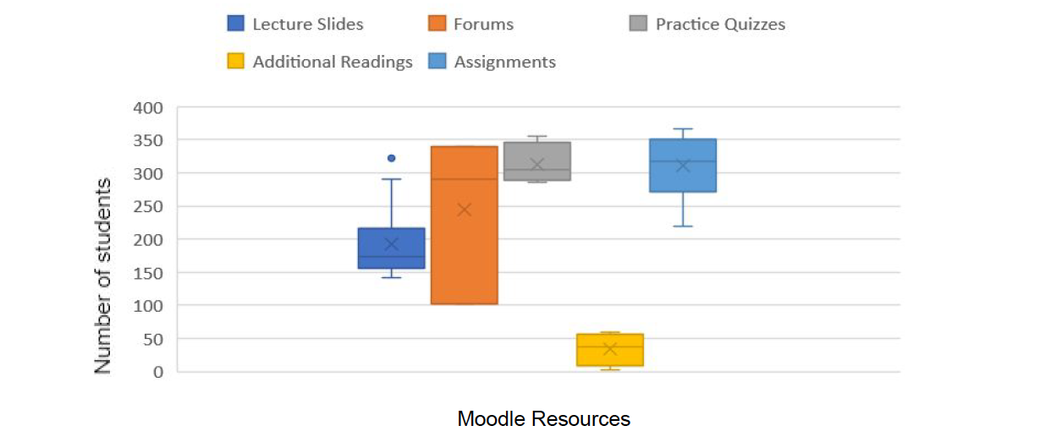
4/10 attending lectures regularly, 1/10 attended all of them. 70% say that the book is more useful than lecture slides

Slide 14
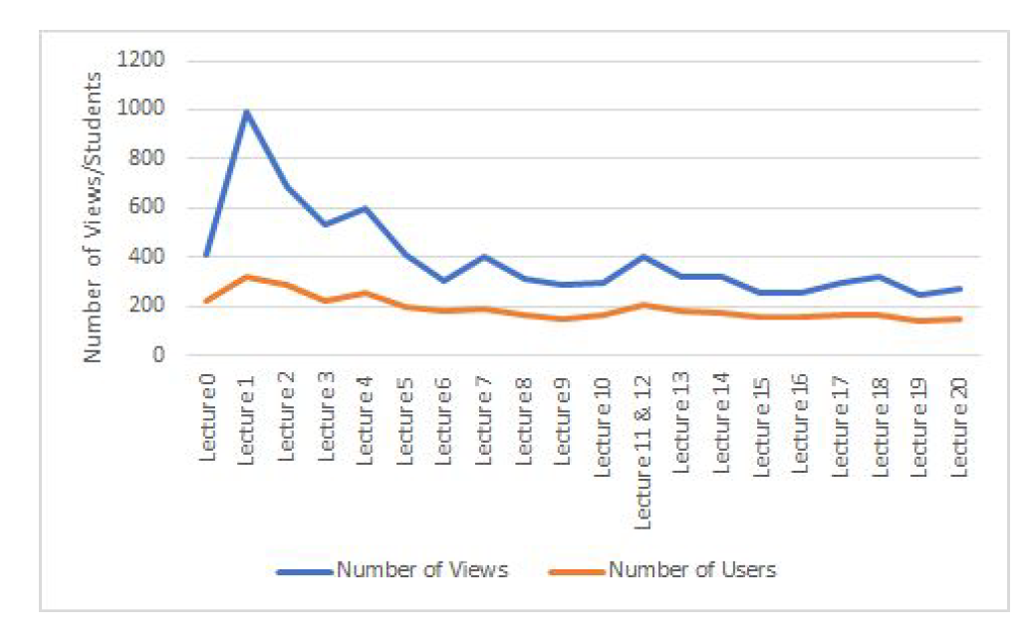
Lecture slides
50% suggested two different versions of the lecture slides: one with the additional notes made during lectures and
one without.

Slide 15
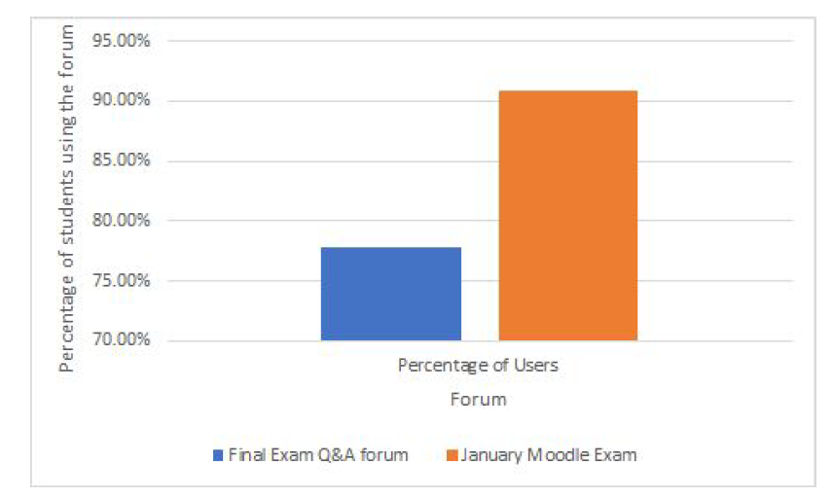
Forums
All focus group participants check Moodle Forums;
60% ask questions;
60% find email updates on forums motivating while 40% find it overwhelming
All prefer the presence of the lecturers in the forum and they do not envisage the necessity of attaching a mark to participation
Notes:
Suggestions:
opt-in instead of opt-out option;
Weekly updates

Slide 16
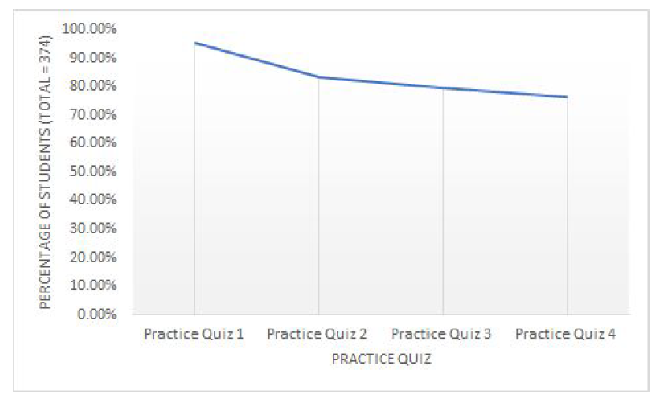
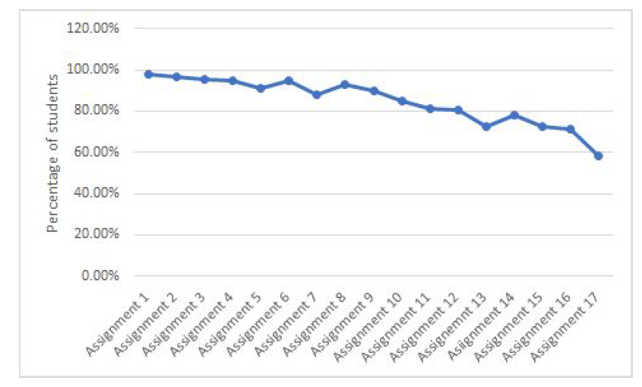
Formative assessments
Practice quizzes mainly used for January summative assessments
Assignments fundamental for exam preparation
Notes:
Assignments’ submission

Slide 17
Effects of online resource usage on academic outcomes

Slide 18
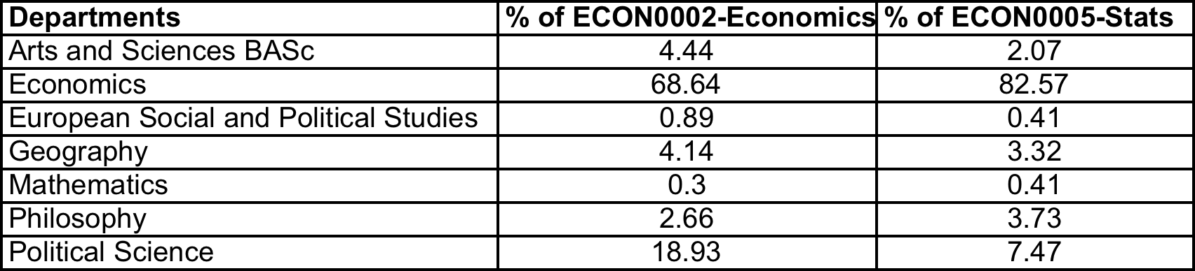
Data: the sample
Notes:
Description of the sample we are using:
Comment on missing data (because of marks of assessed on-line quiz, taken in January); majority is male-home, then we have 20% for each other cathegory;
Majority from Economics (68%), then political science (20%)
Add details on assessment in the talk

Slide 19
Variables’ description

Slide 20
Grades’ distribution
Notes:
Average mark is 71 in ECON002 and 69 in ECON0005
Marks are more spread in Stats than in Economics

Slide 21
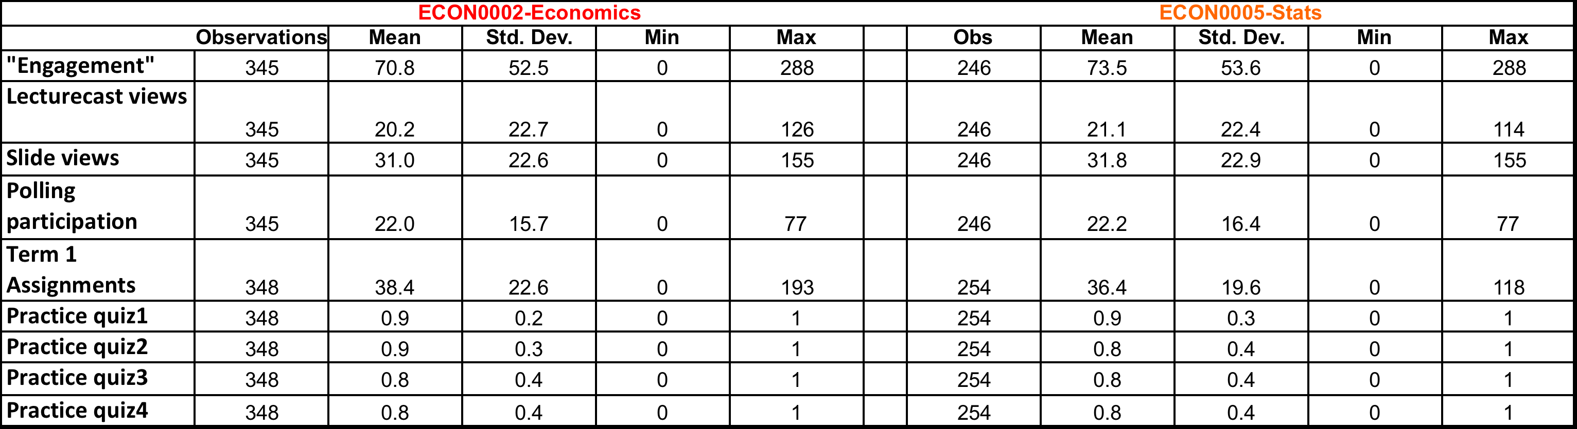
Descriptive Statistics
Notes:
Average mark is 71 in ECON002 and 69 in ECON0005
Marks are more spread in Stats than in Economics

Slide 22
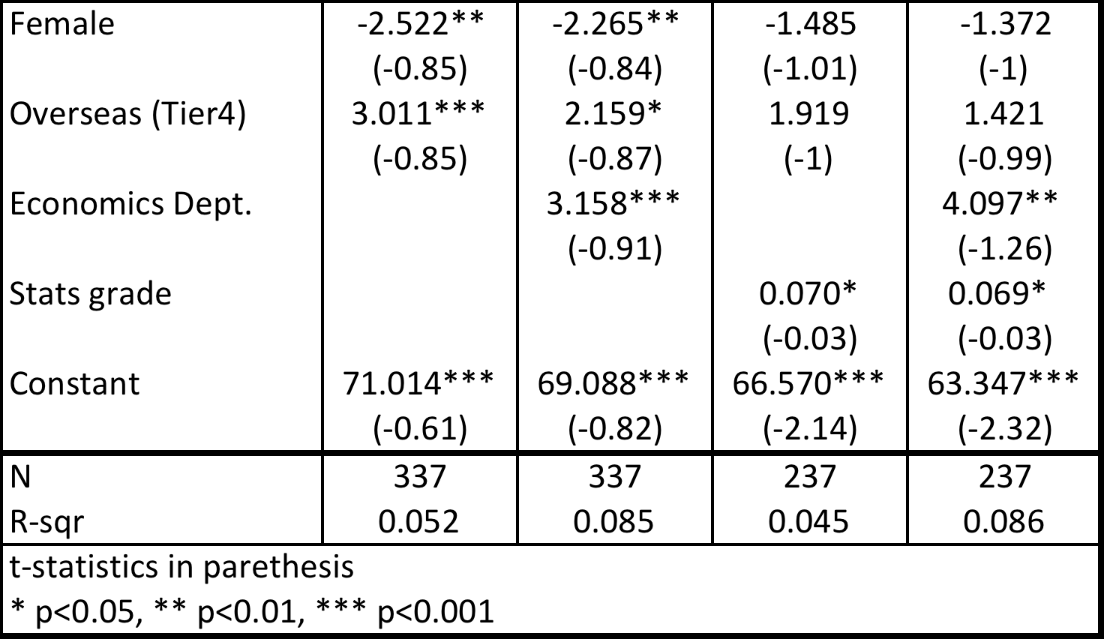
Effects of student characteristics on grade
Notes:
WE add students’ characteristics one by one and we can see that gender and visa status become insignificant when we consider “being an economist” and “ability”. Economics students perform better than others, especially if they are good performers in other core economics courses.
Interpretation: male students tend to perform better than female and overseas better than home ones. Being an overseas student can ensure more than 2 marks on average.
Economics students perform better than others (they get 4 marks more on average) and the higher the grade in other 1st year core modules raise the mark for Economics
Robust result across specification is that once we condiiton for ability, personal characteristics, namely gender and nationality, seem not important any more. As I said the result is robust across specifications, hence I will not comment on that any more.

Slide 23
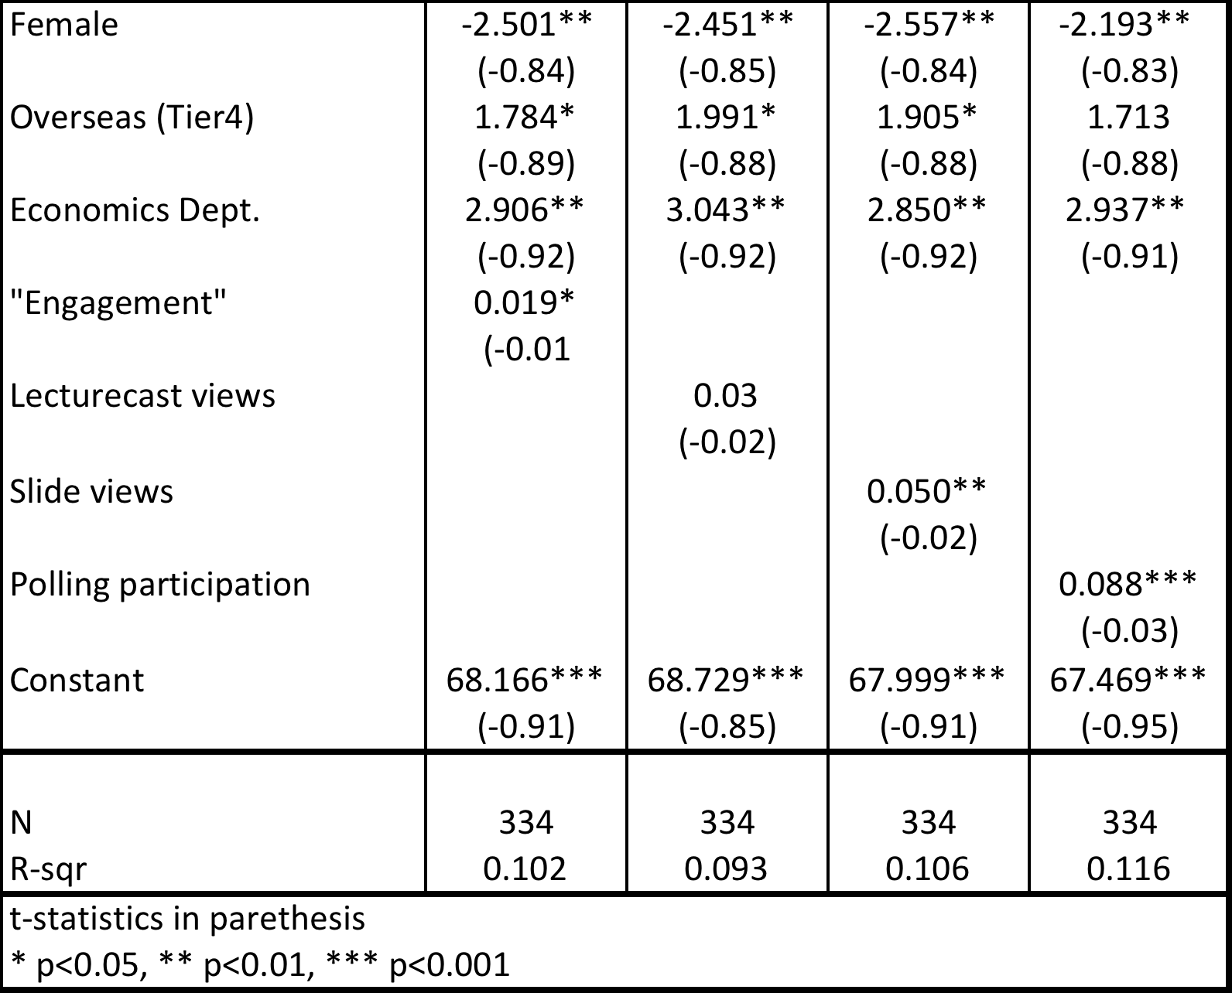
Impact of Moodle resources on grades
Notes:
WE add use of resources one by one. On average Economics students perform better than others.
Also we can notice that different resources have different impact.
In particular, lecturecast views is nor significant. Maybe because some students take them as a substitute for lectures (see the results of the focus group, only 4 out of 10 students were regularly going to lectures).
Then, it is extremely interesting to notice that polling participation –Forum participation- helps female students in particular and it overcomes the effect of being a good performer in other compulsoty modules.
So far our analysis point towards the importance of forums.

Slide 24
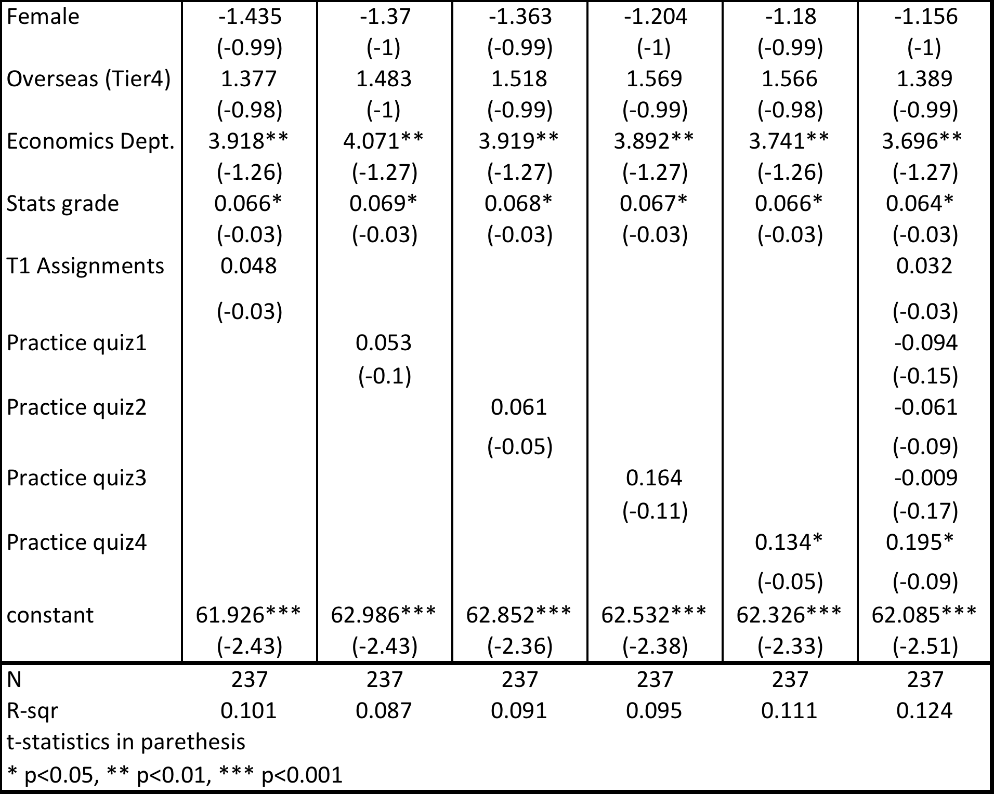
Impact of (e)preparation on grades
Notes:
Students’ characteristics such as gender and nationality are not significant when we condition for stats grades, which are always significant
Our measure for assignments is quite general, it shows “access” to resource frequency rather than “submission and feedback” contribution to grades
Practicing with assignments is important and less is for quizzes, a part from quiz 4
Interestingly quiz 4 seems to be very important, why? Maybe it was closer to the exam date?
This point towards the importance of self-assessment

Slide 25
Takeaways
Different VLE resources don’t seem to be affecting different learners in different ways
Being “more able” matters a lot but selected VLE resources could mitigate the importance of initial conditions
Participating in in-lecture polling helps grade, though this may be an attendance effect
Notes:
Out story is: students’ characteristics influence grades; use of VLE influence grades…we are not able to say to what extent different learners are influenced; but what we do see is that polling participation seems to mitigate the effect of initial conditions.
1) For the first point on the takeaways slide, can we say that different resources don't affect different learners as we haven't interacted gender/ethnicity with the resources right? Are we just showing that e.g. women don't use more or less of a resource than men, but not saying anything about the effect of that choice?
You are right, we are not showing any direct effect on different resources on different learners. What it is found is that pooling participation has a mitigating effect on "being a female". So, it seems that polling participation is extremely helpful, especially for women. But this is not a robust result across specifications. Actually we did not check for differential use of resources.

Slide 26
Thanks for listening! Questions?
s.dalbianco@ucl.ac.uk
p.chaudhury@ucl.ac.uk

