Slide 1
‘The games students play’: simulating pricing decisions in oligopolistic markets
Dr Vincent Rich, Westminster Business School, University of Westminster (richv@wmin.ac.uk)
‘(B)usiness students with little patience for economic abstractions…want to see the point right away’ (Beckman, 2003: 27).

Slide 2
Our Aim
This presentation examines pricing decisions made by student ‘teams’ each playing the part of a company operating in an oligopolistic market, as part of a semester-long, web-based business simulation ‘game’.
The aim is to explore how far student ‘teams’ (intuitively) use price as a ‘strategic variable’ and whether this tends to result in price stability (and convergence) or instability.

Slide 3
Playing Games: Pedagogy
On-line simulations, including games, reportedly offer more effective learning experiences because they are interactive, engaging and immersive (Ulicsak & Williamson, 2010), enhancing participants’ critical thinking and creativity.
They enable students to reflect on their knowledge and to integrate their learning in an environment that enables them to solve problems and work collaboratively (Sutcliffe, 2002: 40), potentially deepening conceptual understanding.
However, the competitive dynamic of ‘games’ – where teams compete and are ranked according to performance – needs to be managed properly, to ensure ‘learning’ is enhanced.
In this respect, it is crucial that ‘assessment focuses on students’ reflection on their experience ,rather than performance in the simulation’ (Sutcliffe, 2002: 22)
Two words of caution for tutors (i) be willing to relinquish control over the learning process and to embrace unexpected outcomes;
(ii) ensure that students do not see the ‘game’ as a break from learning, but rather an intrinsic part of it.

Slide 4
Simulating Oligopoly Markets: Brief Literature Review
The idea of role-play/student interaction to support active learning using prisoners’ dilemma games to model oligopoly markets dates back more than 50 years (Joseph, 1965). He used face-to-face interaction between groups of three students who competed against each other.
Others (see Brouhle, 2011, for a useful summary) have varied the number of players, the form/nature of the interaction (both in-class and web-based), the information available, or duration of the game (within a single class, over multiple days etc).
Beckman (2003) used a series two-person games with decisions recorded on spreadsheets to provide business students with intuitive understanding of Cournot and Bertrand behaviour.
Sorenson (2002) extended the duration to an entire semester, and included three key features…which permitted an ‘escape from the prisoners’ dilemma: repeated interaction, multimarket contact, and detailed (“fine”) information about firms’ pricing decisions’ (p.317)

Slide 5
The Players
The simulation game forms part of the weekly learning activities (alongside lectures and seminars) on a second year core module (Business Decision Making, or BDM) taken by some 600 Business Management students, across a range of specialisms.
Some students may have studied Economics prior to University, but all will certainly have taken an introductory business environment module in their first year with us.
For most, their understanding of oligopoly theory at the start of the module is therefore likely to be limited to market form, barriers to entry and the interdependence of firms – and the need to take account of rival behaviour.
The first three weeks of the BDM module includes a review of Market structure, Porter’s Strategic Framework, and simple Prisoner Dilemma-type games.
The simulation ‘game’ allows students to observe the strategies used by fellow ‘teams’ and then try to adopt effective counter-strategies; this helps to illustrate ‘real-world’ business behaviour and how price can be used effectively as a ‘decision variable’.

Slide 6
Dimensions of the ‘game’
The companies operate in city markets, with three or four other multi-market companies firms as direct rivals competing for market share, but part of a ‘universe’ of up to 80 firms with ‘ranking’ based on Balanced Score Card points.
The companies offer the same four products for sale, simultaneously determining the selling price for each one over nine or ten weekly operating rounds (or ‘years’, in the company’s life).
Weekly one-hour workshops, with 40-50 students, although most decisions are taken outside of this, often virtually. There is the possibility of some limited product differentiation due to quality differences (Price only one of a possible range of decisions). Companies submit their decisions once a week.
Two or three ‘mock’ rounds, so students can learn to play the game and model/recognise the impact of their decisions. Information – on rival’s prices, market demand two rounds ahead and consumer quality preferences – can be ‘purchased’.
The in-module assessment involves a 2,000 word group report, reflecting on the ‘team’s’ performance in the ‘game’; the final ranking counts for up to 10%.
The tutor does not control the ‘rules of the game’. However, as Brouhle (2011) asserts, the existence of uncertain and diverse outcomes may be helpful in highlighting the range of outcomes that can arise in real-world markets. Ultimately, as Sorenson (2002) rightly points out, although the ‘results of the game’s plays are of interest in themselves…the primary purpose of the game is pedagogical’ (317).
URL: http://game.edumundo.co.uk
Notes:
Complex reality. Link between market share, financial performance and ‘ranking’? + contribution to assessment? Group assessment?
What do (can) students know about rivals?
Scope for communication? Knowledge of end period of game affecting behaviour? Collusion is permitted, although students not explicitly told this.
Students observe outcomes in the form of profits & market shares, but not rivals’ prices (although teams can buy market research which provides them with this information and overall market size, growth etc). Most operate with limited information – ‘bounded rationality’?

Slide 7
Overall company ‘ranking’

Slide 8
Methods
Quantitative analysis of pricing decisions by individual companies in selected markets to identify patterns of behaviour. This is compared with profit performance and market share.
Qualitative elements: (i) an ex-post, in-class survey of a sub-group of individual students reflecting on pricing behaviour; (ii) an analysis of Student Module Evaluations to gauge impact on engagement and learning.

Slide 9
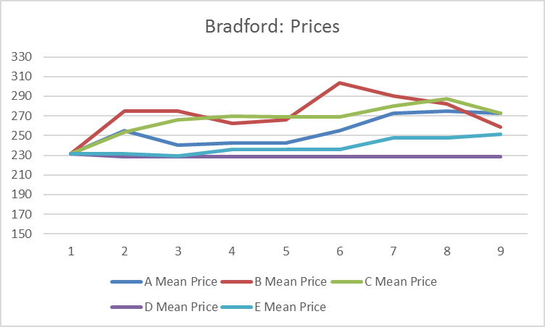
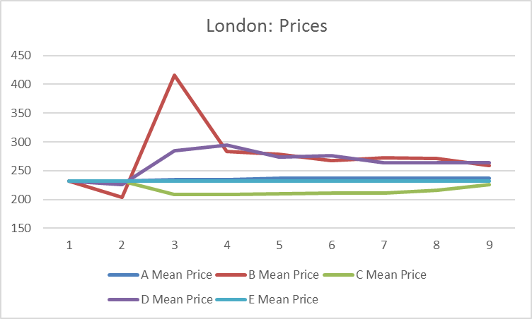
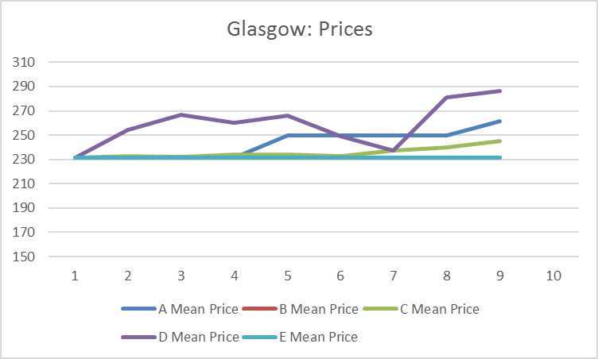
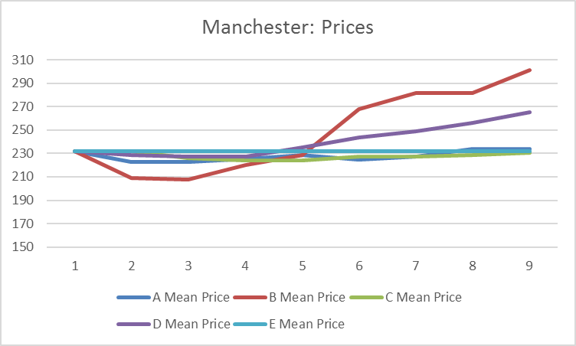
Pricing decisions in four city markets

Slide 10
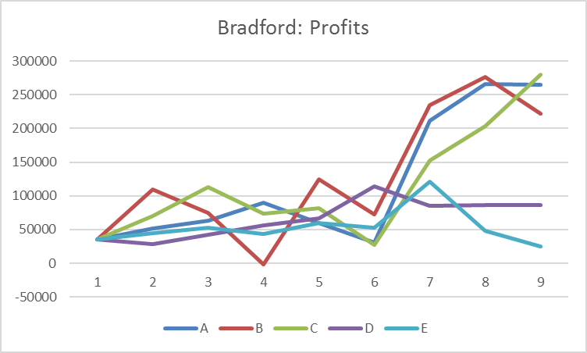
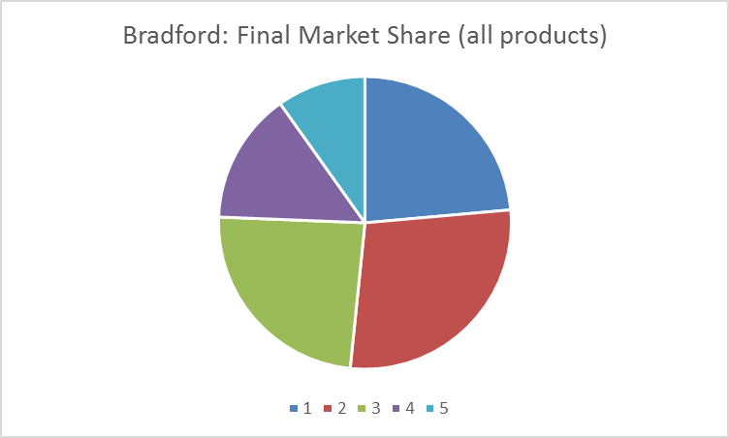
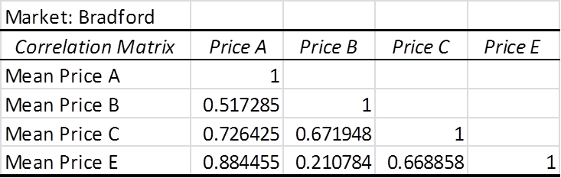
Bradford: price convergence?
Notes:
‘Total market profits’ = 4.34m
Mean overall price = 252

Slide 11
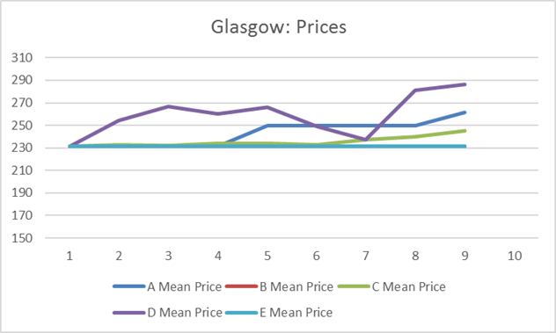
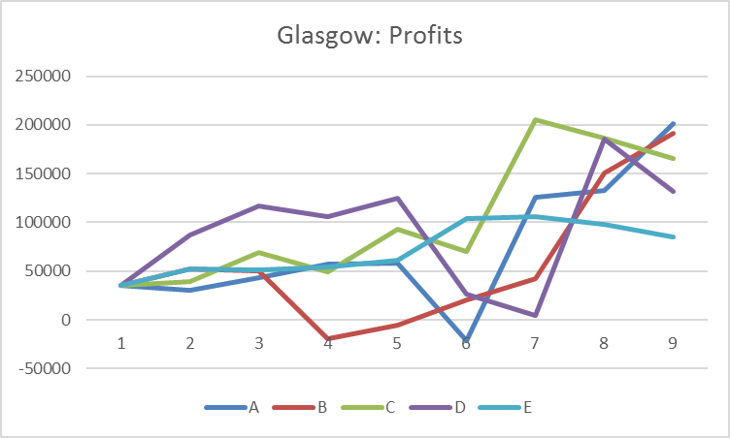
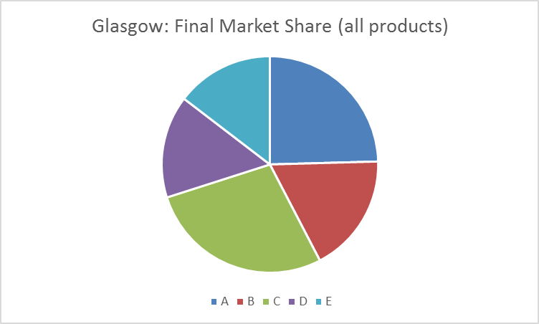
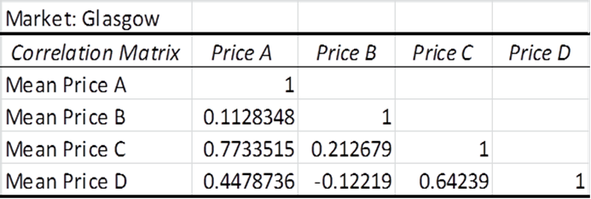
Glasgow: price divergence?
Notes:
‘Total market profits’ = 3.56m
Mean overall price = 242

Slide 12
Price behaviour: student reflection
What was the main influence on you choice of product price in the business game? | Gain market share | Undercut rivals | Make higher profits | Maintain price stability
Student Responses | 40% | 0% | 30% | 30%
In the decision game, if rival firms reduced their prices, did you: | Cut prices in line with rivals | Keep prices stable, but improve quality | Keep prices stable, but choose lower cost supplier | Raise prices
Student Responses | 24% | 38% | 29% | 10%
Source: ‘What price success? Pricing decisions in oligopoly markets’
End of module in-class survey using kahoot.it , April 2017 (n=50)

Slide 13
Student feedback: time well spent?
‘Interactive learning’
‘Theory into practice’
‘Ability to make decisions as a business’
‘Shows what is needed to make a profitable company’
‘Insufficient briefing; game not explained properly’
‘Limited integration with taught topics/theory’
‘Too long’
What did you most like?
(n=35)
What did you least like?
(n=21)
Source: Student Module Evaluation, January 2017; Semester 1; Weeks 7-11; n=211 (48% response)

Slide 14
Summary and Reflections
The ‘game’ offers an opportunity to link theory with practice, in a simulated, but realistic world.
Student engagement and interest is good
The ‘game’ involves Bertrand competition, but with incomplete substitutability. Pricing decisions are approached iteratively, with signs that ‘teams’ react to rival behaviour; there is evidence of both price convergence and divergence.
There is no evidence of tacit collusion or cooperation – although it is not precluded. However, contrary to their stated behaviour, students appear to learn during the ‘game’ that higher ‘market’ prices are associated with higher profits and behave accordingly.
Notes:
4336411 (Bradford)
252
3561041 (Glasgow)
242
3608052 (London)
248
3521092 (Manchester)
236

Slide 15
References
Beckman, S R, (2003), ‘Cournot and Bertrand Games’, The Journal of Economic Education, 34:1, 27-35.
Brouhle, K, (2011), ‘Exploring Strategic Behavior in an Oligopoly Market Using Classroom Clickers’, The Journal of Economic Education, 42:4, 395-404.
Engelhardt, L M, (2015), ‘Simulating Price-Taking’, The Journal of Economic Education, 46:4, 430-439.
Greco, M, Baldissin, N & Nonino, F, (2013), ‘An Exploratory Taxonomy of Business Games’, Simulation and Gaming, 44:5, 645-682.
Joseph, M, (1965), ‘Role playing in teaching economics;, American Economic Review, 55: 1,556-565.
Meister, J P, (1999), ‘Oligopoly – An In-Class Economic Game’, The Journal of Economic Education, 30:4, 383-391.
Ryan, M P & Doyle-Portillo, S M, (2014), ‘Do student responses parallel theory? Evidence from an oligopoly experiment’, International Review of Economics Education, 17, 66-73.
Sorenson, T L, (2002), ‘Theory and Practice in the Classroom: a repeated game of multimarket oligopoly’, Contemporary Economic Policy, 20:3, 316-329.
Sutcliffe, M (2002), ‘Simulations, Games and Role-play’, The Handbook for Economics Lecturers, Economics Network (last accessed 29th August 2017, via https://www.economicsnetwork.ac.uk/handbook/games/)
Ulicsak, M. and Williamson, B. (2010). Computer Games and Learning. (Futurelab Handbook). Bristol: Futurelab.

