Slide 1
Little, big, and vast steps towards open education
Dr Martin Poulter
@mlpoulter
DEE Conference 2017
This work is licensed under a Creative Commons Attribution-ShareAlike 4.0 License.

Slide 2
Images from the “Matrix” films appeared here and have been removed from this copyright-sanitised version.

Slide 3
Cape Town Open Education Declaration
“We are on the cusp of a global revolution in teaching and learning.
[…] [p]lanting the seeds of a new pedagogy where educators and learners create, shape and evolve knowledge together, deepening their skills and understanding as they go.”
http://www.capetowndeclaration.org/read-the-declaration (2007)

Slide 4
Budapest Open Access declaration
“By "open access" […], we mean its free availability on the public internet, permitting any users to read, download, copy, distribute, print, search, or link to the full texts of these articles, […] or use them for any other lawful purpose…”
“…accelerate research, enrich education, share the learning of the rich with the poor and the poor with the rich…” (my emphasis)
http://www.budapestopenaccessinitiative.org/read (2002)

Slide 5
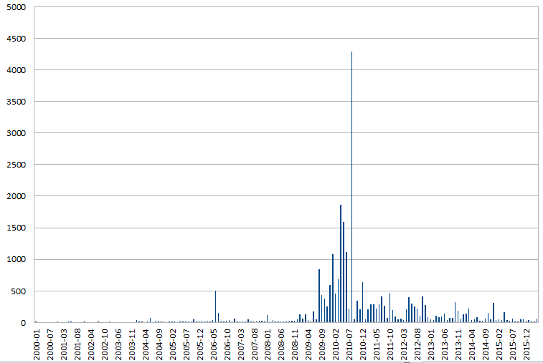
Creative Commons deposits in UK Repositories (HT @patlockley)

Slide 6
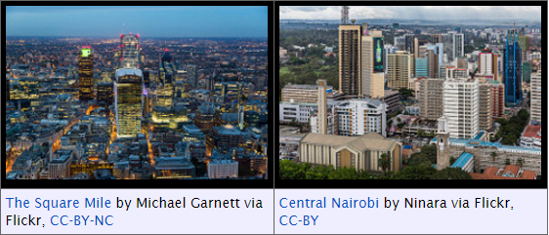


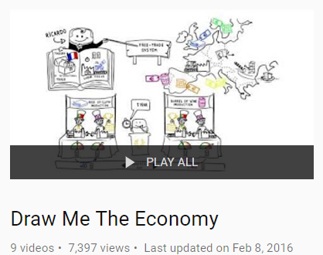



Little OER
Big OER
Institutional projects
Subject-wide projects
Open textbooks
MOOCs(?)

Slide 7

Vast OER

Slide 8
Wikipedia readership
https://tools.wmflabs.org/pageviews/?project=en.wikipedia.org&platform=all-access&agent=user&range=latest-90&pages=Economics

Slide 9
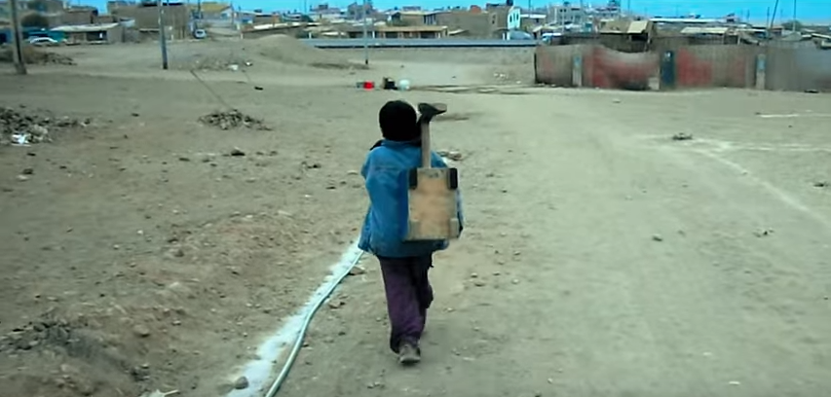
Abel
Still from the documentary film “Life in a Day” via National Geographic

Slide 10
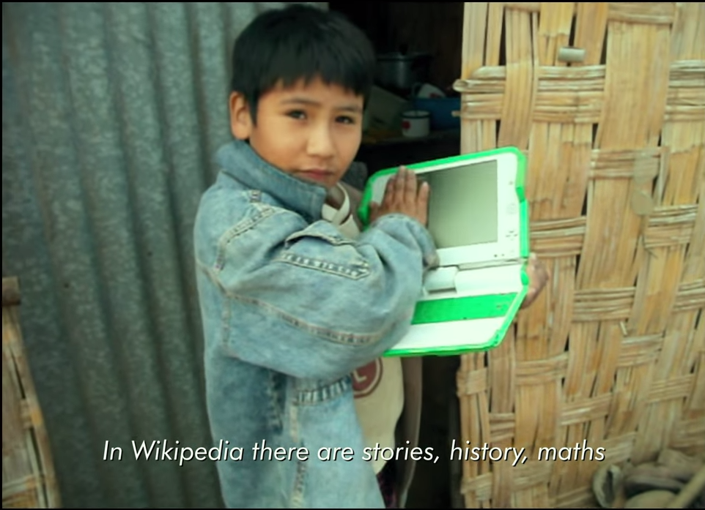
Abel
“The thing I love most is my laptop. In Wikipedia there are stories, history, maths, science, religion: it has everything. It’s a giant library.”
Still from the documentary film “Life in a Day” via National Geographic

Slide 11
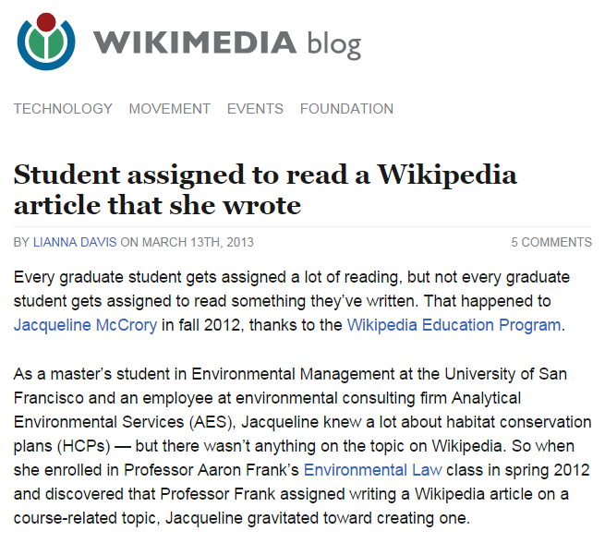
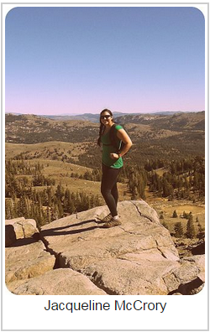
http://blog.wikimedia.org/2013/03/13/student-assigned-to-read-a-wikipedia-article-that-she-wrote/

Slide 12
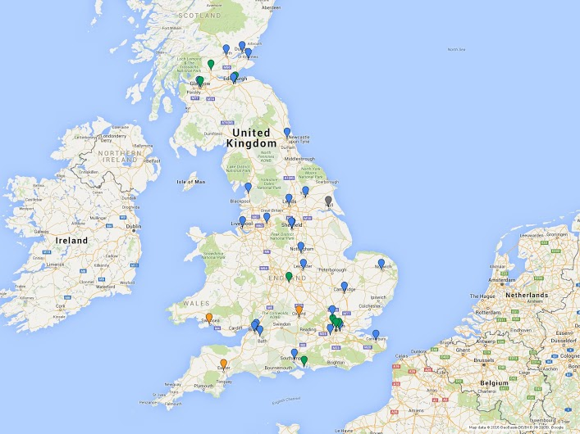
UK Universities that are doing/ have done wiki education assignments
Image by Richard Nevell, Wikimedia UK

Slide 13
Some articles written by students
Water scarcity
Illegal drug trade
Food security
Microfinance
Economy of Nicaragua

Slide 14

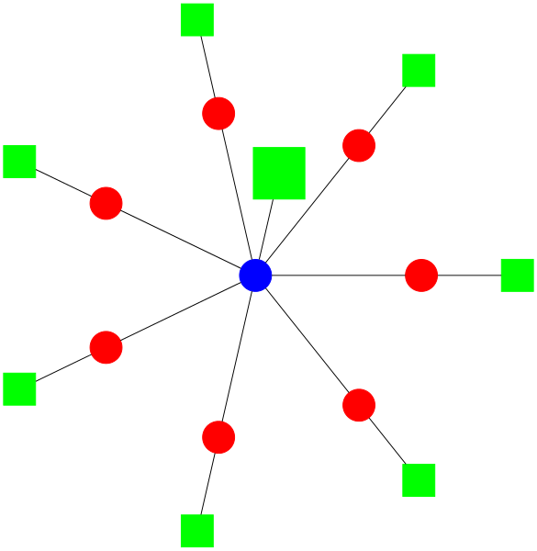
Wikidata
Free multilingual knowledge base with billions of statements about tens of millions of items.
Biographical
Bibliographic
Geographical
Taxonomic
…
(Some) Economic

Slide 15
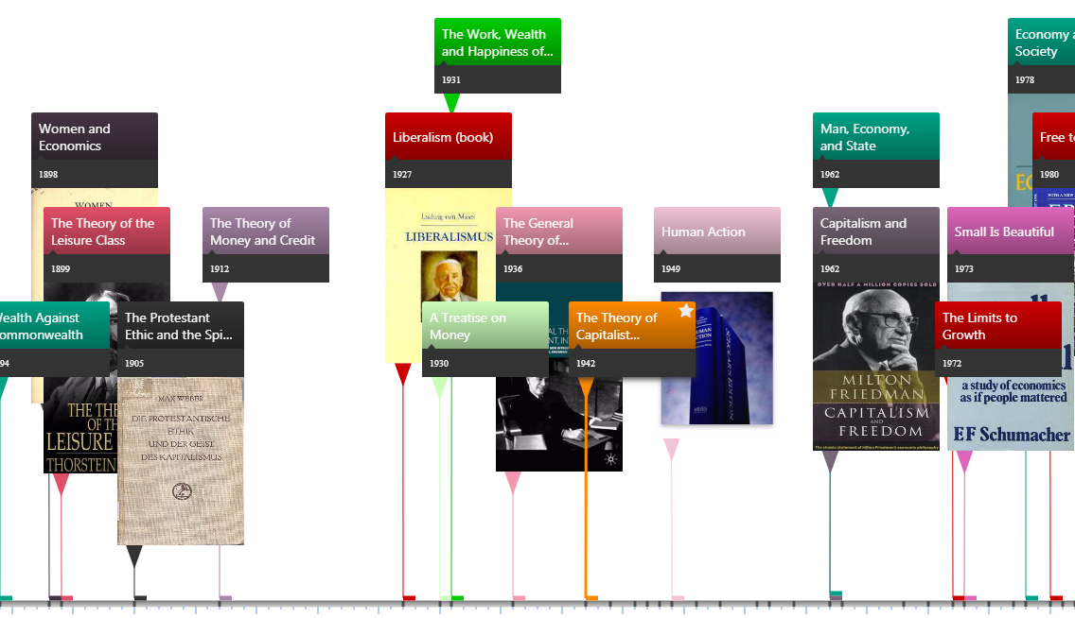
Histropedia
http://histropedia.com/timeline

Slide 16
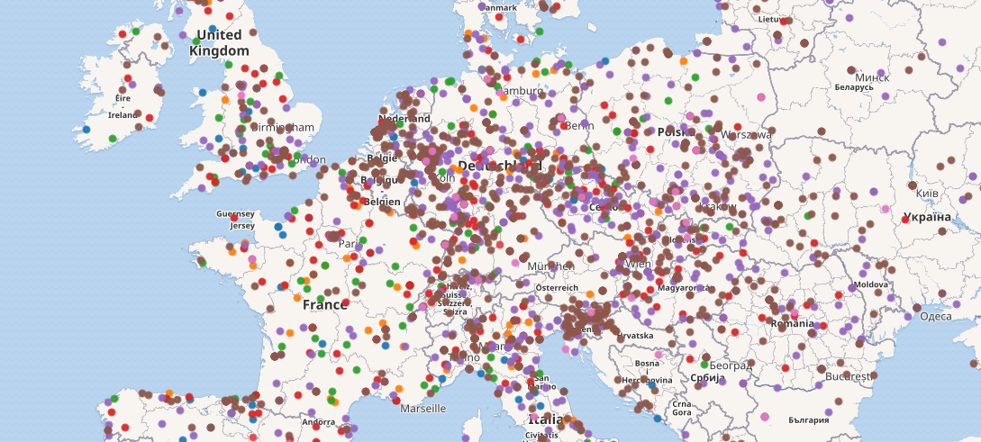
Wikidata query service
https://www.economicsnetwork.ac.uk/poulter_wikidata
Cartography via OpenStreetMap, CC-BY-SA 2.0

Slide 17
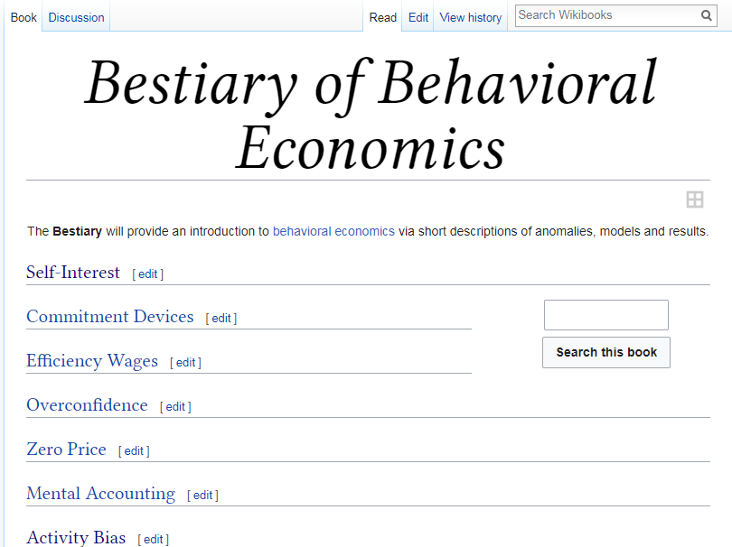
https://en.wikibooks.org/wiki/Bestiary_of_Behavioral_Economics

Slide 18
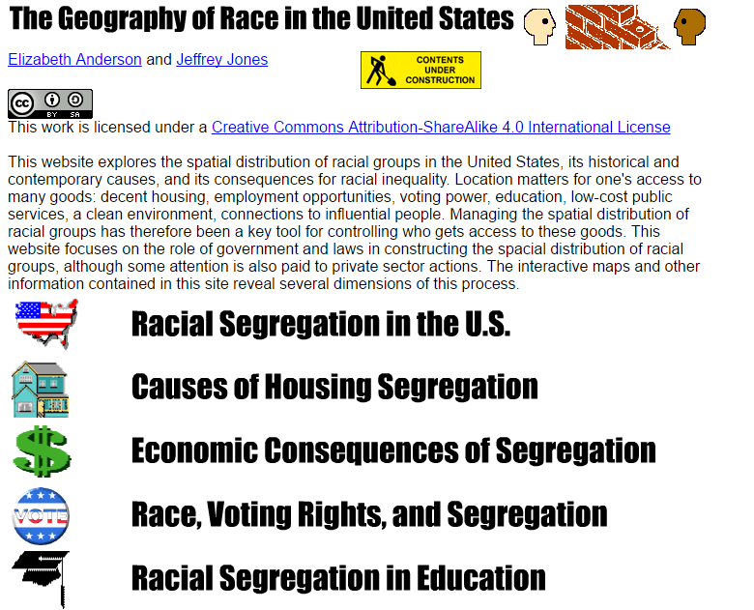

Slide 19
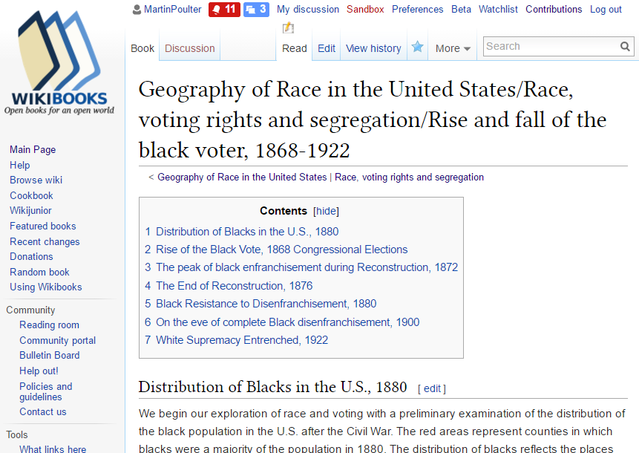

Slide 20
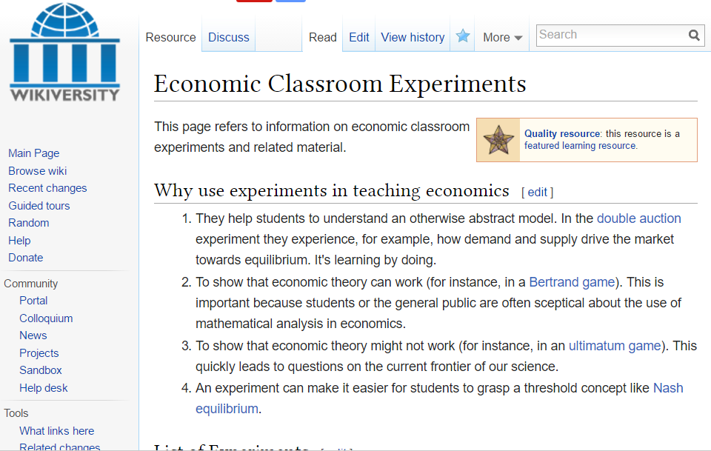

Slide 21
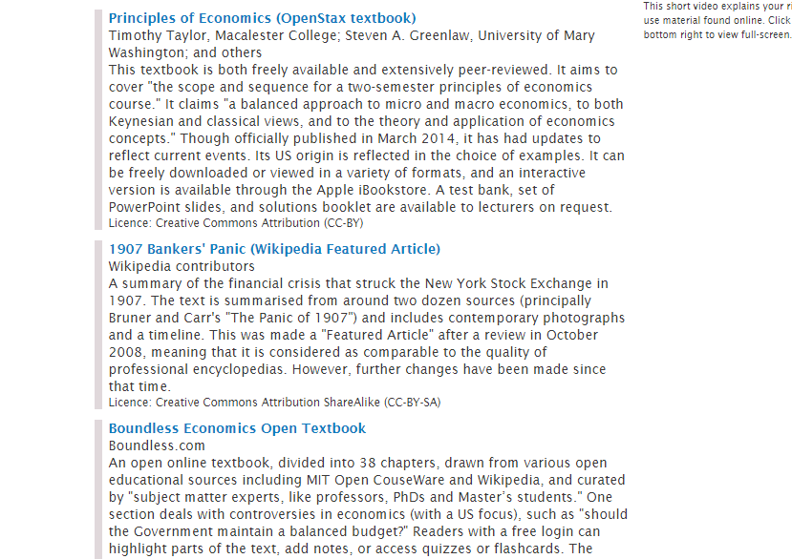

Slide 22
Summary (1)
More open educational content is being created now than ever before
The promised benefits of the open education revolution are starting to materialise.

Slide 23
Summary (2)
To preserve educational content for the long term, we need to preserve its relevance, which involves preserving its ability to change.
The successful platforms are the ones treating content as a web of knowledge and giving readers the edit button.
They aren’t repositories in a traditional sense.
I want to edit your content: please give me the edit button.

Slide 24
Summary (3)
Educational content overlaps with other sorts of thing: research outputs, secondary data, and archival text.
We need publishing models that recognise these multiple functions.

Slide 25
Thanks
m.l.poulter@bristol.ac.uk
infobomb.org
Twitter: @mlpoulter
User:MartinPoulter on Wikipedia, Wikibooks, Wikisource, Wikidata, Wikimedia Commons

