Slide 1
Targeted workshops for underperforming students
Dr Antonio Rodriguez Gil
Dr Peter T Hughes

Slide 2
Study aims to identify commonalities between underperforming students.
Work by Lizzio & Wilson 2013 suggest that workshops targeted at underperforming students are effective in improving performance of these students.

Slide 3
Identifying target students
Second year and final year students who were achieving a year average equating to a 2:2 award or lower were each invited to two workshops – one in semester 1 and a second workshop in semester 2.
  22 students in level 2
  20 students in level 3

Slide 4
How were the sessions structured?
1 hour workshops
2 academic staff (personal tutors) present to facilitate discussions in small groups.
Each student was asked to complete a reflective survey at each workshop.
First workshop students asked to complete a form where they identified three improvement goals and strategies

Slide 5
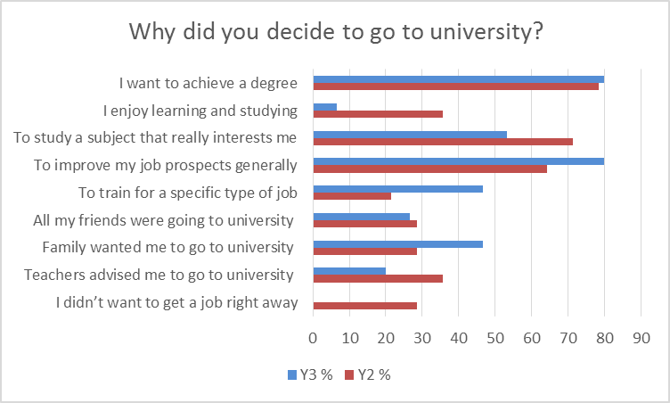

Slide 6
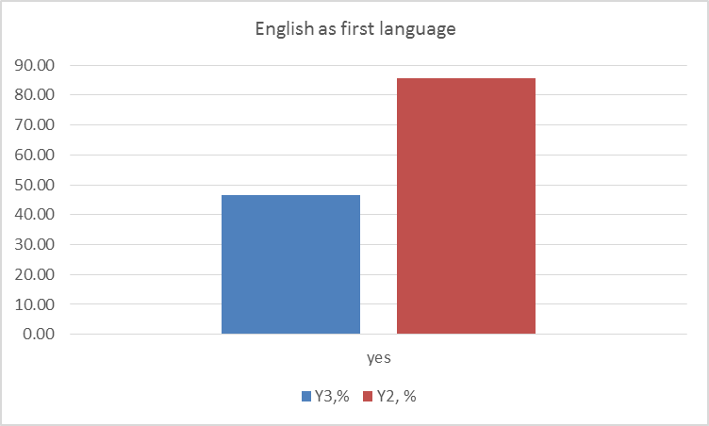

Slide 7
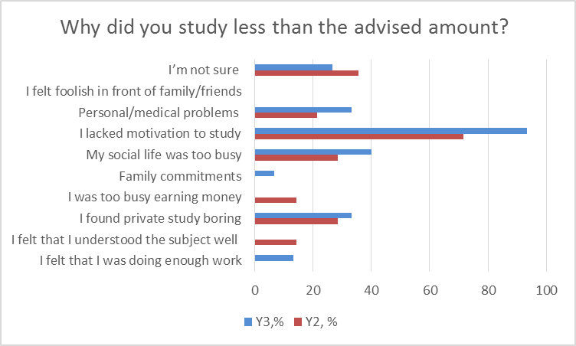

Slide 8
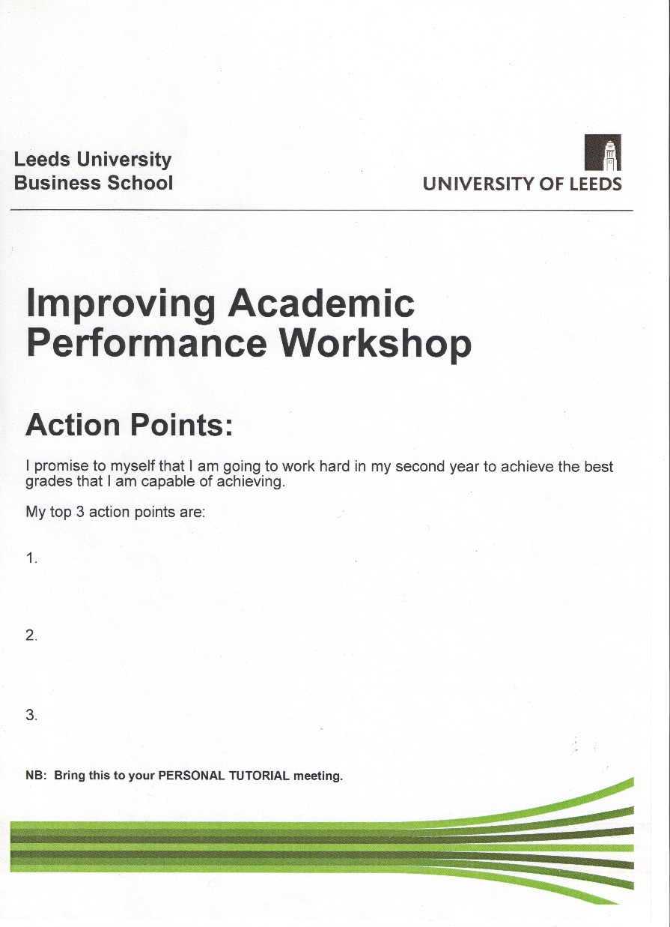

Slide 9
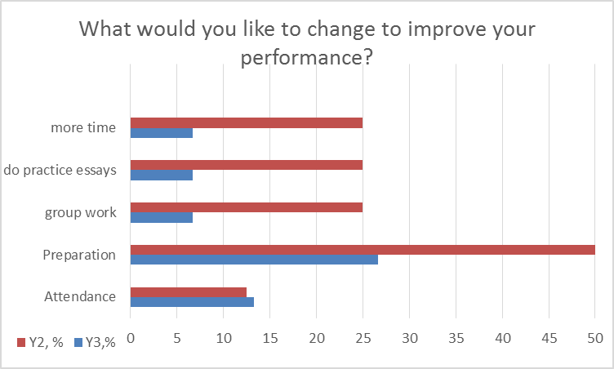

Slide 10
Highlights from discussions
Student reflection for under-performance largely self-directed: they don’t blame the university or course.
Students who are under-performing academically are also disengaged from university activities and with cohort.
Passive in terms of goals and identifying actions

Slide 11
Academic performance of targeted students
Year 2 treatment group (compared to Year 1)
  28% improved grade boundary (4/14)
  14% fell grade boundary
Year 3 treatment group (compared to Year 2)
  40% improved grade boundary (6/15)
  13% fell grade boundary
Rest of cohort average – selection bias present
  10% improved grade boundary
  23% fell grade boundary

