Slide 1



Enhancing Engagement through interaction and team work
going beyond
the classroom walls
Liliana Harding, UEA
DEE 2017, UCL
Notes:
To view this presentation, first, turn up your volume and second, launch the self-running slide show.

Slide 2
How to understand ‘engagement’
Two essential dimensions of engagement observed here, as in Hermann (2013):
willingness to engage in interactive class discussions
engagement as learning approach that uncovers meaning within subject matter

Slide 3

Approach
FIRST
Designed class and assessment around team work and
‘co-operation’
encouraging learners to explore collaborative tools
including social media of their choice
incentivising reflective questions and answers from all team
members in class
SECOND
Constructed a survey considering
Main Question: How and for whom does co-operation foster participation in class and engagement with the subject?
Notes:
To view this presentation, first, turn up your volume and second, launch the self-running slide show.

Slide 4
Background
Students often arrive into final year without having interacted with any peers beyond their friendship circle and engage little in class discussion
YET constantly engage with social media, which could be channelled into academic engagement, addressing low level of subject communication and related skills.
Economics cited to lag behind in social media use for education (e.g. Al Bahrani, Patel and Sherigan, 2015)
Question of creating individual accountability in team work, to encourage the achievement of learning outcomes through active co-operative learning.

Slide 5
DESIGN
Who would co-operate with whom?
Tutor allocates students to study groups (SG) of 3-4 students each, in 4-5 seminars of up to 16 students (week 2).
Random allocation of study groups in assigned seminars
Non-native speakers evenly distributed across groups, acknowledging challenges to be managed (see as well Dolan and Macias, 2017)
Notes:
To view this presentation, first, turn up your volume and second, launch the self-running slide show.

Slide 6
DESIGN
How would co-operation happen?
Students meet in seminar 1 and agree group management
Seminar 2 involves class group work and preparation of outline for a group presentation in seminar 3, with formative feedback.
SG choose a European economy which they will research over the rest of the semester as country teams, outside the class.
So: channeling co-peration for deep learning (see also Marburg, 2005) by reflecting on application of theories of economic integration in European countries and their position on Brexit.
Notes:
To view this presentation, first, turn up your volume and second, launch the self-running slide show.

Slide 7
DESIGN
What are the goal and accountability factors driving co-operation
(see also Slavin (2010) on ‘what makes group-work work’)
Initial assessed group presentation (familiar from other modules).
Compilation of a joint country team report submitted on BB, to be read by other study groups online and followed by assessed Q&A session in class, with tutor monitoring individual Questions and Answers based on team reports.
Notes:
To view this presentation, first, turn up your volume and second, launch the self-running slide show.

Slide 8
Out-of-class co-operation and networking platforms:
Students are encouraged to make their own out-of-class co-operation choices, making use of social media (e.g. Whatsapp, Facebook) and other collaborative platforms (e.g. OneDrive, GoogleDocs)
Output is team country report - to be uploaded on university BB through File Exchange and visible to all students in each class
FB as most frequently used platform (Al Bahrani, Patel and Sheridan, 2015)?
Assessment Criteria for co-operation based task include:
co-ordination of report preparation and submission
inclusiveness of study group members
coherence of final team report
individual contribution to Q&A on each country, i.e.:
Reflective and informed answers to peers’ questions;
Informed questions for other country’s team members.

Slide 9
Our survey
Class-administered survey including two cohorts of 53 and 80 students respectively, in 2015-16 and 2016-17 (pre- and post Brexit!).
Questions address:
students’ engagement with subject and preferences for online collaborative learning tools,
a reflection an individuals’ contribution to peer learning and teaching,
the inclusion of ‘new’ learners through co-operative learning design.

Slide 10
Selected sample characteristics
2015-16:
Answers collected in discussion seminar → response rate 89%
Non-native English speakers in cohort: 26%
Only one non-ECO student
Study groups the same across semester
2016-17:
Answers collected in revision session → response rate 39%
Non-native English speakers in cohort: 15%
Three non- ECO students and two exchange students
Study groups merged into larger country teams mid-term
TWO changes:
Co-operation element extended over Easter break
One exam question linked to reflection on country researched

Slide 11
Are students engaging more with a particular type of co-operative work?
SO:

Slide 12
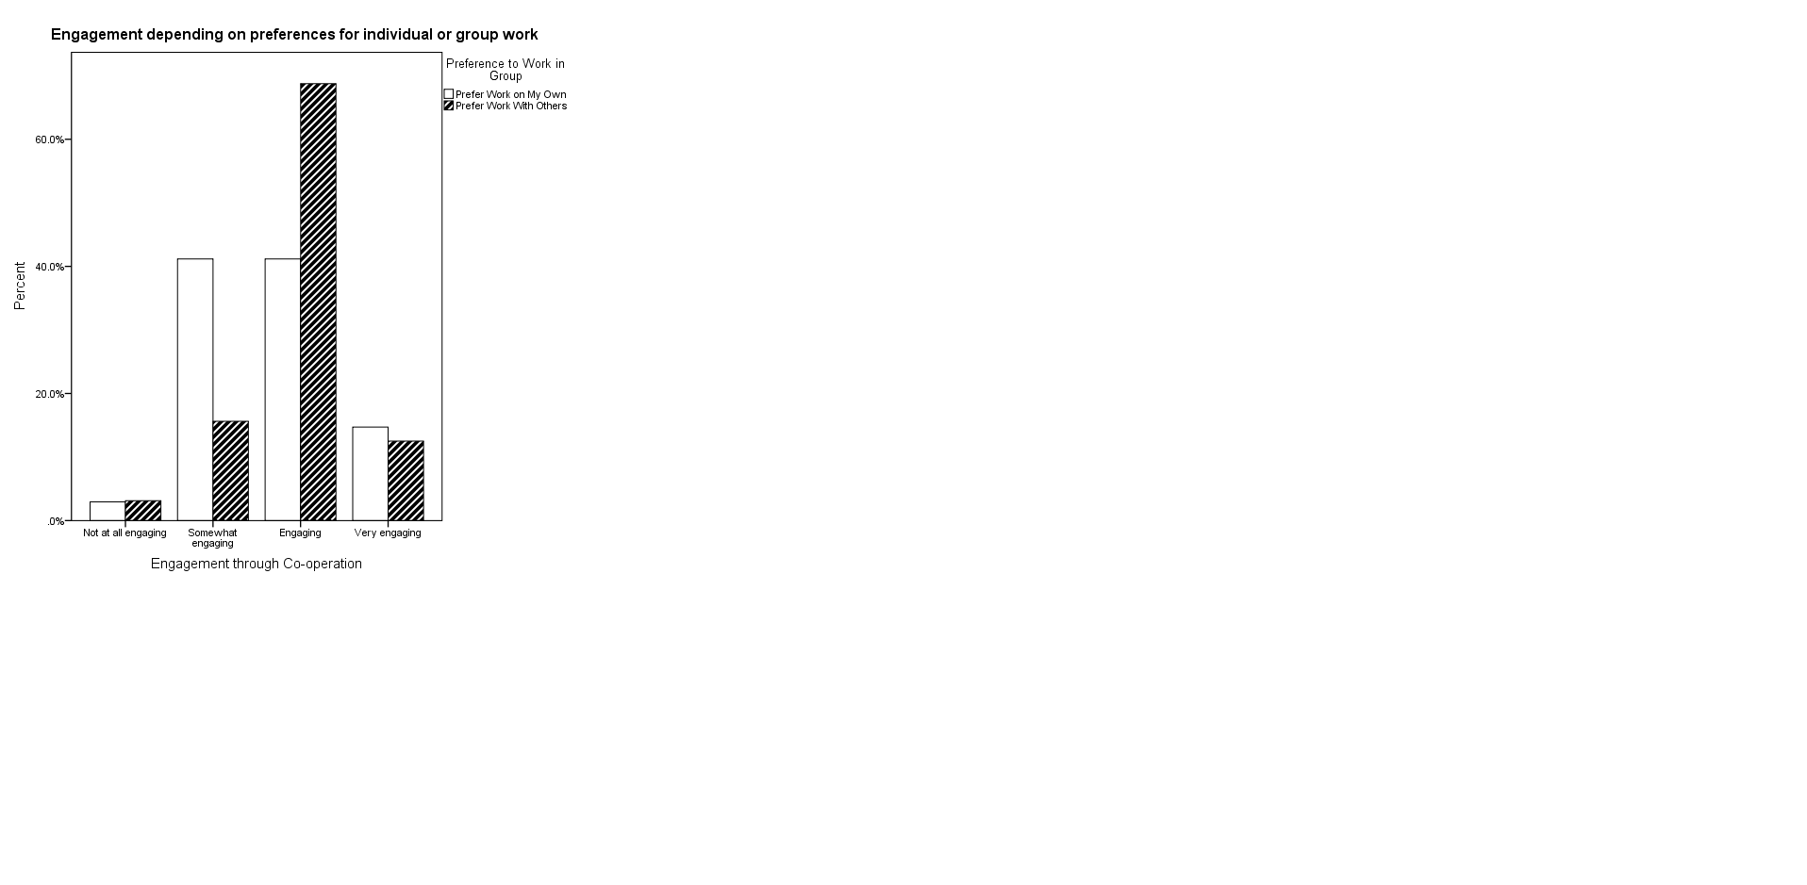
Student’s own reaction to the co-operative learning design.
Or in their words:
‘MOST GROUP PROJECTS INCLUDE PRESENTATIONS; THIS WAS A NICE ALTERNATIVE, LESS MONOTONOUS AND MORE ENGAGING […].’

Slide 13
what did students learn from each other?
OUTCOMES:

Slide 14
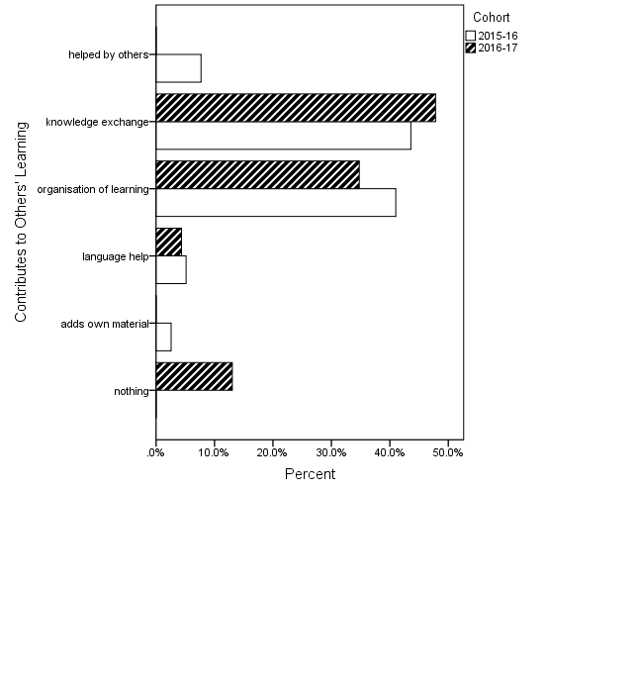
What do students perceive as their contribution to peer learning?

Slide 15
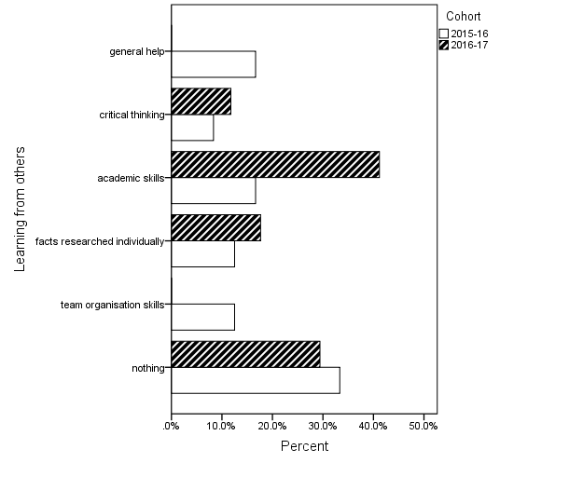
What do students perceive as their learning from peers?

Slide 16
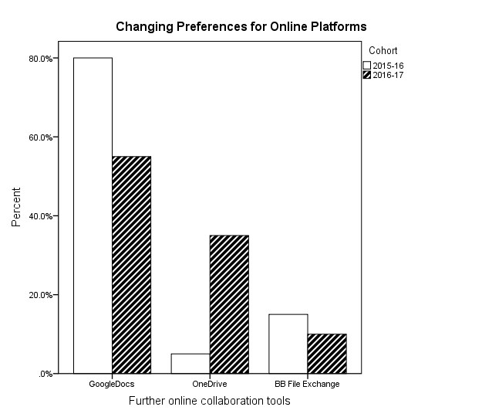
And what are the most popular tools facilitating co-operation beyond the classroom (walls)?
69% of all respondents choose Facebook as social media learning tool
34% also use GoogleDocs or Google Drive as online collaboration platform (note: against the 5% citing BB file exchange)
Caution!
While a steady % of students prefer to connect via FB outside the classroom, there are =================➔

Slide 17
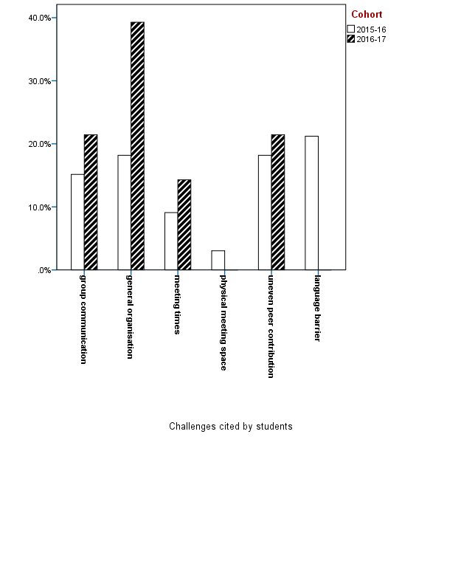
And what makes co-operation difficult in this context?
The Easter ‘out of class effect’

Slide 18
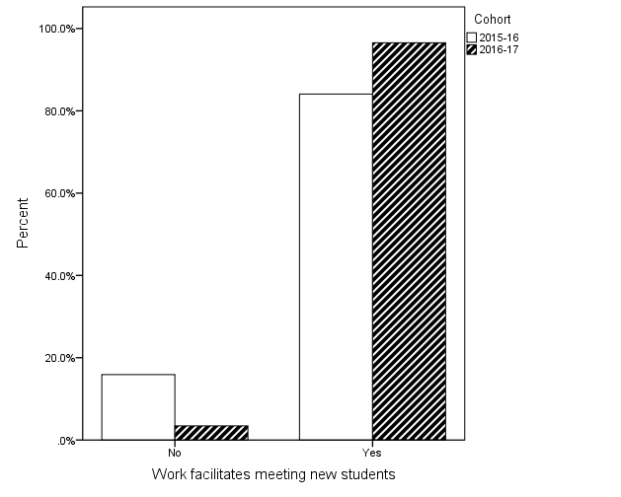
Have students managed to bridge the distance amongst themselves?
What about including ‘new’ students?
‘Yes, met new student: some did not know much but co-ordination led to success.
Taught my group partner
everything he knows about economics’.

Slide 19
AND THE WRITING ON THE WALL:
HOW WAS THIS DIFFERENT AND HOW DID STUDENTS DEAL
WITH THOSE OF DIFFERENT BACKGROUND?
‘IT IS VERY RARE TO BE ABLE TO WORK TOGETHER I GROUPS. [I] BROUGHT THE GROUP TOGETHER IN A LEADERSHIP ROLE. ENGAGED EVEN THE QUIETER STUDENTS IN DISCUSSIONS’.
‘I MET SOME STUDENTS WHO I PREVIOUSLY PROBABLY WOULD NOT HAVE SPENT TIME WITH, SOME OF WHOM I AM NOW GOOD FRIENDS WITH’.
‘I FELT SLIGHTLY AT A DISADVANGE AT THE START OF THE MODULE AS I AM NOT AN ECONOMICS STUDENT, HOWEVER OTHERS ON THE MODULE HELPED ME TO UNDERSTAND THE SUBJECT BETTER.’
Notes:
To view this presentation, first, turn up your volume and second, launch the self-running slide show.

Slide 20
CONCLUSION
Raised engagement through co-operation in group work was equally acknowledged by two cohorts, yet preferences for individual work matter.
Difficulties faced with co-operation depended strongly on set teaching dates and team size.
The extensive use of online collaboration tools is not embraced as an opportunity to learn beyond formal teaching times (or: ‘the class walls’ remain significant boundaries for their work environment, in spite of learners’ constant presence on social networks)
Peer pressure and externally set goals are equally enabling factors in achieving learning outcomes more efficiently in the co-operative learning setting.
Notes:
To view this presentation, first, turn up your volume and second, launch the self-running slide show.

Slide 21
CONCLUSION
Learners are flexible and highly receptive to new social media and other online collaboration tools.
They acknowledge more readily their own contribution to others’ learning than vice-versa.
Reflection on researched subject and readiness to critically evaluate peers’ contribution has been significantly improved, heightening engagement with the subject.
Yet… exam results (as often observed in the literature!) have not shown an upward trend compared to earlier cohorts where co-operation was not part of the module design!
Notes:
To view this presentation, first, turn up your volume and second, launch the self-running slide show.

