Slide 1

Communicating Economics
Evidence from a national survey
conducted by the Economics Network and ING
Special session sponsored by the Royal Economic Society

Slide 2
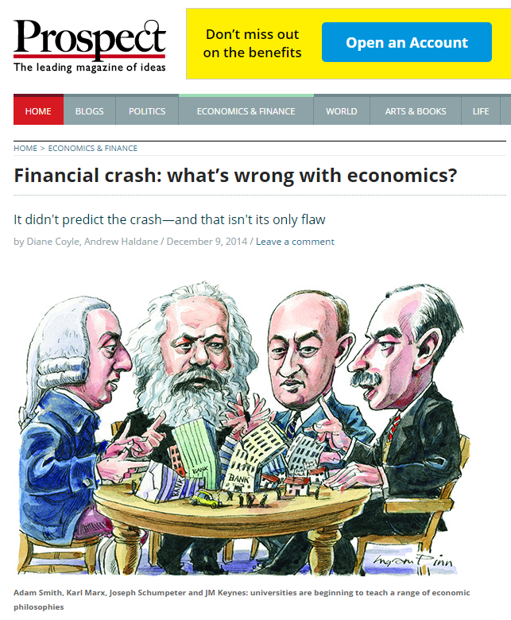
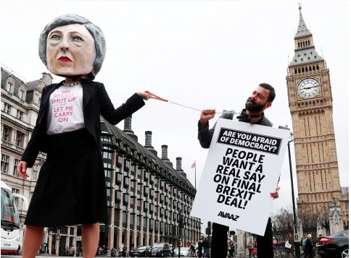
Shock of economic crash & Brexit

Slide 3



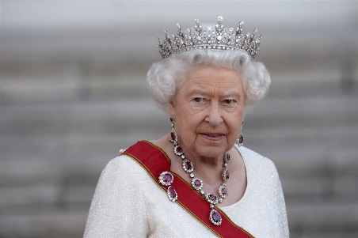
Complaints
Students
Employers
Media
Queen
“The real world should be brought back into the classroom, as well as debate and a pluralism of theories and methods”
“It is time to rethink some of the basic building blocks of economics”
“It is important for economics to engage more with the public, not just to understand economics, but so that we understand the concerns and questions people have about our work and influence”
“Why did nobody see it coming?”

Slide 4

Survey on public understanding
Conducted by YouGov
Representative:
  Gender
  Age
  Region
  Political party (vote in 2015 general election)
  EU referendum vote

Slide 5
Understanding & education

Slide 6
Education
Notes:
Nearly 2/3 of respondents have not studied economics but ¾ think it should be taught in schools.
How do we start this conversation with schools?

Slide 7
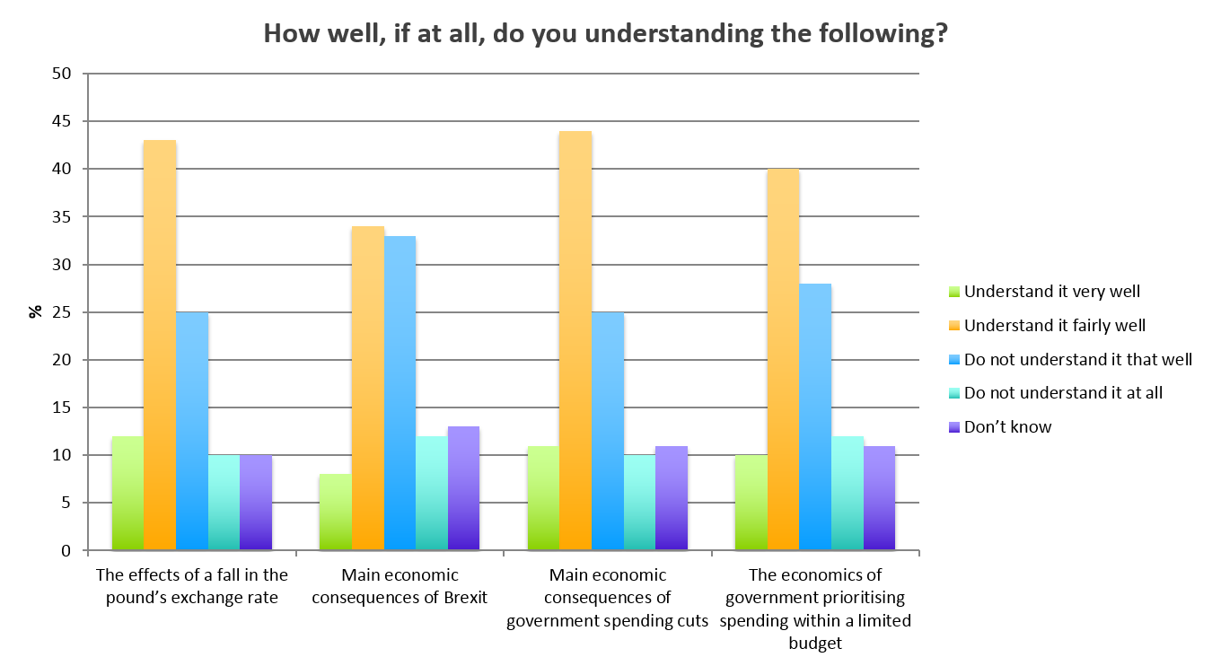
Understanding

Slide 8
Importance

Slide 9
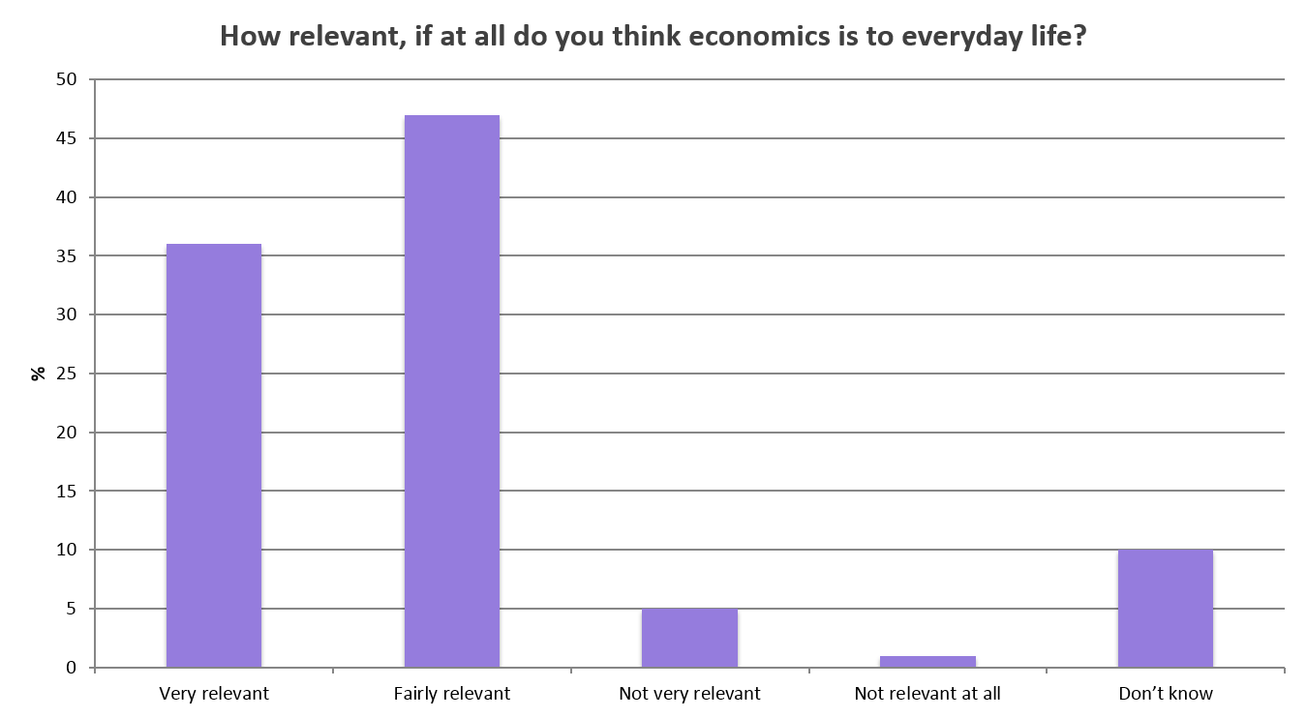
Importance

Slide 10
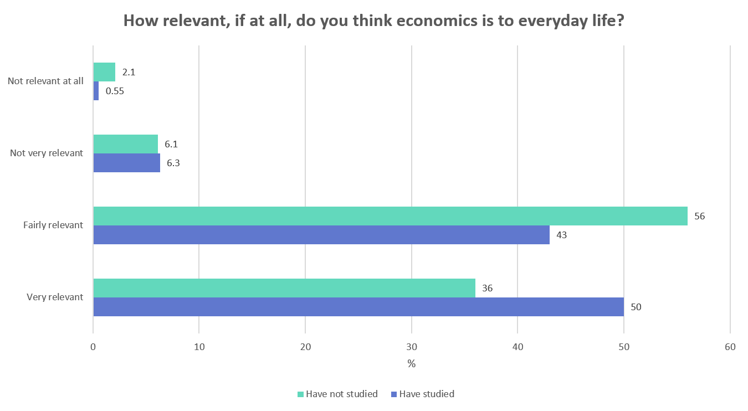
Importance

Slide 11
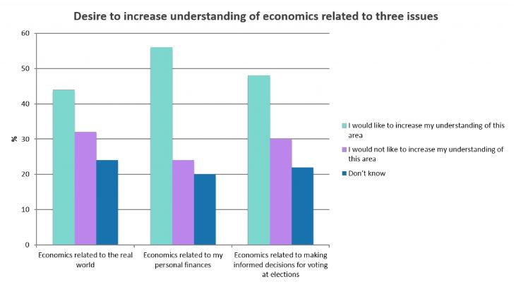
Desire to know more

Slide 12
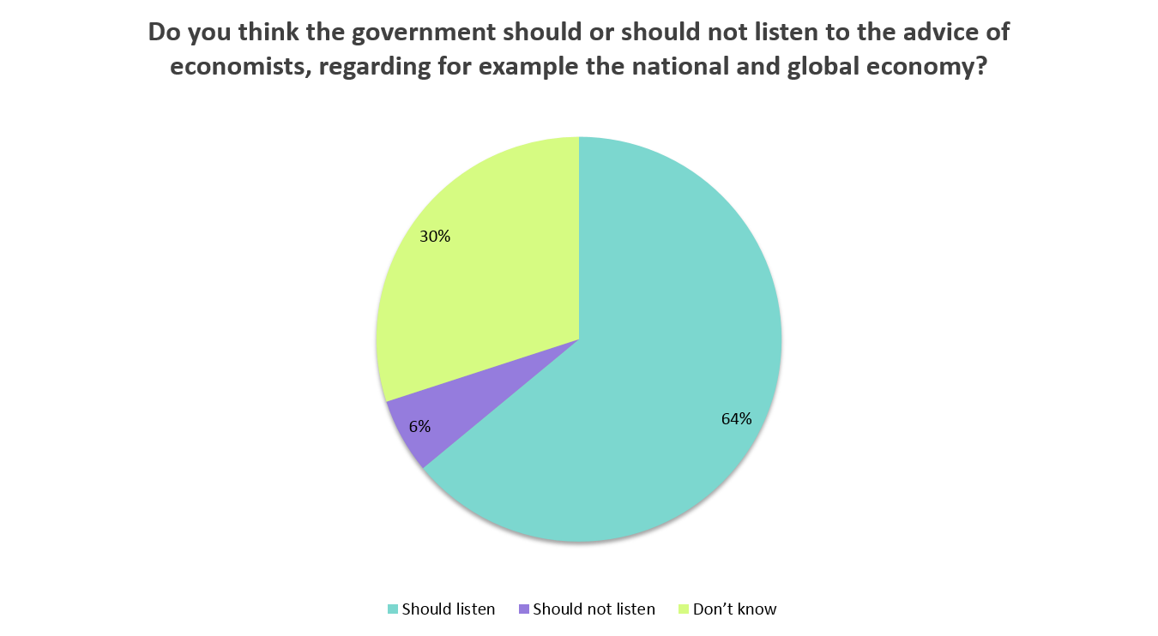
Importance

Slide 13
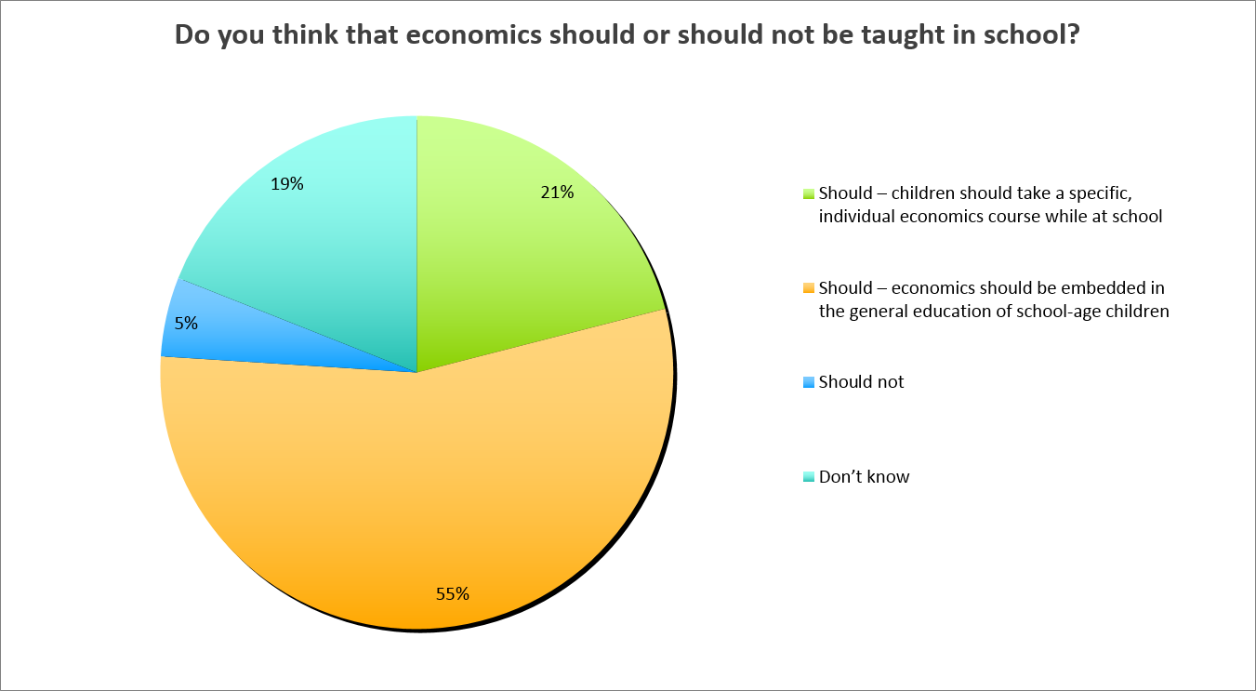
Importance

Slide 14
Communication

Slide 15
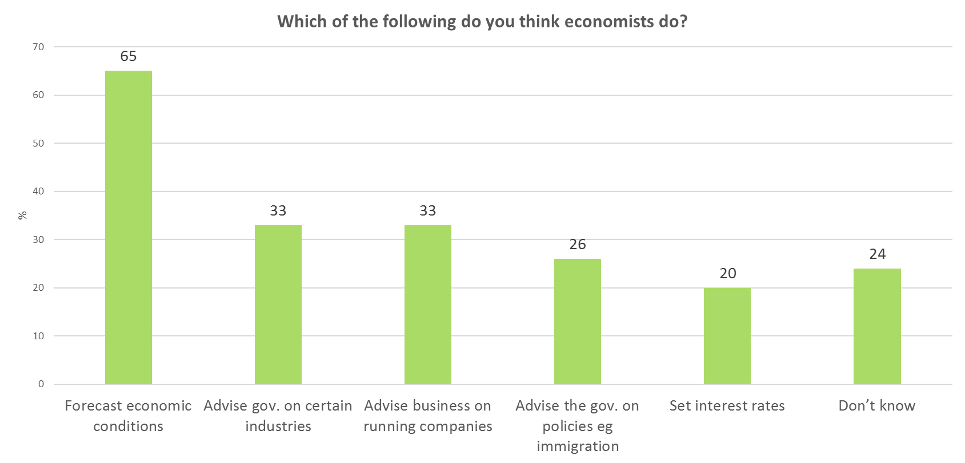
Communication & understanding

Slide 16
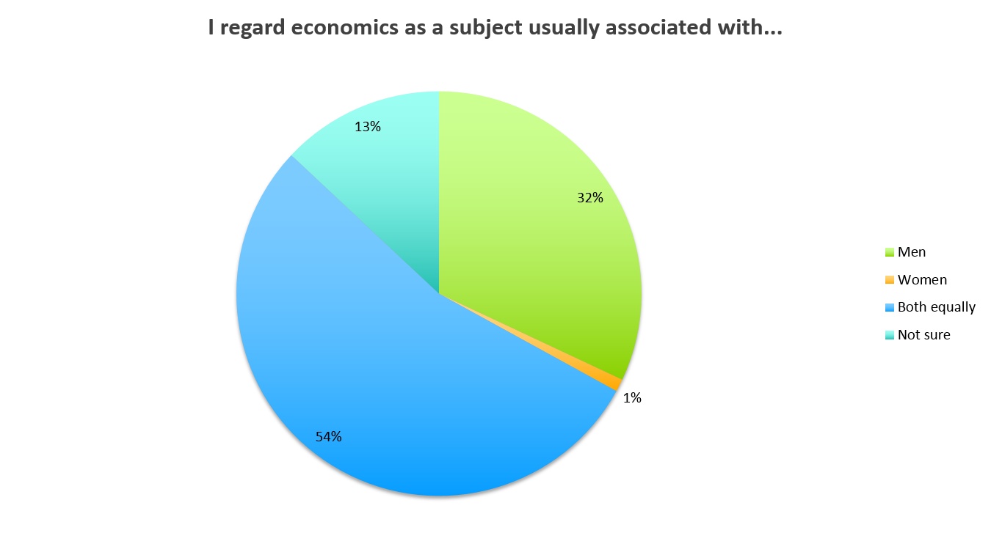
Communication & understanding

Slide 17
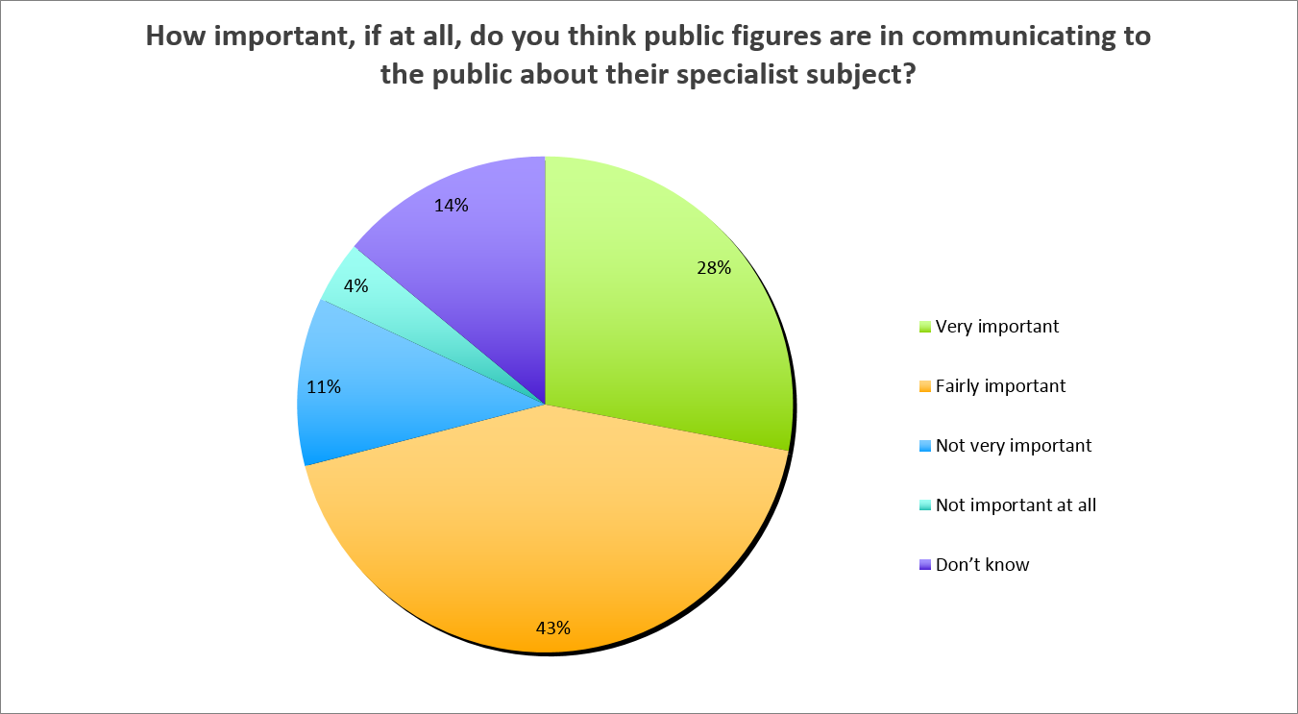
Communication & understanding

Slide 18
An economist in the public eye
21% response to this question
16% recognisable as economist/economics-related (including role-holders)
Less than 1% academic economists (Krugman, Stiglitz)
Around 6% mentioned journalists (Robert Peston, Evan Davies, Kamal Ahmed)
Most popular single entry Martin Lewis
Also had Teresa May, Jeremy Corbyn, Jed Bartlett (!!), Jeremy Paxman

Slide 19
What’s all this saying?
Public see economics as important for understanding the world & participation in public life
See economics as part of a rounded education
BUT….
Don’t know much about economics or what economists do
Don’t feel there is a clear voice representing them
Also few females representing the discipline

