Slide 1

Lecture 9 Bank Credit Creation and the Quantity Theory of Credit
Maurice Starkey

Slide 2
Quantity Theory of Credit

Slide 3
The Quantity Theory of Credit
Part B of this lecture will consider insights from the quantity theory of credit, in relation to the economic consequences of different types of bank lending.
The Quantity Theory of Credit proposes that the sector allocated lending by banks is important in determining economic impact of lending.

Slide 4
Source: The Bank of England
"Lending for speculation on real estate has become the main function of the private banking sector" (Steve Keen, 2017).

Slide 5
Source: The Bank of England

Slide 6
Lending for GDP Transactions
The Quantity Theory of Credit proposes that bank lending for business investment to private non-financial corporations and unincorporated businesses encourages growth in economic activity.
Lending that increases the output of goods and services included in GDP transactions suppresses inflationary pressures in the economy, as a consequence of increased production of goods and services, and also raises the incomes of factors of production.
Lending for productive investment creates the ‘added value’ that borrowers require to repay the interest and capital on their loans, which reduces the risk of banking crises.
However, only 15.5% of lending by UK financial institutions is directed towards non-financial firms and unincorporated businesses.

Slide 7
Lending for GDP Transactions
Lending money for consumer borrowing creates new consumer purchasing power, which may encourage increased output, but is also likely to increase the rate of consumer price inflation.
Consumer borrowing transfers future purchasing power to the current period.
Consumers future purchasing power will be reduced as a consequence of repaying interest on outstanding debts.
Approximately 8% of lending by UK financial institutions is associated with consumer borrowing.

Slide 8
Credit Money For Non-GDP Transactions
The Quantity Theory of Credit proposes that increasing the allocation of credit money for non-GDP transactions (transactions that do not increase GDP (gross domestic product)) will have no impact on economic growth, and will instead promote asset price inflation.
Lending in this category includes:
Lending for property purchase (50% of total lending)
Lending to other financial institutions, in order to purchase property and financial assets (23% of total lending).

Slide 9
Lending is primarily being channelled to purchase existing assets
"The vast majority of bank lending in advanced economies does not support new business investment but instead funds either increased consumption, or the purchase of already existing assets, in particular real estate. Real estate is relatively fixed in supply, and consequently the transfer of funds to this sector leads to asset price increases that induce yet more credit demand and more credit supply, which is at the core of financial instability in modern economies”.
Source: Adair Turner (2016). Between Debt and the Devil – Money, Credit and Fixing Global Finance, Princeton University Press, p.6.
“Self-reinforcing credit and asset price cycles are the inevitable result”.

Slide 10
Say’s Law of Bank Credit Creation
Increasing supply of credit money for non-GDP transactions creates demand for more lending.
Creating credit money creates new purchasing power that did not previously exist.
Rising borrowing increases demand for assets - both property and financial assets.
Given that both property and financial assets are relatively fixed in supply, the resulting additional demand causes asset prices (property and financial asset prices) to increase.
Rising asset prices increase demand to borrow, because investors are increasingly attracted to make a speculative gain from rising asset prices.

Slide 11
Source: Office for National Statistics

Slide 12
Median house price is rising relative to earnings
Median English house price increased from 3.5 times median annual earnings in 1997 to 8 times median annual earnings in 2018.

Slide 13
Ratio of median English house price to median annual earnings in England
Source: Office for National Statistics

Slide 14
The Quantity Theory of Credit
23% of bank lending is allocated to other financial institutions, which use the money for activities such as purchasing property and financial assets (such as company shares and bonds)

Slide 15
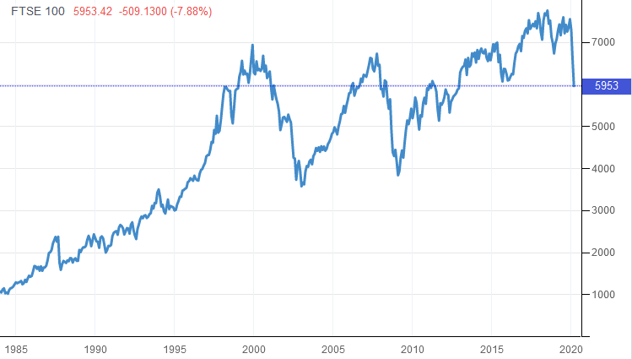
Rising Share Prices
FTSE 100 Share Index
Source: http://www.tradingeconomics.com/united-kingdom/stock-market
(retrieved 19th March 2020)
QE influenced the 100% growth in the FTSE 100 share index between 1st February 2009 & 1st December 2017.

Slide 16
Credit Money For Non-GDP Transactions
The ability of the borrower to repay the debt is a consequence of a future purchaser being prepared to pay more for the asset than the original asset purchaser previously paid (sometimes referred to as the greater fool theory, when asset prices are at historically high levels).
When lending for non-GDP transactions accounts for a large proportion of total lending in an economy, it can create instability in the banking sector.

Slide 17
Future Banking Crisis?
Banking crises tend to follow a period of rapid increases in asset prices (Reinhart & Rogoff, 2009).
A Minsky moment refers to a sudden fall in asset prices, following the excessive use of credit to purchase assets.
Increased borrowing for the purposes of purchasing property and financial assets risks creating a 'Minsky Moment'

Slide 18
Financialisation
“Financialisation refers to the increasing dominance of the economy, politics and economic policy by financial interests and financial institutions”.
(page ix)
Article discussing financialisation
Financialisation refers to an increase in the size and importance of a country's financial sector relative to its overall economy.
Financialisation is a consequence of the financial sector elite (within financial markets and institutions) pursuing policies to increase their wealth, and influence over the economy and political institutions.
“Financialisation refers to the increasing role of financial motives, financial markets, financial actors and financial institutions in the operation of the domestic and international economies”.
(Page 1)

Slide 19
Appendices

Slide 20
Economist magazine article explains that whilst in John Maynard Keynes lifetime most saving was recycled into business investment (S=I), today almost 50% of bank lending goes to mortgage lending on property.

Slide 21
Financialisation
Financialisation:
elevates the significance of the financial sector relative to the real economy,
transfers income from the real economy to the financial sector
contributes to increasing income inequality and wage stagnation.

Slide 22
Consequences of Financialisation?
The economic system is burdened by three major structural problems:
First, there is a debt hangover from past borrowing that negatively impacts aggregate expenditure in the economy.
Second, there are the scars of the financial crisis and recession ... destroyed creditworthiness, reduced collateral values, and diminished animal spirits.
Third, the economy is still afflicted by the structural demand gaps caused by deteriorated income distribution.
Consequently, the prognosis is one of prolonged economic stagnation.
page 7
Source: Thomas I. Palley (2013). Financialization – the economics of finance capital domination, Palgrave Macmillan.

Slide 23
Consequences of Financialisation
Severe risk of asset price deflation that could be a consequence of a Minsky moment.
Value of assets will fall that secure mortgages.
Holders of depreciated assets (consequently in negative equity) will walk away from their debts
Animation explaining the credit crisis
Paul Krugman explains the American sub-prime loan crisis.
Bird and Fortune explain the sub-prime crisis.
leaving the banks at risk of insolvency (bank liabilities are greater than bank assets)
Lehman Brothers collapse.
Banks stop lending to one another, companies and individuals.
Credit Crunch!

Slide 24
Challenge to Financialisation Hypothesis
Failure of financial institutions may undermine the hypothesis that the financial sector is increasing their share of national wealth.
However, it could also be argued that:
government takeover of failed banks caused government to be co-opted to pursue the financialisation agenda, in order to recover tax-payers money used to acquire ‘too big to fail banks’.
Financial institution elite benefitted from the collapse of weaker financial institutions.

Slide 25
Financialisation
Even if financialisation is not being driven by a financial elite.
The potential systemic impacts on both the financial system and wider economy may justify attention being given to a range of independent factors that could potentially coalesce to significantly impact the economy,

Slide 26
Financialisation
Thomas Palley’s academic paper explaining the term financialisation.
Thomas Palley, After the bust: The outlook for macroeconomics and macroeconomic policy.

Slide 27
Additional Sources
Thomas Palley explains Hyman Minsky’s super-cycles.
Hyman Minsky’s Financial Instability Hypothesis.

