Slide 1

Lecture 9
Bank Deposit Creation and the Quantity Theory of Credit
Maurice Starkey

Slide 2
Lecture 9
Part A - first video
  Bank Deposits Multiplier
  Credit Creation Theory of Banking
Part B - second video
  Quantity Theory of Credit

Slide 3
Banks and money creation

Slide 4
Most money in the economy is created by commercial banks
Cash / currency accounts for approximately 3% of the money in circulation.
  bank notes account for approximately 94% of the total cash / currency in circulation
  coins account for approximately 6% of the total cash / currency in circulation
Approximately 97% of the money in the UK economy comprises of money that was created by commercial banks, not the Bank of England.
Primary form of money is not physical cash created by the state, but the liabilities of banks - 'Credit Money'.

Slide 5
Bank deposits
Notes and coins in circulation
Source: The Bank of England

Slide 6
Source: The Bank of England and Office for National Statistics
There has been a significant divergence in the growth of broad money (M4) relative to GDP growth.

Slide 7
Money and GDP
Gross Domestic Product (GDP) measures the amount of money spent in an economy (also value created and incomes earned) from producing new products (includes services), within a country or administrative region (such as the United Kingdom).
Following banking deregulation in the early to mid 1980’s, money supply has expanded at a much faster rate than GDP.
  Key aspects of banking deregulation are presented at the beginning of my quantity theory of credit article.
The reason for the divergence between money supply and GDP is that an increasing proportion of money is being used to purchase pre-owned assets in secondary markets, which are being sold by their previous owners.
  Examples include previously purchased property, and previously purchased financial assets such as shares and bonds.

Slide 8
Financial Deepening
Financial deepening refers to an increase in private sector debt as a percentage of GDP.
Private sector debt increased from 50% of national income in 1950 to 170% in 2006.
  Source: Adair Turner (2016). Between Debt and the Devil – Money, Credit and Fixing Global Finance, Princeton University Press.
The debt overhang explains why the recovery from 2007 to 2009 financial crisis has been so anaemic.

Slide 9
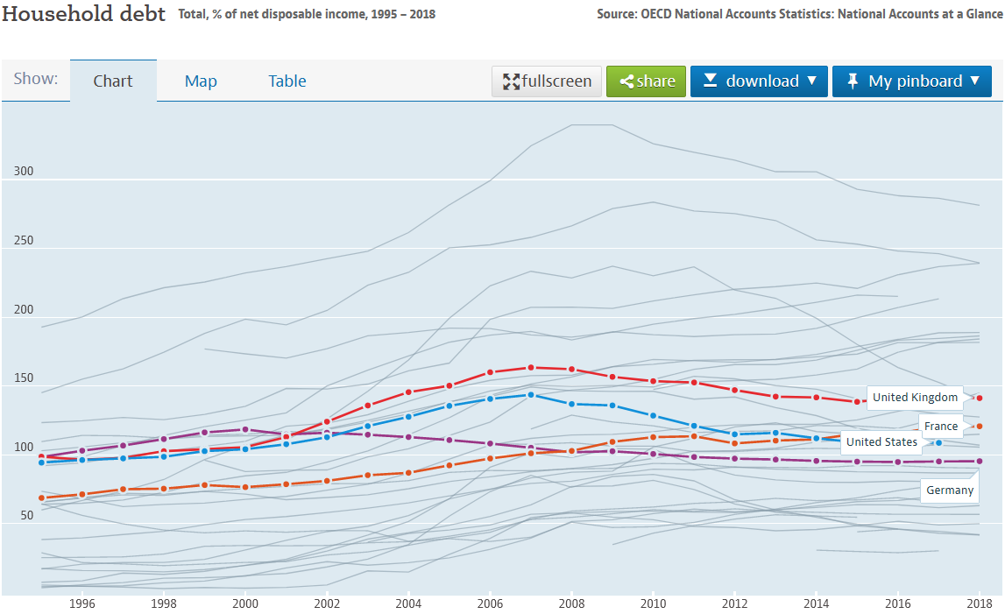
Household debt as a percentage of net disposable income (1995 – 2018)
Source: The Organisation for Economic Co-operation and Development (OECD)

Slide 10
How is money created?
There are two theories regarding how the banking system creates new money:
Bank deposits multiplier
Credit creation theory of banking
  please see my credit creation theory of banking article.

Slide 11
Bank Deposits Multiplier
Fractional reserve banking system. Banks only maintain a small proportion of customer deposits in liquid assets, which enables them to loan out the majority of their money holdings to achieve a financial return.
Banks do not create new money, but the banking system does.
Chain of deposit creation. A loan to one bank customer is used to make payments that lead to deposits being made into the recipient’s bank account. The bank receiving the deposit uses the money to issue new loans, but retains some deposited money for those wanting to withdraw their cash.

Slide 12
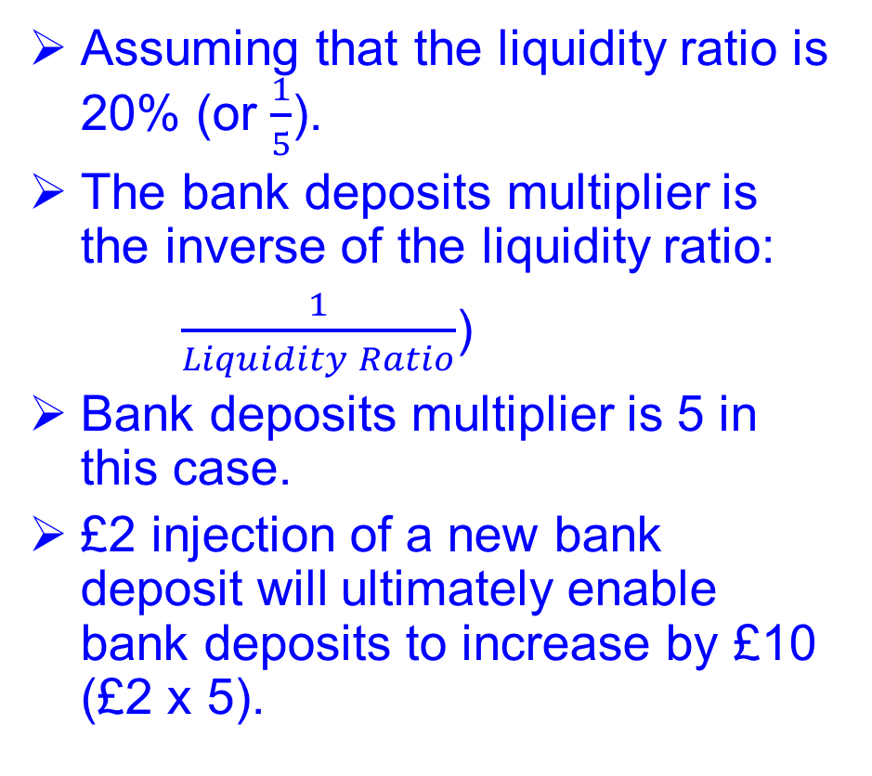
Bank Deposits Multiplier
Bank deposit | Liquidity ratio (20%) | Injection / Bank Advance
 |  | £2.00
£2.00 | £0.40 | £1.60
£1.60 | £0.32 | £1.28
£1.28 | £0.26 | £1.02
£1.02 | £0.20 | £0.82
£0.82 | £0.16 | £0.66
£0.66 | £0.13 | £0.52
£0.52 | £0.10 | £0.42
£0.42 | £0.08 | £0.34
£0.34 | £0.07 | £0.27
£0.27 | £0.05 | £0.21
£0.21 | £0.04 | £0.17
£0.17 | £0.03 | £0.14
£0.14 | £0.03 | £0.11
£0.11 | £0.02 | £0.09
£0.09 | £0.02 | £0.07
£0.07 | £0.01 | £0.06
£0.06 | £0.01 | £0.05
£0.05 | £0.01 | £0.04
£0.04 | £0.01 | £0.03
£0.03 | £0.01 | £0.02
 |  | £9.91
Assuming that the liquidity ratio is 20% (or $\frac{1}{5}$).
The bank deposits multiplier is the inverse of the liquidity ratio:
$\frac{1}{Liquidity Ratio}$)
Bank deposits multiplier is 5 in this case.
£2 injection of a new bank deposit will ultimately enable bank deposits to increase by £10 (£2 x 5).

Slide 13
Bank Deposits Multiplier
Liquidity ratio.
  A bank will maintain a proportion of customer balances in liquid form, in order to meet expected customer demand for cash.
  A liquid asset is one that can be easily and quickly converted to cash, with no risk of financial loss.
  Liquid asset ratio / minimum liquidity ratio is also influenced by policies defined by the central bank (Bank of England in the UK).
Liquidity ratio determines how much new money banks can create.

Slide 14
Credit Creation Theory of Banking
Banks do not solely lend out money deposited with the bank.
The actual act of bank lending creates bank deposits.
  Credit money is created when a bank generates a bank deposit, which is a consequence of fulfilling a loan agreement, extending an overdraft facility, or purchasing assets.
  In creating credit, banks simultaneously create deposits in our bank accounts, which, to all intents and purposes, is money.
  Act of bank lending creates new purchasing power that did not previously exist.
  Bank of England quarterly bulletin explains how banks create money
Therefore, the amount of money a bank can create is not constrained by their deposit taking activities.

Slide 15
Credit Creation Theory of Banking
Bank deposits are sometimes referred to as ‘credit money’, because the majority of bank deposits were originally created by banks issuing new loans.
  Credit money represents a commercial bank’s IOU, which only remains valid whilst the bank remains solvent.
An individual bank can create ‘credit money’.

Slide 16
Credit Money
Credit money represents a commercial bank’s IOU, which only remains valid whilst the bank remains solvent.
Bankruptcy of a bank would destroy a significant proportion, if not all, of the credit money created by a bank.
  Government guarantees the first £85,000 of an individual’s bank deposits through the Financial Services Compensation Scheme.
Money is destroyed when an existing debt is repaid.

Slide 17
A bank’s ability to create new money is a consequence of:
Non-cash transactions account for more than 95% of all transactions conducted within the economy
  settled through non-cash transfers within the banking system.
  cash transactions account for less than 5% of total transactions in the economy.
Banks’ act as the ‘accountant of record’ within the financial system.
  No one notices: Individuals cannot distinguish between money that is actually being saved and deposited with the bank, and money that has been created by a bank.

Slide 18
Banks are exempt from the 'Client Money Rules'
Client money rules require non-bank organisations (for example, stockbrokers, solicitors and accountants) to keep clients’ money separate from the non-bank organisation’s assets and liabilities on their balance sheet.
Exemption enables a bank to rename their account payable liability as a customer deposit, despite the money not being a consequence of a customer making a deposit.
Banks exemption from the client money rules means that when a customer deposits money at their bank, the customer no longer owns the money, and becomes a general creditor of the bank.

Slide 19
Seigniorage
Seigniorage traditionally refers to the profit received by the central bank from creating new money, and is calculated as the difference between the cost of producing physical money and the purchasing power of the newly created money in the economy.
  For example, a £10 note can purchase £10 worth of products within the economy, but only costs a few pence to produce.
Given that commercial banks create the majority of money in an economy, we can also calculate commercial bank seigniorage acquired from bank credit creation.
It is estimated that commercial bank seigniorage profits from credit creation that arose from lowering banks cost of capital generated commercial banks an annual £23 billion of addition profit per annum during the period 1998 to 2016 (Macfarlane, Ryan-Collins, Bjerg, Nielsen, & McCann, 2017, p. 2).
Source: New Economics Foundation publication: Making Money from Making Money: Seigniorage in the Modern Economy, page 7.

Slide 20
Banks and Credit Money Creation
Banks have not been granted a licence to print money. However, custom and practice within the banking industry enables banks to create credit money, which is to all intents and purposes money.

