Slide 1

Lecture 10 Monetary Policy (part 2)
Maurice Starkey

Slide 2
Lecture 10
Part 1: Risks arising from the 2008 Banking Crisis:
Risk: A lack of bank liquidity that reduces bank lending to the wider economy, and may risk runs on a bank by depositors.
Risk: Insolvency and failure of financial institutions.
Debt-deflation (Irving Fisher) impacting the wider economy.
Part 2: Response of governments and monetary authorities:
Expansionary Monetary Policies (EMP).
Use Keynes Liquidity Preference theory to explain how monetary authorities reduce interest rates.
Use the Monetary Transmission Mechanisms to describe the channels by which lower interest rates impact the wider economy.

Slide 3
Monetary Policy
Monetary Policy refers to monetary authorities influencing interest rates (price of money), the amount of money in an economy (money supply), bank reserve ratios and credit terms, in order to achieve economic objectives.
Monetary Policy influences the general structure of interest rates in the economy,
influencing aggregate expenditure and inflation.

Slide 4
Expansionary Monetary Policy
Monetary authorities expand money supply to reduce interest rates, which encourages both companies and individuals to increase borrowing.
Quantitative easing:
An expansionary monetary policy can involve quantitative easing, whereby the central bank purchases assets from banks and non-bank financial institutions, which leads to an increase in bond prices.
An increase in bond prices lowers bond yields, which reduces the costs of borrowing in an economy.
The increase in bank reserves boosts banks' capacity to lend to individuals and businesses.
An expansionary monetary policy risks creating inflationary pressures within the economy.
Source: FT.com

Slide 5
How do central banks influence interest rates? Keynes Liquidity Preference theory

Slide 6
Three Motives for Holding Money
Classical School: Money is a medium of exchange (active balances): -
Transactions motive for holding money.
People hold money to buy goods and services.
Precautionary motive.
People maintain cash balances to facilitate unexpected transactions, as a consequence of uncertainties regarding the precise timing and size of receipts and payments.
Demand to hold transaction and precautionary balances is motivated by the desire to spend, and so is unaffected by interest rates.
Demand for transactions and precautionary balances is inelastic with respect to interest rates.

Slide 7
Three Motives for Holding Money
John Maynard Keynes
Speculative (Asset) motive.
Money is also a store of wealth (idle balances)
Money is an asset class, just like government Treasury Stock (bonds), property and company shares.
Money is desirable, because the value of money is fixed.
Money is an alternative to other types of asset class that can vary in price (fall in price).

Slide 8
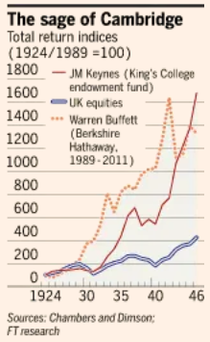
Speculative Demand for Money (Keynes)
John Maynard Keynes was a successful investor.
John Authers (2012). The Long View: Keynes stands tall among investors, Financial Times.
Chambers, David and Dimson, Elroy and Foo, Justin, Keynes the Stock Market Investor: A Quantitative Analysis (September 26, 2013). Journal of Financial and Quantitative Analysis (JFQA), Vol 50, No 4, 2015, pages 431–449. Available at SSRN: https://ssrn.com/abstract=2023011 or http://dx.doi.org/10.2139/ssrn.2023011

Slide 9
Treasury Stock / Treasury Gilts
Treasury Stock (Treasury Gilts since 2005 – 2006) have a maturity date of more than one year.
‘Gilt-edged’ is the term traditionally used to refer to UK government debt, due to the near certainty that a sovereign authority that is able to print its own money supply, is able to repay government debt.
However, printing money to repay both debt and debt interest could lead to inflation in the currency area (an increase in the general level of prices).
Moody’s credit rating agency downgraded UK government debt from AAA (the highest credit rating) in 2013, before downgrading it again in 2017. The British government’s credit rating in April 2020 is AA2, which is still very good.
A reduction in credit rating could in future increase the United Kingdom’s cost of borrowing, to reflect an increased risk to lenders of credit default by the United Kingdom government.
Treasury Stock is issued by the UK Debt Management Office (DMO), an Executive Agency of the UK Government Treasury (The Bank of England prior to April 1998).

Slide 10
Treasury Stock / Treasury Gilts
For example, Treasury Stock 15% 1985
Coupon rate refers to the fixed cash payment defined in terms of a percentage yield, received from owning a bond with a £100 issue price.
owner of the bond shown above receives £15 per annum per £100 bond, with payment being made in two equal semi-annual payments (every six months).
bond yield reflects the money market interest rate when a bond is issued.
Coupon date refers to the date a bond matures,
in the case of the above bond 1985
when the bond matures, the bond owner receives their final interest payment, and the return of the face value of their bond (£100).
Bond auction. Tendering process for some bonds.
investor can bid from £97.50 per £100 bond
government use tendering process to potentially increase the revenue received – highest bidders receive the available Treasury Stock.
also provides investors with an opportunity to increase their yield.
for example, if the above bond had been sold through a tendering process, an investor bidding £97.50 for 15% Treasury Stock 1985 with a face value of £100 would increase their bond yield to 15.4%.

Slide 11
Speculative Demand for Money (Keynes)
Keynes suggested:
Holding bonds creates the potential for financial gain (or loss) that is not present when holding money.
Government bond (Treasury Stock) price varies according to the variable money market interest rate, because it provides an interest rate (yield) that is fixed at the time of issue (usually a percentage of the nominal bond value of £100).
Value of money is fixed, and earns a variable money market interest rate.
There is an inverse relationship between a bond price and the market interest rate.
Investors vary their holding of money, according to their expectation of future changes in bond (Treasury Stock) prices – creating a Speculative Demand for Money.

Slide 12
Bond Prices and Investment Decisions
Investors make a capital gain by:
buying bonds when the bond price is likely to rise, which is a consequence of the variable market interest rate on money being expected to fall.
Falling market interest rates cause bond prices to rise.
Investor will buy bonds if they anticipate that bond prices will rise in the future, which would generate a capital gain on bond holdings.

Slide 14
Bond Prices and Investment Decisions
Investors avoid a capital loss by:
Selling bonds when the bond price is likely to fall, which is a consequence of market interest rates being expected to rise.
Increasing money market interest rates cause bond prices to fall.
Investor will sell bonds if they expect bond prices to fall in the future, in order to avoid a capital loss on their bond holding.

Slide 15
Calculating Bond Prices
Example is for an undated bond, often referred to as a consol.
Bond price = Face value * (coupon rate / money market interest rate)
Bonds (Treasury Stock) face value is £100.
Therefore, a Treasury Stock coupon (interest) rate of 4% will generate an annual £4 return on every £100 stock held.
assuming a money market interest rate of 2%, the value of the Treasury Stock is:
£100 multiplied by (percentage coupon rate of bond 4 / 2 percent money market interest rate) = £200
At a Treasury Stock price of £200 the £4 annual return is equivalent to a running yield (or interest yield) of 2%, which is the same as the variable market interest rate of 2%.

Slide 16
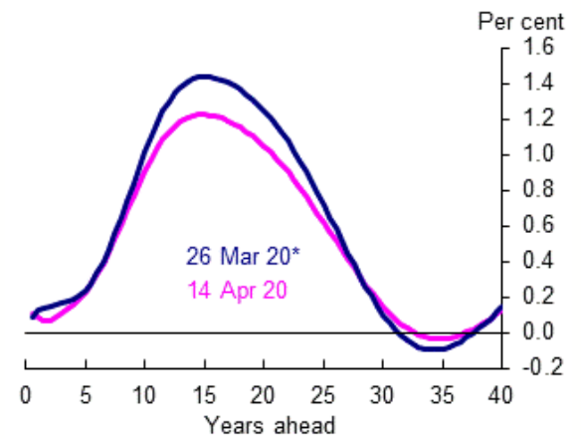
Yield Curve
The yield curve is a line presenting the yield (interest rate) required by investors to purchase bonds that have the same credit quality (for example, gilt-edged securities), but at different maturity dates.
Investors required rate of return is influenced by investors time preference for money, and expected interest rate changes that is influenced by the:
inflation rate
exchange rate
return on capital (for example, resulting from technological progress).
rate of economic growth
perceived economic risks at different points in time
Nominal yield curve for gilt-edged securities on 14th April 2020.
Source: https://www.bankofengland.co.uk/statistics/yield-curves

Slide 17
Speculative Demand for Money
Consider whether other assets (for example, shares and houses) can be considered to have similar features to a bond
Provide a future income stream over a period of time
Houses provide rental income after deducting expenses for property repair and maintenance.
Equity provides the investor with a share in a company’s stream of future profits.
and the discount rate that is used to determine the present value of a future stream of income is influenced by the variable market interest rate.

Slide 18
Precautionary demand (P)
Transactions demand (T)
Rate of Interest (%)
Money Demand (M_{d}) / (Liquidity Preference Schedule) (T + P + S)
Demand for Money comprises:
Transactions demand
+ Precautionary demand
+ Speculative demand
Speculative demand (S)
Quantity of Money

Slide 19
Point of Clarification
Reference to the Dollar, when discussing speculative demand for money, refers to the American Dollar.

Slide 20
Interest Rate Determination
Rate of Interest (%)
Money Supply¹
ir_{e}
Money Demand (Liquidity Preference Schedule)
Quantity of Money

Slide 21
Expansionary Monetary Policy - Quantitative Easing

Slide 22
Monetisation
Monetisation refers to the central bank creating money to purchase interest-bearing government debt.
When government expenditure exceeds tax revenue, it must borrow from the public... If the government has a significant amount of debt outstanding, it may choose to purchase its own debt with newly printed currency. The government has thereby replaced its interest-bearing debt with money, and has thus monetised part of its debt.
Central banks usually purchase government debt through the secondary market, where the debt was previously issued.
A consequence of purchasing debt with money is that money supply increases, which increases bank reserves that facilitate increased bank lending. Using the increased money supply to purchase goods and assets will raise the price of goods and assets, and is thus likely to generate inflation.
Consequently, debt monetisation to finance a deficit often creates inflation, as a consequence of using this approach to finance government deficits.
Adapted from: http://lexicon.ft.com/Term?term=monetisation

Slide 23
Quantitative Easing
Quantitative Easing refers to The Bank of England using their ‘Asset Purchase Facility’ to purchase bonds (usually government bonds) from private sector financial institutions (both bank and non-bank financial institutions), in order to increase money supply.
Please see the Bank of England video that explains quantitative easing, and page discussing quantitative easing.
The Bank of England purchase government bonds in secondary markets.
Quantitative Easing also includes the purchase of private sector bonds, such as corporate bonds, and in America includes the Federal Reserve Bank purchasing mortgage-backed securities.
When the government engages in QE, their intention is to sell the purchased government bonds back to the financial markets at some point in the future.
If the government does not intend to sell the bonds they have purchased back to the financial market at some point in the future, the central bank’s purchase of bonds is referred to as ‘Overt Monetary Financing’, rather than being Quantitative Easing.
Financial assets purchased by The Bank of England’s 2009 programme of Quantitative Easing have still not been returned to the market.

Slide 24
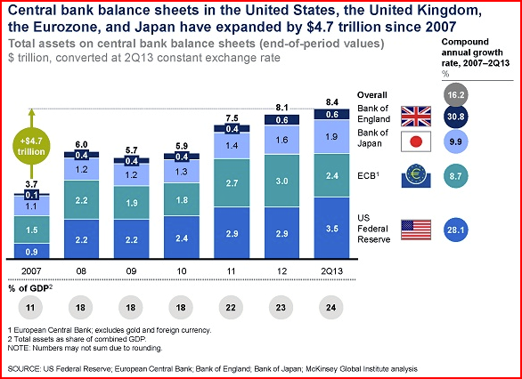
Quantitative easing by global central banks
Source: McKinsey

Slide 25
Quantitative Easing
Rate of Interest (%)
MS¹
MS²
QE
ir₁
ir_{qe}
Money Demand (Liquidity Preference Schedule)
Quantity of Money

Slide 27
Quantitative Easing
The additional central bank demand for government bonds increases the bond price, and reduces the bond yield.
Given that the annual financial return from a bond is usually defined as a percentage of the initial coupon price (£100) of a bond.

Slide 28
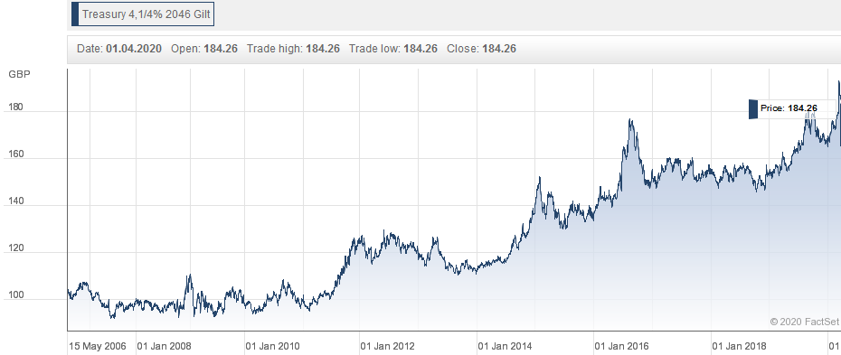
Price of Treasury Stock 4.25% 2046
Source: Hargreaves Lansdown (https://www.hl.co.uk/shares/shares-search-results/t/treasury-4,14-2046/share-charts)

Slide 29
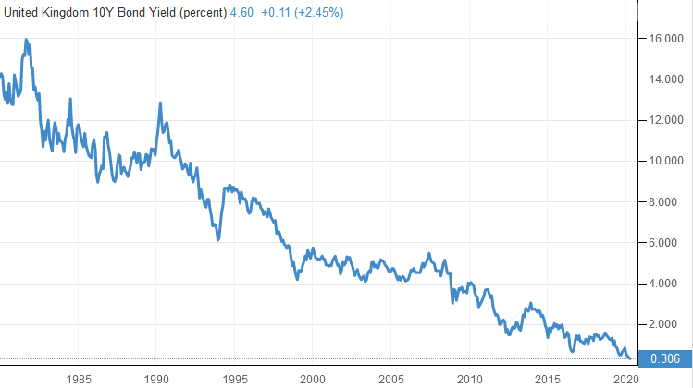
UK Government 10 Year Bond Yield
Bond yields have fallen (bond prices have risen) for the last 30 years, as market interest rates have fallen.
Source: Trading Economics (https://tradingeconomics.com/united-kingdom/government-bond-yield)

Slide 30
Quantitative Easing (QE)
Financial institutions use the money received from the central bank to purchase other types of assets, such as property and company shares, which offer a higher rate of return.
Non-bank financial institutions purchase of property and financial assets provides support to the price of these assets, which prevents a reduction in property and financial asset prices.
Maintaining property and financial asset prices prevents speculators being bankrupted by falling property and financial asset prices, which could cause their bank loans to become non-performing, and may lead to bank insolvencies.
Beneficiaries from QE were those with property and financial assets that benefited from the resulting increase in the value of financial and property assets.

Slide 31
Quantitative Easing and the Value of Pound Sterling in terms of Gold

Slide 32
Direct Monetary Financing
There is an opportunity for the Bank of England to innovate by providing money directly to the UK Treasury in return for government bonds (primary market), which is referred to as ‘direct monetary financing’.
This would be a longer term variant of The Bank of England’s ‘Ways and Means Facility’, which is an overdraft facility for the British government.
The Bank of England’s Ways and Means Facility reached £20 billion after the 2008 financial crisis.

Slide 33
Liquidity Trap
At very low interest rates the Liquidity Preference Schedule (LPS) is interest elastic, due to the speculative demand for money motive.
Demand to hold money varies negatively with interest rates.
At extremely low historic interest rates (Bank of England base rate is 0.1% in April 2020) there may be a preference to hold money, if investors expect that interest rates will increase in the near future.
Investors sell bonds, because they anticipate that higher interest rates will cause bond prices to fall, which would cause them to incur a loss on the value of their bond holdings.
Limited number of people have sufficient creditworthiness to receive additional money, and so banks retain cash holdings.
Liquidity trap causes interest rates to be relatively unresponsive to money supply increases, when interest rates are very low.
Notes:
33
5

Slide 34
Liquidity Trap
Rate of Interest (%)
MS¹
MS²
MS³
Liquidity Trap. An increase in money supply beyond MS² will be held in idle cash balances.
ir₁
ir₂
Quantity of Money

Slide 35
Monetary Transmission Mechanisms

Slide 36
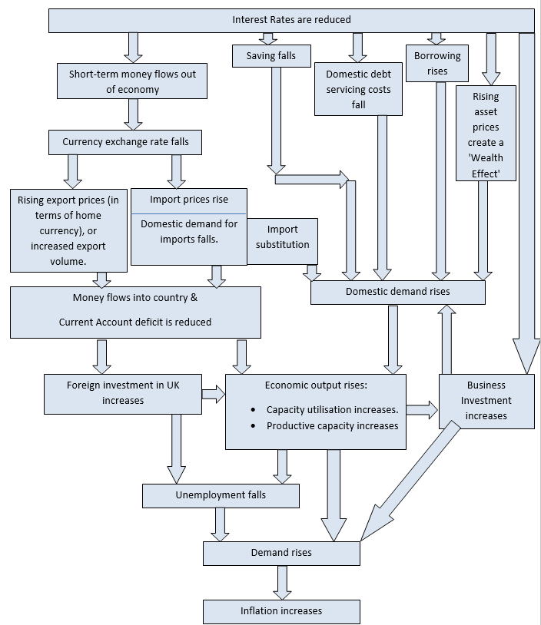

Slide 37
Monetary Transmission Mechanisms – Exchange Rate Channel
Falling interest rates incentivise investors to move their money to currency areas offering a higher interest rate, and reduce foreign investors desire to invest their money in the UK.
Reduction in the £ Sterling exchange rate is a consequence of an increased supply of £ Sterling on foreign exchanges as investors sell their UK assets and seek to move their money abroad to acquire a better rate of return, whilst there is reduced demand for £ Sterling as rates of return on UK assets become relatively less attractive.

Slide 38
Exchange Rate Channel
Lower £ Sterling exchange reduces the price of UK sourced products in export markets,
the greater price competitiveness of UK sourced products in foreign markets increases demand for UK exports.
Lower £ Sterling exchange rate increases the price of foreign produced products in the UK, reducing demand for imported products.
Fall in the £ Sterling exchange rate reduces the purchasing power of UK households,
encouraging import substitution by UK households (financial incentive for UK consumers to replace foreign products with UK produced products).
Assumes that demand for both imports and exports is price sensitive. This may not be valid when non-price factors significantly influence consumer purchasing decisions, or the product cannot be produced in the UK.

Slide 39
Increased Consumption
Lower interest rates encourage increased consumption of goods and services,
Promoting increased economic activity, when there is a risk of the economy entering a recession.
Lower interest rates reduce debt servicing costs, increasing the amount of money available for consumption.
Lower interest rates encourage people to borrow, as a consequence of the increased affordability of loans (reducing total future repayments).
Lower interest rates provides households, the corporate sector, and government with a motivation to increase their indebtedness.
Reduced personal savings ratio is a consequence of lower interest rates creating a disincentive to save.

Slide 40
Wealth Effect
Rising asset prices cause people to perceive that they are wealthier, which encourages people to increase their consumption.

Slide 41
Increased Business Investment
An expansionary monetary policy promotes increased business investment.
Increase in capacity utilisation by companies is a consequence of:
Rising export demand
Import substitution by UK households and business
Increased UK consumption as a consequence of:
Lower debt servicing costs
Increased incentive to borrow
Reduced incentive to save
Lower borrowing costs

Slide 42
Increased Consumer and Business Confidence / Improved Expectations
Expectations that the economy will improve produces self-fulfilling expectations.
However, there is a risk that reduced interest rates will cause consumers and businesses to believe that the economy is in trouble, which could lead to an increased rate of saving and a deferring of both consumption and investment.

Slide 44
Appendices

Slide 45
Calculating bond prices:
Coupon rate refers to the interest rate a bond initially pays when first issued.
Running yield (or interest yield). Interest rate based on the latest market price.
Pre-tax coupon rate *100 = Cons 4% = 400 = 4.14%
Current Market Price 96.59
Redemption yield (also called yield to maturity). Adds to running yield the additional expected percentage gain or loss on the face value of the bond, when it is redeemed.
(for calculation see: http://monevator.com/how-to-calculate-bond-yields/)

Slide 46
Useful videos
Bank of England explains how quantitative easing works.
Bank of England buy bonds from the private sector to increase money supply.

Slide 47
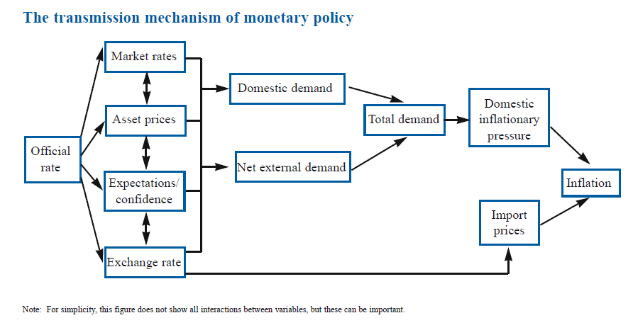
Transmission Mechanisms of Monetary Policy

