Slide 1
Logistic Regression III
SIT095
The Collection and Analysis of Quantitative Data II
Week 9
Luke Sloan

Slide 2
Introduction
Recap – Last Week
Workshop Feedback
Multinomial Logistic Regression in SPSS
Model Interpretation
In Class Exercise
Writing-Up
Summary

Slide 3
Recap – Last Week
Variable selection
Binary logistic regression in SPSS
Model interpretation
Intuitive results?

Slide 4
Workshop Feedback
TASK:
To run and interpret a binary logistic regression model with ‘Sex’ as the dependent variable using your own choice of independent variables
Were your models successful?
Did you have any problems or issues?
Did you find anything interesting (interpretation of odds ratios)?
Did you have difficulty in interpretation?
TODAY: I will show you how to run and interpret a multinomial logistic model in SPSS. I will use a different dependent variable (‘edlev7’) and the same dataset.

Slide 5
Multinomial Logistic Regression in SPSS I
Very similar to binary logistic regression
For a categorical dependent variable with more than two categories
‘edlev7’ asks for the highest educational qualification of a respondent and has three categories: ‘Higher Education’, ‘Other Qualification’ and ‘None’
One of these categories has to be designated a ‘reference category’ to which the others will be compared
E.g. if ‘None’ is the ‘reference category’…
  respondents who had Higher Education qualifications were more likely to be female (odds increase of 2.3) than respondents with no qualifications
  Respondents who had other qualifications were less likely to be female (odds decrease of 0.45) than respondent with no qualifications
It is not possible to compare groups that are not the ‘reference category’ i.e. we cannot draw comparisons between ‘Higher Education’ and ‘Other Qualification’ directly

Slide 6
Multinomial Logistic Regression in SPSS II
Deciding on a ‘reference category’ should be an informed decision – what do we want to compare?
Education Level - 2000 (3 groups)
 |  | Frequency | Percent | Valid Percent | Cumulative Percent
Valid | HIGHER EDUCAT | 2015 | 24.5 | 31.2 | 31.2
 | OTHER QUAL | 2826 | 34.4 | 43.8 | 75.0
 | NONE | 1614 | 19.6 | 25.0 | 100.0
 | Total | 6455 | 78.5 | 100.0
Missing | NEV WENT SCH | 16 | .2
 | NA | 4 | .0
 | AGEOUT,MSPR | 1745 | 21.2
 | System | 1 | .0
 | Total | 1766 | 21.5
Total |  | 8221 | 100.0
As a rule of thumb, the ‘reference category’ should be the most populated response (highest frequency), but this can be over-ruled by your research agenda
In this case I am going to use ‘Other Qualification’ for several reasons: largest group, median point and interesting from a theoretical perspective (difference between ‘Other Qual’ and ‘Higher Education’ might question value of studying at university…

Slide 7
Multinomial Logistic Regression in SPSS III
You still need to select your variables carefully
Consider hypotheses, frequencies, recoding, relationships and multicolinearity
My variables (including recodes):
  ‘manual2’ (non-manual/manual)
  ‘ethnic2’ (white/non-white)
  ‘marital2’ (married/cohabiting/single/widowed/divorced or separated)
  ‘seefrnd2’ (weekly/monthly/less than monthly/not in last year)
  ‘cntctmp’ (yes/no)
  ‘age’ (in years)
  ‘alcdrug2’ (very big problem/fairly big problem/minor problem/not a problem/happens but is not a problem)
  ‘influence2’ (yes/no)
Excluded due to multicolinearity – could be interesting…

Slide 8
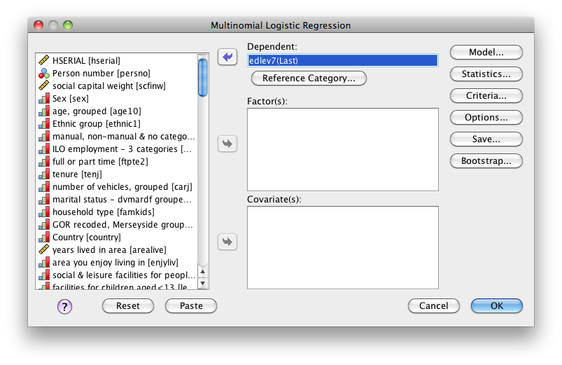
Multinomial Logistic Regression in SPSS IV
1) To begin, go to ‘Analyze’, ‘Regression’ and select ‘Multinomial Logistic…’
2) Your dependent goes here
3) Click on ‘Reference Category…’
By default SPSS will use the last category in your independent categorical variables as the ‘reference category’

Slide 9
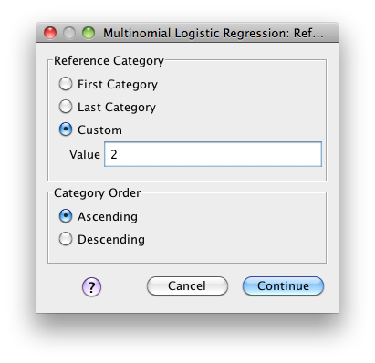
Multinomial Logistic Regression in SPSS V
You need to tell SPSS which response for the dependent variable you want to be used as the ‘reference category’
4) Because ‘Other Qualification’ is coded as ‘2’ in our dataset and we want to use this as the ‘reference category’ we select ‘Custom’ and type the value (‘2’)
‘Category Order’ is important when specifying ‘First Category’ or ‘Last Category’ – always a good idea to specify a custom value manually
5) Click ‘Continue’

Slide 10
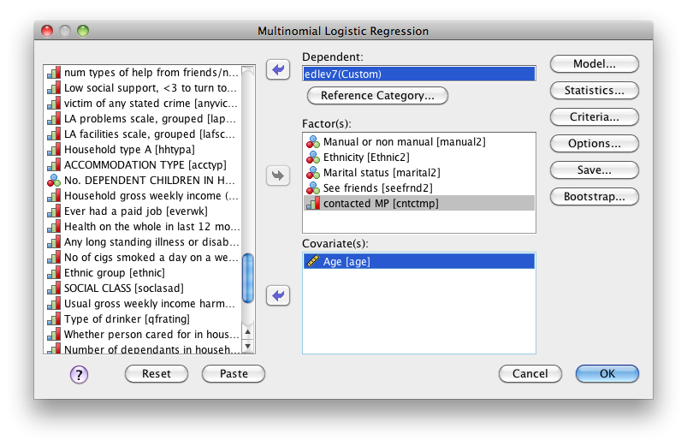
Multinomial Logistic Regression in SPSS VI
Notice that the dependent is now follows by ‘(Custom)’
6) Your categorical independent variables (factors) go here
7) Your interval independent variables (covariates) go here
8) Click on ‘Statistics…’

Slide 11
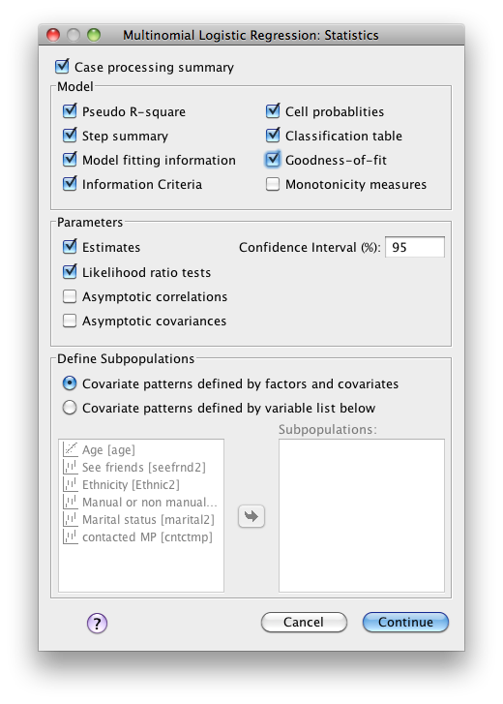
Multinomial Logistic Regression in SPSS VII
Note that some options are already selected – leave them as they are
9) Select ‘Information Criteria’, ‘Cell probabilities’, ‘Classification table’ and ‘Goodness-of-fit’
10) Click ‘Continue’

Slide 12
Multinomial Logistic Regression in SPSS VIII
11) Click ‘Save…’

Slide 13
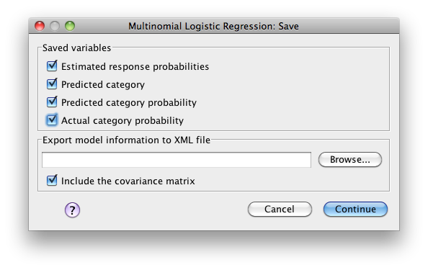
Multinomial Logistic Regression in SPSS IX
12) Select ‘Estimated response probabilities’, ‘Predicted category’, ‘Predicted category probability’ and ‘Actual category probability’
These values will be saved as variables on the datasheet for later analysis
Ignore this option as we are not interested in exporting the model
13) Click ‘Continue’

Slide 14
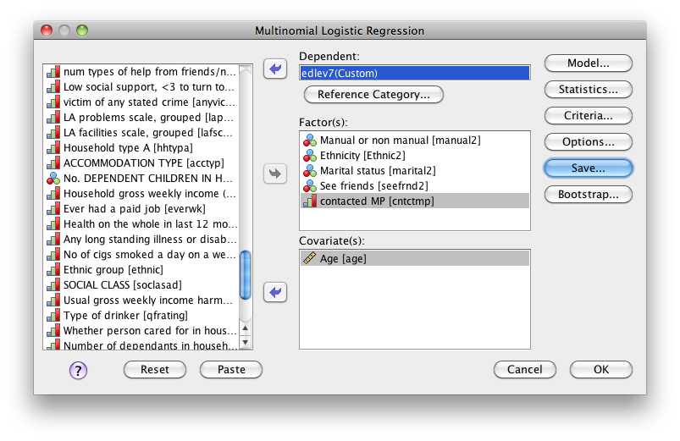
Multinomial Logistic Regression in SPSS X
14) Click ‘OK’ to run the model

Slide 15
Model Interpretation I
This table tells us the frequencies and percentages of respondents from the dataset that fall into each category for all the categorical variables (including the dependent)
Case Processing Summary
 |  | N | Marginal Percentage
Education Level - 2000 (3 groups) | HIGHER EDUCAT | 1942 | 32.2%
 | OTHER QUAL | 2575 | 42.7%
 | NONE | 1515 | 25.1%
Manual or non manual | Non-Manual | 3558 | 59.0%
 | Manual | 2474 | 41.0%
Ethnicity | White | 5760 | 95.5%
 | Non-White | 272 | 4.5%
Marital status | married | 3043 | 50.4%
 | cohabiting&SSC | 547 | 9.1%
 | single | 1291 | 21.4%
 | widowed | 277 | 4.6%
 | div/sep | 874 | 14.5%
See friends | Weekly | 4620 | 76.6%
 | Monthly | 871 | 14.4%
 | Less Than Monthly | 429 | 7.1%
 | Not In Last Year | 112 | 1.9%
contacted MP | no | 5344 | 88.6%
 | yes | 688 | 11.4%
Valid |  | 6032 | 100.0%
Missing |  | 2189
Total |  | 8221
Subpopulation |  | 1511ª
a. The dependent variable has only one value observed in 846 (56.0%) subpopulations.
Notice the number of valid cases – i.e. cases without missing data (remember the assumptions!)
We need to look out for low frequencies – but this shouldn’t be a problem if you’ve chosen your variables rigorously!

Slide 16
Model Interpretation II
This table tells us whether our model is a significant improvement on the ‘intercept only’ (null) model
p<0.05 means rejecting the null hypothesis that there is no difference between the ‘intercept only’ and populated model
Model Fitting Information
Model | Model Fitting Criteria |  |  | Likelihood Ratio Tests
 | AIC | BIC | -2 Log Likelihood | Chi-Square | df | Sig.
Intercept Only | 6820.102 | 6833.512 | 6816.102
Final | 5074.633 | 5235.549 | 5026.633 | 1789.468 | 22 | .000

Slide 17
Model Interpretation III
Pseudo R-Square
Cox and Snell | .257
Nagelkerke | .291
McFadden | .138
The pseudo R-square tells us how much of the variance in the dependent variable is explained by the model – low values are normal in logistic regression (think about variance in dependent!)
Goodness-of-Fit
 | Chi-Square | df | Sig.
Pearson | 3211.136 | 2998 | .003
Deviance | 3114.276 | 2998 | .068
Both of these statistics test how well the model fits that data (expected and actual values) and p<0.05 means that there is a significant difference between the two i.e. the model is not a good fit!
According to the Pearson statistic the model is a bad fit, but the Deviance statistic suggests otherwise (not not by much!)
This could be due to low frequencies in crosstabs or ‘overdispersion’ (see Field 2009:308) – subjective judgment…

Slide 18
Model Interpretation V
This table tells us which independent variables had a significant effect in our model
Likelihood Ratio Tests
Effect | Model Fitting Criteria |  |  | Likelihood Ratio Tests
 | AIC of Reduced Model | BIC of Reduced Model | -2 Log Likelihood of Reduced Model | Chi-Square | df | Sig.
Intercept | 5074.633 | 5235.549 | 5026.633 | .000 | 0 | .
age | 5605.268 | 5752.774 | 5561.268 | 534.634 | 2 | .000
manual2 | 6018.795 | 6166.302 | 5974.795 | 948.162 | 2 | .000
Ethnic2 | 5074.901 | 5222.408 | 5030.901 | 4.268 | 2 | .118
marital2 | 5087.697 | 5194.974 | 5055.697 | 29.064 | 8 | .000
seefrnd2 | 5075.437 | 5196.124 | 5039.437 | 12.804 | 6 | .046
cntctmp | 5096.844 | 5244.350 | 5052.844 | 26.210 | 2 | .000
The chi-square statistic is the difference in -2 log-likelihoods between the final model and a reduced model. The reduced model is formed by omitting an effect from the final model. The null hypothesis is that all parameters of that effect are 0.
Ethnicity (‘Ethnic2’) is the only predictor that does not significantly effect the highest educational qualification of a respondent in the model

Slide 19
Model Interpretation VI
Because we are comparing both ‘Higher Education’ and ‘No Qualification’ with the reference category ‘Other Qualification’ we are given two parameter estimate tables
Parameter Estimates
Education Level - 2000 (3 groups)ª |  | B | Std. Error | Wald | df | Sig. | Exp(B) | 95% Confidence Interval for Exp(B)
 |  |  |  |  |  |  |  | Lower Bound | Upper Bound
HIGHER EDUCAT | Intercept | -.988 | .372 | 7.063 | 1 | .008
 | age | .000 | .003 | .028 | 1 | .867 | 1.000 | .994 | 1.005
 | [manual2=1.00] | 1.282 | .073 | 309.342 | 1 | .000 | 3.602 | 3.123 | 4.156
 | [manual2=2.00] | 0^{b} | . | . | 0 | . | . | . | .
 | [Ethnic2=1.00] | -.298 | .146 | 4.181 | 1 | .041 | .742 | .558 | .988
 | [Ethnic2=2.00] | 0^{b} | . | . | 0 | . | . | . | .
 | [marital2=1.00] | .113 | .098 | 1.340 | 1 | .247 | 1.120 | .925 | 1.356
 | [marital2=2.00] | .268 | .134 | 3.992 | 1 | .046 | 1.307 | 1.005 | 1.701
 | [marital2=3.00] | .123 | .114 | 1.156 | 1 | .282 | 1.130 | .904 | 1.413
 | [marital2=4.00] | -.310 | .207 | 2.242 | 1 | .134 | .734 | .489 | 1.100
 | [marital2=5.00] | 0^{b} | . | . | 0 | . | . | . | .
 | [seefrnd2=1.00] | .204 | .301 | .461 | 1 | .497 | 1.226 | .680 | 2.211
 | [seefrnd2=2.00] | .193 | .309 | .391 | 1 | .532 | 1.213 | .662 | 2.222
 | [seefrnd2=3.00] | .305 | .321 | .906 | 1 | .341 | 1.357 | .724 | 2.543
 | [seefrnd2=4.00] | 0^{b} | . | . | 0 | . | . | . | .
 | [cntctmp=0] | -.249 | .094 | 6.993 | 1 | .008 | .780 | .649 | .938
 | [cntctmp=1] | 0^{b} | . | . | 0 | . | . | . | .
This is the parameter estimates table comparing respondents with a ‘Higher Education Qualification’ with respondents with a ‘Other Qualification’

Slide 20
Model Interpretation VII
This is the parameter estimates table comparing respondents with a ‘No Qualification’ with respondents with a ‘Other Qualification’
NONE | Intercept | -2.705 | .357 | 57.555 | 1 | .000
 | age | .065 | .003 | 428.739 | 1 | .000 | 1.068 | 1.061 | 1.074
 | [manual2=1.00] | -1.184 | .074 | 255.802 | 1 | .000 | .306 | .265 | .354
 | [manual2=2.00] | 0^{b} | . | . | 0 | . | . | . | .
 | [Ethnic2=1.00] | -.164 | .182 | .806 | 1 | .369 | .849 | .594 | 1.214
 | [Ethnic2=2.00] | 0^{b} | . | . | 0 | . | . | . | .
 | [marital2=1.00] | -.215 | .100 | 4.618 | 1 | .032 | .806 | .663 | .981
 | [marital2=2.00] | -.195 | .165 | 1.384 | 1 | .239 | .823 | .595 | 1.138
 | [marital2=3.00] | .093 | .125 | .550 | 1 | .458 | 1.097 | .859 | 1.401
 | [marital2=4.00] | .062 | .174 | .128 | 1 | .721 | 1.064 | .757 | 1.496
 | [marital2=5.00] | 0^{b} | . | . | 0 | . | . | . | .
 | [seefrnd2=1.00] | -.468 | .240 | 3.811 | 1 | .051 | .627 | .392 | 1.002
 | [seefrnd2=2.00] | -.664 | .255 | 6.781 | 1 | .009 | .515 | .312 | .848
 | [seefrnd2=3.00] | -.273 | .270 | 1.018 | 1 | .313 | .761 | .448 | 1.293
 | [seefrnd2=4.00] | 0^{b} | . | . | 0 | . | . | . | .
 | [cntctmp=0] | .392 | .121 | 10.525 | 1 | .001 | 1.480 | 1.168 | 1.875
 | [cntctmp=1] | 0^{b} | . | . | 0 | . | . | . | .
a. The reference category is: OTHER QUAL.
b. This parameter is set to zero because it is redundant.
The interpretation of results is exactly the same as for binary logistic regression – SPSS doesn’t provide a parameter coding table, so you need to work this out manually

Slide 21
Model Interpretation VIII
Finally you are given a classification table that tells you how well the predictive model performed – look for misclassifications and ask yourself why… you can always run a new and improved model!
Classification
Observed | Predicted
 | HIGHER EDUCAT | OTHER QUAL | NONE | Percent Correct
HIGHER EDUCAT | 1405 | 402 | 135 | 72.3%
OTHER QUAL | 1217 | 943 | 415 | 36.6%
NONE | 319 | 428 | 768 | 50.7%
Overall Percentage | 48.8% | 29.4% | 21.9% | 51.7%
The model has trouble with ‘Other Qualification’ respondents – it tries to assign many of the to ‘Higher Education’
51.7% correctly predicted is okay – but the model is best at predicting respondents with ‘Higher Education’ qualifications… can you do better?

Slide 22
In Class Exercise
Work in small groups to interpret the results of my model (the odds ratios) for ‘manual2’ and ‘seefrnd2’
Remember to…
  Look for significance
  Negative or positive coefficient?
  Interpret the Exp(B) (odds ratio)
  We are not comparing ‘No Qual’ with ‘HE Qual’
You need to know that…
[‘manual2’ = 1.00] refers to non-manual respondent
[‘manual2’ = 2.00] refers to manual respondent (reference category)
[‘seefrnd2’ = 1.00] refers to seeing friends weekly
[‘seefrnd2’ = 2.00] refers to seeing friends monthly
[‘seefrnd2’ = 3.00] refers to seeing friends less than monthly
[‘seefrnd2’ = 4.00] refers to seeing friends not in the last year (reference category)

Slide 23
Writing-Up I
Report the test results from the output – always give the test statistic, degrees of freedom (if appropriate) and the p-value
Always explain what the test result means for your model
Remember – if your model doesn’t fit then there’s no point in writing about it!
Report which coefficients are not significant – offer an explanation as to why (why were your hypotheses and bivariate tests wrong?... complexity of interactions?)
Regarding reporting odds ratios:
  Report whether the odds increase or decrease
  Give the odds ratio (or percentage point increase if you prefer)
  Give the degrees of freedom
  Give the Wald statistic
Remember to say ‘all other things being equal’ every now and again!

Slide 24
Writing-Up II
EXAMPLE:
The coefficient for the variable ‘manual2’ (whether a respondent has a manual or non-manual occupation) was significant for both respondents with a higher education and no qualification.
Non-manual respondents were much more likely to have a higher education than an ‘other’ qualification than manual respondents (odds = 3.6, 1 d.f., Wald = 309.34) all other things being equal.
Also, non-manual respondents were much less likely not to have any qualifications than to have an ‘other’ qualification than manual respondents (odds = 0.31, 1 d.f., Wald = 255.80) all other things being equal.
Although the language is awkward we can summarise by saying that respondents with higher education qualifications are more likely to have non-manual jobs than respondents with ‘other’ qualifications. Also, respondents with no qualifications are less likely to have non-manual jobs than respondents with ‘other’ qualifications. Both of these statements are made in reference to respondents who have manual occupations (the dummy ref cat.) and with ‘other’ qualifications (DV ref cat.)

Slide 25
Summary
Binary and multinomial models are very similar, but notice the subtle differences
Again interpretation of the coefficients and Exp(B) are the tricky bit
The models are very powerful, even when saying ‘more likely’ or ‘less likely’

Slide 26
Workshop Task
Run a multinomial logistic regression model with the dependent variable ‘edlev7’
See if you can get a better prediction rate than me!
Use everything you’ve learnt over the past weeks, starting with the proper procedure for variable selection
Use these slides to check that the model works (follow my step-by-step guide to operation and interpretation)
Interpret the odds ratios and draw some conclusions about your model
If your model doesn’t work then work in pairs
This technique is advanced, so ask for help if you are unsure

