Slide 1
Logistic Regression II
SIT095
The Collection and Analysis of Quantitative Data II
Week 8
Luke Sloan

Slide 2
Introduction
Recap – Choosing Variables
Workshop Feedback
My Variables
Binary Logistic Regression in SPSS
Model Interpretation
Summary

Slide 3
Recap – Choosing Variables
Hypothesis formation
Frequencies and missing data
Recode and collapse categories?
Relationship with dependent (chi-square, t-test)
Multicolinearity

Slide 4
Workshop Feedback
TASK:
To select appropriate variables for a binary logistic regression model with ‘Sex’ as the dependent variable
What variables did you decide would go into the model?
Did you have any problems or issues?
TODAY: I will show you how to run and interpret a binary logistic model in SPSS. I will use the same dependent variable and dataset (‘Sex’).

Slide 5
My Variables I
Variable | Label | Response | Freq. (Missing) | Rel. With DV (p)
arealive | Years live in area | Years | 7854 (367) | 0.96
age | Age (years) | Years | 8221 (0) | 0.00
edlev7 | Education Level | HE/Other/None | 6455 (1766) | 0.00
ftpte2 | Full or part-time work | Full Time/Part Time | 4442 (3779) | 0.00
leiskids | Facilities for kids <13 | V.Good/Good/Average/Poor/V. Poor/DK | 7853 (368) | RECODE
walkdark | How safe walking alone after dark | V.Safe/Fairly Safe/A Bit Unsafe/V.Unsafe/Never Go | 7851 (370) | RECODE
involved | Involved in local org. (last 3 years) | Yes/No | 7855 (366) | 0.01
favdone | Favour for neighbour | Yes/No/Spontaneous | 7848 (373) | RECODE
seerel | See relatives | Every Day/5-6 Days A Week/3-4 Days A Week/1-2 A Week/1-2 A Month/1 Every Couple of Months/1-2 A Year/Not In Last Year | 7850 (371) | RECODE
spkneigh | Speak to neighbours |  | 7847 (374) | RECODE
illfrne | Friend/neighbour helps when ill | Yes/No | 7847 (374) | 0.00
illpart | Partner helps in illness | Yes/No | 7847 (374) | 0.00
cntctmp | Contacted an MP | Yes/No | 8221 (0) | 0.47
everwk | Ever had a paid job | N.A./No Answer/Not Eligible/Yes/No | 8221 (0) | RECODE
thelphrs | Hours spent caring (weekly) | 10 Categories (Needs Recoding Anyway) | 8221 (0) | RECODE

Slide 6
My Variables II
Variable (NEW NAME) | Label & Notes | Old Responses | Recode | Notes | Sig Rel. With DV
leiskids (leiskids2) | Facilities for kids <13 | V.Good/Good | Good | ‘Don’t Know’ Excluded | 0.02
 |  | Average | Average
 |  | Poor/V. Poor | Bad
walkdark (walkdark2) | How safe walking alone after dark | V.Safe/Fairly Safe | Safe | ‘Never Go’ Excluded | 0.00
 |  | A Bit Unsafe/V.Unsafe | Unsafe
favdone (favdone2) | Favour for neighbour | Yes/No/Spontaneous |  | ‘Spontaneous’ Excluded | 0.25
seerel (seerel2) | See relatives | Every Day/5-6 Days A Week/3-4 Days A Week/1-2 A Week | Weekly |  | 0.00
 |  | 1-2 A Month | Monthly
 |  | 1 Every Couple of Months/1-2 A Year | Less Than Monthly
 |  | Not In Last Year | Not In Last Year
spkneigh (spkneigh2) | Speak to neighbours | SAME AS ‘seerel’ | SAME AS ‘seerel’ |  | 0.66

Slide 7
My Variables III
Variable (NEW NAME) | Label & Notes | Old Responses | Recode | Notes | Sig Rel. With DV
everwk (everwk2) | Ever had a paid job | Does Not Apply/No Answer/Not Eligible/Yes/No |  | ‘No Answer’ and ‘Not Eligible’ Excluded | 0.00
thelphrs (thelphrs2) | Hours spent caring (weekly) | N.A. | Not Applicable | ‘Not Applicable’ is Potentially Interesting… ‘Child or Proxy or No Int’ Excluded ‘Varies – More Than 20 Hrs’ Excluded ‘Other’ Excluded | 0.29
 |  | 0-19 Hrs Per Week/Varies – Less Than 20 Hrs | 0-19 Hrs Per Week
 |  | 20-34 Hrs Per Week | 20-34 Hrs Per Week
 |  | 35-49 Hrs Per Week | 35-49 Hrs Per Week
 |  | 50-99 Hrs Per Week | 50-99 Hrs Per Week
 |  | 100+ Hrs Per Week | 100+ Hrs Per Week

Slide 8
My Variables IV
After hypothesising 15 possible independent variables we are down to 10
Variable | Label
age | Age (years)
edlev7 | Education Level
ftpte2 | Full or part-time work
involved | Involved in local org. (last 3 years)
illfrne | Friend/neighbour helps when ill
illpart | Partner helps in illness
leiskids2 | Facilities for kids <13
walkdark2 | How safe walking alone after dark
seerel2 | See relatives
everwk2 | Ever had a paid job
Collinearity diagnostics indicate potential relationships between:
- ‘edlev7’ and ‘leiskids2’ (p< 0.01)
‘ftpte2’ and ‘walkdark2’ (p< 0.01)
‘age’ and ‘edlev7’ (ANOVA p< 0.01)
You need to justify how you will deal with this based on your research question
I’m going to exclude ‘ftpte2’ and ‘edlev7’ – you might think differently!

Slide 9
Binary Logistic Regression in SPSS I
Finally we have all of our tried and tested independent variables
The hard part is over – running the model is easy!
Start by clicking on ‘Analyze’ (on the toolbar)
Select ‘Regression’ and then ‘Binary Logistic’
The directions in the following slide are numbered in order of process
Green boxes are user actions and orange boxes are for your information

Slide 10
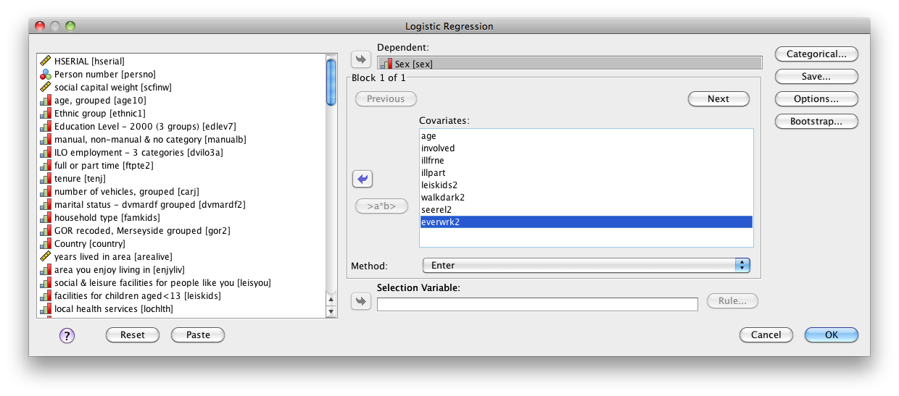
Binary Logistic Regression in SPSS II
1) Select the dependent to go here
2) Place your independents here
Entry method for independents is ‘Enter’ (default), see Field 2009:271 for discussion
3) Click ‘Categorical…’ – see next slide…

Slide 11
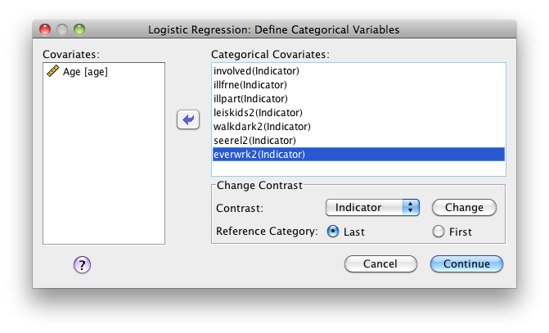
Binary Logistic Regression in SPSS III
4) SPSS needs to be told which predictor variables are categorical so place them here
SPSS will automatically treat them as ‘Indicators’. This means that dummy variables will be created
Remember our discussion last week – if not, it will be clearer when we look at the output
6) Choosing a reference category can be tricky, but try to use the most populous field (mode)
7) Click ‘Continue’

Slide 12
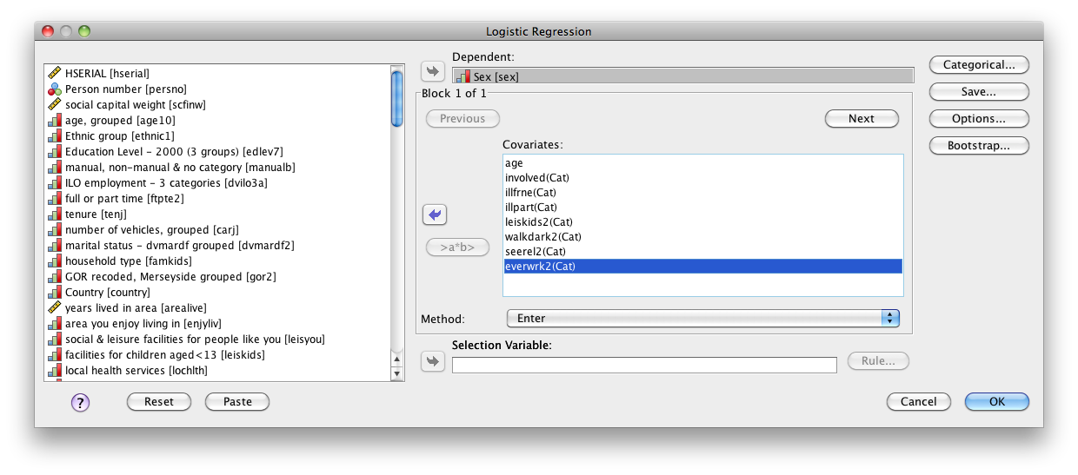
Binary Logistic Regression in SPSS IV
Notice that the categorical independents now have ‘(Cat)’ written after them
8) Click ‘Save’ to open an alternative menu…

Slide 13
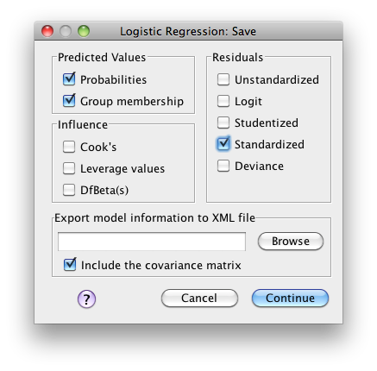
Binary Logistic Regression in SPSS V
9) Select ‘Probabilities’ – this will give us the calculated probability value (0 to 1) of each case, telling us how likely each respondent is to be ‘Male’ or ‘Female’ according to the model
11) Select ‘Standardized’ under the ‘Residuals’ section – this is important for later interpretation
10) Select ‘Group membership’ so we know whether each case was assigned as ‘Male’ or ‘Female’
This option is selected by default – leave it as it is
12) Click ‘Continue’

Slide 14
Binary Logistic Regression in SPSS VI
13) Select ‘Options…’ to open an alternative menu

Slide 15
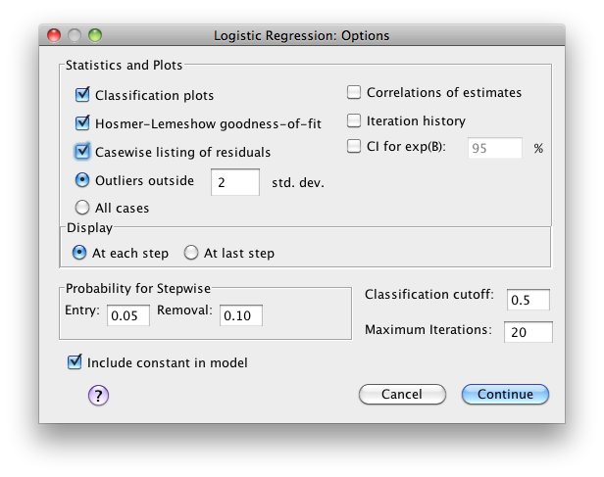
Binary Logistic Regression in SPSS VII
14) Select ‘Classification plots’ to provide a visual display of how well the model fits the data (histogram)
15) Select ‘Hosmer-Lemeshow goodness-of-fit’ to formally test how well the model fits the data
16) Select ‘Casewise listing of residuals’ and leave the default ‘2 std. dev.’ – this will allows us to quickly see any problem cases
17) Click ‘Continue’

Slide 16
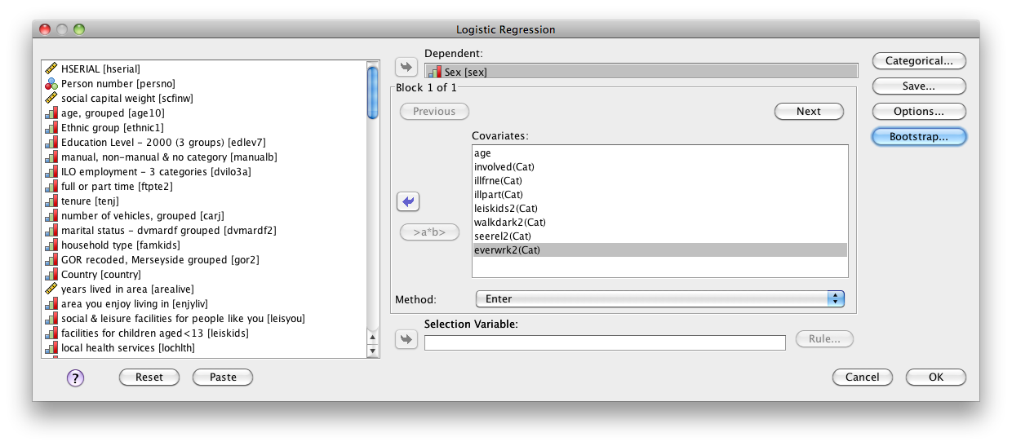
Binary Logistic Regression in SPSS VIII
Ignore ‘Bootstrap…’ as this is for more complicated analyses
18) Click ‘OK’ to run the model!

Slide 17
Model Interpretation I
In total there are 14 tables/plots to interpret based on the options that we requested and some are more important than others
Case Processing Summary
Unweighted Casesª |  | N | Percent
Selected Cases | Included in Analysis | 4343 | 52.8
 | Missing Cases | 3878 | 47.2
 | Total | 8221 | 100.0
Unselected Cases |  | 0 | .0
Total |  | 8221 | 100.0
a. If weight is in effect, see classification table for the total number of cases.
This is the first table and simply tells us how many cases in the dataset were included in the model
Notice the high number of missing cases due to the assumption that all independent variables must be populated for each cases (missing values leads to the exclusion of the whole case)

Slide 18
Model Interpretation II
This tables tells us the coded values for the categories of the dependent variable. Notice that because we did not manually recode ‘Sex’ as a true binary (i.e. 0/1), SPSS has done it for us.
Dependent Variable Encoding
Original Value |  | Internal Value
 | Male | 0
 | Female | 1
The values of ‘Male’ and ‘Female’ really matter! The category coded as ‘0’ is the reference category and the category coded as ‘1’ is the outcome we are trying to predict.
Therefore we are measuring whether certain independent variables increase or decrease the odds of the outcome occurring i.e. the respondent being ‘Female’

Slide 19
Model Interpretation III
SPSS also creates dummy variables for every categorical predictor - it is important to use this table when interpreting the coefficients later (keep this in mind)…
Categorical Variables Codings
 |  | Frequency | Parameter coding
 |  |  | (1) | (2) | (3)
See relatives (RECODE) | Weekly | 2936 | 1.000 | .000 | .000
 | Monthly | 676 | .000 | 1.000 | .000
 | Less than monthly | 651 | .000 | .000 | 1.000
 | Not in last year | 80 | .000 | .000 | .000
Ever had a paid job (RECODE) | Yes | 1382 | 1.000 | .000
 | No | 156 | .000 | 1.000
 | Does not apply | 2805 | .000 | .000
Facilities for kids <13 (RECODED) | Good | 1054 | 1.000 | .000
 | Average | 1176 | .000 | 1.000
 | Poor | 2113 | .000 | .000
How safe do you feel walking alone in area after dark (RECODE) | Safe | 2893 | 1.000
 | Unsafe | 1450 | .000
whether friend or neighbour helps in illness | no | 1848 | 1.000
 | yes | 2495 | .000
whether partner helps in illness | no | 2020 | 1.000
 | yes | 2323 | .000
involved in local oganisation in last 3 yrs | yes | 1038 | 1.000
 | no | 3305 | .000
Potential confusion could arise due to inconsistent coding because we did not specify the dummy variables manually (different codes for ‘Yes’ and ‘No’)
‘Reference categories’ are coded ‘zero’ – you will not get a coefficient for these!

Slide 20
Model Interpretation IV
This table shows the predictive power of the ‘null model’ i.e. only the constant and no independent variables – it is important because it give us a comparison with the populated (full) model and tells us whether the predictors work!
Classification Tableª,b
 | Observed |  | Predicted
 |  |  | Sex |  | Percentage Correct
 |  |  | Male | Female
Step 0 | Sex | Male | 0 | 2153 | .0
 |  | Female | 0 | 2190 | 100.0
 | Overall Percentage |  |  |  | 50.4
a. Constant is included in the model.
b. The cut value is .500
This table tells us the details of the ‘empty model’ i.e. only the constant, no predictors
Variables in the Equation
 |  | B | S.E. | Wald | df | Sig. | Exp(B)
Step 0 | Constant | .017 | .030 | .315 | 1 | .574 | 1.017

Slide 21
Model Interpretation V
Here we can see the predictors that have not been included in the ‘empty model’
‘Overall Statistics’ p<0.05 tells us that the predictor coefficients are significantly different to zero – thus will improve predictive power
Variables not in the Equation
 |  |  | Score | df | Sig.
Step 0 | Variables | age | 22.936 | 1 | .000
 |  | involved(1) | 7.151 | 1 | .007
 |  | illfrne(1) | 44.662 | 1 | .000
 |  | illpart(1) | 33.693 | 1 | .000
 |  | leiskids2 | 4.007 | 2 | .135
 |  | leiskids2(1) | .011 | 1 | .915
 |  | leiskids2(2) | 3.660 | 1 | .056
 |  | walkdark2(1) | 352.700 | 1 | .000
 |  | seerel2 | 27.728 | 3 | .000
 |  | seerel2(1) | 27.249 | 1 | .000
 |  | seerel2(2) | 12.886 | 1 | .000
 |  | seerel2(3) | 7.069 | 1 | .008
 |  | everwrk2 | 59.540 | 2 | .000
 |  | everwrk2(1) | 39.219 | 1 | .000
 |  | everwrk2(2) | 13.269 | 1 | .000
 | Overall Statistics |  | 550.460 | 12 | .000
Sig. of dummy variables is indicative, but multivariate models cause further interactions that may change this

Slide 22
Model Interpretation VI
Most of this table is redundant and refers to stepwise entry methods – we are interested in the p-value for ‘Model’ which tells us whether our model is a significant improvement on the ‘empty model’ (like the F-test in linear regression)
Omnibus Tests of Model Coefficients
 |  | Chi-square | df | Sig.
Step 1 | Step | 581.273 | 12 | .000
 | Block | 581.273 | 12 | .000
 | Model | 581.273 | 12 | .000
Model Summary
Step | -2 Log likelihood | Cox & Snell R Square | Nagelkerke R Square
1 | 5439.088ª | .125 | .167
a. Estimation terminated at iteration number 4 because parameter estimates changed by less than .001.
This table tells us how much of the variance in the dependent variable is explained by the model (pseudo rather than true R square measure - as used in linear regression) i.e. between 12.5% and 16.7%

Slide 23
Model Interpretation VII
The ‘Hosmer and Lemeshow Test’ is the most robust test for model fit available in SPSS – but unlike most p-values we want p=>0.05 to indicate a good fit to the data (H₀ = there is not difference between the observed and predicted (model) values of the dependent)
Hosmer and Lemeshow Test
Step | Chi-square | df | Sig.
1 | 6.023 | 8 | .645
Contingency Table for Hosmer and Lemeshow Test
 |  | Sex = Male |  | Sex = Female |  | Total
 |  | Observed | Expected | Observed | Expected
Step 1 | 1 | 329 | 328.932 | 105 | 105.068 | 434
 | 2 | 305 | 298.770 | 130 | 136.230 | 435
 | 3 | 263 | 279.232 | 171 | 154.768 | 434
 | 4 | 258 | 258.176 | 176 | 175.824 | 434
 | 5 | 242 | 238.766 | 192 | 195.234 | 434
 | 6 | 213 | 214.766 | 221 | 219.234 | 434
 | 7 | 192 | 185.071 | 242 | 248.929 | 434
 | 8 | 154 | 150.457 | 280 | 283.543 | 434
 | 9 | 126 | 117.909 | 309 | 317.091 | 435
 | 10 | 71 | 80.920 | 364 | 354.080 | 435
This table offers more information about the Hosmer and Lemeshow test on how a chi-square statistic is calculated (i.e. 8 df)

Slide 24
Model Interpretation VIII
Classification Tableª
 | Observed |  | Predicted
 |  |  | Sex |  | Percentage Correct
 |  |  | Male | Female
Step 1 | Sex | Male | 1499 | 654 | 69.6
 |  | Female | 862 | 1328 | 60.6
 | Overall Percentage |  |  |  | 65.1
a. The cut value is .500
This is a very important table! It tells you how many cases were predicted correctly by your model – the ‘null model’ predicted 50.4% of cases correctly, this populated model predicts 65.1% of cases correctly.
This 14.7% increase in predictive power explains why the ‘Omnibus Test of Model Coefficients’ was significant

Slide 25
Model Interpretation IX
This table tells us the effect that our predictor variables had on the model
Variables in the Equation
 |  | B | S.E. | Wald | df | Sig. | Exp(B)
Step 1ª | age | -.018 | .002 | 58.747 | 1 | .000 | .982
 | involved(1) | .382 | .078 | 24.059 | 1 | .000 | 1.465
 | illfrne(1) | -.541 | .067 | 65.425 | 1 | .000 | .582
 | illpart(1) | .223 | .067 | 10.976 | 1 | .001 | 1.250
 | leiskids2 |  |  | 3.273 | 2 | .195
 | leiskids2(1) | .095 | .081 | 1.347 | 1 | .246 | 1.099
 | leiskids2(2) | -.069 | .079 | .778 | 1 | .378 | .933
 | walkdark2(1) | -1.282 | .072 | 320.096 | 1 | .000 | .277
 | seerel2 |  |  | 34.620 | 3 | .000
 | seerel2(1) | .647 | .244 | 7.044 | 1 | .008 | 1.910
 | seerel2(2) | .226 | .255 | .789 | 1 | .374 | 1.254
 | seerel2(3) | .286 | .255 | 1.257 | 1 | .262 | 1.330
 | everwrk2 |  |  | 52.241 | 2 | .000
 | everwrk2(1) | .561 | .081 | 47.475 | 1 | .000 | 1.752
 | everwrk2(2) | .497 | .186 | 7.146 | 1 | .008 | 1.644
 | Constant | .996 | .274 | 13.221 | 1 | .000 | 2.707
a. Variable(s) entered on step 1: age, involved, illfrne, illpart, leiskids2, walkdark2, seerel2, everwrk2.
Interpreting this table is what takes the time in logistic regression…

Slide 26
Model Interpretation X
First we need to identify insignificant variables (and dummies!) – we use the Wald statistic to do this (like the t-statistic in linear regression)…
Variables in the Equation
 |  | B | S.E. | Wald | df | Sig. | Exp(B)
Step 1ª | age | -.018 | .002 | 58.747 | 1 | .000 | .982
 | involved(1) | .382 | .078 | 24.059 | 1 | .000 | 1.465
 | illfrne(1) | -.541 | .067 | 65.425 | 1 | .000 | .582
 | illpart(1) | .223 | .067 | 10.976 | 1 | .001 | 1.250
 | leiskids2 |  |  | 3.273 | 2 | .195
 | leiskids2(1) | .095 | .081 | 1.347 | 1 | .246 | 1.099
 | leiskids2(2) | -.069 | .079 | .778 | 1 | .378 | .933
 | walkdark2(1) | -1.282 | .072 | 320.096 | 1 | .000 | .277
 | seerel2 |  |  | 34.620 | 3 | .000
 | seerel2(1) | .647 | .244 | 7.044 | 1 | .008 | 1.910
 | seerel2(2) | .226 | .255 | .789 | 1 | .374 | 1.254
 | seerel2(3) | .286 | .255 | 1.257 | 1 | .262 | 1.330
 | everwrk2 |  |  | 52.241 | 2 | .000
 | everwrk2(1) | .561 | .081 | 47.475 | 1 | .000 | 1.752
 | everwrk2(2) | .497 | .186 | 7.146 | 1 | .008 | 1.644
 | Constant | .996 | .274 | 13.221 | 1 | .000 | 2.707
a. Variable(s) entered on step 1: age, involved, illfrne, illpart, leiskids2, walkdark2, seerel2, everwrk2.
Notice that all dummies for ‘leiskids2’ are insignificant [p>0.05] (remember the ‘Variables Not in Equation’ table?) but only two dummies for ‘seerel’ are also insignificant (overall the whole variable is significant though)

Slide 27
Model Interpretation XI
Categorical Variables Codings
 |  | Frequency | Parameter coding
 |  |  | (1) | (2) | (3)
See relatives (RECODE) | Weekly | 2936 | 1.000 | .000 | .000
 | Monthly | 676 | .000 | 1.000 | .000
 | Less than monthly | 651 | .000 | .000 | 1.000
 | Not in last year | 80 | .000 | .000 | .000
Ever had a paid job (RECODE) | Yes | 1382 | 1.000 | .000
 | No | 156 | .000 | 1.000
 | Does not apply | 2805 | .000 | .000
Facilities for kids <13 (RECODED) | Good | 1054 | 1.000 | .000
 | Average | 1176 | .000 | 1.000
 | Poor | 2113 | .000 | .000
How safe do you feel walking alone in area after dark (RECODE) | Safe | 2893 | 1.000
 | Unsafe | 1450 | .000
whether friend or neighbour helps in illness | no | 1848 | 1.000
 | yes | 2495 | .000
whether partner helps in illness | no | 2020 | 1.000
 | yes | 2323 | .000
involved in local oganisation in last 3 yrs | yes | 1038 | 1.000
 | no | 3305 | .000
‘seerel2(1)’ is significant and refers to ‘seeing relatives weekly
‘seerel2(2)’ and ‘seerel2(3)’ are not significant (‘monthly’ and ‘less then monthly’)
This is the ‘reference category’ and thus does not receive a coefficient
‘leiskids2(1)’ and ‘leiskids2(2)’ are both insignificant – in this case ‘Poor’ is the ‘reference category’

Slide 28
Model Interpretation XII
Remember that we are assessing whether each of the predictor variables (and dummies) increase or decrease the likelihood of the outcome (‘female’ or ‘1’)
Variables in the Equation
 |  | B | S.E. | Wald | df | Sig. | Exp(B)
Step 1ª | age | -.018 | .002 | 58.747 | 1 | .000 | .982
 | involved(1) | .382 | .078 | 24.059 | 1 | .000 | 1.465
 | illfrne(1) | -.541 | .067 | 65.425 | 1 | .000 | .582
 | illpart(1) | .223 | .067 | 10.976 | 1 | .001 | 1.250
 | walkdark2(1) | -1.282 | .072 | 320.096 | 1 | .000 | .277
 | seerel2 |  |  | 34.620 | 3 | .000
 | seerel2(1) | .647 | .244 | 7.044 | 1 | .008 | 1.910
 | everwrk2 |  |  | 52.241 | 2 | .000
 | everwrk2(1) | .561 | .081 | 47.475 | 1 | .000 | 1.752
 | everwrk2(2) | .497 | .186 | 7.146 | 1 | .008 | 1.644
 | Constant | .996 | .274 | 13.221 | 1 | .000 | 2.707
a. Variable(s) entered on step 1: age, involved, illfrne, illpart, leiskids2, walkdark2, seerel2, everwrk2.
A negative beta coefficient results in a decrease in the likelihood of the expected outcome
NOTE: non-significant coefficients have been removed for clarity

Slide 29
Model Interpretation XIII
Remember your linear equations! If a coefficient is negative then the line will slope downwards as bx increases (i.e. the probability of a respondent being classified as ‘female’ will decrease).
Prob (Female)
1
In contrast, a positive coefficient will result the sloping upwards as bx increases (i.e. the probability of a respondent being classified as ‘female’ will increase).
0.5
0
bx_{n}

Slide 30
Model Interpretation XIV
Therefore all these predictors decrease the likelihood of a respondent being classified as ‘female’ by the model – they also have Exp(B) values of >1 (odds increase)
Variables in the Equation
 |  | B | S.E. | Wald | df | Sig. | Exp(B)
Step 1ª | age | -.018 | .002 | 58.747 | 1 | .000 | .982
 | involved(1) | .382 | .078 | 24.059 | 1 | .000 | 1.465
 | illfrne(1) | -.541 | .067 | 65.425 | 1 | .000 | .582
 | illpart(1) | .223 | .067 | 10.976 | 1 | .001 | 1.250
 | walkdark2(1) | -1.282 | .072 | 320.096 | 1 | .000 | .277
 | seerel2 |  |  | 34.620 | 3 | .000
 | seerel2(1) | .647 | .244 | 7.044 | 1 | .008 | 1.910
 | everwrk2 |  |  | 52.241 | 2 | .000
 | everwrk2(1) | .561 | .081 | 47.475 | 1 | .000 | 1.752
 | everwrk2(2) | .497 | .186 | 7.146 | 1 | .008 | 1.644
 | Constant | .996 | .274 | 13.221 | 1 | .000 | 2.707
a. Variable(s) entered on step 1: age, involved, illfrne, illpart, leiskids2, walkdark2, seerel2, everwrk2.
In contrast, all these predictors increase the likelihood of a respondent being classified as ‘female’ by the model – they also have Exp(B) values of <1 (odds decrease)

Slide 31
Model Interpretation XV
What does this mean?! I’ll tell you…
Variables that decrease the likelihood of a respondent being classified as ‘female’
Ind Var | Description | B | Exp(B) | Interpretation
‘age’ | Age in years | -0.018 | 0.982 | 1 unit increase in age decreases odds of being ‘female’ (odds multiplied by 0.98)
‘illfrne(1)’ | Friends and neighbours do not help you in illness | -0.541 | 0.582 | Decrease in the odds of being ‘female’ (females are 58% as likely to not receive help as males)
‘walkdark2(1)’ | You feel safe when walking alone in the area after dark | -1.282 | 0.277 | Decrease in the odds of being ‘female’ (females are 27% as likely to feel safe as males)

Slide 32
Model Interpretation XVI
Variables that increase the likelihood of a respondent being classified as ‘female’
Ind Var | Description | B | Exp(B) | Interpretation
‘involved(1)’ | Involved in local org. | 0.382 | 1.465 | Being involved in a local org. increases the odds of being female by 1.47 (47% more likely)
‘illpart(1)’ | Partner does not help you in illness | 0.223 | 1.250 | Having a partner who does not help you in illness increases the odds of being female by 1.25 (25% more likely)
‘seerel2(1)’ | See relatives weekly | 0.647 | 1.910 | Odds of being female are 1.91 greater for those who see relatives weekly than for those who have not seen relative in the last year (ref!)

Slide 33
Model Interpretation XVII
Ind Var | Description | B | Exp(B) | Interpretation
‘everwrk2(1)’ | Have had a paid job | 0.561 | 1.752 | Odds of being female are 1.75 greater for those who have had a paid job than for those to whom this ‘does not apply’ (ref!)
‘everwrk2(2)’ | Have not had a paid job | 0.497 | 1.644 | Odds of being female are 1.64 greater for those who have not had a paid job than for those to whom this ‘does not apply’ (ref!)
This may seem strange but it is because SPSS specified the ‘reference category’ as ‘does not apply’, thus these observations are formulated based on making reference to the ‘reference category’
In this case we can infer that the ‘does not apply’ category is probably populated with a disproportionately large number of ‘male’ respondents – bad parameters!

Slide 34
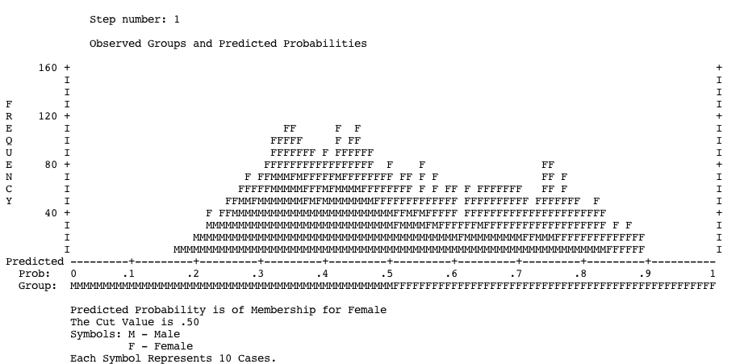
Model Interpretation X
This histogram shows the frequency of probabilities of respondents being female
Probabilities higher than 0.5 = female classification - this shows us how accurate this is

Slide 35
Model Interpretation XI
Finally, this table lists cases with unusually high residual values
Casewise List^{b}
Case | Selected Statusª | Observed | Predicted | Predicted Group | Temporary Variable
 |  | Sex |  |  | Resid | ZResid
438 | S | M** | .890 | F | -.890 | -2.841
488 | S | M** | .889 | F | -.889 | -2.836
1258 | S | M** | .882 | F | -.882 | -2.734
1855 | S | M** | .880 | F | -.880 | -2.703
4749 | S | M** | .880 | F | -.880 | -2.706
6348 | S | M** | .870 | F | -.870 | -2.590
6966 | S | M** | .873 | F | -.873 | -2.623
a. S = Selected, U = Unselected cases, and ** = Misclassified cases.
b. Cases with studentized residuals greater than 2.000 are listed.
Basically it tells us which cases the model thought were ‘female’ that were actually ‘male’, but it only displays the cases in which the probability of being ‘female’ was exceptionally high (thus have high residual values)

Slide 36
Summary
Logistic regression is awesome
Very important for social sciences where interval data is hard to come by
Is a predictive model that assesses the probability of a specific outcome
Interpretation on coefficients and odds ratios is more intuitive than in linear regression (I think)
The hardest part is getting your head around interpretation, but most of the modeling and reporting up to this stage is simple (few difficult assumptions to avoid violating)

Slide 37
Workshop Task
Run a binary logistic regression model with the variables you selected in the workshop last week
Use these slides to check that the model works (follow my step-by-step guide to operation and interpretation)
Interpret the odds ratios and draw some conclusions about your model
If your model doesn’t work then work in pairs
This technique is advanced, so ask for help if you are unsure

