Slide 1
SI0030 Social Research Methods
Week 4
Coding With NVivo8
Luke Sloan

Slide 2
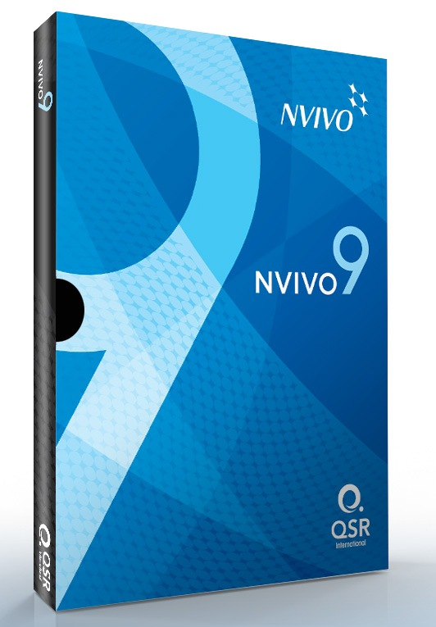
Introduction
Why Use It
Advantages & Disadvantages
Developing Codes & Themes
Developing Themes (Example)
Getting Started With NVivo8

Slide 3
Why Use It I
You must show evidence of either SPSS or NVivo in your research projects
You will be assessed on both in the exam
It’s really very simple – only a data retrieval tool
Think about how else you could code 30 pages with multiple codes for single pieces of text…

Slide 4
Why Use It II
NVivo will also allow you to import images, audio recordings and videos
This allows you to create themes across media types – this is increasing important as visual methods are becoming more popular
For example, you might identify a theme for ‘litter’ in an interview transcript and then tag the same theme in a photograph of the neighbourhood in which the interview was conducted

Slide 5
Developing Codes & Themes I
Developing themes refers to the process of:
Identifying patterns within the data to make the amount of data manageable
To give the data structure and meaning
Collecting and collating evidence
Addressing the research question
However by ‘coding’ qualitative data we also lose the context and deep richness
Remember that qualitative analysis is more than how many times a given theme occurs (intensity, context, relationships etc)

Slide 6
Developing Codes & Themes II
Thematic analysis is a catch-all term which many different qualitative analysis approaches use including:
Grounded theory
Qualitative content analysis
Critical discourse analysis
Narrative analysis
It is not enough to say that you are doing ‘thematic analysis’ without specifying your theoretical framework (it’s like saying that you’re going to use ‘statistics’ to analyse your SPSS data)
You may approach the data knowing your themes (deductive) or you may allow your themes to develop from the data (inductive) – most of the time it’s both

Slide 7
Developing Codes & Themes III
Step 1: Read the data
Step 2: Re-read and highlight “chunks” of texts (general)
Step 3: Identify sub-themes within chunks
Step 4: Theme reduction – relationships between themes
Step 5: Re-code data with newly derived themes – hierarchy?
Step 6: Repeat process?
Step 7: Potential extensions – compare themes across:
- Groups
- Timescales
You can do this by hand, but imagine trying to rearrange your codes/themes on paper…

Slide 8
Developing Themes (Example) I
“The new Apple iMac has a quad-core processor supported by 2GB of high quality RAM. The 27” screen is crystal clear with backlit high definition technology, and there are a range of connectivity options on the rear of the unit including 4 USB ports, Firewire and mini DVI. Mac OSX has been upgraded to Leopard and increases user accessibility, although many of the new functions will be of little interest to the average consumer. The upgrade of the Terminal window has it’s uses, but the lack of a ‘plist editor’ in the software bundle proves to be a surprising oversight on apple’s part.”

Slide 9
Developing Themes (Example) II
“The new Apple iMac has a quad-core processor supported by 2GB of high quality RAM. The 27” screen is crystal clear with backlit high definition technology, and there are a range of connectivity options on the rear of the unit including 4 USB ports, Firewire and mini DVI. Mac OSX has been upgraded to Leopard and increases user accessibility, although many of the new functions will be of little interest to the average consumer. The upgrade of the Terminal window has it’s uses, but the lack of a ‘plist editor’ in the software bundle proves to be a surprising oversight on apple’s part.”

Slide 10
Developing Themes (Example) III
Note that these two themes are discrete groups (i.e. they do not over lap) and they are separate to each other
In NVivo themes are called ‘nodes’ and when they are discrete such as this we refer to them as ‘free nodes’
So far so good, but what if we want to develop themes within each of these ‘nodes’?
Hardware
Software

Slide 11
Developing Themes (Example) IV
“The new Apple iMac has a quad-core processor supported by 2GB of high quality RAM. The 27” screen is crystal clear with backlit high definition technology, and there are a range of connectivity options on the rear of the unit including 4 USB ports, Firewire and mini DVI. Mac OSX has been upgraded to Leopard and increases user accessibility, although many of the new functions will be of little interest to the average consumer. The upgrade of the Terminal window has it’s uses, but the lack of a ‘plist editor’ in the software bundle proves to be a surprising oversight on apple’s part.”

Slide 12
Developing Themes (Example) V
Connectivity
Now we’ve started to develop ‘nested nodes’ within ‘Hardware’ and ‘Software’
When nodes are nested (i.e. are in a hierachy) we call them ‘tree nodes’
In Nvivo it is normal to start with ‘free nodes’ and then create ‘tree nodes’ as you proceed
Hardware
Speed
Screen
Accessibility
Software
Provision

Slide 13
Developing Themes (Example) VI
Colour
Compact
Size
STYLE
Screen
Shape
Cable Management??
Power (hardware)
Hardware
Connectivity
Accessibility
Software
Function
Power (software)
Keyboard
Wireless
Cable Management??
Hot Keys

Slide 14
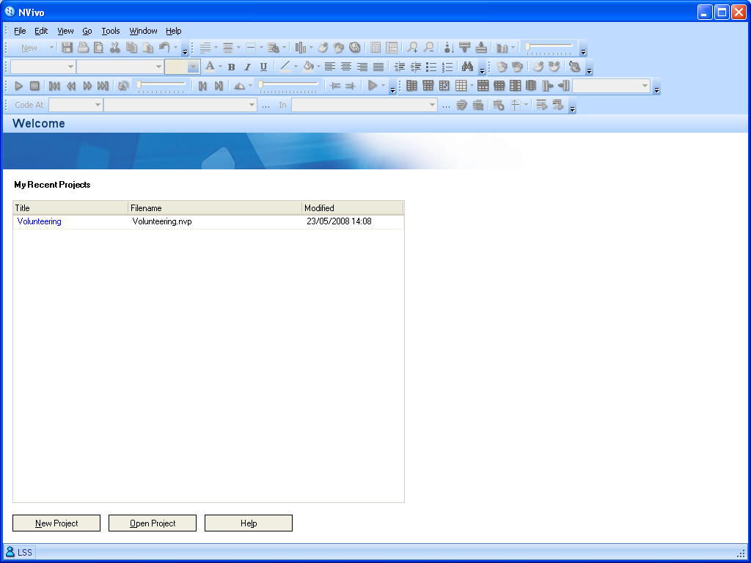
Getting Started With NVivo8 I
1) Start by creating a new project

Slide 15
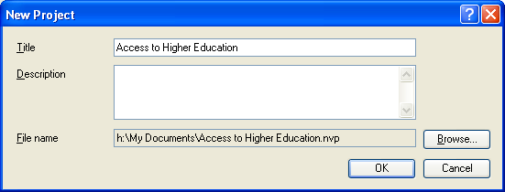
Getting Started With NVivo8 II
2) Give your project a suitable name
3) Click OK

Slide 16
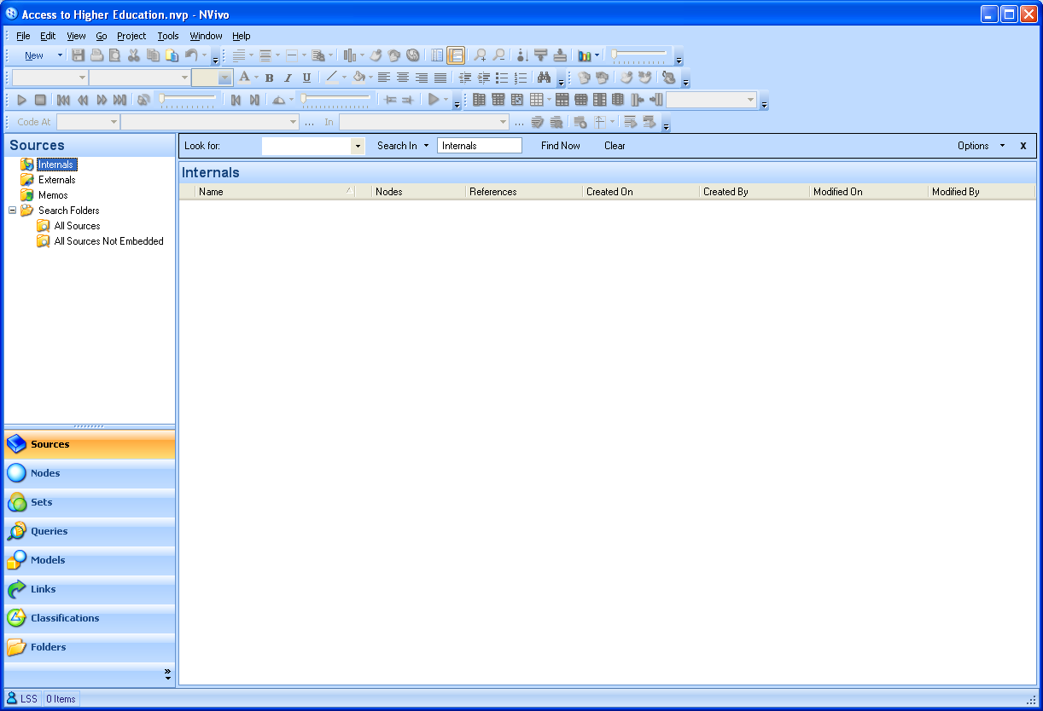
Getting Started With NVivo8 III
4) Ensure that ‘Internals’ is highlighted – this is where we import the transcripts to (or images, audio, videos!)
5) Right click anywhere in this pane and select ‘Import Internals’

Slide 17
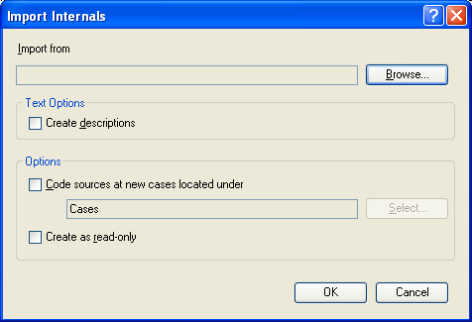
Getting Started With NVivo8 IV
6) Click ‘Browse’ to select the file you wish to import

Slide 18
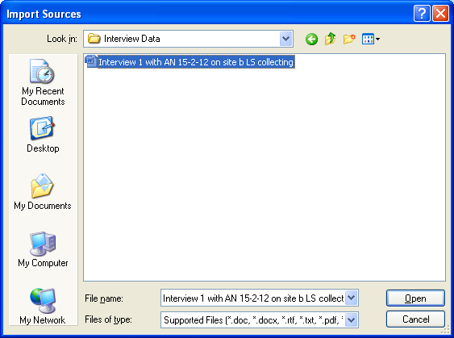
Getting Started With NVivo8 V
7) Browse to find the file you want to import, select it and click ‘OK’

Slide 19
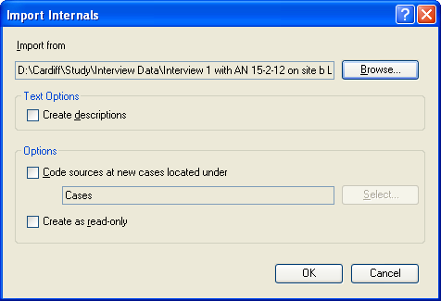
Getting Started With NVivo8 VI
8) Click ‘OK’ to import the file

Slide 20
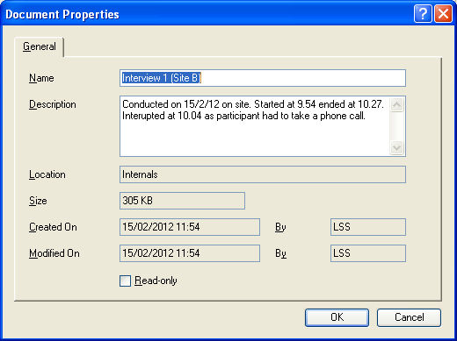
Getting Started With NVivo8 VII
9) This window will appear every time you import a new file. Use the fields to enter useful data about the source (in my example I’ve included logistic details of an interview transcript). Click ‘OK’ when you’ve entered the information.

Slide 21
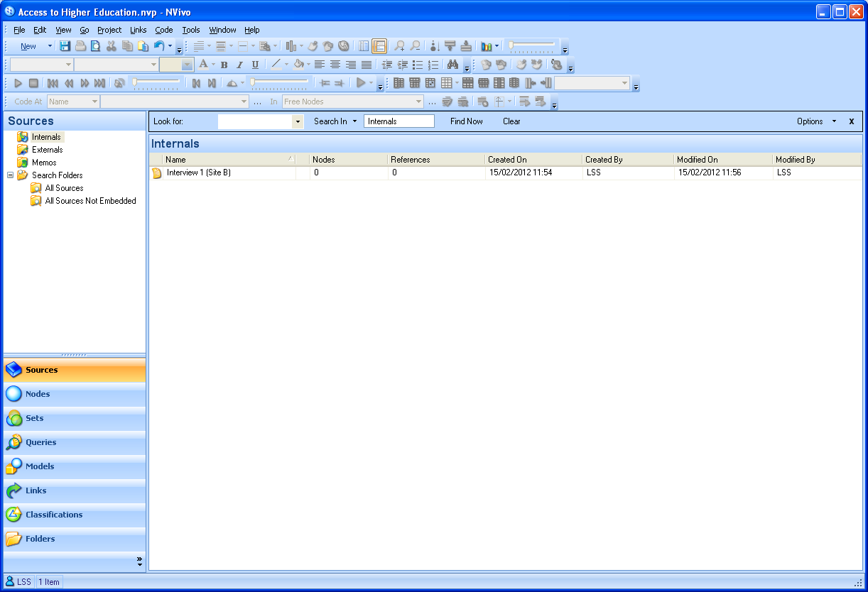
Getting Started With NVivo8 VIII
10) Note that your imported file is now displayed in this pane. Every file you add will be listed here

Slide 22
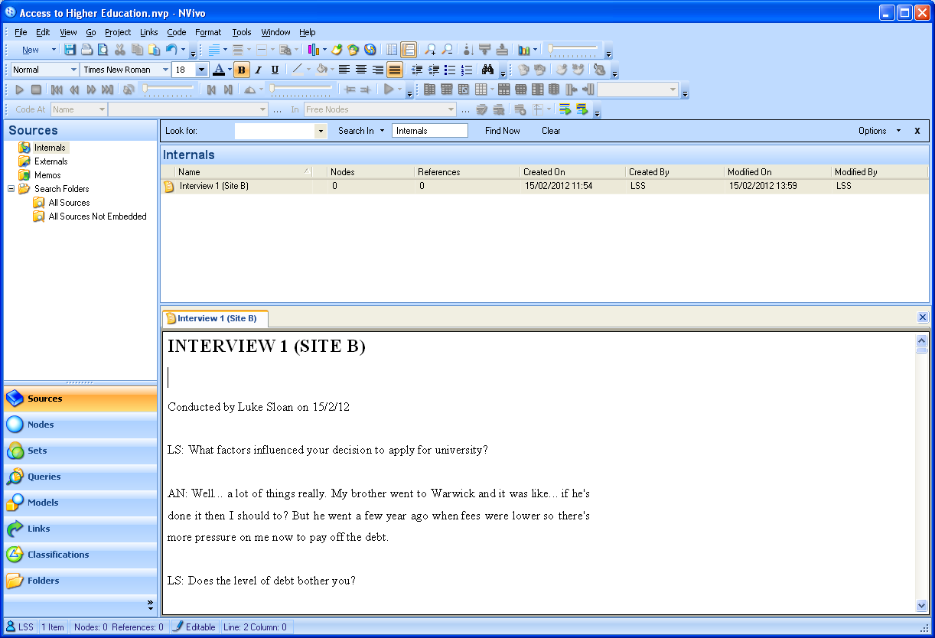
Getting Started With NVivo8 IX
11) Double clicking on any file will cause it to open in a tab below. You can open multiple files at any one time.
12) Click on the cross in the top right corner to close the file
13) To start coding your data click on ‘Nodes’

Slide 23
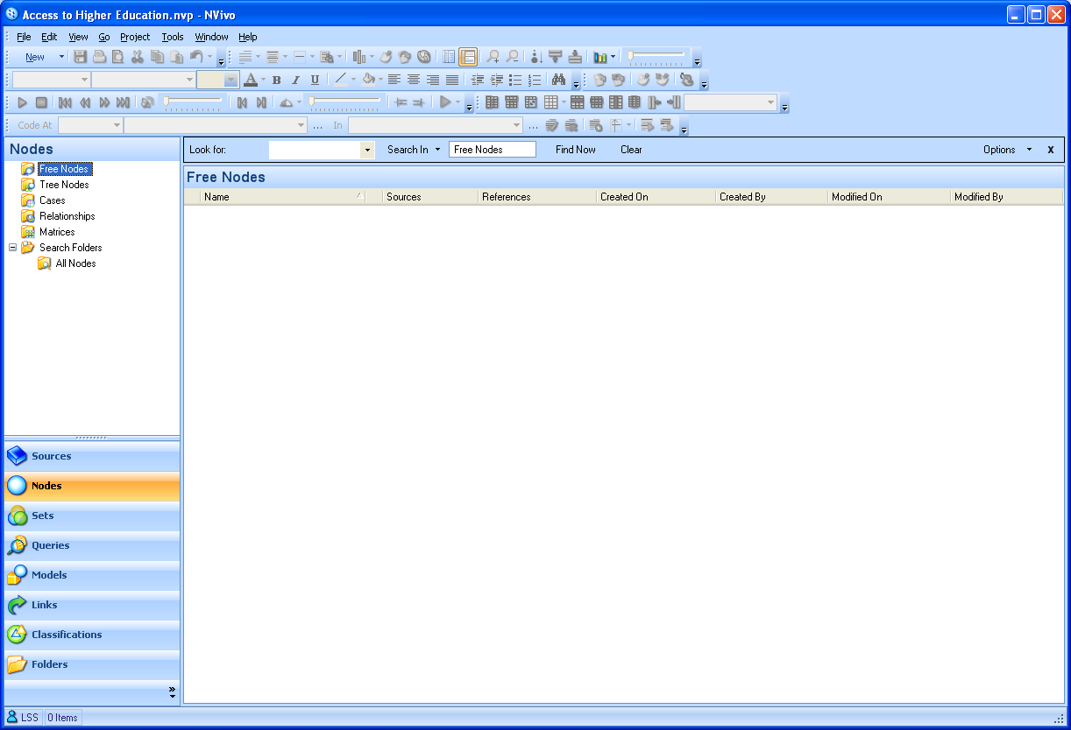
Getting Started With NVivo8 X
14) Ensure that ‘Free Nodes’ is highlighted
15) Right click anywhere in this pane and select ‘New Free Node’

Slide 24
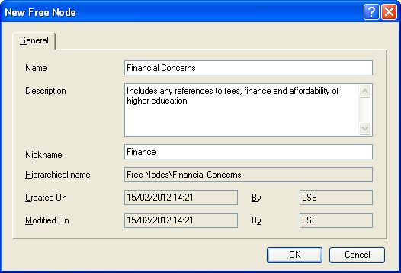
Getting Started With NVivo8 XI
16) Give your theme a name and a more general description if you want to. The ‘Nickname’ field should be a shorthand version for quick reference
18) Click ‘OK’ to continue

Slide 25
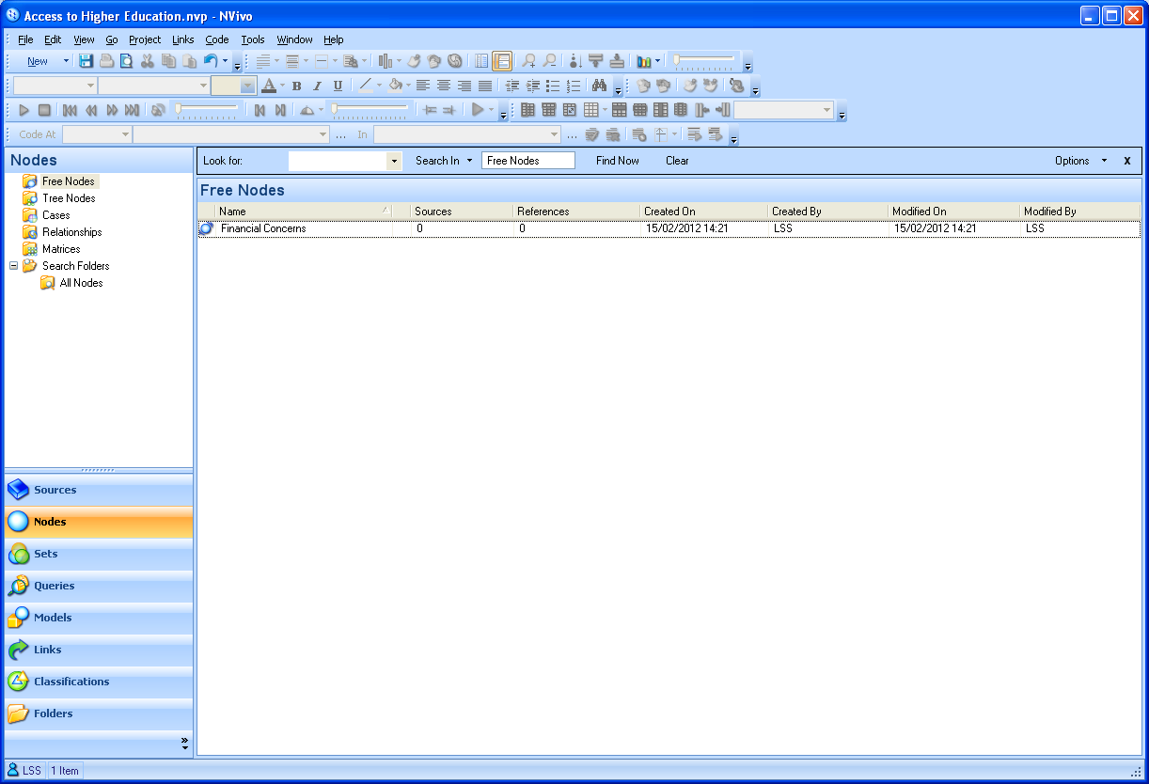
Getting Started With NVivo8 XII
19) Every new node that you create will appear in this list
20) To start coding click ‘Sources’

Slide 26
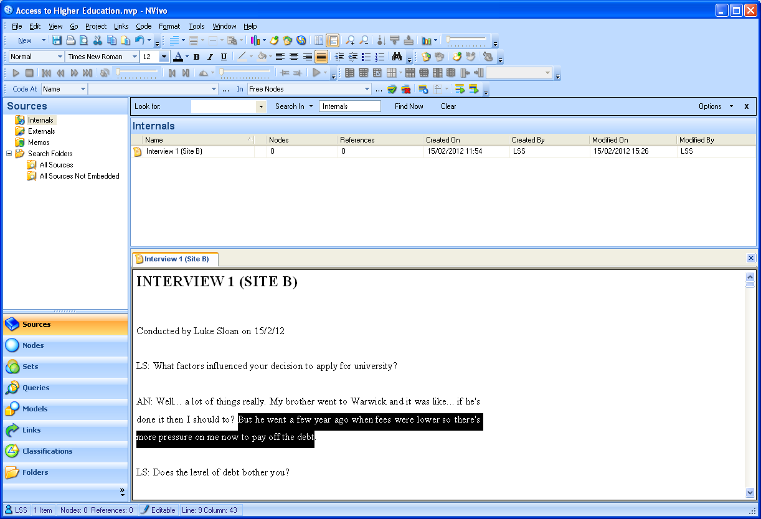
Getting Started With NVivo8 XIII
21) Double click on the file you want to code so it opens in a tab below
22) To code a section of text highlight it, right click over the highlighted text and select ‘Code Selection’ and then ‘At Existing Node’

Slide 27
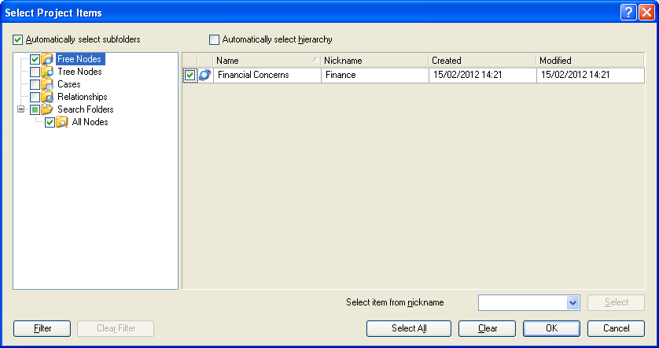
Getting Started With NVivo8 XIV
23) All your nodes will be listed here – simply tick the nodes you want to code this piece of text to
24) Click ‘OK’

Slide 28
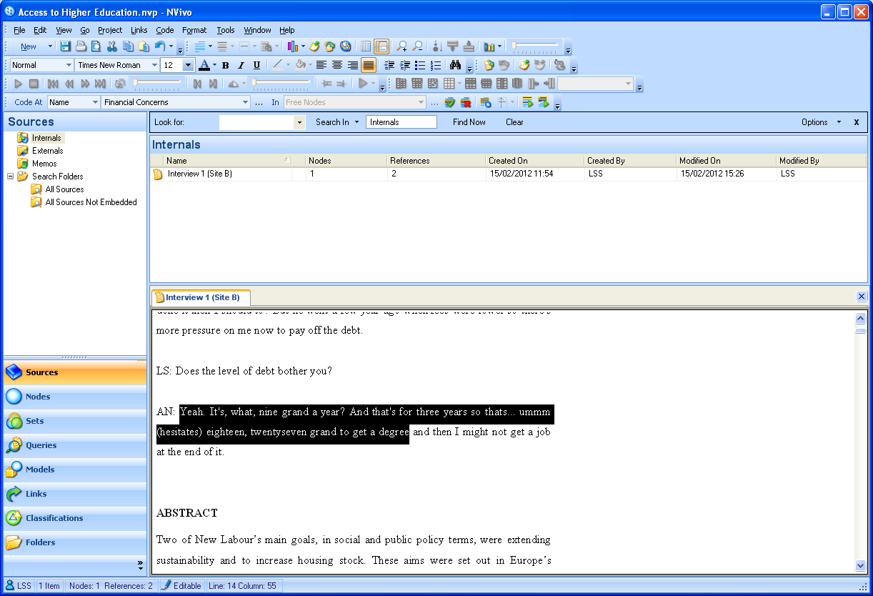
Getting Started With NVivo8 XV
25) Run through the same process again to code other parts of the transcript (or whatever data you are using)
26) Click on ‘Nodes’ again to review all the data coded under a particular node

Slide 29
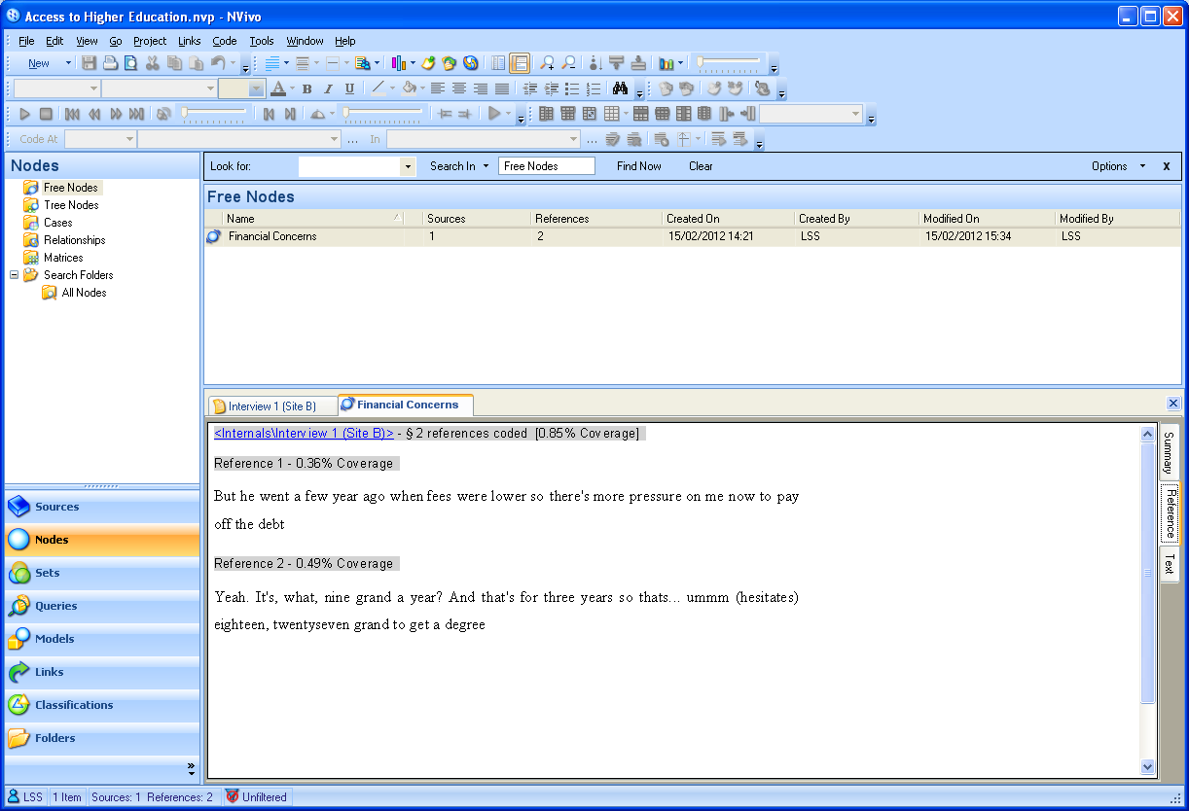
Getting Started With NVivo8 XVI
27) Double click on the relevant node to open a tab containing all text coded under this node
28) In this tab you can see what data has been coded under this node and which file it is located in

Slide 30
Getting Started With NVivo8 XVII
There are many more things you can do with NVivo – you can use the Student Guide on Learning Central to find out more
Remember to save regularly
The project file can be quite large and often exceeds your university file space so try to work from a portable drive and back-up your work often!
More advanced information can be found at: http://www.qsrinternational.com/support_resource-articles_detail.aspx?view=346

